Slide 1



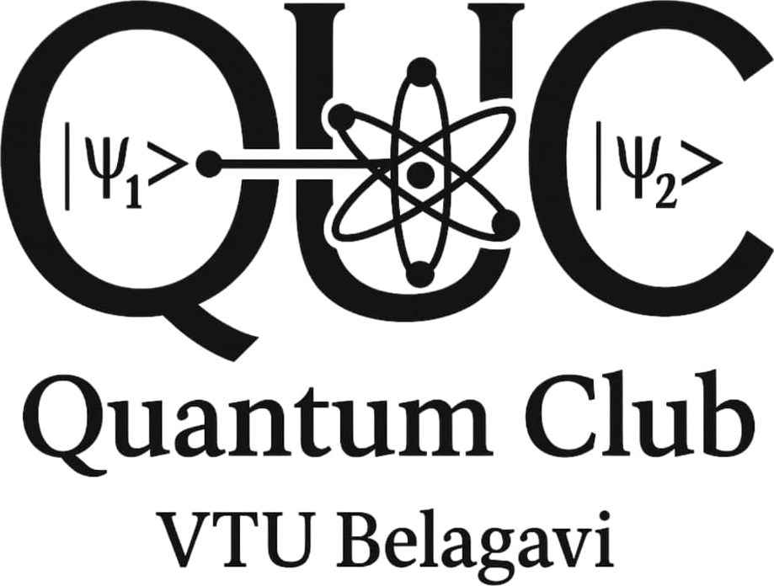
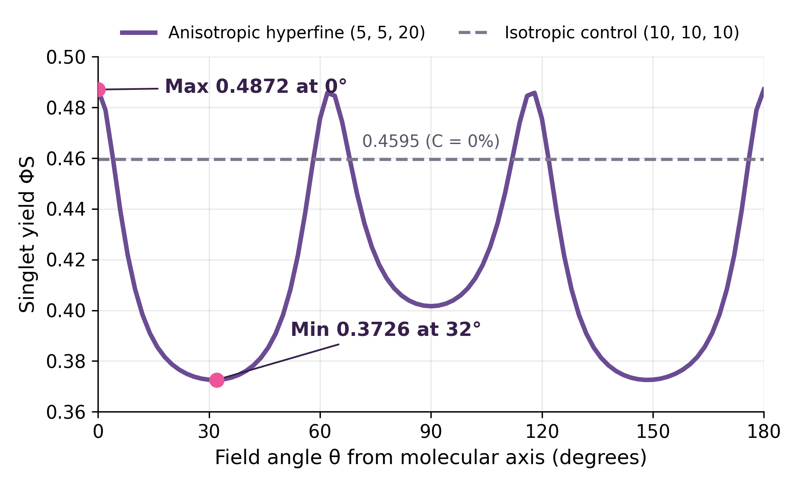
Poster no: [VTU-assigned number]
VTU HOSTS · IBM QUANTUM PRESENTS
Quantum Compass Lab: Can a Spin Compass Survive Noise?
Simulating radical-pair magnetoreception under decoherence in Qiskit | Nikitha H. D. | hdnikitha282006@gmail.com
KEY TAKEAWAY | Field direction shifts chemical yield by 13.3%, and the signal fades once decoherence exceeds about 2.7 µs⁻¹ (T₂ < 0.36 µs).
Introduction & Motivation
Background: Migratory birds may sense Earth's magnetic field through light-triggered electron-spin pairs in cryptochrome proteins.
Problem: Does field direction change chemical yield, and how much of that signal survives decoherence?
Objective: Build a three-spin open-system model, measure its directional signal over a 91-point angle sweep and a decoherence sweep, and cross-check it with Qiskit.
Research Gap / Challenges
Proposed Methodology / Framework
• Two-spin models miss the nucleus that gives direction.
• Noise can wipe out the signal before it is used.
• One numerical method is not proof; cross-check it.
• A simulation cannot prove what birds actually do.
1. Prepare an electron singlet pair and a mixed nuclear state.
2. Build the 8 × 8 Hamiltonian (Zeeman + anisotropic hyperfine) with reaction and noise terms.
3. Sweep field angle (0° to 180°, 91 points) and decoherence rate γ; compute yields by exact Liouvillian inversion.
4. Test density-matrix physicality, yield conservation, convergence and Qiskit Trotter agreement (82 automated tests).
System Architecture / Implementation
1. Three spin-½ particles (2 electrons + 1 nucleus) give 8 states.
2. Hamiltonian = electron Zeeman + anisotropic hyperfine.
3. Python, NumPy and SciPy solve the dynamics; Qiskit builds the Hamiltonian and Trotter circuits.
4. Exact and Trotter results are compared; a Streamlit dashboard explores parameters.
Applications / Use Cases
• Shows how anisotropic coupling turns field direction into a chemical signal.
• Maps how coherence time (T₂) and reaction rates tune that signal.
• Provides a reusable workflow for validating open quantum-system simulations.
• Theoretical work only; not proof of animal navigation.
Theoretical Model / Algorithm
Initial state: ρ(0) = |S⟩⟨S| ⊗ I₂/2
Open-system evolution: dρ/dt = −i[H,ρ] − (kS/2){PS,ρ} − (kT/2){PT,ρ} + Ldecoh(ρ)
Singlet yield: ΦS = kS ∫ Tr[PSρ(t)] dt
Contrast: C = (ΦS,max − ΦS,min) / (ΦS,max + ΦS,min)
Yield is solved by exact Liouvillian inversion and checked against numerical integration.
Parameters: B = 50 µT; A = (5, 5, 20) rad/µs (isotropic control: 10, 10, 10); kS = kT = 1 µs⁻¹; γ = 1/T₂ = 0 baseline, swept 0.05 to 31.6 µs⁻¹.
Conclusion & Key Contributions
1. Field direction shifts singlet yield from 0.4872 to 0.3726: a 13.3% directional contrast.
2. Control test: isotropic coupling gives 0% contrast, so anisotropy creates the compass.
3. The compass needs γ ≤ 2.74 µs⁻¹ (T₂ ≥ 0.36 µs) to keep contrast above 1%.
4. Qiskit Trotter circuit (r = 25) matches exact evolution to 1.8 × 10⁻³ (0.22%) in PS at t = 0.5 µs; positivity and yield-conservation checks pass.
Experimental / Simulation Results
Future Work
1. Add more nuclei and realistic hyperfine tensors.
2. Test non-Markovian and temperature-dependent noise.
3. Run circuits on IBM hardware and compare with experimental constraints.
Acknowledgement
Singlet yield vs. field angle (91-point sweep, B = 50 µT). Max ΦS = 0.4872 at 0°; min ΦS = 0.3726 at 32°; C ≈ 13.3%. Dashed line: isotropic control, ΦS = 0.4595 at every angle (C = 0%).
Thanks to VTU, the VTU Quantum Club and IBM Quantum for Qiskit Fall Fest 2026.
Code & dashboard: github.com/<your-username>/quantum-compass-lab
NOISE TOLERANCE (decoherence sweep)
γ ≤ 2.74 µs⁻¹
T₂ ≥ 0.36 µs keeps contrast C ≥ 1%
γ ≤ 6.67 µs⁻¹
T₂ ≥ 0.15 µs keeps ΔΦS ≥ 0.001
References
1. Schulten et al., Z. Phys. Chem. 111, 1–5 (1978).
2. Ritz et al., Biophys. J. 78, 707–718 (2000).
3. Hore & Mouritsen, Annu. Rev. Biophys. 45, 299–344 (2016).
4. Haberkorn, Mol. Phys. 32, 1491–1493 (1976).
5. Qiskit contributors, Qiskit: An open-source framework for quantum computing.
Decoherence rate γ = 1/T₂ swept from 0.05 to 31.6 µs⁻¹ (T₂ = 20 to 0.03 µs); thresholds from the simulation.
Visvesvaraya Technological University
Qiskit Fall Fest 2026
Poster Presentation

