Slide 1

Never compromise on safety.
Rev 0

Slide 2
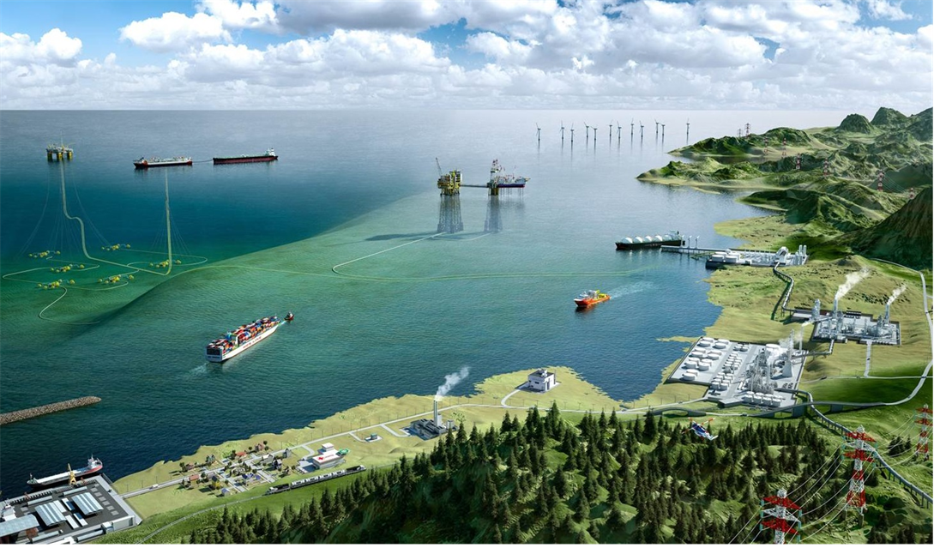
DMAR CONSULTANCY FOR OFFSHORE ENERGY INDUSTRY
Marine warranty
Wind Farm
Marine warranty consultancy
Wind Farm
Dynamic positioning
Jacket and Topsides
Dynamic positioning
Jacket and Topsides
Converter platforms
Jack-up and geotechnical engineering
Floating assets
Jack-up and geotechnical engineering
Floating assets
Floating wind
Marine operations and survey
Sub-Sea Installations
Grid connections
Marine operations and survey
Sub-Sea Installations
Terminals
Meteorological and oceanographic studies
Meteorological and oceanographic studies
Naval architecture and engineering
Ground based structures
Naval architecture and engineering
Transport and Installation
Decommissioning
Transport and installation

Slide 3
The Marine Warranty consultancy assistance process
1
Engineering document review and approval
Office documents review for marine operations
Location survey analysis review and approval
Load-out and transportation analysis review and approval
Installation analysis review and approval
Technical Review Note
2
On-site surveillance
Attendances of marine operations
Condition and suitability surveys for a wide range of vessels
Loadout and transportation attendances
Installation attendances
Certificate of Approval
Suitability Survey Report
Daily Progress Report
DMAR acts based on the requirements given from JNRC (Joint Natural Resources Committee)

Slide 4
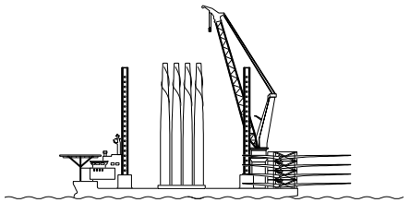
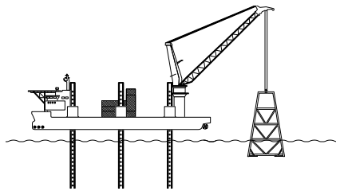
Marine Warranty Consultancy on all the phases of Offshore Wind Example for offshore bottom fixed wind farm
Loadout
Transportation
Installation
Engineering document review and approval
On-site surveillance
Loadout of the main equipment such as Monopiles, transition pieces, anode cages, substations, nacelles, blades, cables etc.
Roll-on or lifted loadout
Transportations of main equipment
Transshipments of equipment between transportation and installation vessels
Installation of foundations: Pile driving, Transition pieces and anode cages
Installation of wind towers, generators and blades
Substations installations
Inter-array and export cable laying

Slide 5
Contacts LT Office +370 699 28380 info@dmarinternational.com UK Office +44 7404 810279 info@dmarinternational.com

