Slide 1
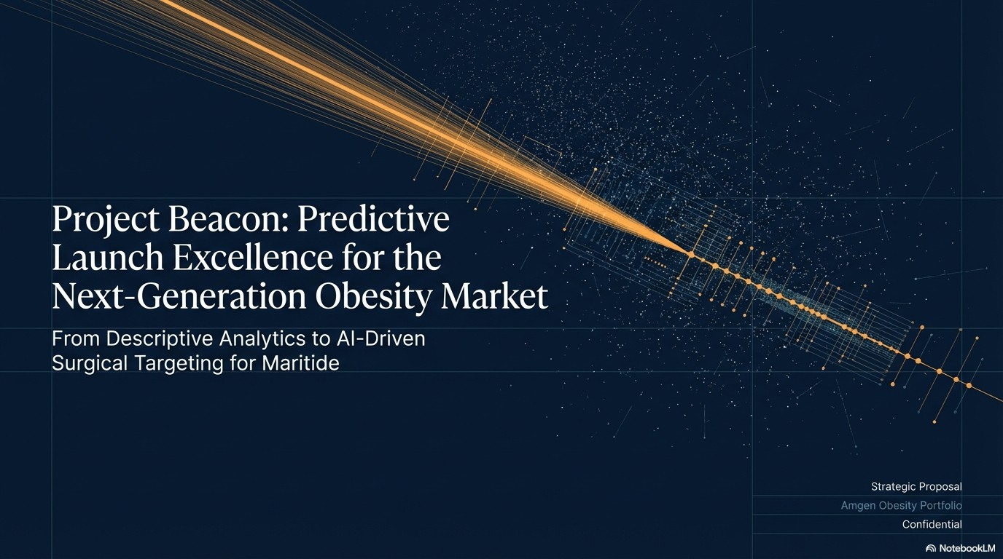

Slide 2
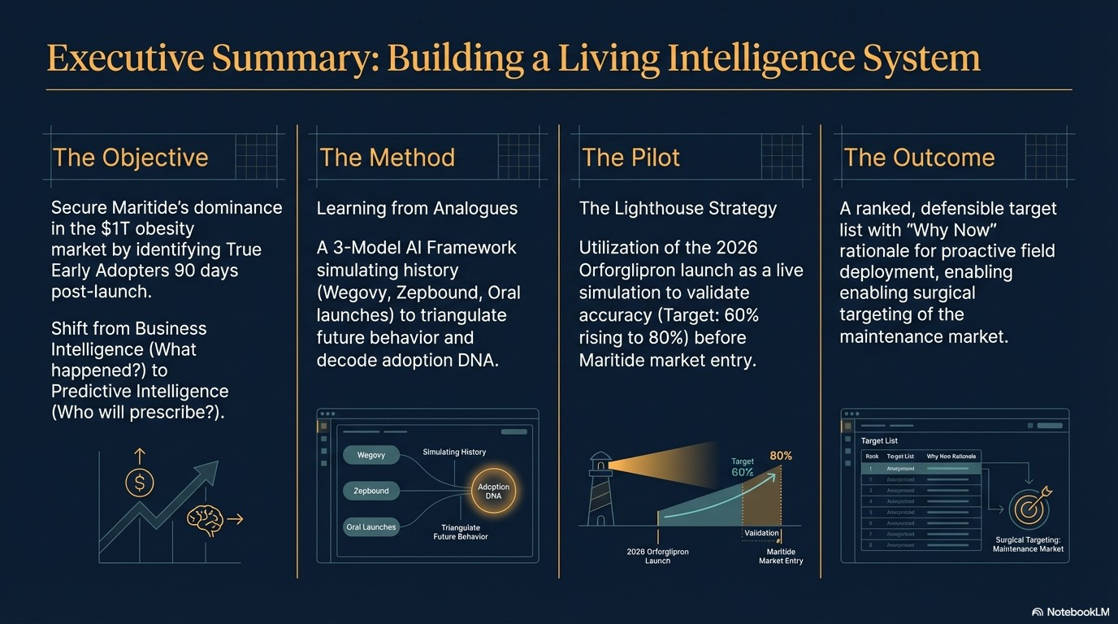

Slide 3
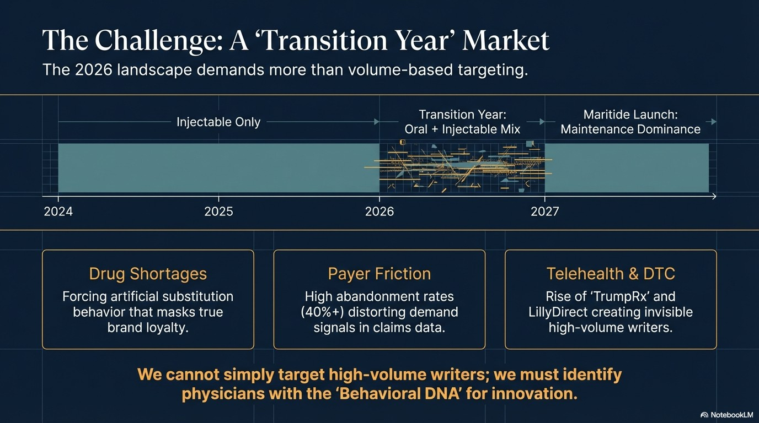

Slide 4
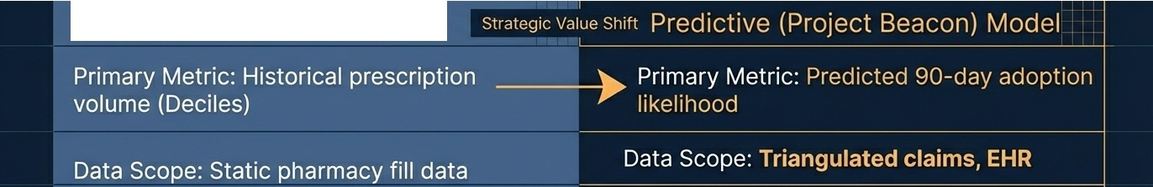
The Paradigm Shift: From Reporting to Prediction
Descriptive (Traditional) Model
Data Scope: Static pharmacy fill data
Market Context: Assumes stable conditions
HCP Insight: What the docto� did
Actionability: Proactive, prescriptive field
Actionability: Reactive resource allocation
engagement
ls\l NotebookLM

Slide 5
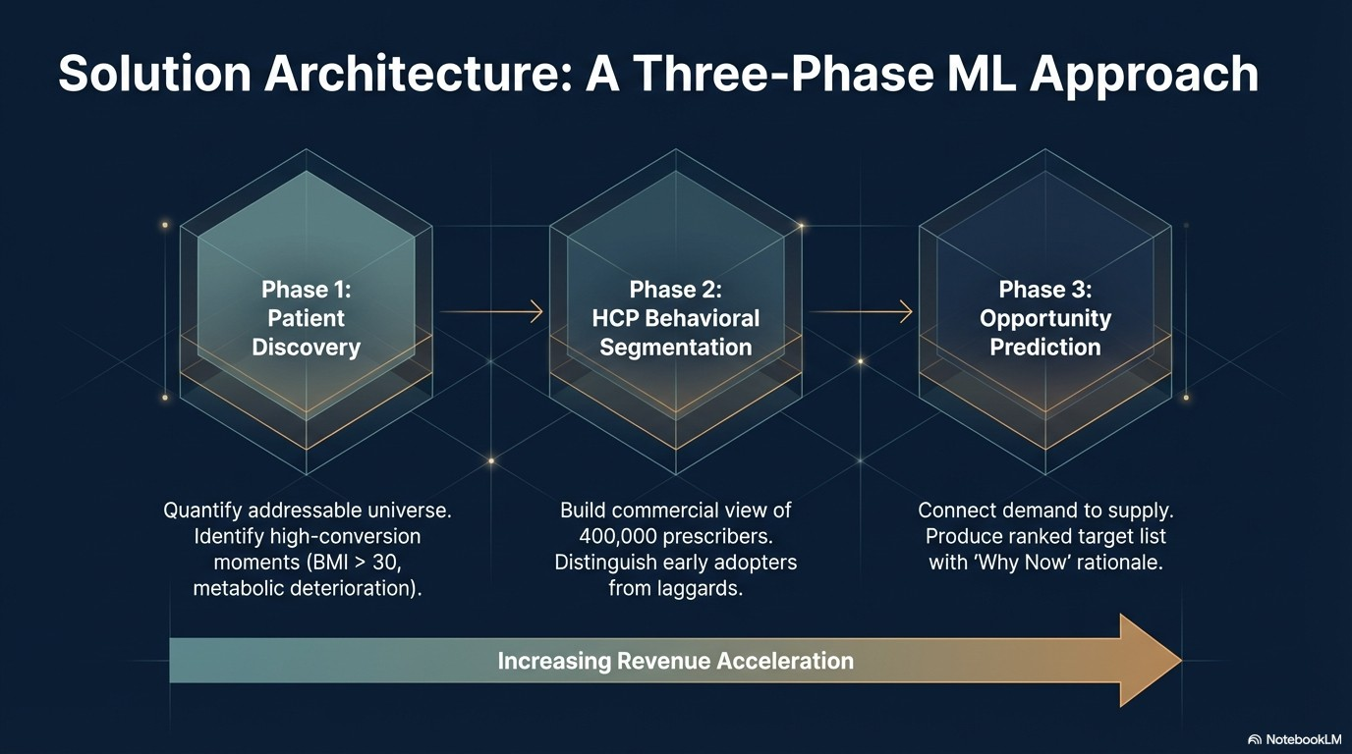

Slide 6
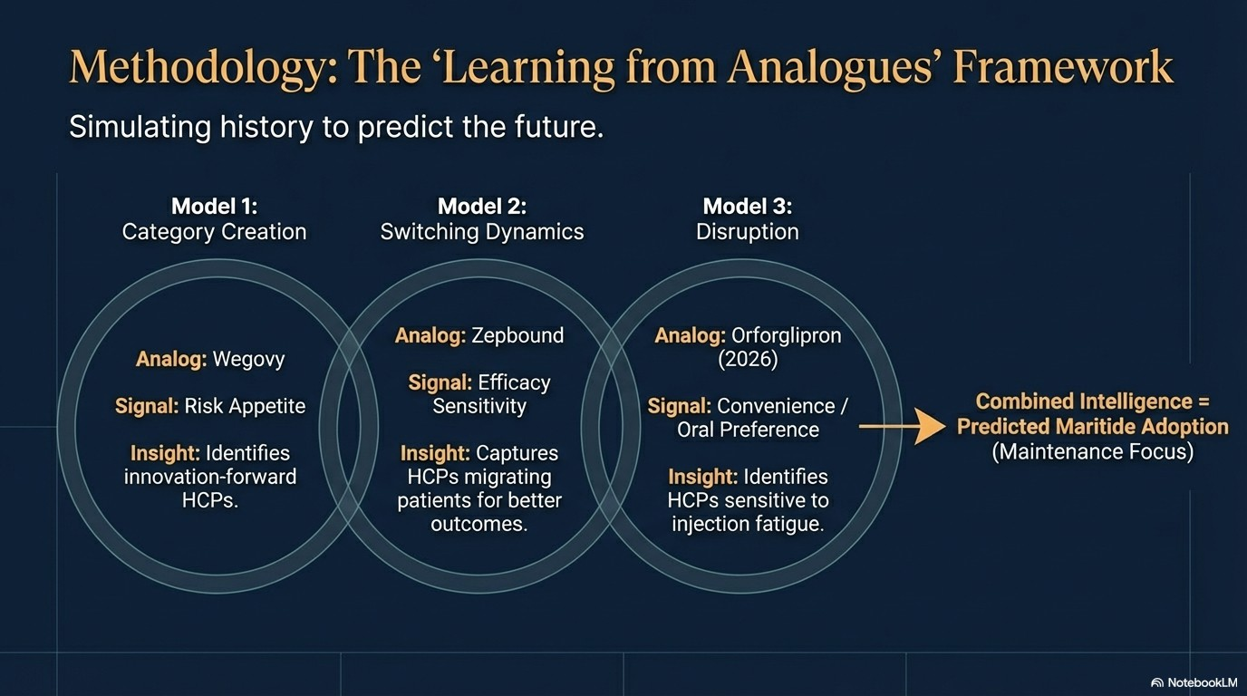

Slide 7
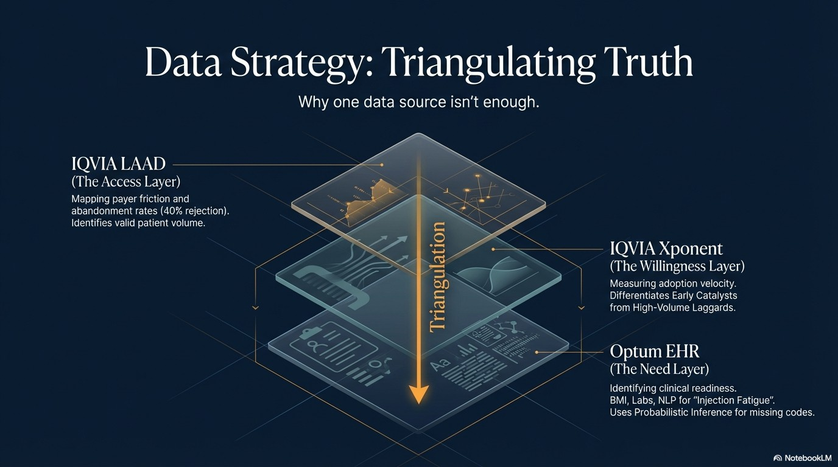

Slide 8
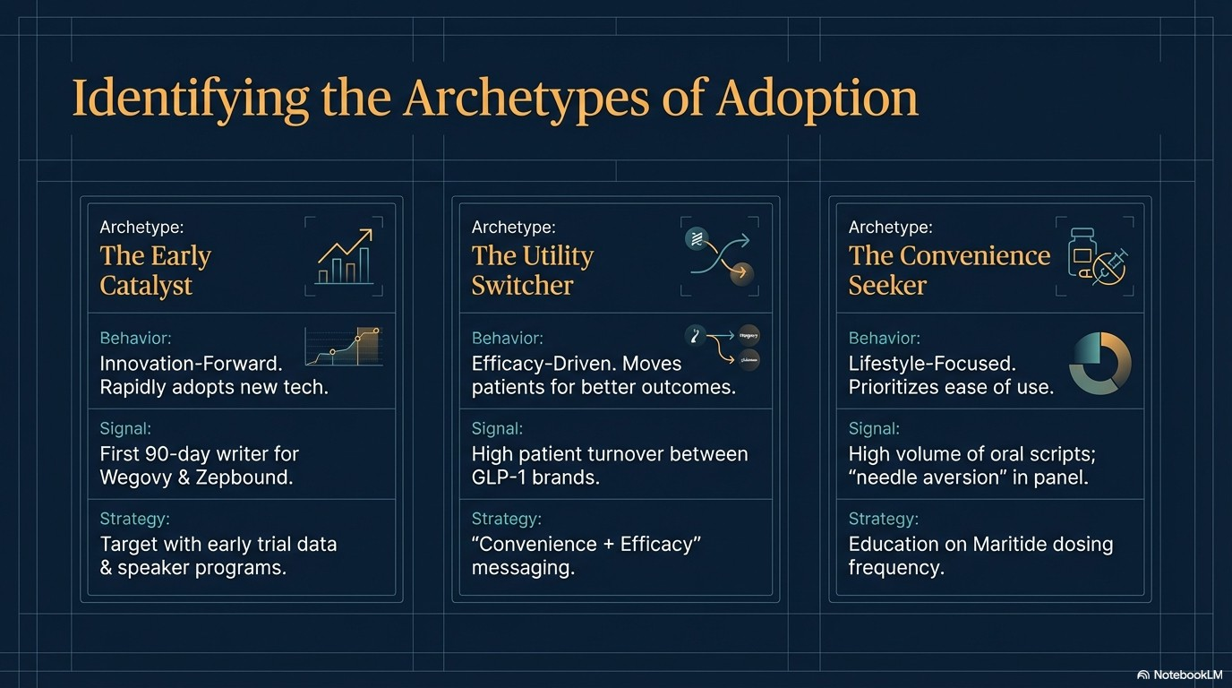

Slide 9
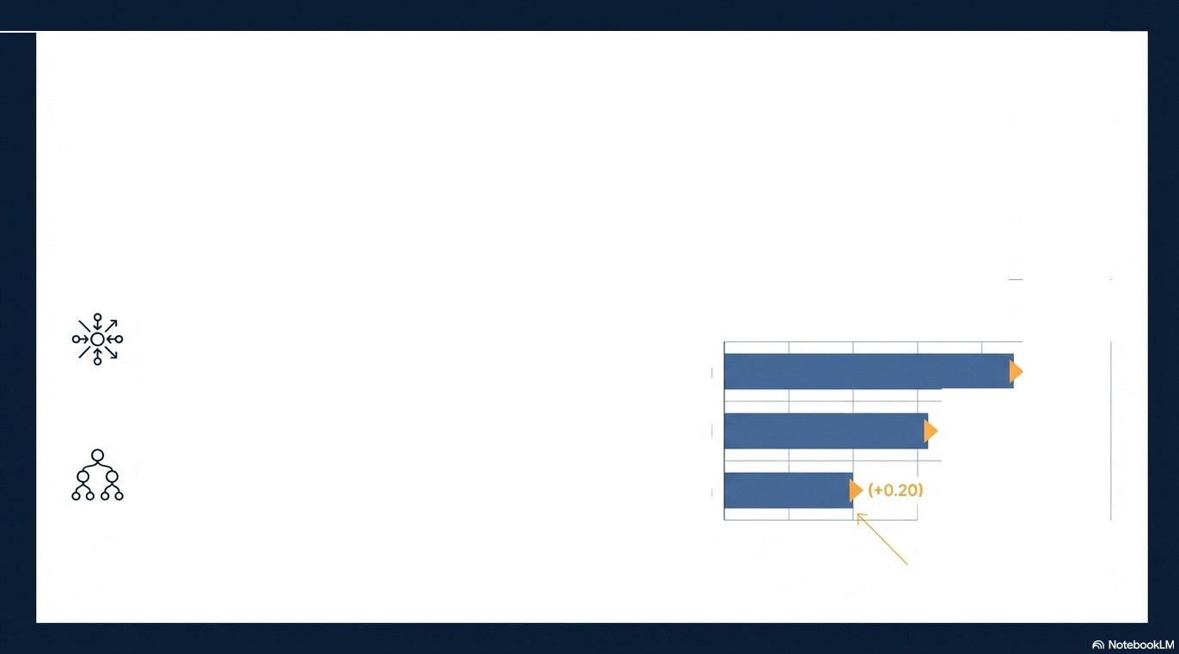
Technical Deep Dive: Advanced Analytics with Explainability
The Engine
The "Glass Box" Explainability
Unsupervised Clustering: Grouping 400k physicians by adoption behavior, not
geography.
Example SHAP Contribution Analysis
High Zepbound Switching
(+0.45)
Metabolic Deterioration in Panel
(+0.32)
XGBoost (Gradient-Boosted Trees}: High-accuracy scoring of adoption likelihood.
History of Oral Adoption
We don't jus.t give a score; we give a reason.

Slide 10
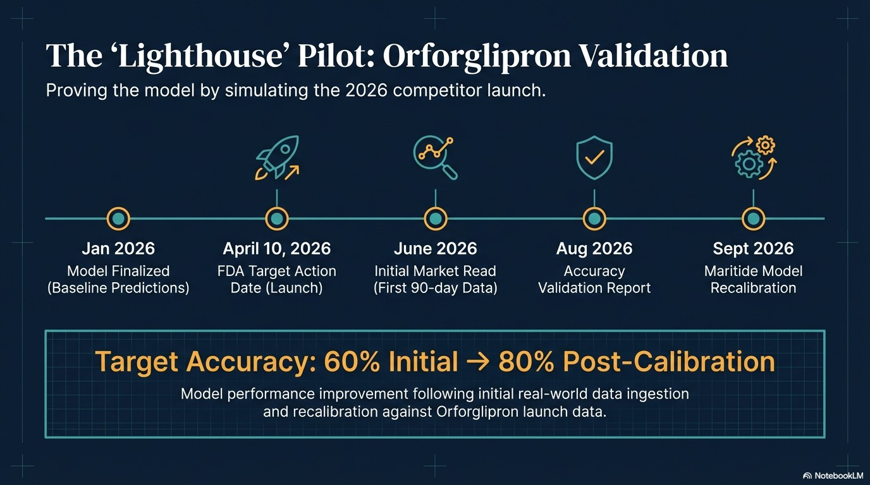

Slide 11
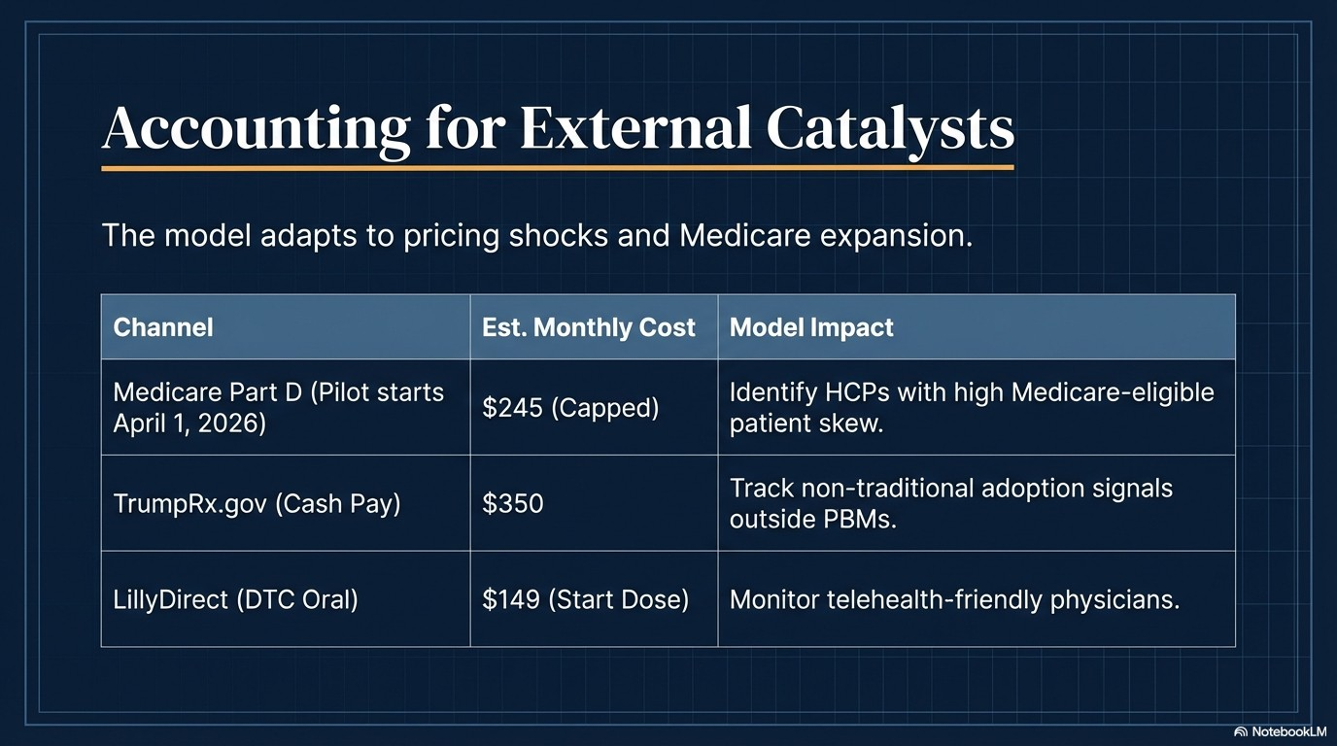

Slide 12
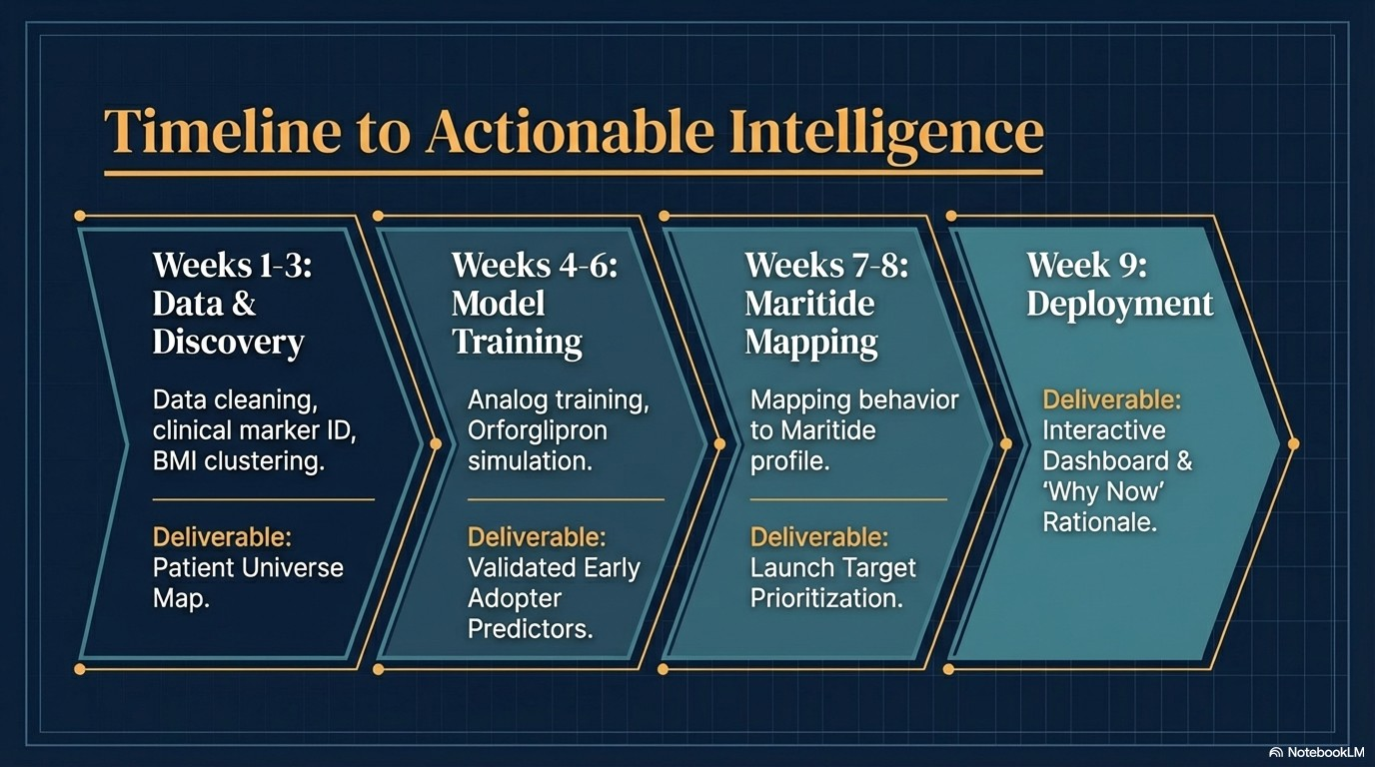

Slide 13
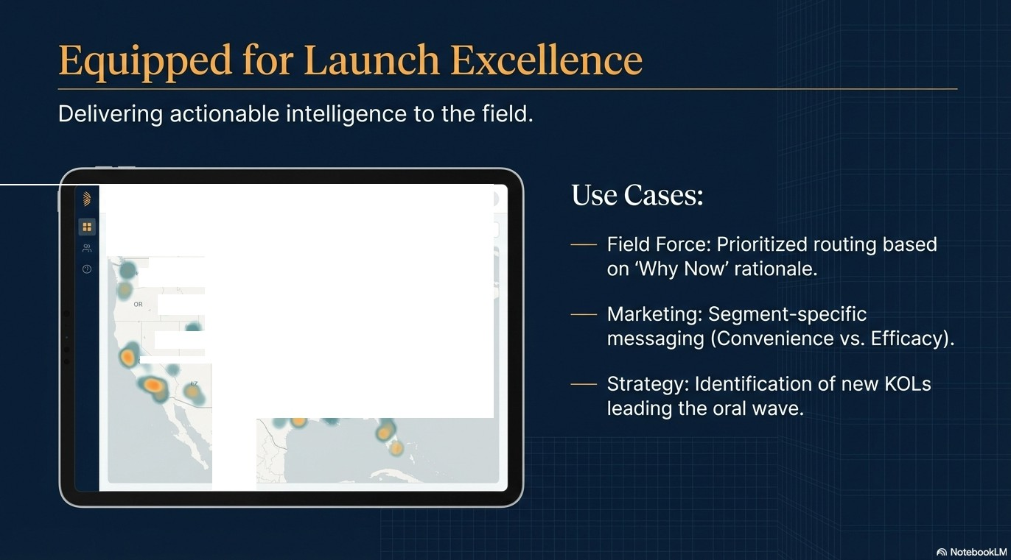
Beacon Dashboard
US City
V
15%
460).
el hltary v Eratantnary v
••
"
""
MT
NO
so
Physician Detail Card
X
.IO
WY
Dr. A. Smith.
Priority: Tier 1.
NE
IA
HV
UT
KS
MO
Why Now
High Injection Fatigue in Patient Panel. High affinity for innovation.
A
NM
AR
r
'-'
✓

Slide 14
Immediate Mobilization Plan
1. Immediate Actions
- Secure TPA Access
: Optum, IQVIA LAAD, Xponent.
- Align Protocol: C4 Center for Research data sharing.
-
Schedule Market Definition Workshop.
2. Key Workshop Decision
- Adoption Window: 90-day (Innovator) vs. 180-day?
- Hypothesis:
Defining 'Action Moments' in patient journey.
3. Governance
-
Bi-weekly progress reviews with Steering Committee.
IS\\ NotebookLM

Slide 15
