Slide 1
How Does Augmentation Affect Feature Space: A Study Using Various Augmentation Methods in Distributed Learning
Nikil Sharan Prabahar Balasubramanian
The University of Texas at Tyler
19th November 2024

Slide 2
Introduction
Overview of the Study:
The growth of deep learning, particularly convolutional neural networks (CNNs), has transformed fields like healthcare by enhancing pattern recognition.
However, challenges like imbalanced datasets and limited feature diversity restrict these models' real-world applicability, especially in healthcare settings.
Data Augmentation as a Solution:
Data augmentation techniques aim to create synthetic variations of data to:
Address data scarcity.
Improve model robustness.
Enhance class balance in datasets.
Feature Space Challenges:
Despite its benefits, data augmentation can introduce inconsistencies in feature space, particularly in tasks requiring precise signal interpretation like ECG classification.
In multi-label settings, augmentation often fails to address temporal dependencies and overlapping labels, resulting in suboptimal performance.
Why Distributed Learning?:
Distributed learning (e.g., federated learning) offers a way to train models across decentralized datasets without aggregating raw data.
However, distributed setups face unique challenges, including data heterogeneity and feature space misalignment.
Study Objectives:
Evaluate the impact of data augmentation on feature space in centralized and distributed learning settings.
Investigate embedding-level augmentation as a potential solution to balance feature spaces and improve model performance.
Key Hypotheses:
Data augmentations are effective for multi-class tasks but may fail for multi-label tasks in centralized learning.
Embedding-level augmentations can resolve feature space inconsistencies in distributed setups.

Slide 3
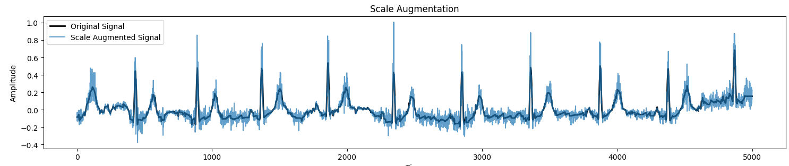
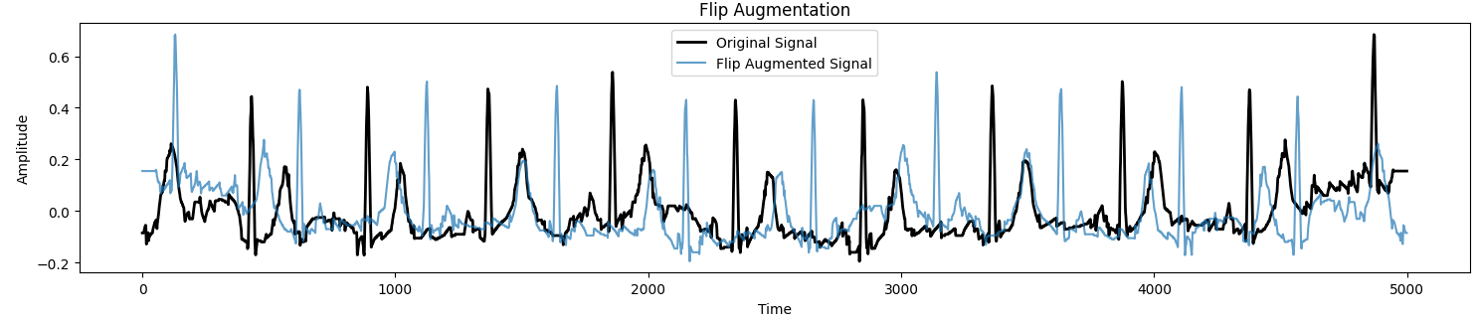
Data Augmentation
Basic Augmentation Techniques:
No Augmentation (Baseline): Signals remain unchanged, serving as a reference.
Jittering: Adding controlled random noise to simulate natural variations in the data.
Scaling: Adjusting the amplitude of the signal without distorting its structure.
Time Warping: Altering the time axis to represent shifts in timing or event duration.
Flipping: Reversing the order of the signal to test sequence-invariant properties.
Window-Based Techniques:
Window Slicing: Selecting a specific portion of the signal to simulate incomplete data.
Window Warping: Stretching or compressing segments of the signal to mimic prolonged or shortened events.
Advanced Techniques:
Magnitude Warping: Smooth adjustments to the signal’s amplitude using spline-based transformations.
Time-Warping : Enhanced temporal distortions to simulate dynamic signal changes.

Slide 4
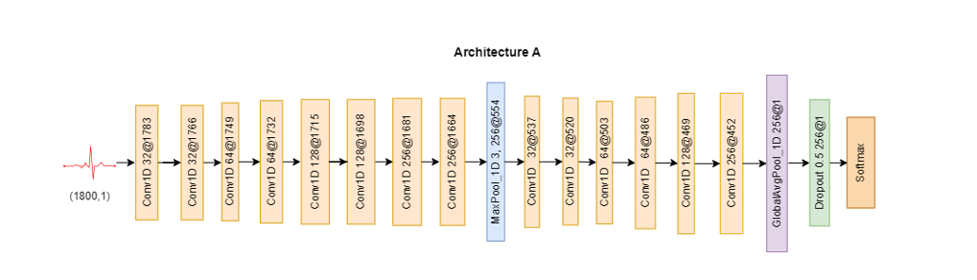
Experiment A: Multi-Class Classification
Objective:
Assess the impact of data augmentation on multi-class classification tasks.
Improve feature space diversity and class separability.
Dataset:
MIT-BIH Arrhythmia Dataset:
Four classes: Normal Sinus Rhythm, Atrial Fibrillation, Peri-Ventricular Contraction, Left Bundle Branch Block.
Challenge: Class imbalance, with rarer conditions underrepresented.
Augmentation Techniques:
No Augmentation (Baseline): Original signals, unmodified.
Jittering: Adds random noise to simulate variability.
Scaling: Adjusts signal amplitude while preserving structure.
Time Warping: Alters the time axis to simulate timing shifts.
Magnitude Warping: Smooth amplitude adjustments for feature diversity.
Window Slicing and Warping: Simulates partial or stretched signals.

Slide 5
Experiment A: Samples before and after Augmentation
Class 0:
Samples before augmentation: 198
Samples after augmentation: 198
Class 1:
Samples before augmentation: 95
Samples after augmentation: 198
Class 2:
Samples before augmentation: 94
Samples after augmentation: 198
Class 3:
Samples before augmentation: 73
Samples after augmentation: 198
Summary: The augmentation process equalized the number of samples in each class, increasing the representation of smaller classes and addressing class imbalance. This resulted in a uniform dataset with 198 samples per class, improving model training conditions.

Slide 6
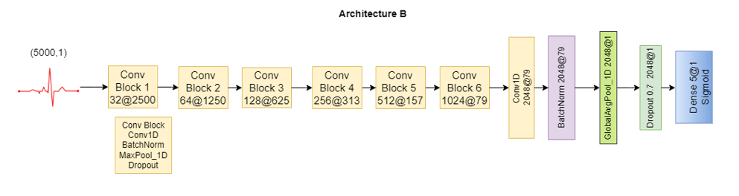
Experiment B: Multi-Class Classification
Objective:
Evaluate the impact of data augmentation on multi-label classification tasks.
Address challenges of overlapping labels and temporal dependencies in feature space.
Dataset:
PTB-XL Dataset:
Multi-label ECG data with five classes:
Normal ECG
Conduction Disturbances
Myocardial Infarction
Hypertrophy
ST/T Changes
Multi-label nature: One signal may belong to multiple classes.
Challenges in Multi-Label Tasks:
Temporal dependencies make signal integrity critical.
Overlapping labels complicate feature space representation.
Augmentation must maintain label invariance.
Augmenting one sample may increase the labels for multiple classes
Augmentation Techniques:
No Augmentation (Baseline): Original signals, unchanged.
Scaling: Simulates variations in signal amplitude.
Jittering: Adds noise, but risks distorting critical features.
Time Warping: Introduces temporal variations to mimic irregularities.

Slide 7
Experiment B: Samples before and after Augmentation
Class 0 (Conduction Disturbances): Samples before augmentation: 4,402 Samples after augmentation: 12,467
Class 1 (Hypertrophy): Samples before augmentation: 2,387 Samples after augmentation: 10,847
Class 2 (Myocardial Infarction): Samples before augmentation: 4,919 Samples after augmentation: 12,925
Class 3 (Normal): Samples before augmentation: 8,551 Samples after augmentation: 8,952
Class 4 (ST-T Changes): Samples before augmentation: 4,714 Samples after augmentation: 13,906
Summary: The augmentation process improved representation across all classes while retaining the inherent multi-label complexity. Although exact class balance is not possible due to overlapping labels, the final distribution ensures a more comprehensive and representative dataset for model training.

Slide 8
Experiment A: Results
Performance Metrics:
Scaling:
Most effective augmentation, improved accuracy by +3.13%.
Enhanced class separability and overall model robustness.
Magnitude Warping:
Improved precision and recall for underrepresented classes.
Strengthened feature space alignment, enabling better class distinction.
Jittering:
Introduced noise, leading to slightly degraded performance in certain cases.
Window Slicing:
Negatively impacted accuracy by disrupting temporal dependencies in signals.
Class-Level Insights:
Underrepresented classes (e.g., Atrial Fibrillation) benefited significantly from scaling and magnitude warping.
Jittering failed to enhance underrepresented classes due to added noise.
Grad-CAM Insights:
Scaling and Magnitude Warping:
Focused attention on diagnostically relevant signal features (e.g., QRS complex).
Jittering and Window Slicing:
Scattered attention across irrelevant regions, reducing model reliability.
Summary:
Scaling and magnitude warping are optimal for multi-class tasks, achieving improved accuracy, precision, and recall.

Slide 9
Experiment A: Results
Performance Metrics:
Scaling:
Most effective augmentation, improved accuracy by +3.13%.
Enhanced class separability and overall model robustness.
Magnitude Warping:
Improved precision and recall for underrepresented classes.
Strengthened feature space alignment, enabling better class distinction.
Jittering:
Introduced noise, leading to slightly degraded performance in certain cases.
Window Slicing:
Negatively impacted accuracy by disrupting temporal dependencies in signals.
Class-Level Insights:
Underrepresented classes (e.g., Atrial Fibrillation) benefited significantly from scaling and magnitude warping.
Jittering failed to enhance underrepresented classes due to added noise.
Grad-CAM Insights:
Scaling and Magnitude Warping:
Focused attention on diagnostically relevant signal features (e.g., QRS complex).
Jittering and Window Slicing:
Scattered attention across irrelevant regions, reducing model reliability.
Summary:
Scaling and magnitude warping are optimal for multi-class tasks, achieving improved accuracy, precision, and recall.

Slide 10
Experiment A: Results
Augmentation Technique | Accuracy | Precision | Recall | AUC
No Augmentation | 90.10% | 0.94 | 0.89 | 0.9864
Flip | 91.15% | 0.91 | 0.91 | 0.9780
Jitter | 89.06% | 0.92 | 0.87 | 0.9798
Magnitude Warp | 92.71% | 0.94 | 0.93 | 0.9839
Scaling | 93.23% | 0.95 | 0.92 | 0.9784
Time Warp | 92.71% | 0.94 | 0.93 | 0.9694
Window Slice | 91.15% | 0.93 | 0.90 | 0.9676
Window Warp | 92.19% | 0.93 | 0.92 | 0.9868

Slide 11
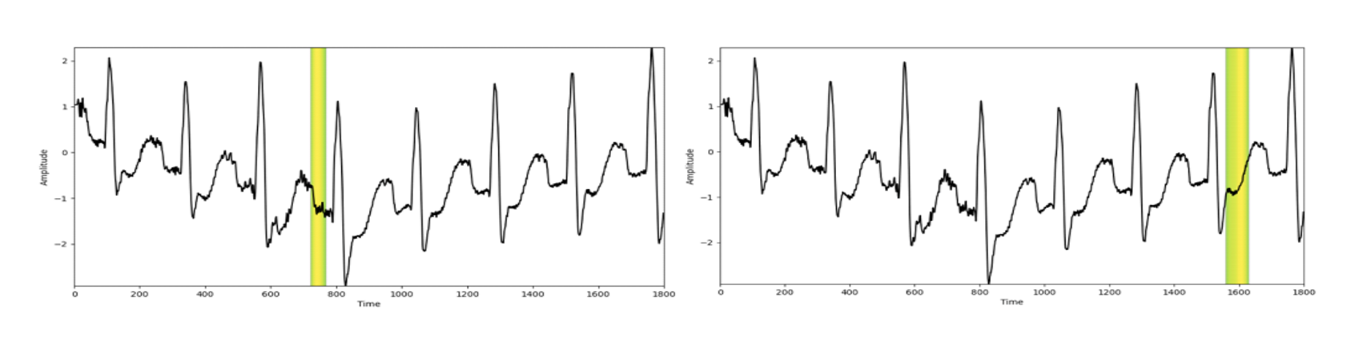
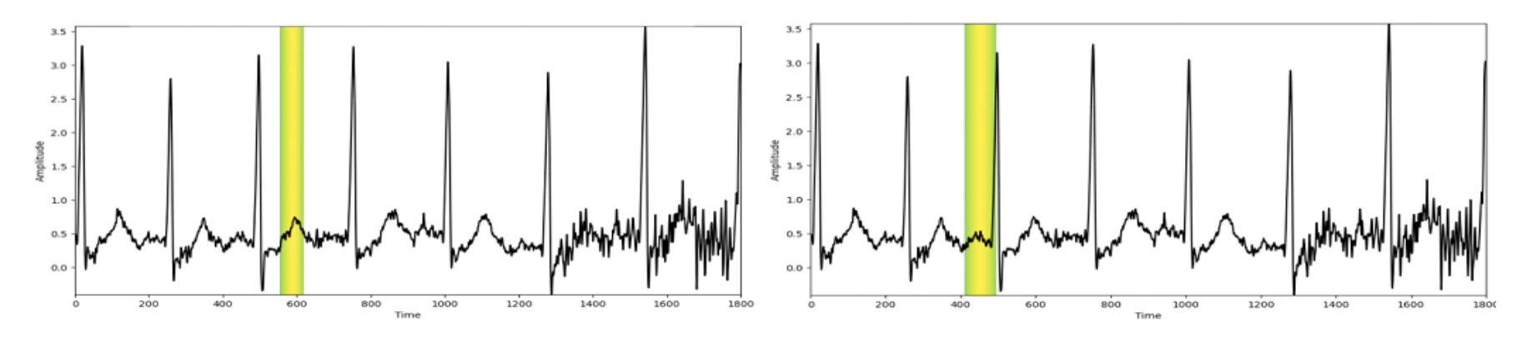
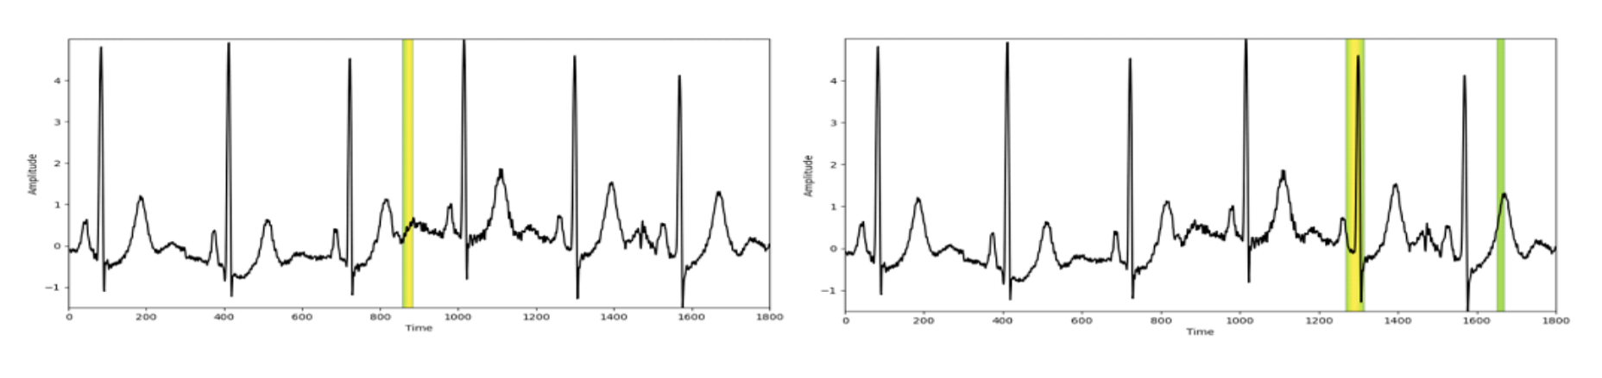
Experiment A: Grad-CAM Insights
Visualizations revealed that scaling preserved critical signal features (e.g., QRS complex).
Jittering added noise, leading to model misfocus.
Fig. 10. Visualizations for Experiment 1 Case A. LEFT: Baseline Model Correctly Classified Output as Class 0, RIGHT: Scale Augmented Model Incorrectly Classified Output
Fig. 11. Visualizations for Experiment 1 Case B. LEFT: Baseline Model Incorrectly Classified Output as Class 1, RIGHT: Scale Augmented Model Correctly Classified Output as Class 0.
Fig. 12. Visualization for Experiment 1 Case C. LEFT: Baseline Model Incorrectly Classified Output as Class 2, RIGHT: Scaling Incorrectly Classified Output as Class 2.

Slide 12
Experiment A: Results
Performance Metrics:
Scaling:
Most effective augmentation, improved accuracy by +3.13%.
Enhanced class separability and overall model robustness.
Magnitude Warping:
Improved precision and recall for underrepresented classes.
Strengthened feature space alignment, enabling better class distinction.
Jittering:
Introduced noise, leading to slightly degraded performance in certain cases.
Window Slicing:
Negatively impacted accuracy by disrupting temporal dependencies in signals.
Class-Level Insights:
Underrepresented classes (e.g., Atrial Fibrillation) benefited significantly from scaling and magnitude warping.
Jittering failed to enhance underrepresented classes due to added noise.
Grad-CAM Insights:
Scaling and Magnitude Warping:
Focused attention on diagnostically relevant signal features (e.g., QRS complex).
Jittering and Window Slicing:
Scattered attention across irrelevant regions, reducing model reliability.
Summary:
Scaling and magnitude warping are optimal for multi-class tasks, achieving improved accuracy, precision, and recall.

Slide 13
Experiment B: Grad-CAM Insights
Scaling and Magnitude Warping were the most effective in maintaining consistent and relevant attention.
Window Slice showed the worst Grad-CAM performance, fragmenting attention and impacting classification accuracy.
Grad-CAM revealed that input-level augmentations often struggled with multi-label challenges, highlighting the need for more sophisticated methods.

Slide 14
Experiment B: Grad-CAM Insights

Slide 15
Conclusion for Experiment 1 and Experiment 2
Experiment 1: Multi-Class Classification
Scaling and Magnitude Warping were the most effective, improving accuracy (+3.13%) and recall (+3%) by enhancing feature space and addressing class imbalance.
Time Warping showed moderate benefits, while Jittering and Window Slicing negatively impacted performance due to noise and fragmented information.
Experiment 2: Multi-Label Classification
Magnitude Warping and Time Warping performed best, improving recall slightly while preserving critical features.
Window Slicing caused a significant drop in accuracy (~3%), highlighting the challenges of handling temporal dependencies and overlapping labels.
Grad-CAM showed scattered attention for Jittering and Window Slicing, while Magnitude Warping maintained focus.
Overall:
Multi-class tasks benefit most from Scaling and Magnitude Warping, while multi-label tasks require Time Warping and Magnitude Warping to balance diversity and feature integrity.

Slide 16
Disadvantages of Data Augmentation for Multi-Label Tasks
Label Inconsistency:
Augmentations like jittering, time warping, or window slicing can distort the relationship between overlapping labels.
Multi-label tasks rely on the co-occurrence of specific features, and augmentation risks introducing inconsistencies that misalign these relationships.
Loss of Temporal Dependencies:
Techniques such as window slicing and warping disrupt the temporal continuity of signals.
Noise Introduction:
Augmentations like jittering may add unnecessary noise, which can obscure critical features.
This noise makes it harder for the model to learn meaningful representations, especially for rare label combinations.
Reduced Effectiveness in Overlapping Labels:
Augmentations may not effectively differentiate overlapping labels, leading to reduced recall and misclassification.
The complexity of multi-label tasks requires transformations that preserve nuanced, multi-dimensional relationships in the data.
Overfitting to Augmented Patterns:
Over-reliance on synthetic patterns from augmentation can lead to overfitting.
This limits the model’s generalizability, particularly when augmented data deviates from real-world distributions.
Limited Improvements in Model Performance:
As seen in the experiments, traditional input-level augmentations show minimal improvements in metrics like accuracy, recall, and AUC for multi-label tasks.
This highlights the need for more advanced augmentation methods or alternative approaches like embedding augmentation.

Slide 17
How a Distributed Approach Helps
Handles Data Diversity:
Distributed learning can incorporate diverse datasets across multiple nodes, capturing a broader range of feature variability.
This diversity reduces overfitting to specific classes and enhances model generalization for multi-label tasks.
Improves Feature Space Alignment:
By synchronizing model parameters across nodes, distributed learning helps align feature spaces, mitigating the inconsistencies introduced by augmentation in centralized setups.
It ensures that overlapping labels are handled consistently across datasets.
Addresses Data Scarcity:
Data augmentation techniques combined with distributed learning allow the model to utilize synthesized variations across multiple nodes, compensating for the limited availability of labeled data.
Supports Real-World Heterogeneity:
Distributed learning reflects real-world scenarios where data is scattered and heterogeneous, making it more robust for multi-label tasks.
It enables training on data with diverse distributions, ensuring better adaptability to unseen conditions.
Potential for Scalability:
Distributed approaches allow scaling to larger datasets and more complex models, which can improve performance in multi-label classification over time.

Slide 18
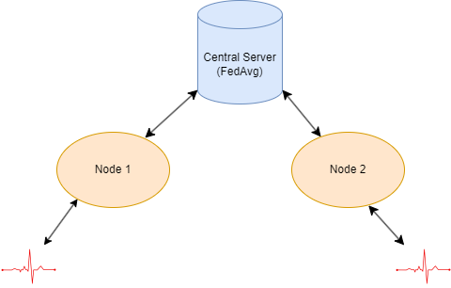
Distributed Learning Framework
Central Server:
Acts as the coordinator of the learning process.
Collects model updates (e.g., weights, gradients) from the nodes after local training.
Aggregates the updates using the FedAvg algorithm, which averages the locally trained models to create a global model.
Sends the updated global model back to the nodes for the next training round.
Represent individual data sources or decentralized entities participating in the training process (e.g., hospitals or institutions).
Each node trains the model locally on its dataset using the current global model parameters from the central server.
The locally trained model updates are sent to the central server instead of raw data, preserving data privacy and security.
Communication:
Bidirectional communication exists between the central server and nodes.
Nodes:
Model parameters flow from the central server to nodes, and local model updates flow back to the server.
Each node has the same model architecture as Experiment 2 (Multi Label Classification)

Slide 19
Results of No Augmentation in Distributed Learning
Performance Metrics:
Accuracy: Improved steadily from 0.7600 (Round 1) to 0.7785 (Round 5), showing the effectiveness of collaborative training across nodes.
Loss: Decreased from 0.5052 to 0.4821, indicating more precise predictions over training rounds.
AUC: Rose from 0.7743 to 0.7952, reflecting better discrimination between classes.
Recall & Precision: Recall improved from 0.4115 to 0.4563, and precision from 0.5361 to 0.5817, but at a slower pace due to lack of data diversity.
Comparison to Centralized Approach:
Distributed metrics closely mirrored the centralized setup, showing the distributed approach successfully captures global data patterns without directly centralizing data.
Round | Distributed Loss | Distributed Accuracy | Distributed AUC | Distributed Recall | Distributed Precision | Centralized Loss | Centralized Accuracy | Centralized Recall | Centralized Precision | Centralized AUC
1 | 0.505208492 | 0.760054588 | 0.774293512 | 0.411532938 | 0.536164284 | 0.505205035 | 0.760054588 | 0.411532938 | 0.536164284 | 0.774283767
2 | 0.485137552 | 0.77079165 | 0.788061857 | 0.441260755 | 0.562300324 | 0.485158086 | 0.77079165 | 0.441260755 | 0.562300324 | 0.788057148
3 | 0.483201757 | 0.775841683 | 0.792026103 | 0.448424071 | 0.575499892 | 0.483201325 | 0.775887191 | 0.448424071 | 0.575632155 | 0.792023778
4 | 0.483513877 | 0.777115554 | 0.793497115 | 0.452005744 | 0.578501076 | 0.483428297 | 0.777161062 | 0.452005744 | 0.578633666 | 0.793512166
5 | 0.48210229 | 0.778525919 | 0.79527694 | 0.456303716 | 0.581735283 | 0.482084155 | 0.778434932 | 0.456303716 | 0.581469655 | 0.795277357

Slide 20
Challenges in the No Augmentation Setup
Class Imbalance:
Rare conditions were underrepresented, negatively impacting recall and detection rates.
Reduced Robustness:
Without augmentation (e.g., jittering or time warping), models were overly sensitive to subtle variations and noise in data, affecting reliability.
Limited Generalization:
Lack of synthetic samples restricted the model's ability to adapt to unseen patterns and diverse conditions.

Slide 21
Results of Magnitude Warping in Distributed Learning
Performance Metrics:
Accuracy: Improved steadily from 0.7534 (Round 1) to 0.7701 (Round 5), demonstrating that magnitude warping enhances the model’s ability to generalize across nodes.
Loss: Decreased from 0.5286 to 0.5096, reflecting improved predictions and reduced error rates.
AUC: Increased from 0.7445 to 0.7801, showcasing improved discriminative power for distinguishing between classes.
Recall and Precision:
Recall showed consistent performance (0.4438 to 0.4427), highlighting a limitation in addressing missed positive cases.
Precision improved from 0.5171 to 0.5600, indicating reduced false positives and better focus on relevant features.
Comparison with Centralized Approach:
Centralized and distributed setups performed similarly, suggesting that magnitude warping helps federated models achieve comparable outcomes while preserving privacy.
Round | Distributed Loss | Distributed Accuracy | Distributed AUC | Distributed Recall | Distributed Precision | Centralized Loss | Centralized Accuracy | Centralized Recall | Centralized Precision | Centralized AUC
1 | 0.528649151 | 0.753412187 | 0.744538069 | 0.443767905 | 0.517111838 | 0.528686821 | 0.753412187 | 0.443767905 | 0.517111838 | 0.74451226
2 | 0.483210951 | 0.774431288 | 0.781174183 | 0.467406869 | 0.568132341 | 0.483225822 | 0.774431288 | 0.467406869 | 0.568132341 | 0.781134963
3 | 0.492658079 | 0.772156477 | 0.782415211 | 0.453796566 | 0.564113975 | 0.492673963 | 0.772156477 | 0.453796566 | 0.564113975 | 0.782398403
4 | 0.49675858 | 0.77361238 | 0.78357774 | 0.452369308 | 0.56840682 | 0.496786624 | 0.773521364 | 0.452005744 | 0.568212509 | 0.783560097
5 | 0.50965488 | 0.770063698 | 0.780104697 | 0.442693412 | 0.560036242 | 0.509690166 | 0.770154715 | 0.442693412 | 0.560290098 | 0.780104637

Slide 22
Advantages of Magnitude Warping in Distributed Learning
Enhanced Generalization:
Variability in signal amplitude broadens the model’s learning scope, improving adaptability to heterogeneous data.
Robustness to Data Heterogeneity:
Helps the model handle variations in signal intensity across nodes with diverse recording conditions.
Improved Class Balance:
Magnitude warping indirectly amplifies features of underrepresented classes, enhancing recall for rare conditions.
Efficient Aggregation Cycles:
Steady metric improvements indicate that magnitude warping facilitates effective model updates during aggregation rounds.

Slide 23
Challenges and Limitations of Data Augmentation in Distributed Learning
Key Challenges:
Computational Overhead:
Complex augmentation techniques require significant processing power.
Nodes with limited computational resources may face difficulties in efficiently training locally augmented models.
Communication Overhead:
Augmentations that significantly alter data distributions can lead to inconsistent model updates.
This inconsistency affects the stability of the global model, requiring more communication cycles to converge.
Risk of Noise Introduction:
Augmentation might introduce irrelevant or excessive noise.
This noise can impact model performance and reduce interpretability, especially for sensitive tasks like healthcare.

Slide 24
The Pivot: Embedding Augmentation
What is Embedding Space?:
Embedding spaces transform high-dimensional data into lower-dimensional representations.
They capture meaningful relationships between instances, aiding in classification tasks.
Challenges in Distributed Learning:
Data Heterogeneity:
Variations across nodes distort embeddings, leading to inconsistent feature representations.
Imbalanced Class Distributions:
Minority class embeddings cluster in compressed regions.
Majority classes dominate the feature space, reducing the ability to distinguish rare patterns.
Impact on Model Performance:
Poorly constructed embeddings result in compromised feature representation.
Reduced generalization limits the model’s effectiveness, particularly in distributed settings.
Advanced Techniques for Embedding Challenges:
Label Embedding:
Creates embeddings that incorporate label semantics to improve class representation.
Feature Augmentation:
Expands feature space with synthetic or enriched features to balance class distributions.
Dynamic Feature Expansion:
Continuously adapts embeddings to new data, ensuring better generalization.

Slide 25
Embedding Augmentation in Distributed Learning
Random Walk-Based Embedding Augmentation (RWE).
The approach adds synthetic data points to the embedding space, increasing robustness and enhancing model capacity to generalize across classes.
Angular Variance Adjustments for class-specific embeddings.
Angular variance adjusts the spatial distribution of real data points within the embedding space. Focuses on dispersing tail classes while preserving intra-class exclusiveness, enhancing feature space representation.

Slide 26
Results of RWE Augmentation
Accuracy and Loss:
Distributed accuracy improves steadily from 49.2% (Round 1) to 61.3% (Round 15).
Loss decreases progressively, indicating improved predictions and reduced error rates.
Centralized accuracy improves steadily from 48.8% (Round 1) to 83.7% (Round 15).
.
Round | Distributed Loss | Distributed Accuracy | Centralized Loss | Centralized Accuracy | Recall | Precision | AUC
1.0 | 0.48953 | 0.49249 | 0.69264 | 0.48817 | 0.27865 | 0.17726 | 0.51916
2.0 | 0.43953 | 0.5778 | 0.48951 | 0.77307 | 0.50537 | 0.55903 | 0.76399
3.0 | 0.42196 | 0.59054 | 0.43954 | 0.798 | 0.61533 | 0.59986 | 0.82551
4.0 | 0.414 | 0.59327 | 0.42197 | 0.80783 | 0.60029 | 0.62725 | 0.83588
5.0 | 0.40707 | 0.596 | 0.414 | 0.81438 | 0.60172 | 0.64417 | 0.84191
6.0 | 0.40135 | 0.60328 | 0.40706 | 0.8192 | 0.60638 | 0.65595 | 0.84724
7.0 | 0.39791 | 0.60828 | 0.40134 | 0.82329 | 0.60638 | 0.66759 | 0.85132
8.0 | 0.39395 | 0.60828 | 0.39792 | 0.82712 | 0.60279 | 0.68027 | 0.85327
9.0 | 0.39187 | 0.61192 | 0.39395 | 0.82957 | 0.60279 | 0.68778 | 0.85592
10.0 | 0.39146 | 0.61283 | 0.39187 | 0.83221 | 0.59814 | 0.69816 | 0.85719
11.0 | 0.38869 | 0.6151 | 0.39146 | 0.83276 | 0.58883 | 0.70437 | 0.85758
12.0 | 0.38832 | 0.61374 | 0.38869 | 0.8354 | 0.59814 | 0.70853 | 0.85931
13.0 | 0.38682 | 0.61692 | 0.38832 | 0.8354 | 0.58703 | 0.71416 | 0.86
14.0 | 0.38648 | 0.61465 | 0.38683 | 0.83631 | 0.58632 | 0.71767 | 0.86106
15.0 | 0.38697 | 0.61374 | 0.38648 | 0.83703 | 0.58883 | 0.71885 | 0.86133

Slide 27
Advantages and Applications of RWE Augmentation
Advantages of Synthetic Data Addition:
Enhanced Class Representation:
Enriches minority class embeddings with synthetic samples, expanding intra-class diversity.
Reduced Overgeneralization:
Prevents the loss of critical features by retaining details necessary for class separation.
Robustness to Data Heterogeneity:
Helps the model learn invariant features, improving generalization across diverse nodes.
Improved Tail Class Learning:
Minority classes gain better representation, improving classification for rare categories.
Applications in Distributed Learning:
1. Addresses challenges of class imbalance and heterogeneous data.

Slide 28
Results of Angular Variance Augmentation
Distributed and Centralized Metrics:
Distributed accuracy improves from 57.5% (Round 1) to 61.1% (Round 15).
Distributed loss decreases from 43.1% to 38.5%, reflecting enhanced model predictions.
Centralized accuracy improves from 76.0% (Round 1) to 83.7% (Round 15).
Round | Distributed Loss | Distributed Accuracy | Centralized Loss | Centralized Accuracy | Recall | Precision | AUC
1.0 | 0.43153 | 0.57598 | 0.51222 | 0.76069 | 0.41905 | 0.53719 | 0.76572
2.0 | 0.42111 | 0.5869 | 0.43153 | 0.80737 | 0.53832 | 0.64479 | 0.82361
3.0 | 0.41246 | 0.59349 | 0.4211 | 0.81301 | 0.54907 | 0.65822 | 0.83434
4.0 | 0.41124 | 0.596 | 0.41246 | 0.81947 | 0.56447 | 0.67235 | 0.842
5.0 | 0.40407 | 0.59918 | 0.41125 | 0.82056 | 0.5616 | 0.67703 | 0.84397
6.0 | 0.4015 | 0.60191 | 0.40407 | 0.82402 | 0.56519 | 0.68668 | 0.84929
7.0 | 0.39649 | 0.60692 | 0.4015 | 0.82848 | 0.56554 | 0.70147 | 0.85177
8.0 | 0.39886 | 0.60191 | 0.39649 | 0.83021 | 0.56769 | 0.70633 | 0.85422
9.0 | 0.39295 | 0.60328 | 0.39886 | 0.82957 | 0.55946 | 0.70839 | 0.85431
10.0 | 0.39238 | 0.60555 | 0.39295 | 0.83376 | 0.56554 | 0.72002 | 0.85755
11.0 | 0.38861 | 0.60464 | 0.39238 | 0.83412 | 0.5659 | 0.72113 | 0.85834
12.0 | 0.38765 | 0.60601 | 0.38861 | 0.83594 | 0.57128 | 0.72467 | 0.86032
13.0 | 0.38739 | 0.60646 | 0.38765 | 0.83594 | 0.56877 | 0.72611 | 0.86077
14.0 | 0.38574 | 0.61101 | 0.38739 | 0.83567 | 0.56734 | 0.72594 | 0.86123
15.0 | 0.38573 | 0.61101 | 0.38574 | 0.83776 | 0.56948 | 0.73238 | 0.86193

Slide 29
Advantages of Angular Variance
Increased Interpretability:
Preserves the structure of real data points, making decision boundaries clearer.
Allows better understanding of model decisions in sensitive applications like healthcare.
Consistency Across Nodes:
Distributed and centralized metrics closely align, ensuring stable contributions to the global model.
Centralized Accuracy for both setups reaches 83%, reflecting robust performance.
Scalability and Efficiency:
Removes the need for synthetic augmentation, reducing computational overhead.
Easily implementable in federated systems with heterogeneous data.

Slide 30
Challenges and Future Directions
Challenges: Computational costs of embedding augmentation.
Future Work: Dynamic augmentation techniques and expanding to other medical domains.

Slide 31
Conclusion
Distributed Learning Challenges:
Data is fragmented across nodes, limiting access to comprehensive datasets.
Traditional data augmentation methods alone (e.g., noise, scaling) provided limited improvements due to their inability to capture complex, diverse patterns across nodes.
Role of Embedding Augmentation:
Random Walk and Angular Variance emerged as the most effective augmentation techniques.
These methods operate directly within the model’s feature space, generating synthetic representations that expand feature diversity.
Benefits of Embedding Augmentation:
Enriches the feature space with synthetic internal representations, allowing the model to learn more complex patterns.
Facilitates better generalization across nodes, addressing the challenges of heterogeneity and imbalanced data in distributed setups.

Slide 32
Acknowledgments
Thank you Dr. Sagnik Dakshit, Dr. Yi Li and Dr Arun Kulkarni for your guidance.

