Slide 1



CryoTrack
Pharmaceutical Cold-Chain Monitoring and Logistics Management System
Members: NIKIL SIDDAARTH T | PRAVEEN V | SHAILESH K
CryoTrack
Registration No.: 25BCE5373 | 25BCE5413 | 25BCE5707
Course: DBMS
Reliable. Monitored. Delivered.
Faculty: Geetha S
2°C – 8°C

Slide 2


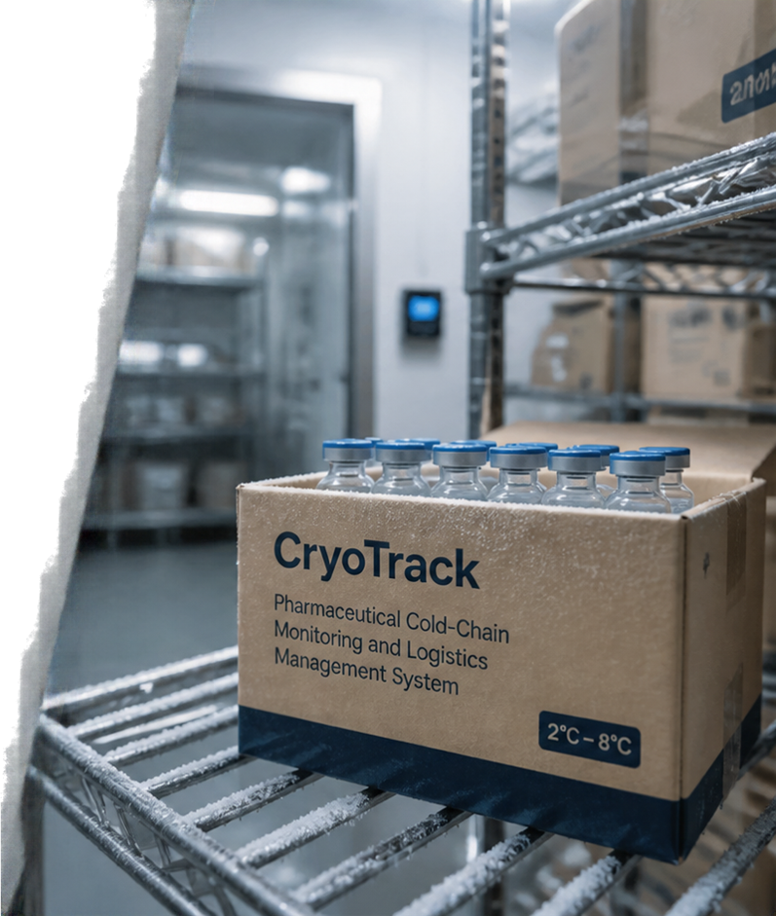




Problem, Motivation & Objectives
The challenge: temperature deviations, limited visibility
and fragmented data put medicine quality and patient
safety at risk.
Why it matters: every break in the cold chain can
compromise potency, increase waste and delay care.
Our solution: an integrated platform for real-time monitoring, end-to-end traceability and smarter logistics.
Objectives:
ensure product integrity across the cold chain
deliver real-time visibility and early alerts
streamline warehouse, transport and delivery operations
enable compliance, accountability and data-driven decisions

Slide 3

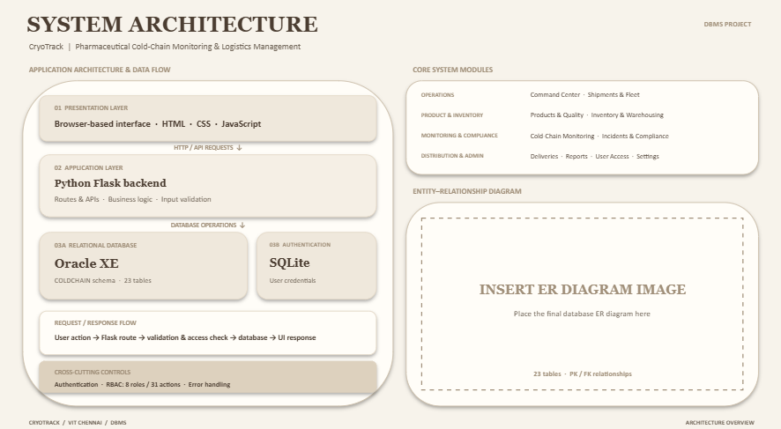









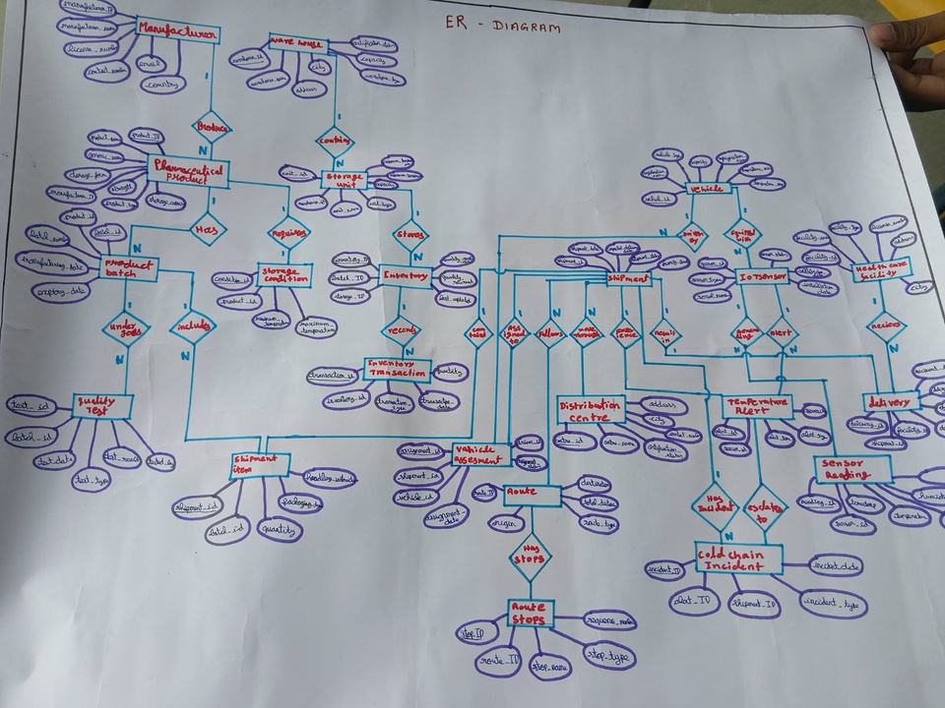




























System Architecture & ER Diagram
SOURCES
DATA
INGESTION
PLATFORM SERVICES
BUSINESS
DOMAIN
STAKEHOLDERS
End-to-end visibility across the pharmaceutical cold chain
Products
Sensor Readings
Monitoring
Alerts & Incidents
Inventory
Warehouses
Events
Shipments
Distribution Centres
Real-time telemetry and intelligent alerts
IoT Sensors
Analytics
Traceability
Routes
Healthcare Facilities
Operations
Transactions
Deliveries
Drivers & Vehicles
Integrated logistics from warehouse to last-mile delivery
Data-driven operations for quality, compliance and reliability
DATA STORE
Centralized Relational Database (23 Entities)
Products
Batches
Inventory
Shipments
Routes
Deliveries
Quality Tests
Storage
Distribution Centres
IoT Sensors
Alerts
Quality Results
Warehouses
Healthcare Facilities
Sensor Readings
Incidents

Slide 4












































Key Database Relationships
CORE RELATIONSHIP GROUPS
Primary keys uniquely identify records. Foreign keys connect related tables and maintain referential integrity.
Products
(1)
Shipments
(1)
Batches
(1)
VERIFIED RELATIONSHIPS
Vehicles
(1)
Quality
(1)
MANUFACTURER → PHARMACEUTICAL_PRODUCT → PRODUCT_BATCH → QUALITY_TEST
WAREHOUSE → STORAGE_UNIT → INVENTORY → INVENTORY_TRANSACTION
ROUTE → SHIPMENT → SHIPMENT_ITEM → DELIVERY
IOT_SENSOR → SENSOR_READING → TEMPERATURE_ALERT → COLD_CHAIN_INCIDENT
Drivers
(1)
Warehouses
(1)
23
Entities
Routes
(1)
Storage
(1)
RELATIONAL DESIGN
Distribution Centres (1)
Inventory
(1)
23 Oracle tables
23 primary-key constraints
23 foreign-key constraints
SHIPMENT_ITEM has a composite primary key: (BATCH_ID, SHIPMENT_ID)
Healthcare Facilities (1)
IoT Sensors
(1)
Sensor Readings (1)
Alerts
(1)
Incidents
(1)
Deliveries
(1)
ORACLE RELATIONAL SCHEMA
Relationship examples shown; the complete schema contains 23 tables.

Slide 5





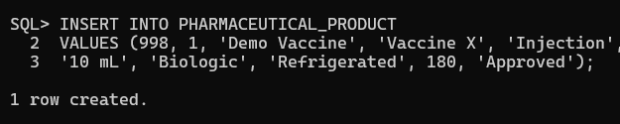



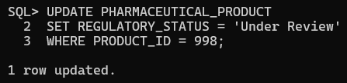
SQL Implementation & Query Examples

Slide 6
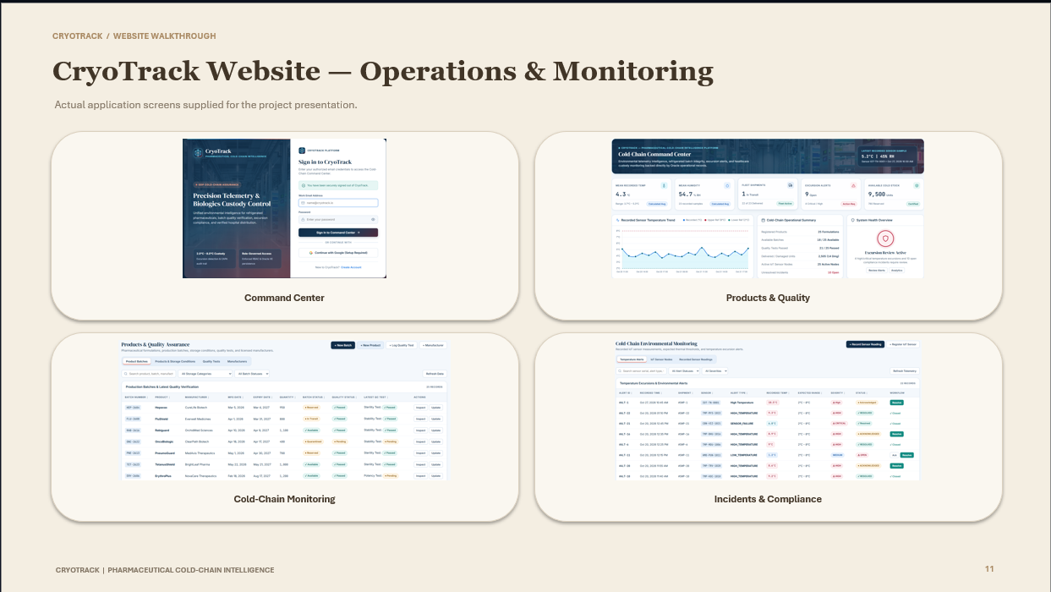
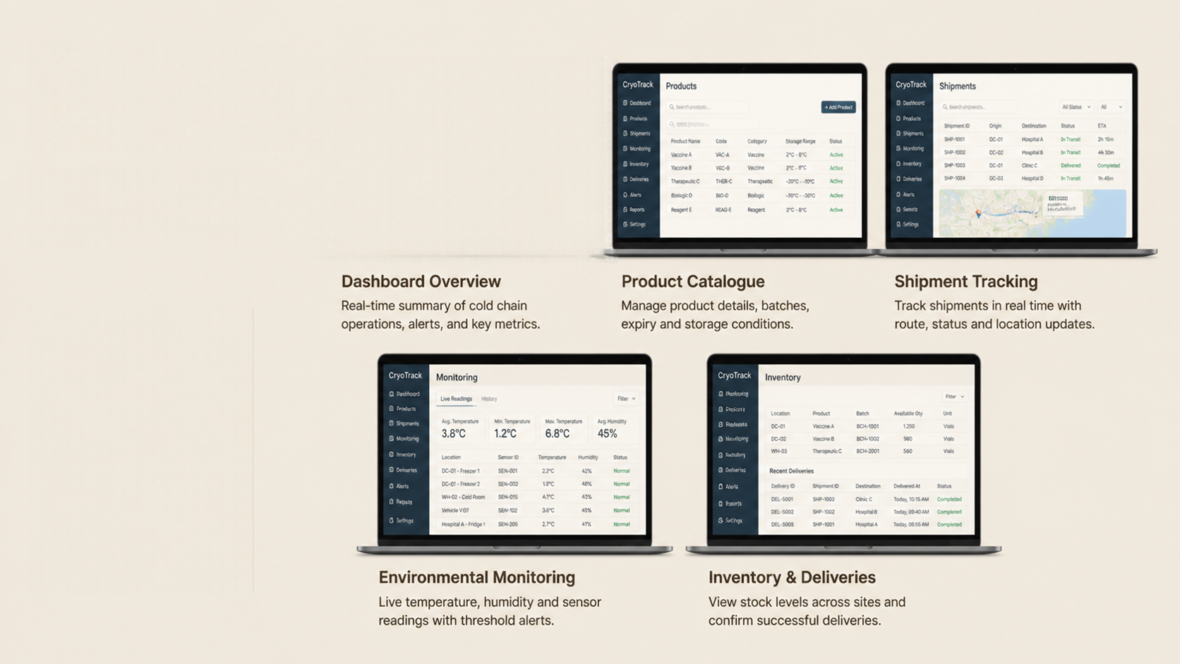

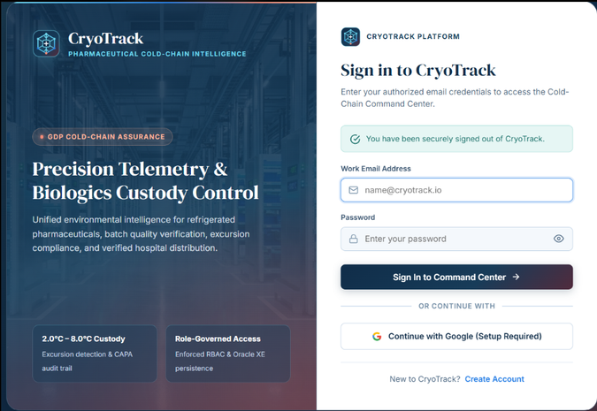
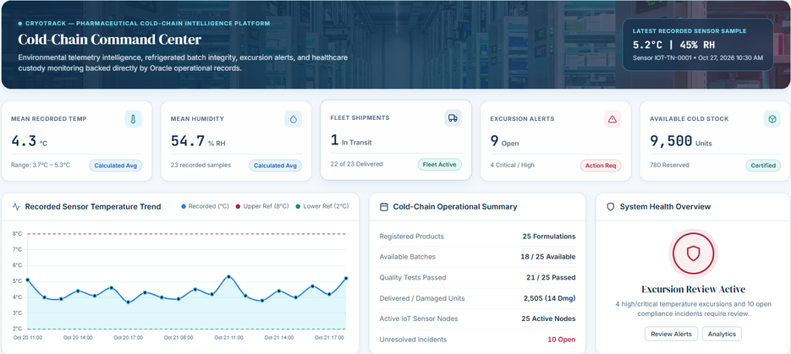

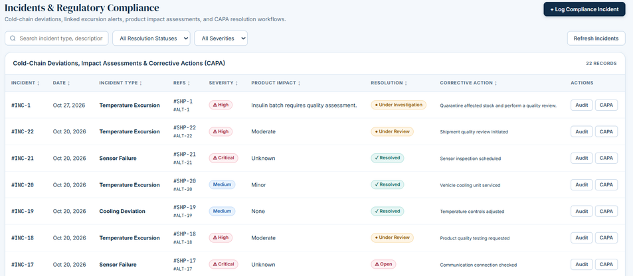
CryoTrack Website — Actual Application Screens
Login Page
Command Center
Explore key
modules in action
Dashboard overview
Product catalogue
Shipment tracking
Environmental monitoring
Inventory & storage
Delivery confirmation

Slide 7
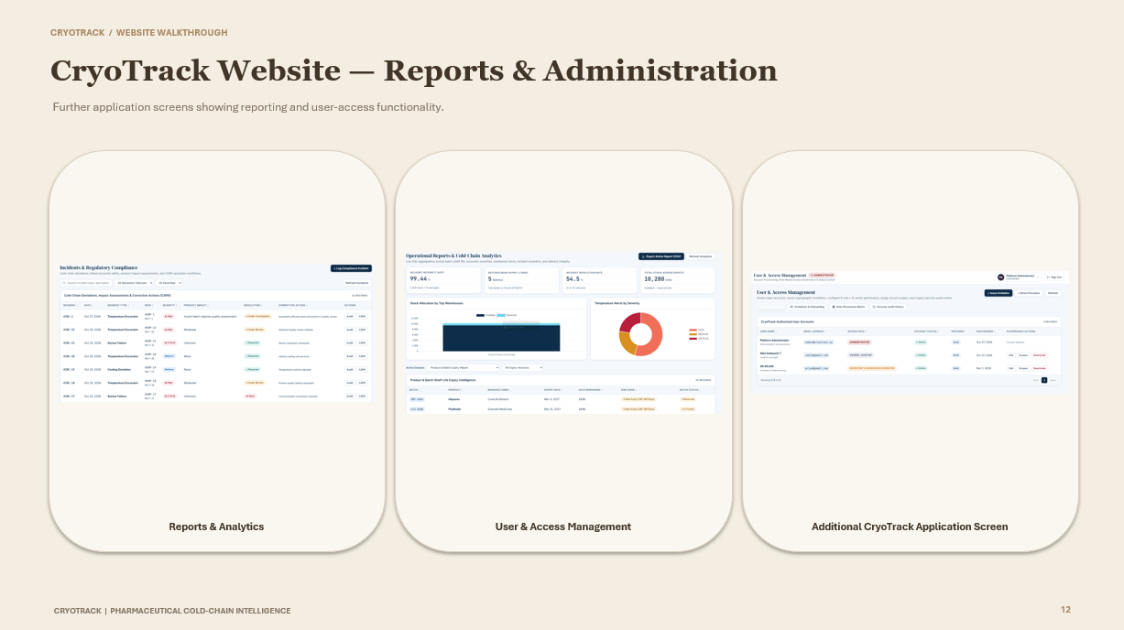

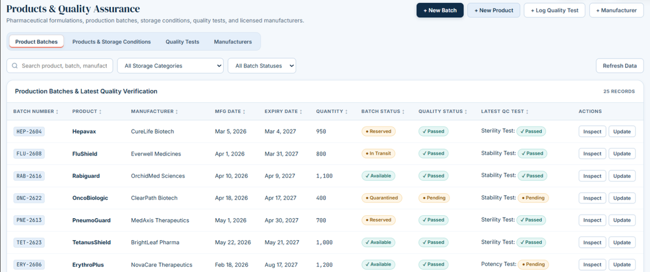
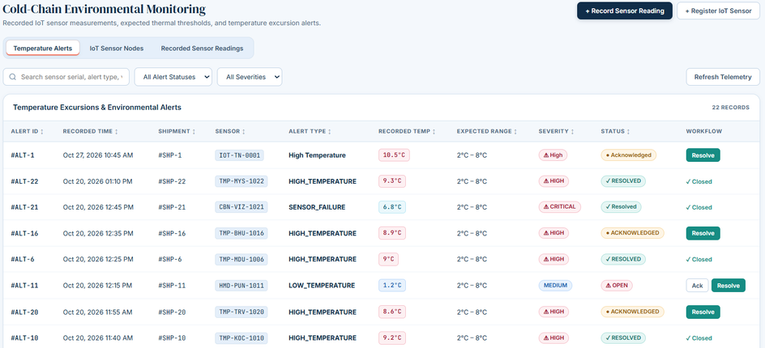
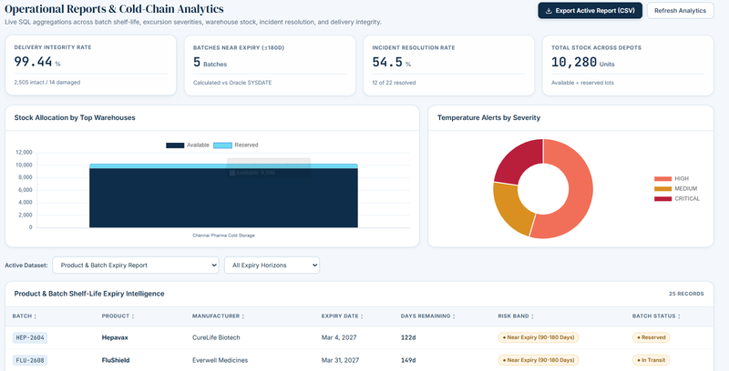
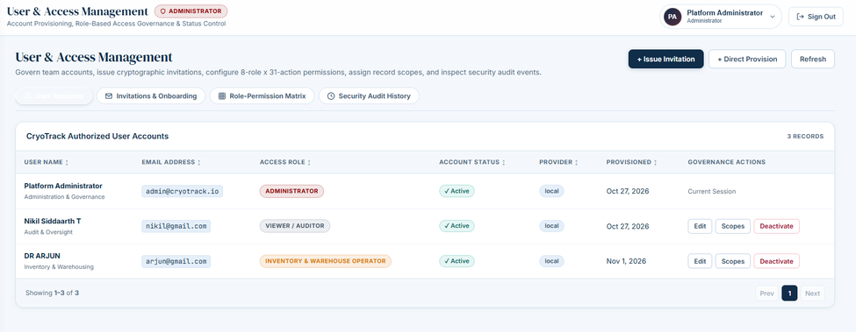
Environmental Monitor
Product & Quality Monitor

Slide 8

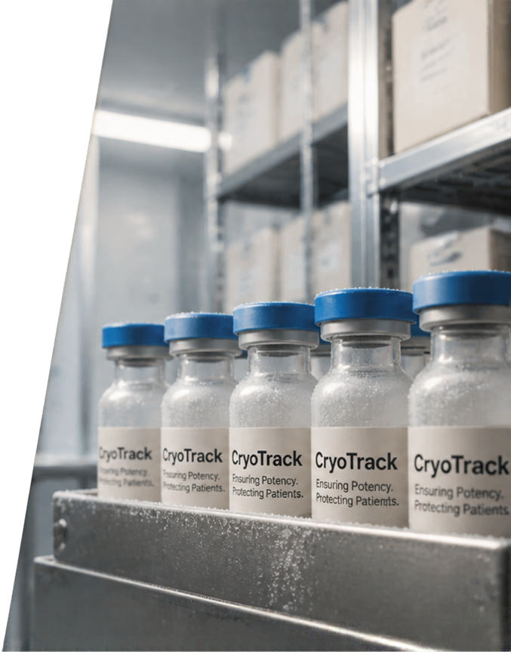








Database Operations & Security
23 primary-key constraints
23 foreign-key constraints
47 column-level rows returned by the SQL*Plus join
VERIFIED SQL CONSTRAINT RESULTS
SHIPMENT_ITEM uses (BATCH_ID, SHIPMENT_ID) as its composite primary key.
Foreign keys link product, shipment, sensor, inventory and delivery records.
COMPOSITE PRIMARY KEY
Eight roles use department-specific permissions and access restrictions.
APPLICATION SECURITY
Products & Quality • Shipments & Fleet • Cold-Chain Monitoring • Inventory • Incidents • Deliveries • Reports • User Access
CORE WEBSITE MODULES

Slide 9
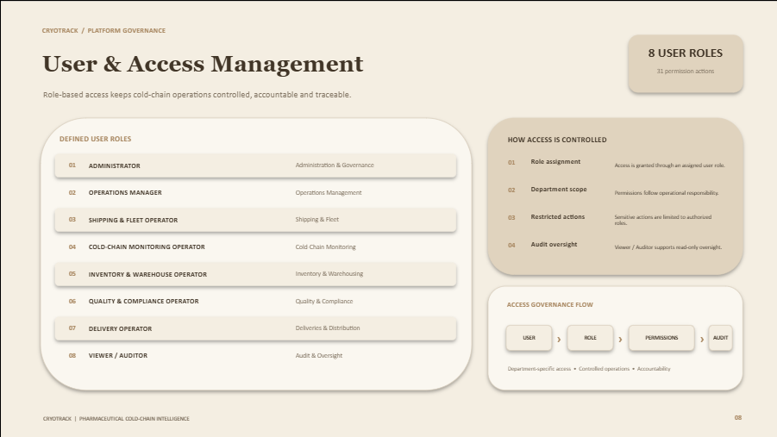











































User Roles & Access Control
Eight roles provide department-specific access and oversight.
ADMINISTRATOR
OPERATIONS MANAGER
SHIPPING & FLEET OPERATOR
COLD-CHAIN MONITORING OPERATOR
INVENTORY & WAREHOUSE OPERATOR
QUALITY & COMPLIANCE OPERATOR
DELIVERY OPERATOR
VIEWER / AUDITOR
ADMINISTRATION & GOVERNANCE
OPERATIONS MANAGEMENT
SHIPPING & FLEET
COLD-CHAIN MONITORING
INVENTORY & WAREHOUSING
QUALITY & COMPLIANCE
DELIVERIES & DISTRIBUTION
AUDIT & OVERSIGHT

Slide 10
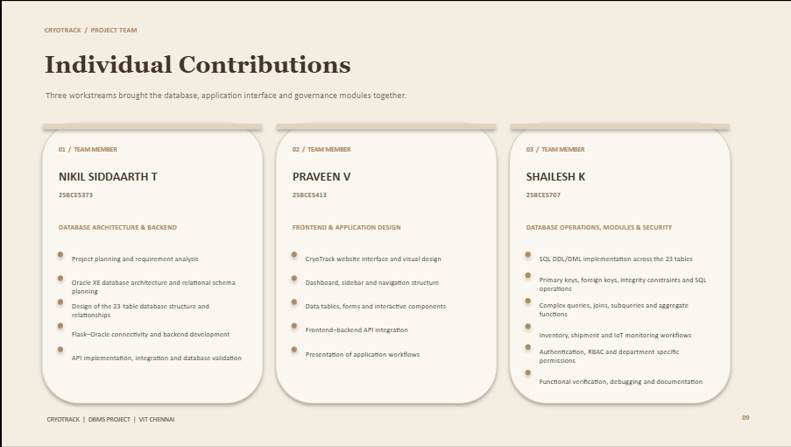







Individual Contributions
Three team members — clearly defined responsibilities
NIKIL SIDDAARTH T
Database architecture and relational schema planning
Design of 23 Oracle tables and relationships
Flask–Oracle connectivity and backend development
API integration and database validation
25BCE5373
PRAVEEN V
Website interface and visual design
Dashboard, sidebar and navigation
Data tables, forms and interactive components
Frontend–backend API integration
25BCE5413
SHAILESH K
SQL DDL/DML, keys and integrity constraints
Complex queries, joins, subqueries and aggregates
Inventory, shipment and IoT monitoring workflows
Authentication, RBAC and department permissions
Functional verification and documentation
25BCE5707

Slide 11

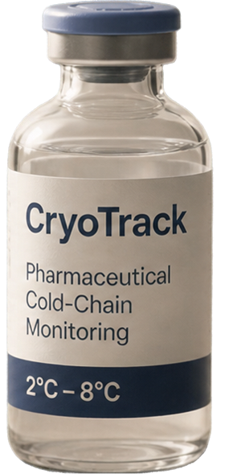
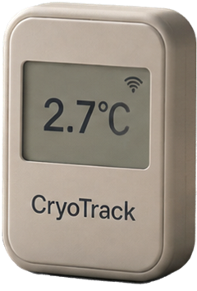


Conclusion
CryoTrack delivers end-to-end visibility and control of the pharmaceutical cold chain.
Real-time monitoring and traceability
protect medicine quality and patient safety.
Smarter logistics and early alerts
reduce waste and delays.
A scalable foundation for compliance, accountability and data-driven decisions.
Acknowledgement
We thank our faculty for guidance and support throughout this project.

