Slide 1
Life
Overview
November 2012

Slide 2
Making the lessons from personal development literature fun, accessible and engaging to help everyone reach their full potential.

Slide 3
Our focus is to help people:
Step back from their daily lives and focus on what they really care about in life
Once they identify these goals, help them achieve them
We are building a product that teaches people how to use Vision Boards and Mastermind Groups to accomplish their dreams.

Slide 4
Current progress
Have been building the product for a few weeks
About to launch a prototype to close friends

Slide 5
Goals
Finish a launchable first version fast
Ramp up getting users to play with the product
Once we are happy with the product, full speed on growth

Slide 6
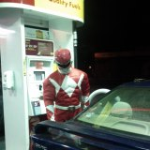
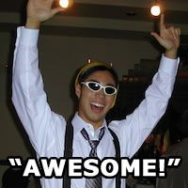
Nikil Viswanathan
Stanford
BS CS (AI) 2010
MS CS (AI) 2012
Loves: Ultimate Frisbee, Laughing
Alex Shye
University of Illinois
BS Computer Engineering 2002
University of Colorado Boulder
MS Electrical and Computer Engineering 2005
Northwestern
PhD EECE 2010
Likes: Running, Awesome Food

