Slide 1
Life
StartX
1/3/2013

Slide 2
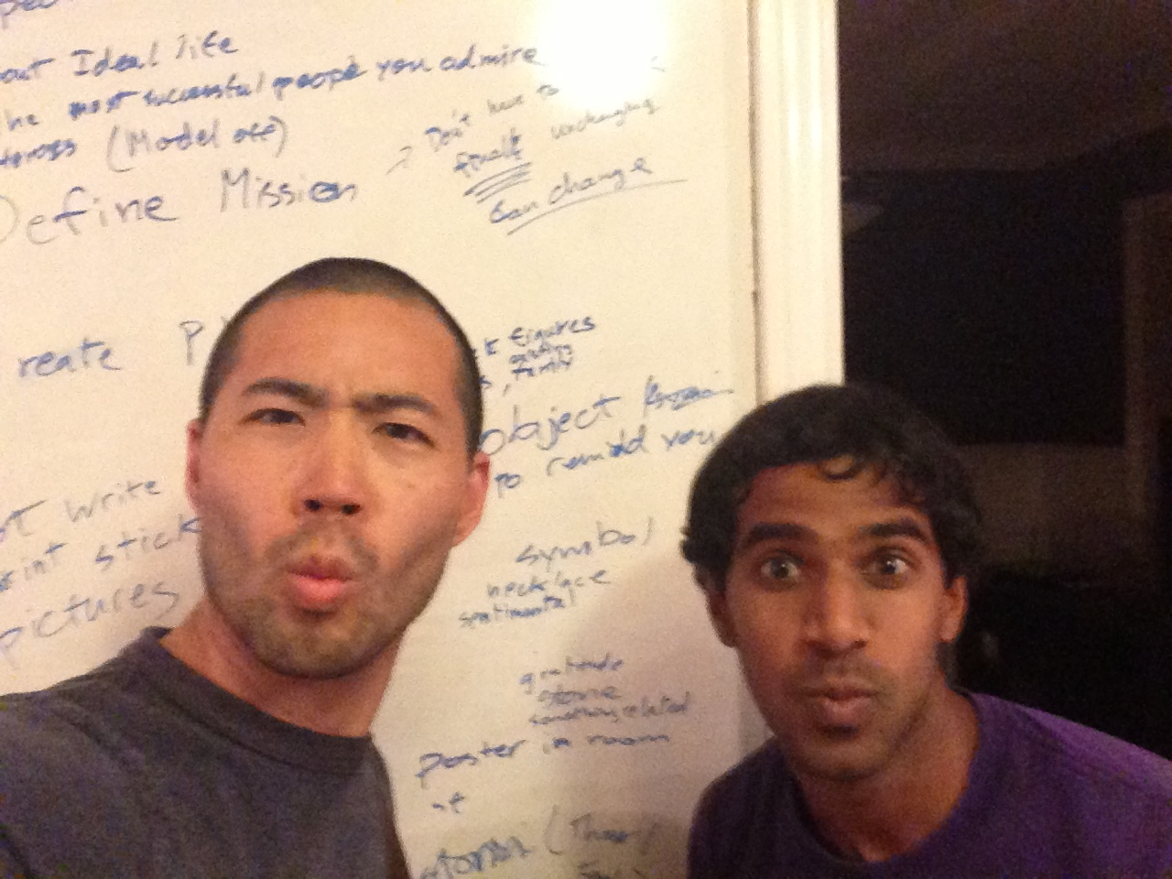
Alex & Nikil
PhD Computer Architecture & BS/MS Artificial Intelligence

Slide 3
Mission
Help YOU live a better life by
helping you determine your life goals and
helping you achieve them

Slide 4


Vision Board

Slide 5
Progress
Building, building, building!
Working Product!
Next Steps
Test with a few people
Improve Product
Release
Iterate

Slide 6

Thanks!
Happy New Year!

