Slide 1

Surgical AI: Semantic Segmentation of Laparoscopic Images and RGB Behavior Cloning for Robotic Tissue Retraction
Final Course Project – Computer vision & Robotics, and Machine Learning
Niki Mahdian
Student ID: 40123153
K. N. Toosi University of Technology

Slide 2
01
Problem and Deliverables
One project, two trained models, one surgical simulation task
1
Model A : Semantic Segmentation
2
Model B : Learned Robotic Control
Input: real laparoscopic RGB frame Output: 13-class semantic mask Dataset: CholecSeg8k Model: DeepLabV3+ / ResNet34
Input: simulator RGB frame only Output: 3D Cartesian action Task: TissueRetraction in sofa_env Method: Behavior Cloning
Goal:
measure visual understanding on real surgery data, then learn closed-loop control from pixels without goal XYZ at test time.

Slide 3
02
End-to-End Workflow
Execution order used in this project
Prepare data
→
2
Train vision
→
3
Evaluate vision
1
4
Build simulator
→
5
Collect demos
→
6
Train + test BC

Slide 4
03
Segmentation Method
• 6,240 training frames; 1,840 validation frames
• Video-level split: no frames from one video appear in both sets
• DeepLabV3+ with ResNet34 encoder
• Combined cross-entropy and Dice loss
• Class weighting and surgical augmentations
• Final run: run3_ft, warm-started and early-stopped
mIoU (present classes)
Dice (present classes)
0.526
0.611
Output classes
Validation videos
13
3
video01 / video09 / video17
Checkpoint selected only by validation performance.

Slide 5
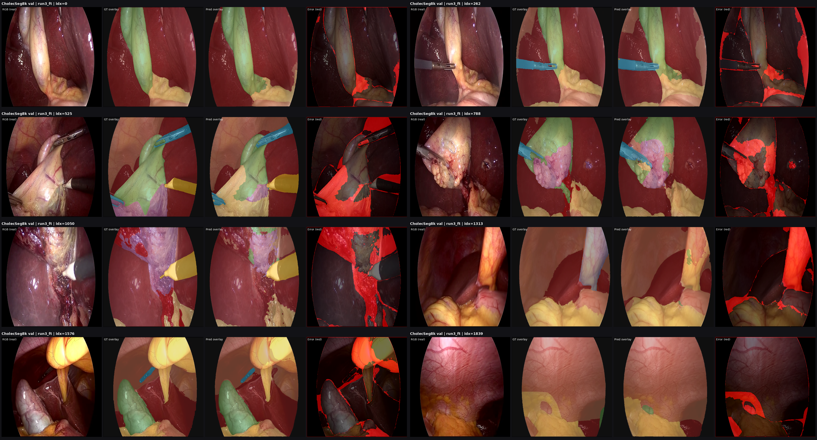
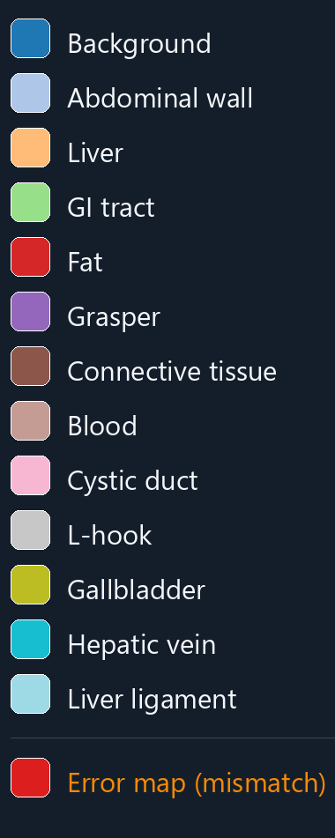
04
Segmentation Outputs
Each group: RGB image → ground truth → prediction → error map
Strong: background, liver, abdominal wall, L-hook, grasper | Weak: blood, cystic duct, liver ligament

Slide 6
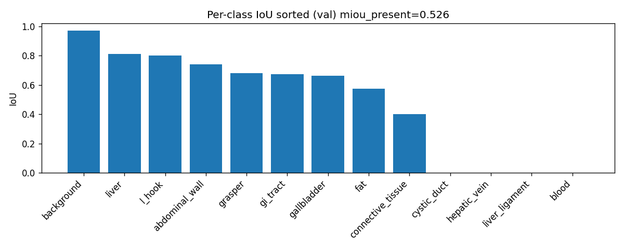
05
Segmentation Result by Class
Performance is strongest on frequent structures and instruments

Slide 7
06
Learned Control Pipeline
Behavior Cloning closes the gap left by direct vision-to-control heuristics
1
Oracle demonstrations
→
2
Supervised dataset
→
3
StrongRGBPolicy
→
4
Closed-loop test
Test-time input: RGB only, no grasping position, no end position, no goal XYZ

Slide 8
07
Control Results
Pooled success rates under the locked evaluation protocol
Oracle
Heuristic
bc_rgb_v2
1.000
1.000
1.000
Full-state ceiling
GT target positions
RGB only — learned
Random
Model vision
Synthetic vision
0.000
0.000
0.000
Failure floor
Direct bridge
HSV bridge
bc_rgb_v2: 5 seeds × 40 episodes | Wilson 95% CI [0.981, 1.000]

Slide 9
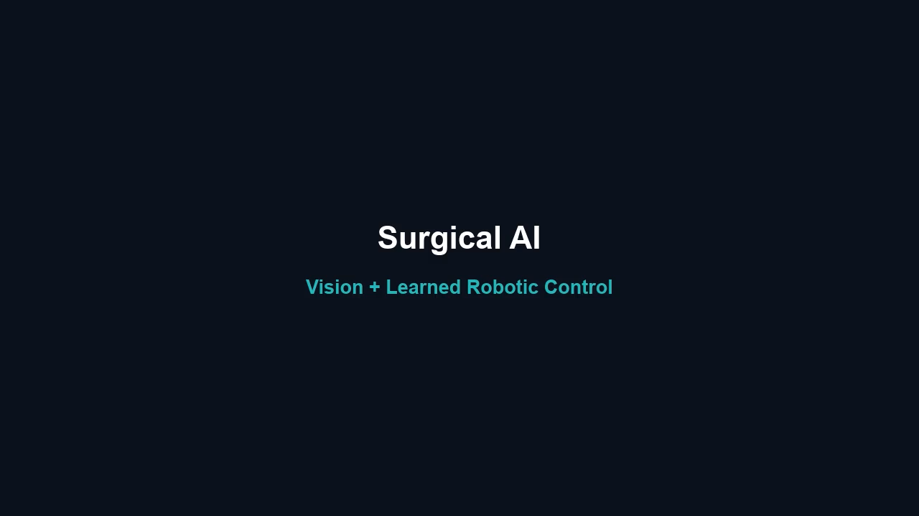
08
Demo Playback
Use the main reel, or play these clips in order

Slide 10
09
Conclusions and Scope
1
Real-image perception
2
Pixel-only control
3
Honest scope
DeepLabV3+ reaches 0.526 mIoU and 0.611 Dice on a video-level split.
bc_rgb_v2 reaches 1.000 success using RGB only at test time.
Vision bridge remains unsuccessful. Evaluation is in sofa_env, not on a physical robot.
Two trained deliverables: semantic segmentation and learned robotic control.

