Slide 1
Course scheduling

Slide 2
Some examples
[[0,1] , [2,1] , [1,3]]
Can the courses be completed?
Yes!
3
0
1
2

Slide 3
Example 2
[[0,1] , [1,2] , [2,0]]
Can the courses be completed?
No!
Cycle?
2
0
1

Slide 4
Kahn’s algorithm
What is topological sorting?
An ordering of nodes such that for every directed edge u->v, node u comes before node v in the ordering.
3,1,0,2
3,1,2,0
0
3
1
2

Slide 5
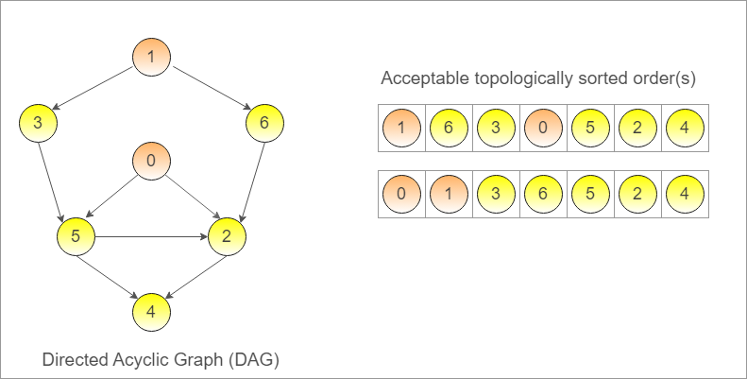

Slide 6
Try it for this graph Can we do topological ordering? Why?
1
0
2
There is no topological sorting for a graph with a cycle!

Slide 7
Kahn’s algorithm
Queue
What is queue? Read here.
What is indegree?
Example
3
out
in
0
1
queue
2

Slide 8
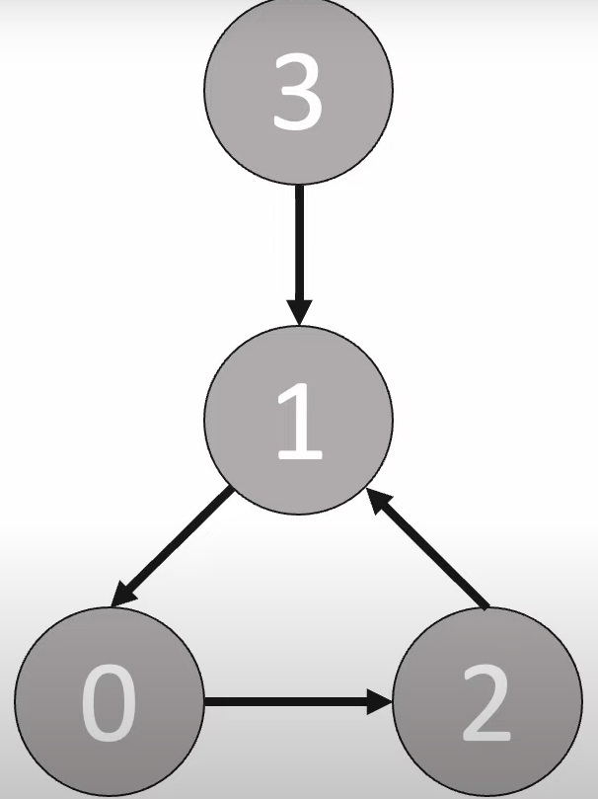
3
0
1
0
1
0
2
2
2
out
in
queue

Slide 9
How about the code?
prerequisites = [[1,0],[1,2],[2,3],[2,4],[2,5],[3,1],[4,5]]
Make a list of indegrees: [0,0,0,0,0,0]
Make a list of adjacencies:
adj_list = [[] for x in range(numCourses)]
Adj_list = [[],[],[],[],[],[]]
Add to indegree of the proper nodes
Step 1
queue = []
for i in range(numCourses):
if indeg[i] == 0:
queue.append(i)
Step 2

Slide 10
How about the code?
prerequisites = [[1,0],[1,2],[2,3],[2,4],[2,5],[3,1],[4,5]]
Step 3
Define a var: visited = 0 what is it?
While queue is not empty:
pop the node from queue
Visited += 1
Decrement the indegree of the nodes in adj list of popped node
Check if indegree of any its neighbors is equal to 0, then add it to queue
Step 4
Step 5
return numCourses == visited

