Slide 1
Improving the Quality of Public Administration under Regime Change
Niklas van der Heide
Hanyang University

Slide 2
Table of contents
Introduction
Identified Issues
Suggestions
Questions

Slide 3

INtroduction
Improving the Quality of Public Administration under Regime Change
KIPA: Korea Institute of Public Administration
2019

Slide 4
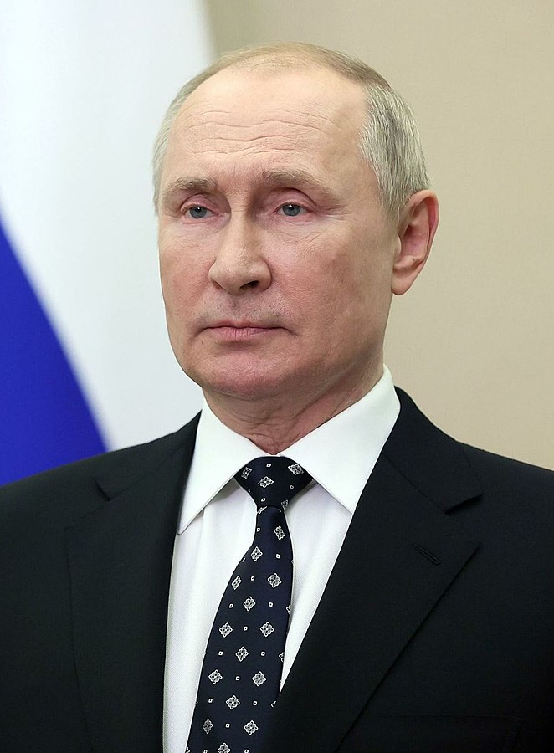
Regime
Organization of political power
Who has access to political power
More permanent than government
Less permanent than state
Types of political regimes
Democratic Regime
Authoritarian Regime
Vladimir Putin
Semi-Democratic Regime
Transitional Regime
Notes:
Semi-Democratic:
-Democracy, but power of elected officials is limited.

Slide 5
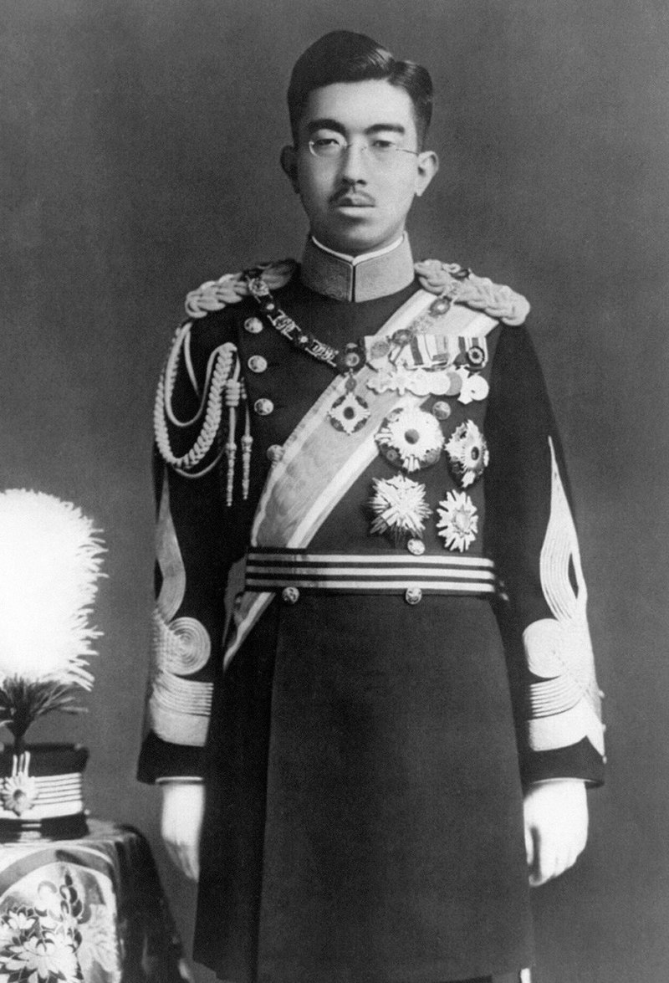
Regime Change
Transition from one type to another
Change of ruler
Reasons for Regime Change
Loss of war
Emperor Shōwa (Hirohito)
Internal political crisis

Slide 6
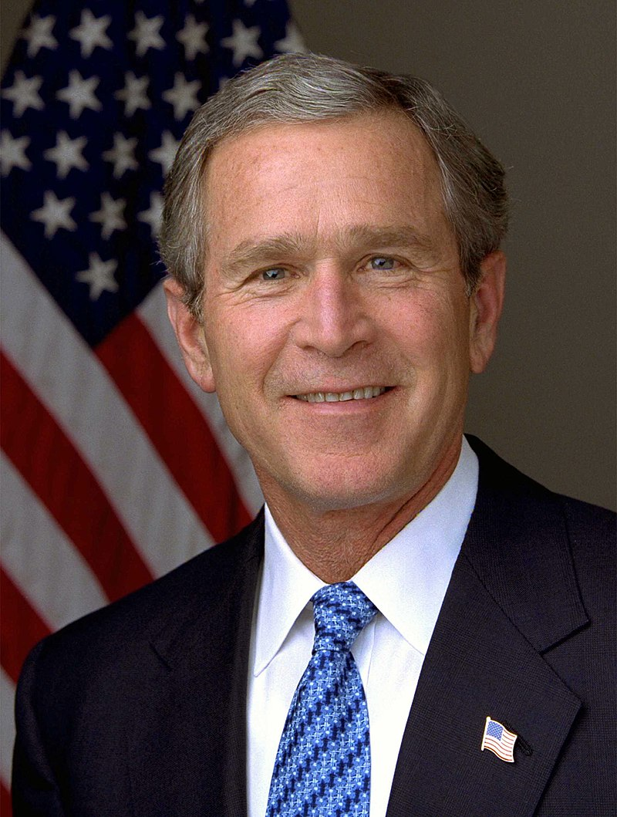
Democratisation
Change to a democratic regime
Natural development
Economic development
Foreign-imposed regime change
US invasion of Iraq
Not sustainable

Slide 7
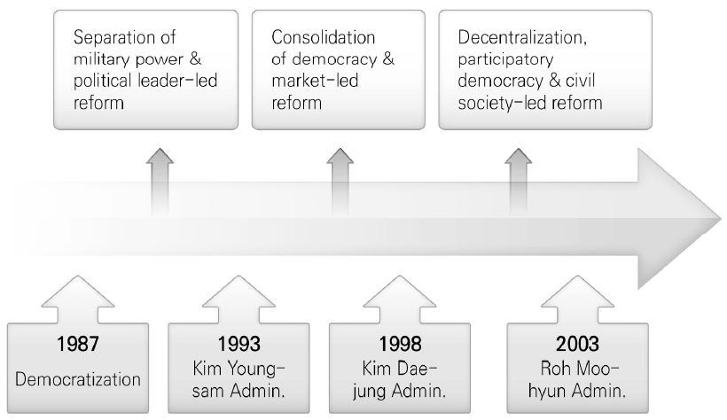
Regime Change in Korea

Slide 8
Identified Issues
Stunted Economic Growth
New Social Movements
Unstable International Relations
Sizable Public Sector Reform

Slide 9
Suggestions
Regime change is a continuous process
Accumulate experiences
Rearrange relations with neighbouring countries
Russia, China
Protect civil services
Health care
Social programs

Slide 10
Questions?

Slide 11
Thank You
감사합니다

