Slide 1

Inventory management System
~By Nikita, Sanjana, Priyanka, Swapnil, Rishab, Dheeraj

Slide 2
Contents:
Introduction.
Technology Used.
Functions of the System.
Working of the System.
Modules in the System.
Scope.

Slide 3

Introduction
The Project is named as “Café Inventory Management System", which deals with managing details of items, orders, customers, inventory control, etc.
It is developed using Python at Front-end and MySQL at Back-end to store the data of orders and customers.
This project is totally built at administrative end and thus only the administrator is guaranteed the access.
This project serves the best way of maintaining Orders and Customer’s Information.

Slide 4
Technology used
Python
Python is an interpreted high-level, general purpose programming language. It was created by Guido van Rossum in 1991. It is one of simplest and most widely used language. We can create Desktop applications in python using tkinter or QT. It is also used for Web development, Machine learning, Data Analysis, Scripting and Game development.
MySQL
MySQL, the most popular Open Source SQL database management system, is developed, distributed, and supported by Oracle Corporation. MySQL is a relational database management system based on SQL – Structured Query Language. It can be used to store anything from a single record of information to an entire inventory of available products for an online store.

Slide 5
Functions of the System
Easy way to serve an Order with various options.
Registration of the Customer so as to provide Discounts and various offers.
Cash Payment Method is provided to pay the Bill.
Generates Bill Receipt.
Stores Details of Everyday orders.

Slide 6
Working of the system
In this System there are various modules used to manage orders and services, such as Registration module, Order module, Customer module and Billing module.
Overview:
In Registration module, it checks whether a customer is Registered or not. if it displays the details of customer, then it provides discount to the Customer on their order.
In Order module, user can just select the items and save it, then the Bill will be generated and displays its SUBTOTAL, GST, DISCOUNT, TOTAL AMOUNT.
A Receipt will be displayed which will be given to Customer.

Slide 7
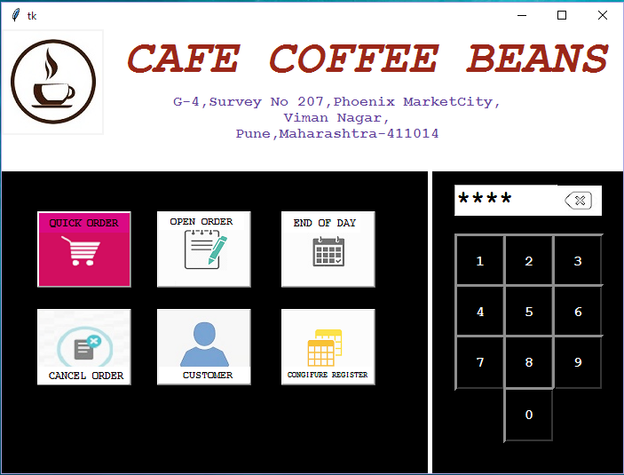
Modules
Home Page:
1
A Dial Pad to Enter Passcode
2
To Search or Register Customer Details

Slide 8
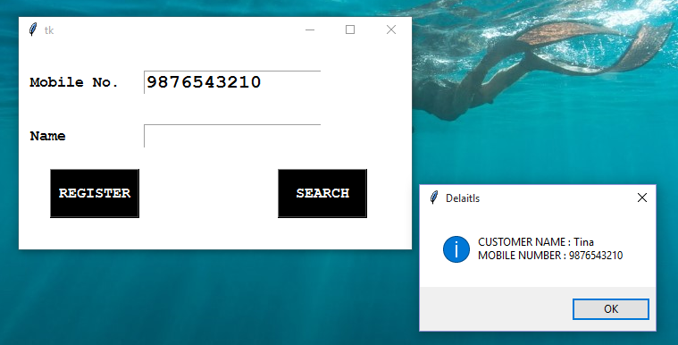
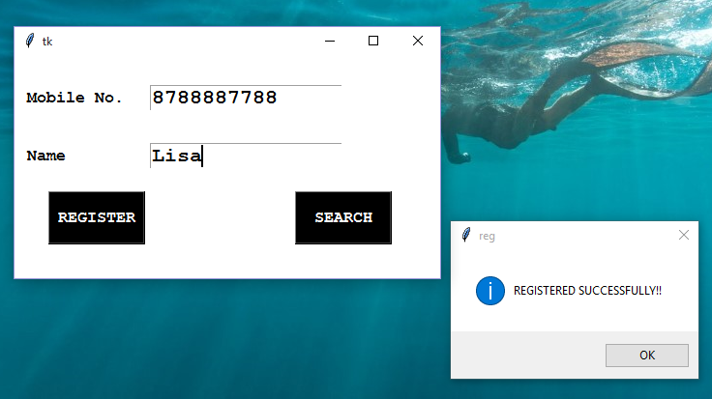
Registration:
4
Register if Record not found.
3
To Search if Registered or not using Mobile Number.

Slide 9
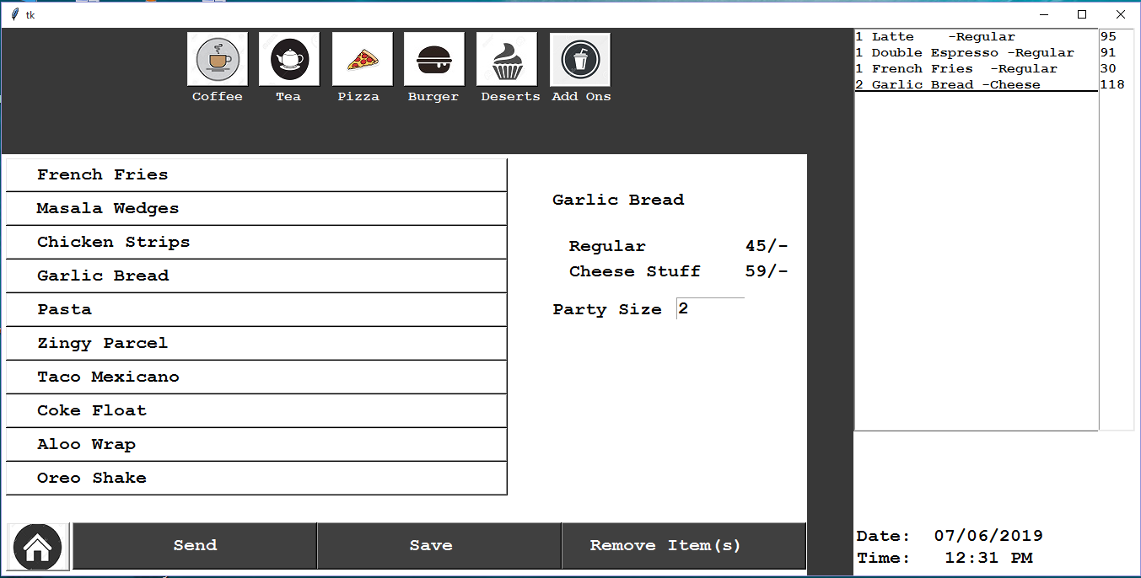
Order Page:
Opens the order page
5
3
Go to Home
6
Select Menus to display items
Items will be added to the cart
Select item with Quantity
8
To save Items present in Cart
Choose Items to display its details
9
7

Slide 10
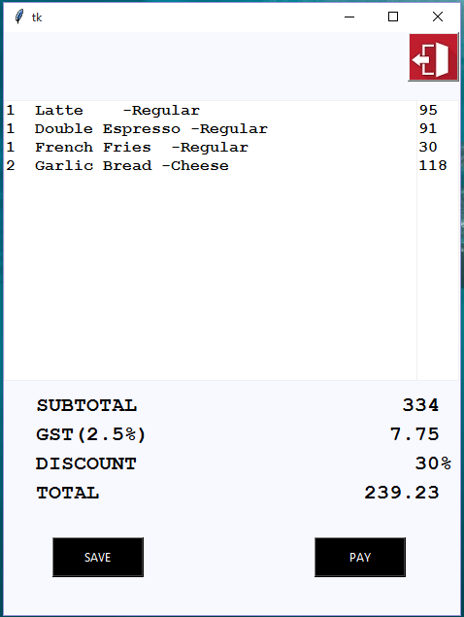
OPEN ORDER PAGE:
10
Opens the order
15
To Close the Order
11
To Display Amount Paid
To generate Bill Receipt
13

Slide 11
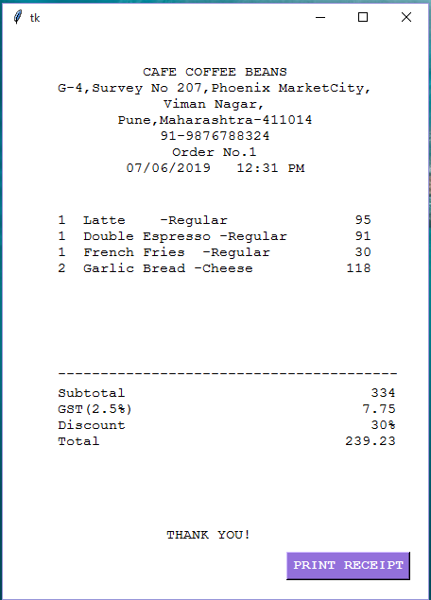
Receipt Page:
14
To Print and Close

Slide 12
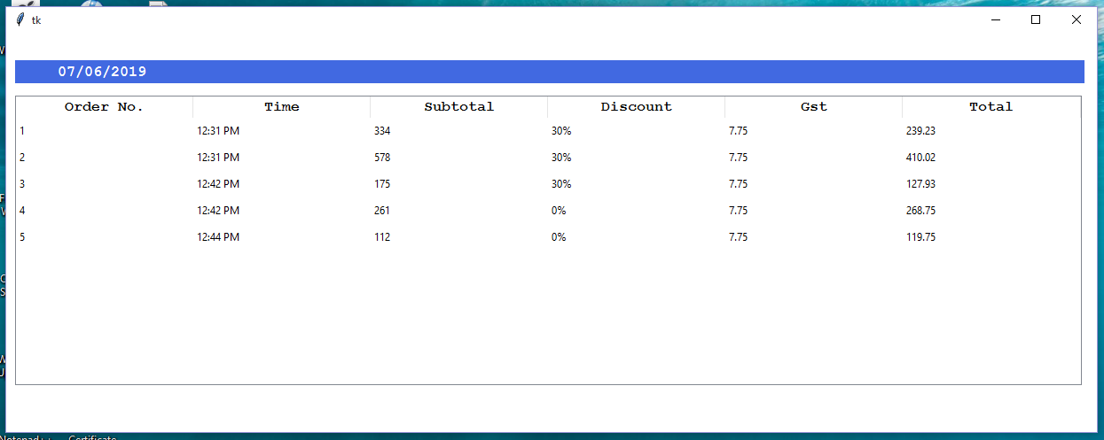
Everyday Orders Page:
16
Opens Order Details

Slide 13
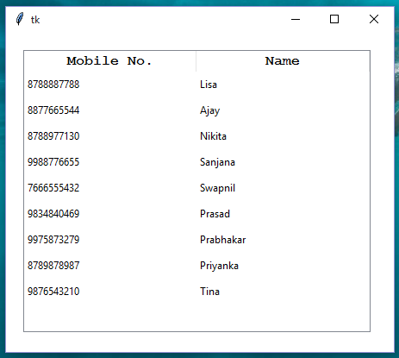
Customer Details Page:
Opens Customer Details

Slide 14
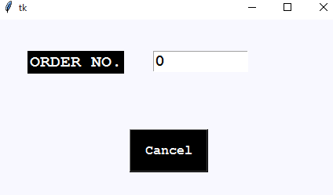
Cancel Order Page:
1
Opens Cancel Order Page
2
To cancel Order using Order number

