Slide 1

InsureClimate AI
Submitted By: NIKITA CHELANI

Slide 2
InsureClimate AI
InsureClimate AI is an advanced research chatbot designed for insurance professionals, risk analysts, and sustainability experts seeking actionable insights on climate-related risks and emerging insurance trends. Powered by cutting-edge AI, it delivers real-time news analysis, comprehensive risk assessments, and regulatory impact summaries from trusted industry sources. By providing up-to-date information and in-depth evaluations, InsureClimate AI helps users navigate climate-driven threats, financial implications, and compliance requirements with greater confidence and strategic clarity.
Key Capabilities
Smart Search & Filtering: Pinpoint relevant research by category, region, or credibility
AI-Powered Summaries: Get synthesized reports on emerging risks and market impacts
Interactive Feedback System: Rate analyses or email suggestions directly to the development team
Professional Reporting: Download polished PDFs with key findings and source references
User Feedback Mail.

Slide 3

Intelligent Search & Filtering System
The platform offers robust filtering capabilities to refine research results. Users can select from specialized insurance and risk categories, including Climate Risk, Cyber Insurance, and Sustainability & ESG. Each category automatically translates to industry-specific search terms for more accurate results.
Geographic filtering allows users to narrow results by global region or specific areas like the USA or Asia, ensuring location-relevant risk analysis.
The system also provides three sorting options: by publication date (latest first), by relevance to the search query, or grouped by authoritative sources.

Slide 4
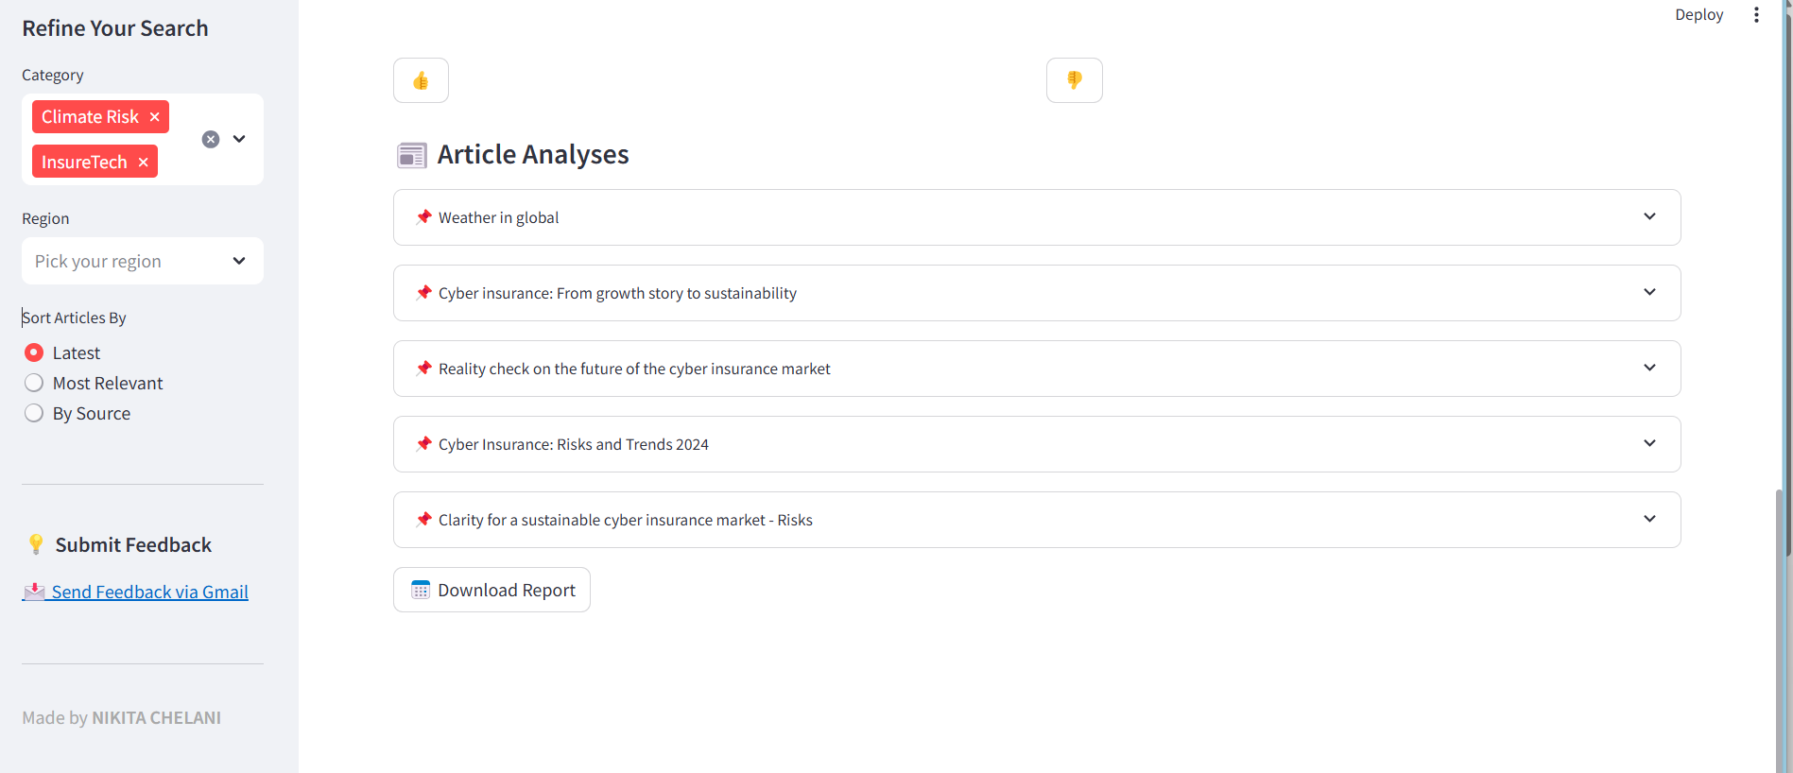
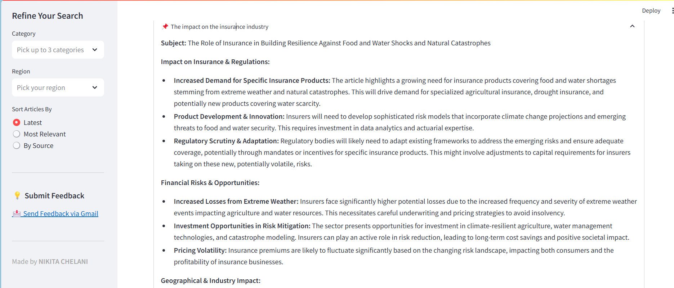
Overview of an App
List of Articles
Individual Articles Analysis

Slide 5
Comprehensive Content Analysis
The AI agent retrieves relevant articles using the Tavily API, ensuring access to the most up-to-date and pertinent information based on the user’s query.
It processes multiple articles to generate two types of summaries:
Combined Summary – Synthesizes insights from all selected articles, highlighting overarching trends such as emerging risks, regulatory changes, and financial impacts in the insurance sector.
Individual Article Summaries – Provides structured breakdowns of the core subject matter, insurance implications, and potential financial consequences of each article.
Each summary undergoes quality evaluation using advanced metrics, ensuring accuracy, relevance, and actionable insights.

Slide 6
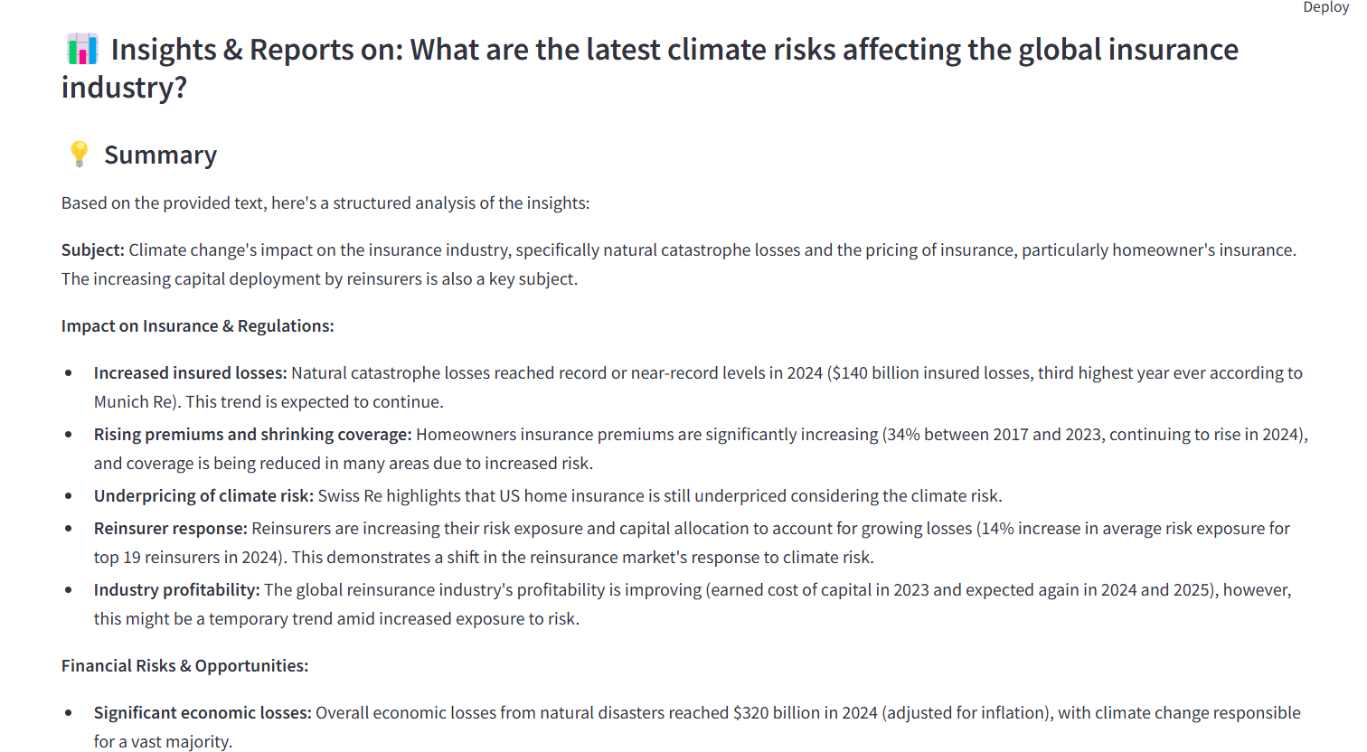
Insights & Reports

Slide 7
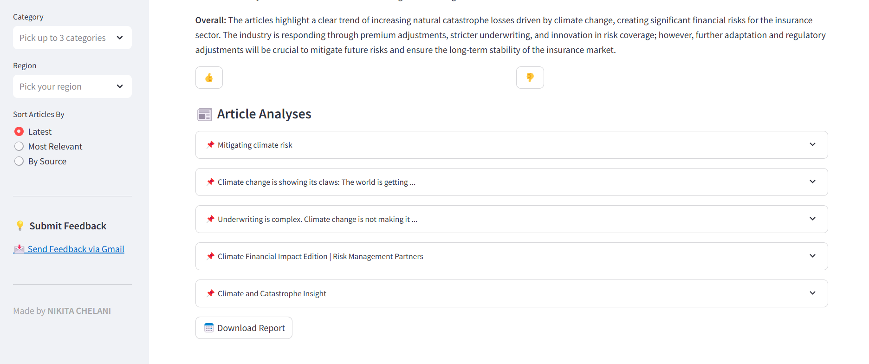

Slide 8

Feedback & Continuous Improvement
The platform incorporates a user-friendly feedback system to enhance results. Users can instantly rate summaries with thumbs up/down buttons.
When requesting improvements, the AI revisits the source material to generate a more detailed analysis, adding deeper insights about risk assessments, long-term projections, or regulatory impacts. The improved versions maintain all factual accuracy while providing enhanced context.

Slide 9
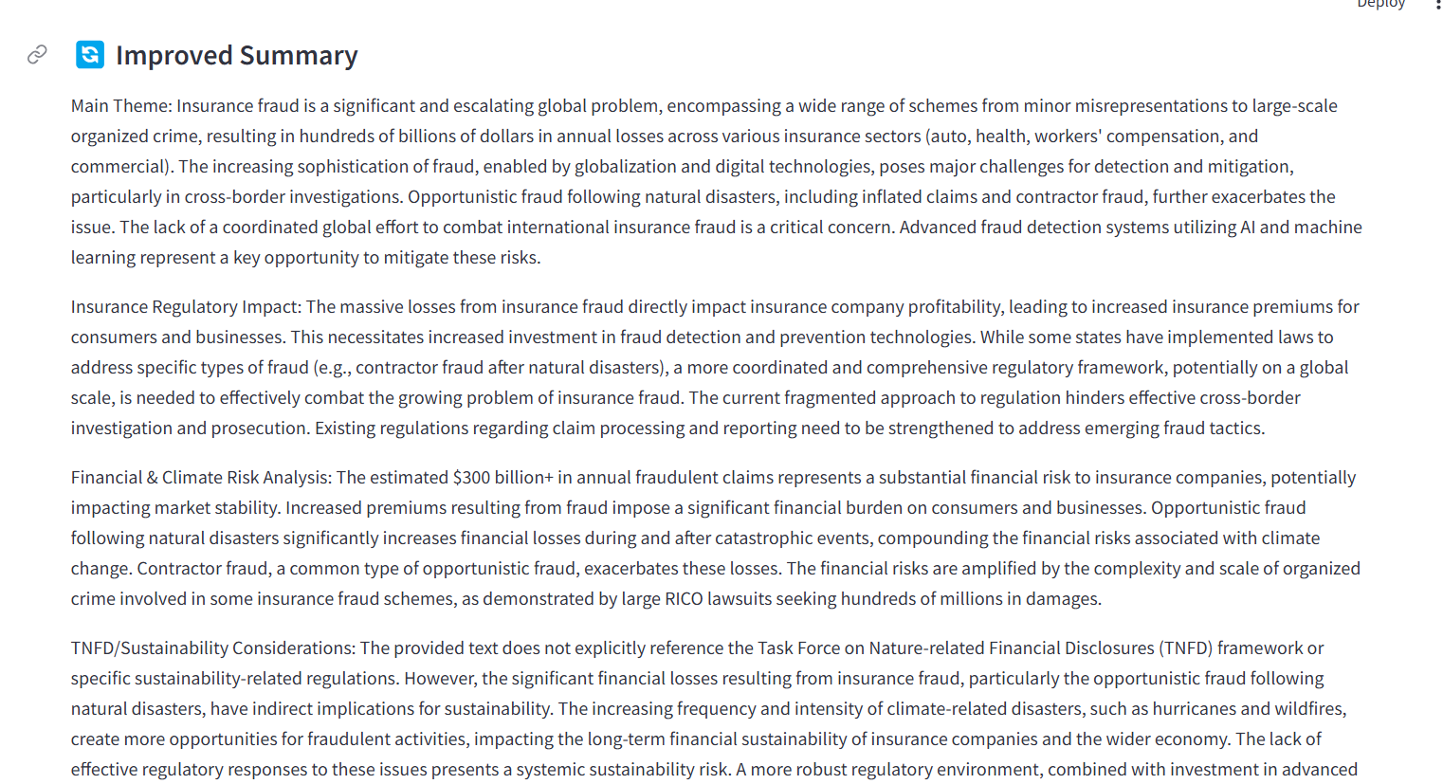
Overall Summary

Slide 10
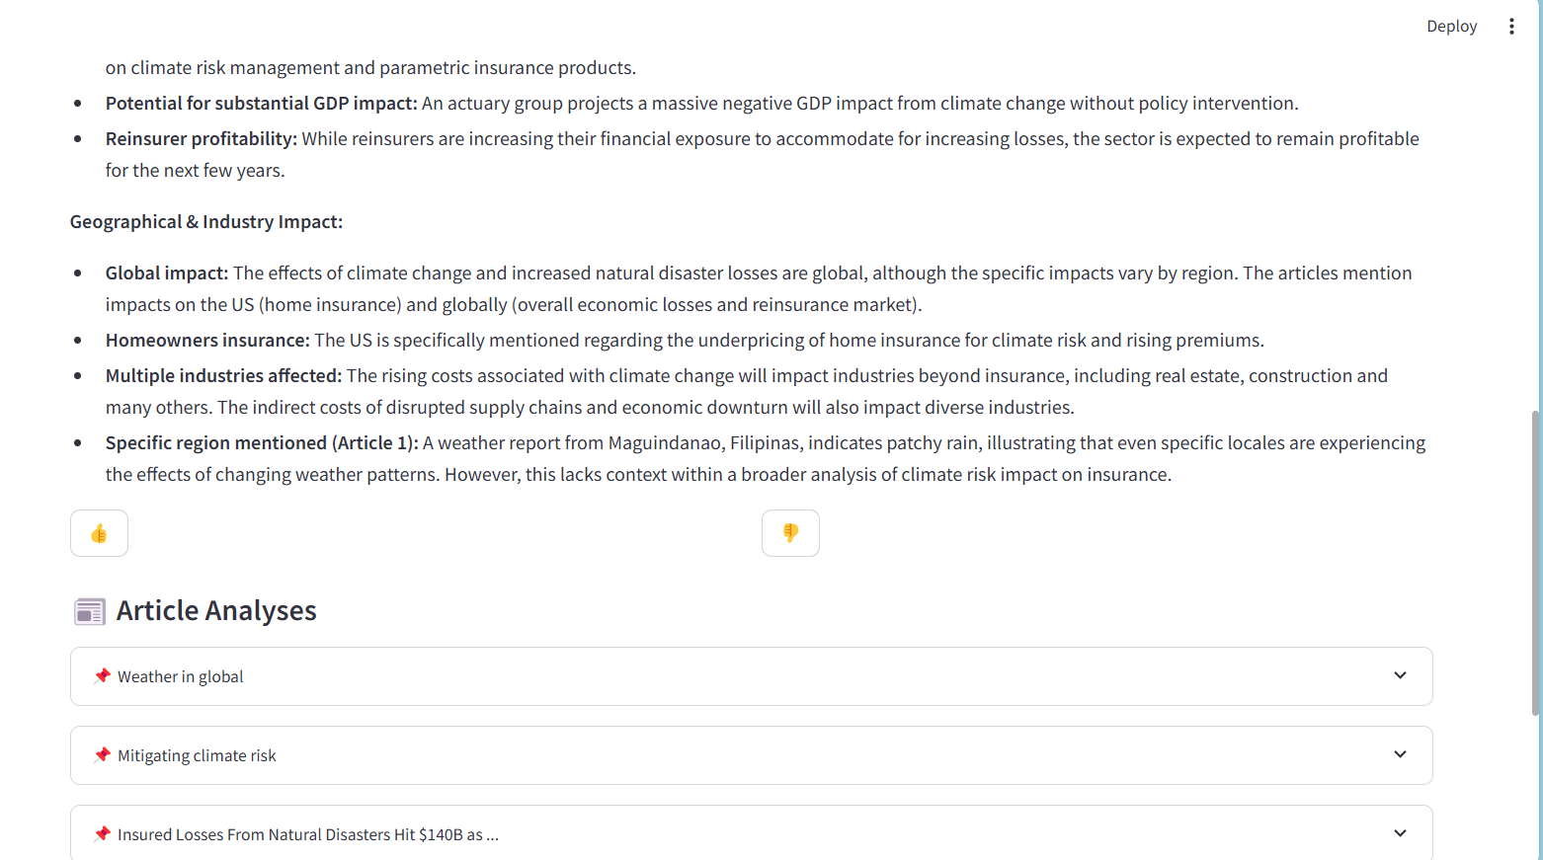

Slide 11
User Feedback System
The platform includes a dedicated feedback submission channel to facilitate direct communication between users and the development team. Located in the sidebar under "Submit Feedback," this feature provides a one-click option to:
Send detailed suggestions/reports via the user's default email client
Auto-generates a pre-addressed email to the owner (nikitachelani15@gmail.com) with the subject line "InsureClimate AI Feedback"
Gmail integration opens a compose window through a secure link while maintaining user privacy

Slide 12

Professional Report Generation
Users can export comprehensive PDF reports containing all research findings. The reports begin with a cover page displaying the search query and generation date, followed by an executive summary of key insights.
The document includes detailed analyses of individual articles, complete with relevance scores and source links. The PDF formatting ensures professional presentation with consistent styling, readable fonts, and proper section organization. All web links remain clickable in the digital document for easy reference to original sources.

Slide 13
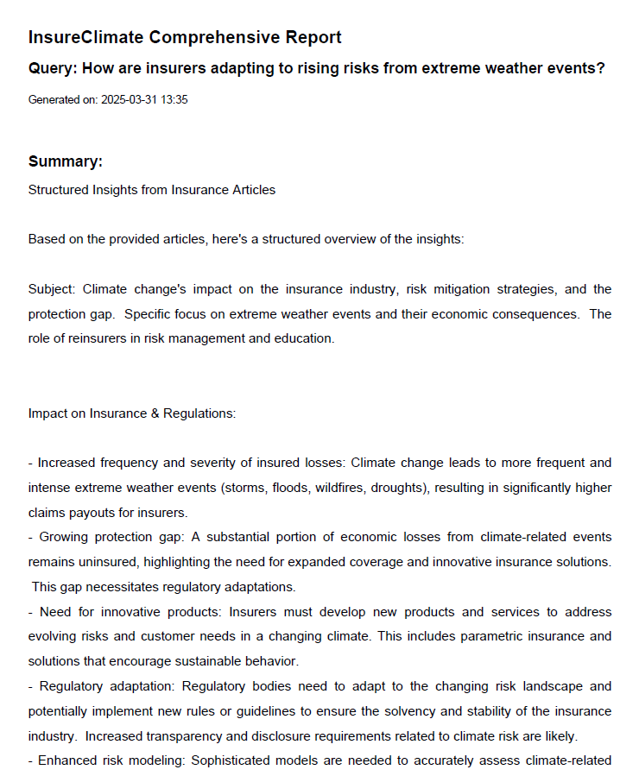

Comprehensive Report

Slide 14
Accuracy Verification System
The platform employs two sophisticated methods to evaluate summary quality.
The source link of the article is also added for each article if the user wants to read the entire article.
Cosine similarity measurement assesses how well each summary reflects the original article's content by analysing semantic relationships between the texts. This ensures summaries stay on-topic and comprehensive.
ROUGE scoring complements this by checking how accurately the summary captures specific phrases and key information from the source material.
Together, these metrics guarantee that summaries are both relevant to the search intent and faithful to the original articles' content, with scores clearly displayed for transparency. High scores in both categories indicate particularly reliable and thorough summaries.

Slide 15
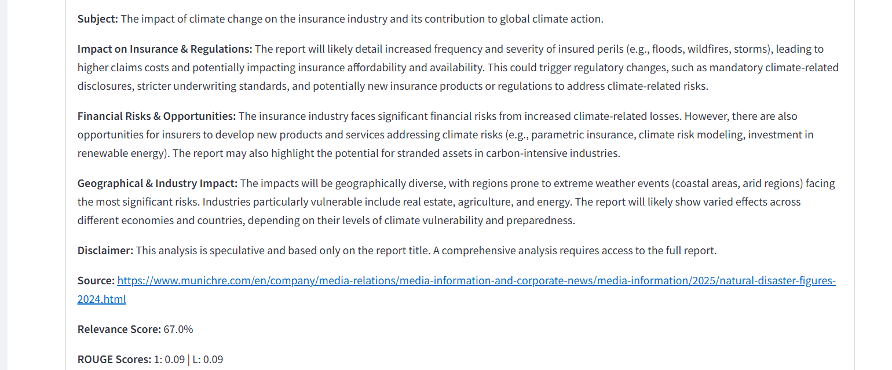
Evaluation

Slide 16


