Slide 1
DSAI Mini Project: Aviation Accident
Ernest
Jin Han
Hao Zhi
Nikita
Notes:
Good Morning Profs, Im ernest. Today our group is presententing on the aviation accident dataset

Slide 2
Dataset Overview
Global civil aviation accidents, its territories and possessions, and in international waters from 1962-present
Size of 84263 with 31 variables
Missing data for numerous variables
Notes:
The dataset consists of global civil aviation accidents from 1962 to present
There are 84263 logged crashes, recorded using 31 unique variables
We found that this dataset was not complete as there were many fields that were left empty

Slide 3
Data Preparation
Problem Formulation
Statistical Description
Pattern Recognition
Machine Learning
Statistical Inference

Slide 4
Problem Formulation
Our Rationale
We decided that we wanted to focus on predicting which variables are most significant in causing a crash that would result in fatalities.
Our Problem
What is the probability that a plane crash will result in fatalities?
Notes:
We felt that it was useful problem to solve for people who want to find out which factors are significant in predicting a crash

Slide 5
Problem Formulation
Dataset Preparation
Removed crashes prior to year 2000 as we felt that the development of aviation prior to year 2000 would not be representative of the current technological state of aviation
Removed crashes where the take-off occurred outside of the United States
Removed cases with unavailable Injury Severity data
Created a new column, “Fatality”, with value “1 ” if there was fatality, and “0” is there was no fatality
Notes:
For Total Fatal Injuries, we replaced the empty fields with “0”s. We found that the empty fields meant that there were no fatal injuries, and therefore could be replaced with 0
We also created a new column, “Fatality”, with value “1 ” if there was fatality (i.e. Total.Fatal.Injury >=1), and “0” is there was no fatality (i.e. Total.Fatal.Injury = 0). We wanted to predict whether a crash would result in a fatality, and not the number of fatalities. Therefore, we had to create a new column in our CSV file that only told us whether a crash had fatalities or not.
We removed crashes where take-off occurred outside of the United States. We found that a significant portion of crashes had take-off locations within the United States. In order to make analysis easier, we decided to solely focus on crashes where take off occurs from the United States.

Slide 6
Problem Formulation
Dataset Preparation
Filled in missing Latitude/Longitude values with the mean of other Latitude/Longitude values from the same Location
For the “Make” variable, the top 9 most frequent variables remained. Other less frequent makes were combined into “Others”
Notes:
In order to obtain more accurate data, we had to fill in missing values for the Latitude/Longitude in order to receive more complete results from the analysis. If we had opted to omit the data instead, the results obtained may not be reliable
Specfically for the “Make” variable, the top 9 most frequent variables remained. Other less frequent makes were included in another column called “Others”. We found that a lot of Makes were duplicates due to naming inconsistency we had to filter through the dataset to pull out the specific Makes which were significant. In essence only that that accounted for >1% of the dataset)

Slide 7
Exploratory Analysis
Problem Formulation
Statistical Description
Pattern Recognition
Machine Learning
Statistical Inference

Slide 8
Statistical Description
Using .info() on the data, we realised that a large number of the variables in the dataset were of the “object” data type.
We ran exploratory analysis of all of the variables using .describe() and countplots
We also created a map visualisation of the locations where the plane crash occurred using GeoDataFrame.plot()
Notes:
For statistical description, we used .info() and realised that a large number of variables were of the object data type. We continued by running .describe() and countplots and specifically for Latitude and Longitude, we created a map visualisation for each plane crash using GeoDataFrame.plot()

Slide 9
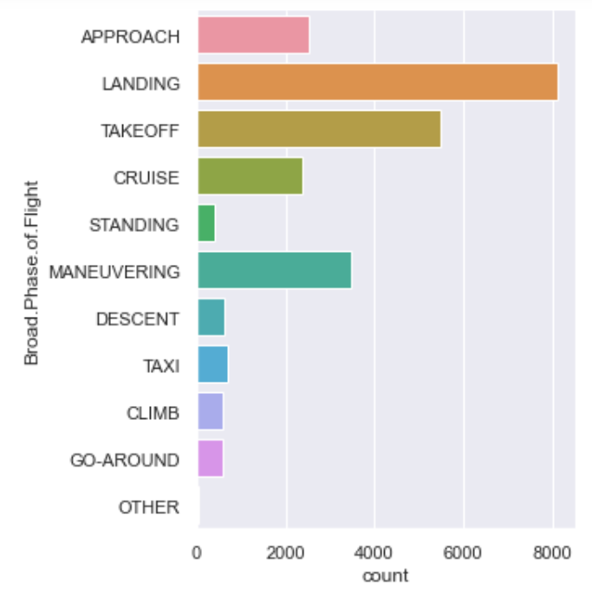
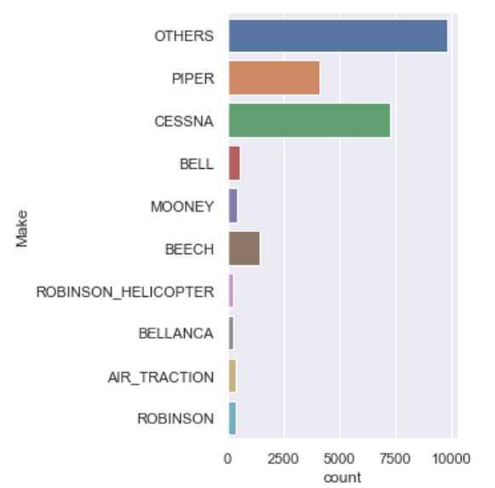
Count Plot Examples

Slide 10
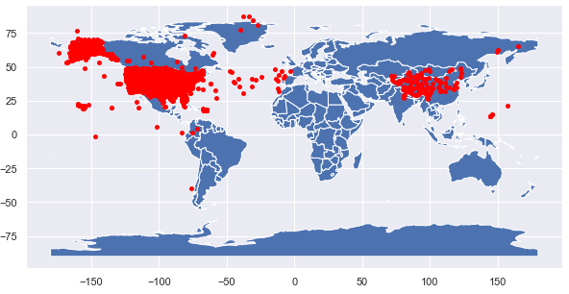
World Map Visualization

Slide 11
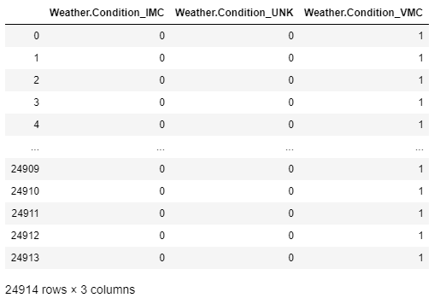
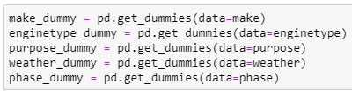
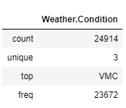
One-Hot Encoding
Notes:
One-Hot Encoding of our categorical variables (e.g. Make, Model , Weather, Broad Phase of Flight, Engine Type). In order to run analysis of our variables, we had to convert our categorical variables into something we could work with, so we used get_dummies() to One-Hot encode the variables. An example of us One-Hot Encoding the Weather.Condition variable is shown above.
I will now pass on the time to Nikita, who will be covering Analytic Visualisation of the dataset

Slide 12
Analytic Visualisation
Problem Formulation
Statistical Description
Pattern Recognition
Machine Learning
Statistical Inference
Notes:
Thank you Ernest, I will now be talking about analytical visualisation of our data.

Slide 13
Pattern Recognition
What is our next step?
Determine the best three variables for predicting whether a plane crash will be fatal
We calculated the individual Classification Accuracies of individual variables using Goodness of Fit models
Notes:
Our goal was to determine the top three variables for predicting whether a plane crash will occur or not
We found the classification accuracies for individual variables using the goodness of fit models

Slide 14
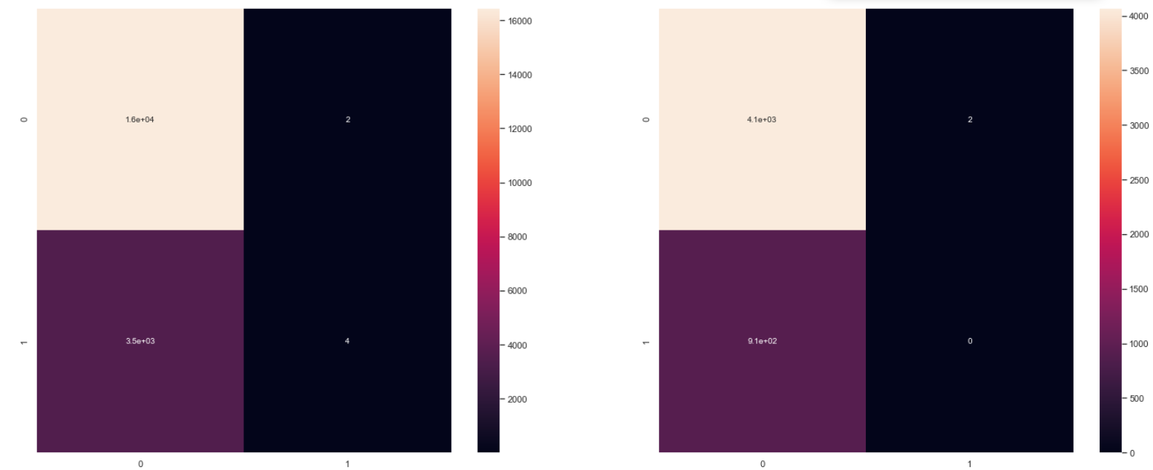
Pattern Recognition
Confusion Matrix and Decision Trees to calculate classification accuracy
Train and test of Weather Condition
Notes:
We used confusion matrix and various decision trees between the different variables and our response variable, fatality
This here is an example of the confusion matrix for the train and test datasets for the variable weather conditions against fatality

Slide 15
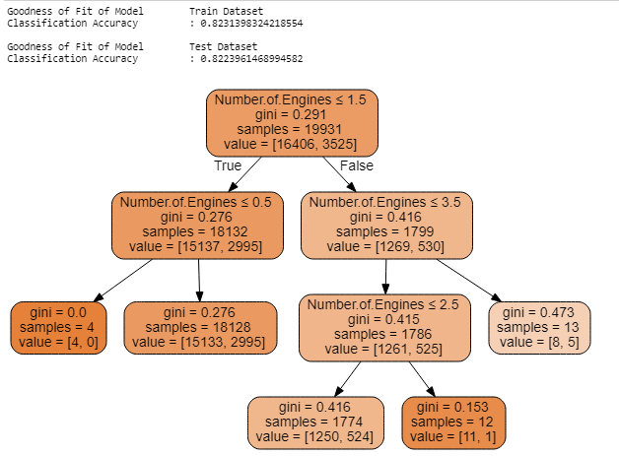
Decision Tree for No. of Engines
Notes:
This is an example of a decision tree for the variable, the number of engines against fatality

Slide 16
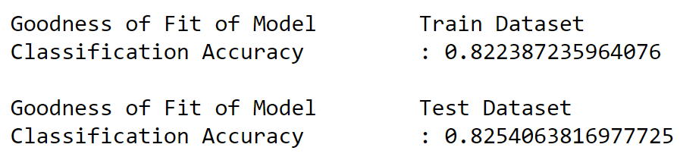
Pattern Recognition
Problem: All variables have ~82% classification accuracy
Due to class imbalance
Solve with Random Forest + SMOTE
Purpose of Flight
Notes:
However, we realised that most of them had roughly the same classification accuracy of around 82%
Upon further research, we found that this was due to class imbalance, which occurs when the class distributions are highly skewed.
This was a problem as class imbalances are masked by relatively good accuracy scores, where the classifier is simply guessing the majority class and not making any evaluation on the underrepresented class.
We solved this problem by using the random forest classification model and SMOTE, which will be explained in greater details in the later part of our presentation

Slide 17
Regression
Problem Formulation
Statistical Description
Pattern Recognition
Machine Learning
Statistical Inference
Notes:
Moving on to the next part: Machine Learning
Initially we decided that using regression was the best method for tackling our problem, which is What is the probability that a plane crash will result in fatalities?

Slide 18
Machine Learning - Initial Use of Regression
Why we thought regression would be a good fit?
We initially wanted to predict the number of fatalities that would occur and this would be best supported using a linear regression model.
Unbiased predictions, which were close to actual values
Why regression failed?
The explained variance (R²) values for most of the variables were very low and close to zero.
This meant that the data points were too varied and nowhere near the mean, to be plotted in a single linear regression line , meaning that there was just too much data that was too varied.
Notes:
However, our regression model also failed
based on our problem, we concluded that prediction works best with regression models
We wanted the predictions to be both unbiased and close to the actual values. Predictions are precise when the observed values cluster close to the already predicted values.
We decided to use the linear prediction model but came to the same conclusion for almost all our variables: that the r^2 value or the explained variance value was too small and close to zero.
This meant that the data points were too varied and nowhere near the mean, to be plotted in a single linear regression line
There was just too much data that was too varied

Slide 19
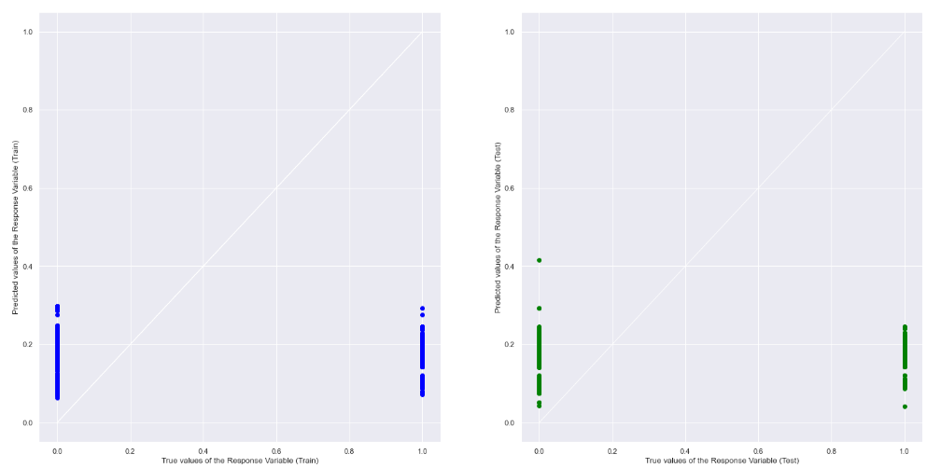
Machine Learning - Initial Use of Regression
An example of our output for linear regression for Latitude/Longitude against Presence of Fatalities
Notes:
As you can see here, most of the data is collated to the sides of the graph rather than forming close to a singular line

Slide 20
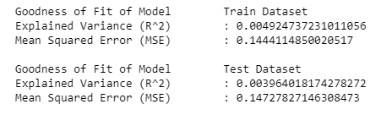
Machine Learning - Initial Use of Regression
An example of our output for linear regression for Longitude, Latitude against Presence of Fatalities
Notes:
As mentioned earlier the obtained r^2 values was too low, coming at around for example 0.004 and 0.003 for our train and test datasets respectively.
As such to solve this problem, we had to use a different machine learning tool, which will be further explained to you by Hao Zhi.

Slide 21
Machine Learning - Initial Use of Regression
Why regression failed?
However, we also found that the data would be skewed because there are other factors which might affect the number of fatalities, such as Number of Passengers.
Therefore, we decided that a switch to predicting presence of fatality rather than number of fatalities occurring in crash the would be more valid given this specific dataset
Notes:
However, our regression model also failed
based on our problem, we concluded that prediction works best with regression models
We wanted the predictions to be both unbiased and close to the actual values. Predictions are precise when the observed values cluster close to the already predicted values.
We decided to use the linear prediction model but came to the same conclusion for almost all our variables: that the r^2 value or the explained variance value was too small and close to zero.
This meant that the data points were too varied and nowhere near the mean, to be plotted in a single linear regression line
There was just too much data that was too varied

Slide 22
Classification
Problem Formulation
Statistical Description
Pattern Recognition
Machine Learning
Statistical Inference
Notes:
Now we will move on to using classification for the machine learning portion of the data science pipeline, seeing how regression it isn’t suitable for our data set.

Slide 23
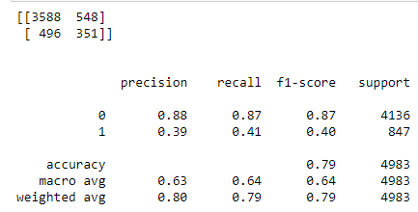
Machine Learning - Classification
Random Forest Classification Model
Creating multiple decision trees for our different variables against Fatality and merging them together to obtain a more stable and accurate prediction
The F1 score conveys the balance between precision and recall.
F1 - Score = 2 * ((precision * recall)/(precision+recall)
Notes:
We use random forest instead of decision tree as our classification model.
Random forest is a more robust classification technique as they aggregate many decision trees to limit overfitting as well as error due to bias which is a bigger possibility here as we are plotting all of the variables against fatality.

Slide 24
Machine Learning - Classification
Random Forest Classification Model
The F1 score conveys the balance between precision and recall.
F1 - Score = 2 * ((precision * recall)/(precision+recall)
The F1-score can actually be overlooked if you have a balanced class
However, as we found out in our pattern recognition that the class distribution between our variables is highly skewed, attaining a high f1-score was essential to ensure that we have a precise and robust classifier
Notes:
Usually we would look at the precision or recall score when we have a balanced class, but due to the imbalance of our samples it is actually more important to use the F1 score as a measure of the reliability of the model.

Slide 25
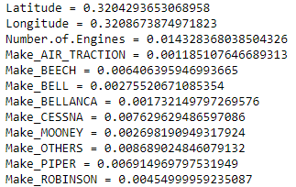
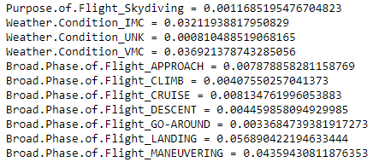
Machine Learning - Classification
Random Forest Classification Model
We also evaluated the importance of each category in each variable in the Random Forest Classifier
rnd_clf = RandomForestClassifier(n_estimators=500, n_jobs=-1, random_state=42)
rnd_clf.fit(X_train, Y_train)
Notes:
Next we also need to determine variable importance, and random forest actually allows for us to do that with the feature_importances_
Function, which gives us a score that indicates how useful or valuable each feature was in the construction of the boosted decision trees within the random forest model.

Slide 26
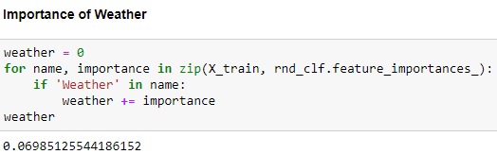
Machine Learning - Classification
Random Forest Classification Model
We then moved on to combine all the categories in every variable together
Group variables of the same class back together
Notes:
And since we have previously used one hot encoding to split our object variables, we need to reverse that and group the variables that belong to the same class back together

Slide 27
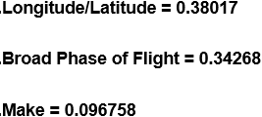
Machine Learning - Classification
Random Forest Classification Model
Taking into account feature_importances_ score and number of categories in each variable.
Variables that affect fatality the most
Longitude/Latitude
Make
Broad Phase of Flight (fewer categories as compared to purpose of flight as they have moderately similar importance score)
Notes:
After calculating the importance score of each variable, we can see that the 3 more important are

Slide 28



Problems with the data & Using SMOTE
Undersampling or Oversampling?
How SMOTE works: Creation of New Samples
Class Imbalance
Notes:
Moving on, we have to overcome the problems of class imbalance in our data.
Thus we had to choose between oversampling or undersampling to do so, which eventually lead us to using SMOTE

Slide 29
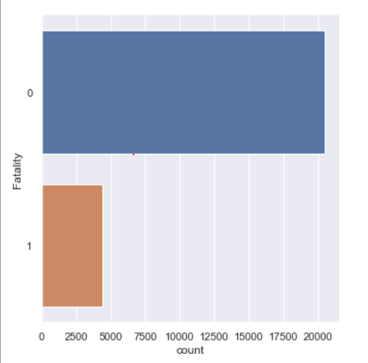
Class Imbalance
After Analytic Visualisation, we realised that our variables all have ~82% classification accuracy due to class imbalance
Decided to use oversampling to fix this imbalance
With undersampling, will be dropping a lot of information which can reduce the reliability of our model.
Notes:
As mentioned by Nikita, there is class imbalance in our dataset as there are much more samples with non-fatal injuries as compared to fatal injuries.
We also decided to use oversampling instead of undersampling to fix the imbalance as with undersampling, we will be dropping a lot of our data, which reduces the reliability of our model.
Now Jin Han will be sharing on how we can use SMOTE to do oversampling

Slide 30


Apply SMOTE
Non-fatal (0) vs Fatal (1) samples in original data
Apply SMOTE to data
Non-fatal (0) vs Fatal (1) samples of data after SMOTE
Notes:
Clear imbalance of samples in the dataset, SMOTE fixes that by oversampling the under represented data
We only apply SMOTE on training data and not test data.
Test data is for checking the validation of the model, running SMOTE on test data would give misleading results since the samples are artificially generated samples by SMOTE

Slide 31
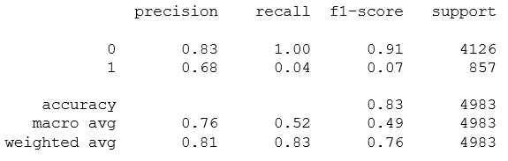
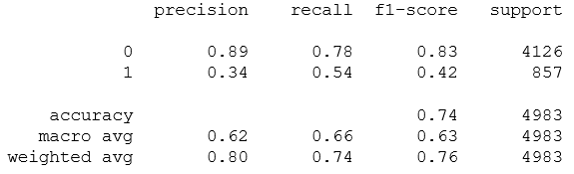
Effect of SMOTE
Logistic Regression on original data
Extremely low recall for fatality is true
Logistic Regression after applying SMOTE
Recall increases for fatality is true
Precision increase for fatality is false
Notes:
Precision is more important than recall when you would like to have less False Positives in trade off to have more False Negatives.
We rather have more false positives than false negatives when predicting that a crash has fatal injuries rather than not for safety concerns, and the reverse is true when predicting for non-fatal injuries.
Thus we see that SMOTE actually helps with the practical goal of our prediction model as it successfully increased recall when the model predicted fatal injuries and increased precision when the model predicted non-fatal injuries

Slide 32
Regression
Problem Formulation
Statistical Description
Pattern Recognition
Machine Learning
Statistical Inference

Slide 33

Machine Learning - Going back to Regression
How did it work in the end?
Once we managed to get the top three variables that had the highest importance, we used logistic regression to plot all three of them against Fatality
Now we have a prediction model for fatality uses 3 variables
Longitude/Latitude
Make
Board Phase of Flight

Slide 34
Conclusion
Problem Formulation
Statistical Description
Pattern Recognition
Machine Learning
Statistical Inference

Slide 35
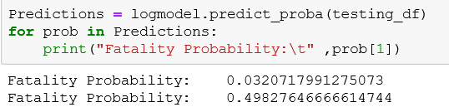
What does our results tell us?
Prediction Model
Initial Problem: Predict probability of a plane crash being fatal
Use the predict_proba function to predict fatality probability with our Logistic Regression Model (SMOTE) given a certain set of values
List(
Longitude ,
Latitude,
Phase.of.Flight,
Make
)
predict_proba
returns fatality
probability

Slide 36
What did we learn beyond the course?
Data Visualization - World Map
One-Hot Encoding
Random Forest Classification and Variable Importance
Logistic Regression and predict_proba
Metrics: f1 score, precision, recall
Class Imbalance and Synthetic Minority Oversampling Technique (SMOTE)

Slide 37
Contributions
Process
Data Preparation | Jin Han, Hao Zhi
Exploratory Analysis | All
Analytic Visualization | All
Machine Learning | All
Statistical Inference | All
Presentation Preparation | All

Slide 38

The End

Slide 39
Time for
Q & A

