Slide 1
Political System of New Zealand
“The Queen reigns, but the government rules“

Slide 2
Content
The Political System
The Prime Minister
Foreign Relations
The Queen of New Zealand

Slide 3
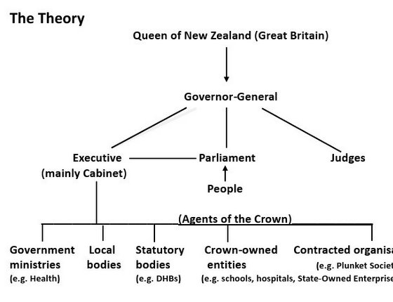
The Political System
Parliamentary monarchy like in Britain
No House of Lords since 1951
Mixed-Member Proportional Election system
New Zealand was dependent on the decisions of the British Parliament
Broke away from its influence 1986
Queen Elizabeth II. remained head of state

Slide 4
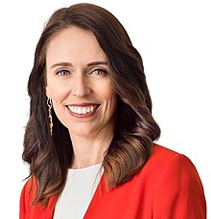
The Prime Minister
Originally called “colonial secretary“ or “first minsiter“
The leader of the Cabinet and takes a coordinating role
Is the leader of the party with more than half of the seats
Serves until they resign, retire or die
Jacinda Ardern
Born at the 26 of July 1980 in Hamilton, NZ
40th Prime Minister
In office since the 26 of October 2017

Slide 5
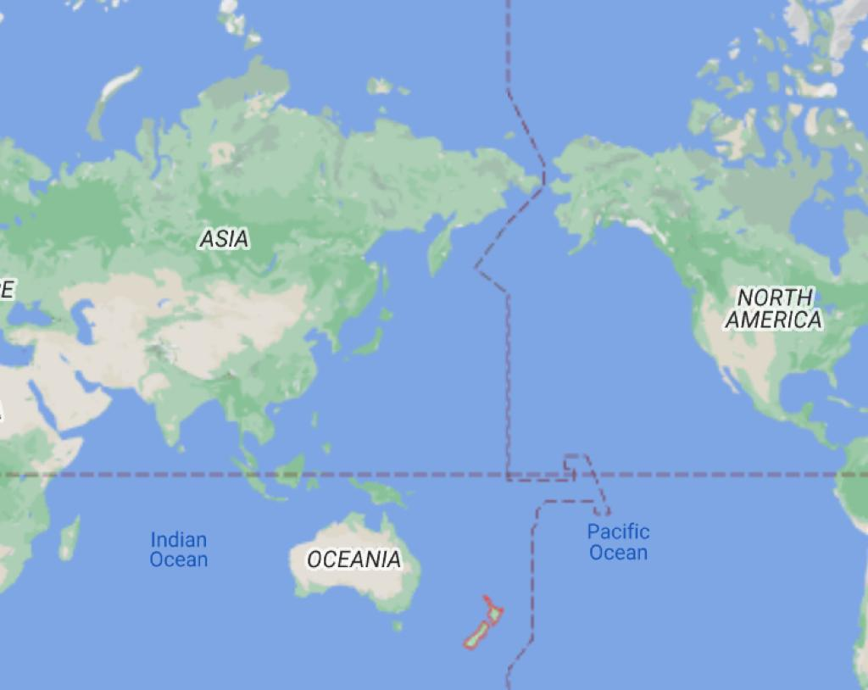
Foreign Relations
Maintains 128 embassies and consulates
Has relations with 150 countries
Involved in multiple forms and cooperations
Has a nuclear-free policy
Especially close with Australia and Asia

Slide 6
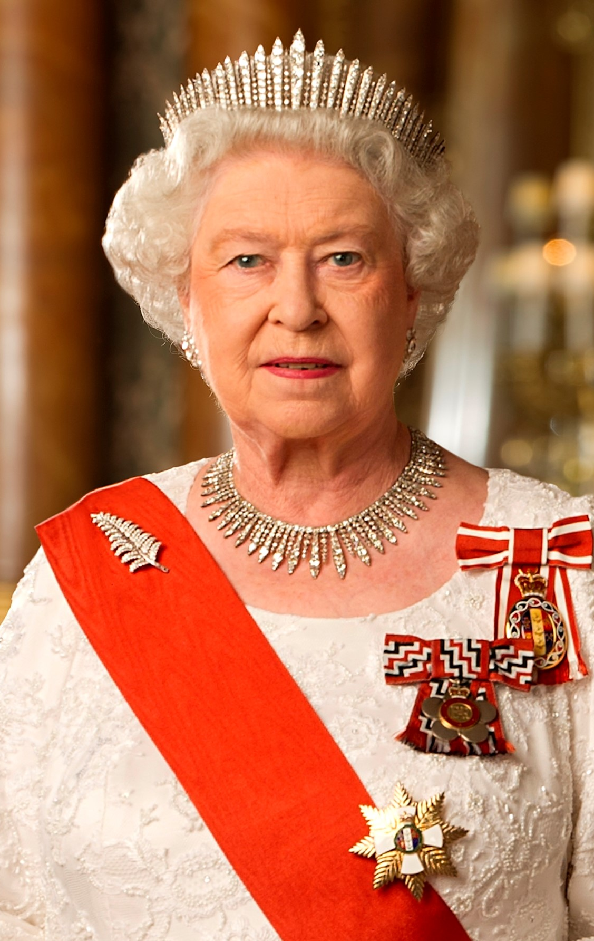
The Queen of New Zealand
Queen Elizabeth II. is the Queen of New Zealand
Born in 1926 in Mayfair, London
Has a younger sister Princess Margaret
Is queen of 15 commonwealth realms including New Zealand
Rules over NZ because of the Treaty of Waitangi, which was signed in 1840
The treaty of Waitangi between the British Goverment and Maori

Slide 7

Thank you for listening!

Slide 8
Sources
www.google.com
www.wikipedia.com

