Slide 1
Political System of New Zealand
“The Queen reigns, but the government rules“

Slide 2
Content
Separation of Powers
The Prime Minister
Foreign Relations
The Queen of New Zealand

Slide 3
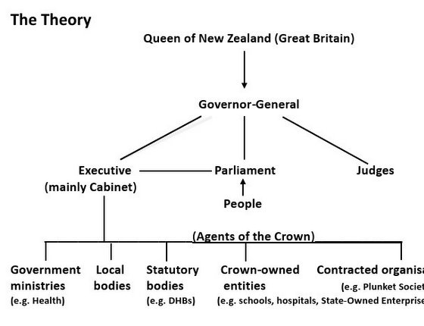
Separation of Powers
Parliamentary monarchy like in Britain
No House of Lords since 1951
Mixed-Member Proportional Election system
New Zealand was dependent on the decisions of the British Parliament
Broke away from its influence 1986
Queen Elizabeth II. remained head of state

Slide 4
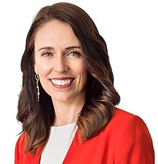
The Prime Minister
Originally called “colonial secretary“ or “first minister“
The leader of the Cabinet and takes a coordinating role
Is the leader of the party with more than half of the seats
Serves until they resign, retire or die
Jacinda Ardern
Born on the 26th of July 1980 in Hamilton, NZ
40th Prime Minister
In office since the 26th of October 2017

Slide 5

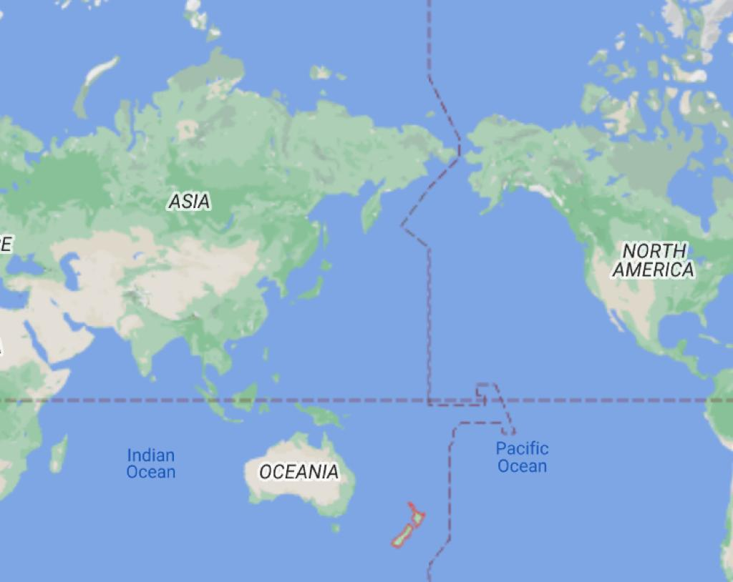
Foreign Relations
Maintains 128 embassies and consulates
Has relations with 150 countries
Involved in multiple forms and cooperations
Has a nuclear-free policy
Especially close with Australia and Asia

Slide 6
The Queen of New Zealand
Queen Elizabeth II. is the Queen of New Zealand
She was born in 1926 in Mayfair, London and has a younger sister — Princess Margaret
When her father died she became queen of 15 commonwealth realms including New Zealand
She rules over NZ because of the Treaty of Waitangi, which was signed in 1840 by Captain William Hobson who was a British Royal Navy officer and many leaders of the indigenous Polynesian people of NZ called Maori
The treaty of Waitangi established a British Governor of New Zealand, at that time Queen Victoria, but at the same time recognised the lands, forests and other possessions of the Maori and gave them the rights of British subjects

Slide 7

Thank you for listening!

Slide 8
Sources
www.google.com
www.wikipedia.com

