Slide 1
DSP 14 Thane CAPSTONE PROJECT: Cash Deposit Prediction
Submitted by:
Nikita Porwal

Slide 2
Problem Statement
Objective Of The Problem: The objective is to predict the cash deposit amount for branches for the year of 2017 (“Deposits 2017” variable)
The data given is of cash deposits made in particular branches of a bank. Please go through the descriptions of variables as below for a conceptional understanding of the data.
Feature Description: Unique identifier for each data point relationship Main Office : Is the branch where the deposit was made the main office of the bank. 0 signifies no and 1 signifies yes Branch Number : Internally used identification number of the branch or certain branches Establishment Date and Acquired Date: The date at which the bank branch was established and acquired by the specific bank franchise City, Country and State : Geographical Details of the bank branch Year Deposits Variables( 2013 Deposits, 2014 Deposits…): Deposit amount in U.S. dollars for specific branch for a specific year

Slide 3
Project Overview
Python is used as coding language and this is a regression problem
Steps followed for prediction:
Importing Library and dataset
Data Sanity Check and Data Cleaning
Class/Method is created for repeated operations
Imputing Missing Values
Adding New Features here it is Establishment Year
Data Label Encoding
Outliers Detection using Boxplot and managing outliers
Checking Linearity in data
Creating histogram to check distribution of data
Model selection based on Accuracy and RMSE value
Preliminary Observations:
As we can see the dataset is of continuous numeric type and Supervised ML data where we will use Regression Algorithms,
In order to predict closest price ,tried various models to check the best fit
2.1 Used Decision Tree Regression Model for prediction
2.2 Used Linear Regression Model for prediction
2.3 Used Random Forest Regression Model for prediction
2.4 Used KNearestNeighbors Regression Model for prediction
2.5 Grid Search CV using Ridge Model for prediction
In order to predict closest price, tried various models to check the best fit
By Comparing Accuracy and RMSE values to check for best fit model
Observations:
Random Forest Regressor has lowest RMSE, Hence considered as best fit model

Slide 4
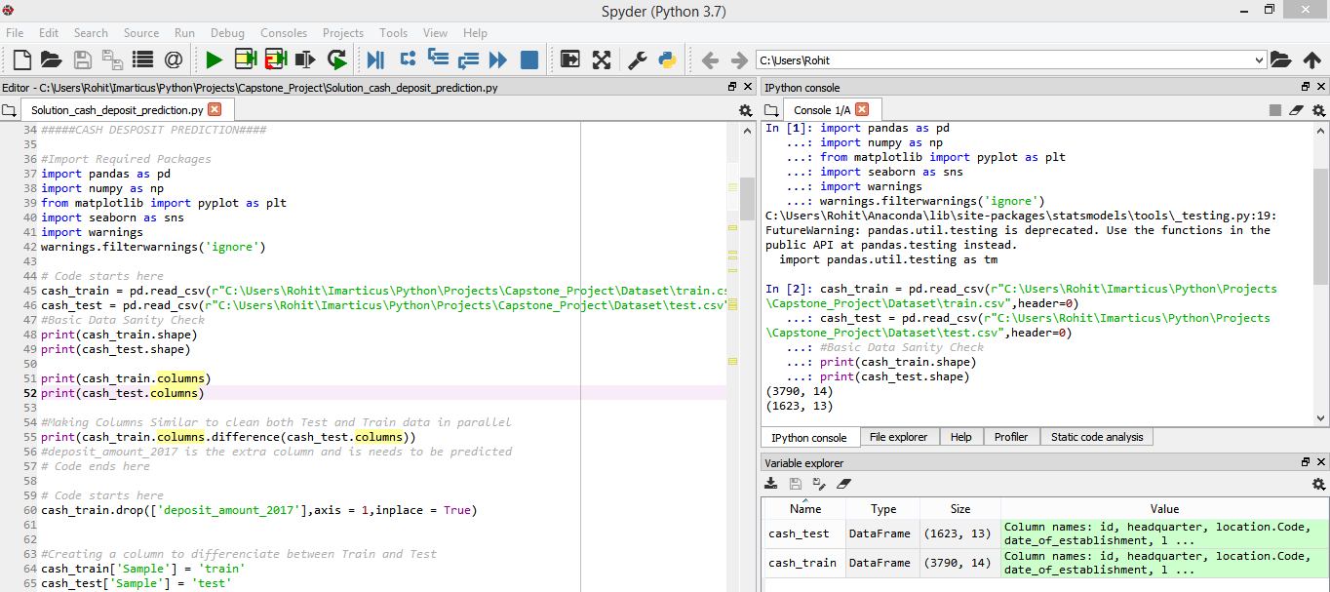
Importing Library and Data sanity check

Slide 5
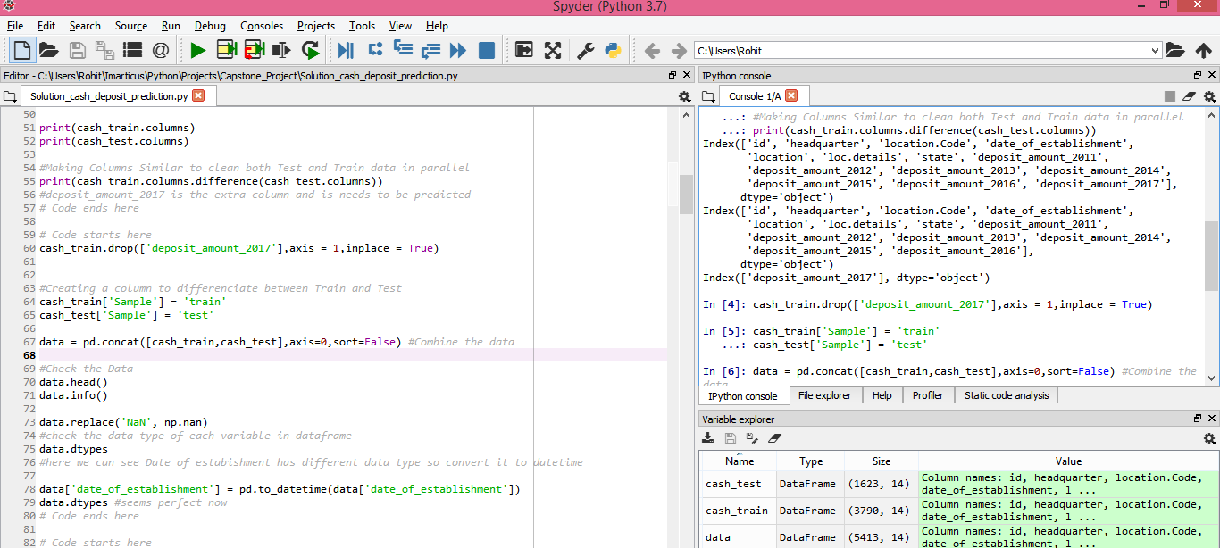
Check for additional columns in train and test

Slide 6
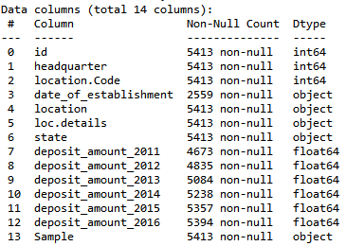
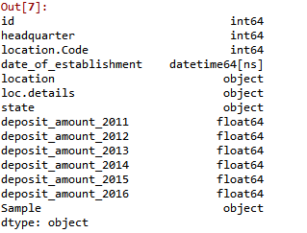
Checking data type of variables Modify Date from object to datetime

Slide 7
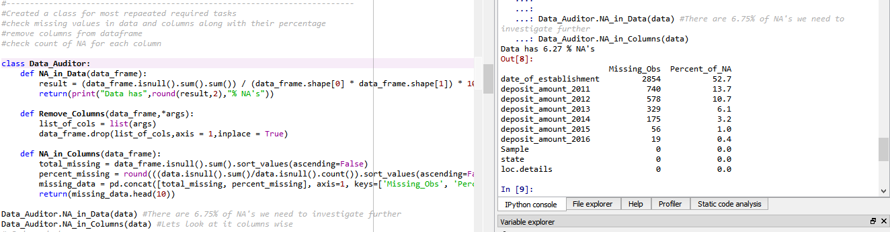
Created class for most repeated tasks checking missing values (sorted) with percentage
Observation: Data contains 6.75% of Null values

Slide 8
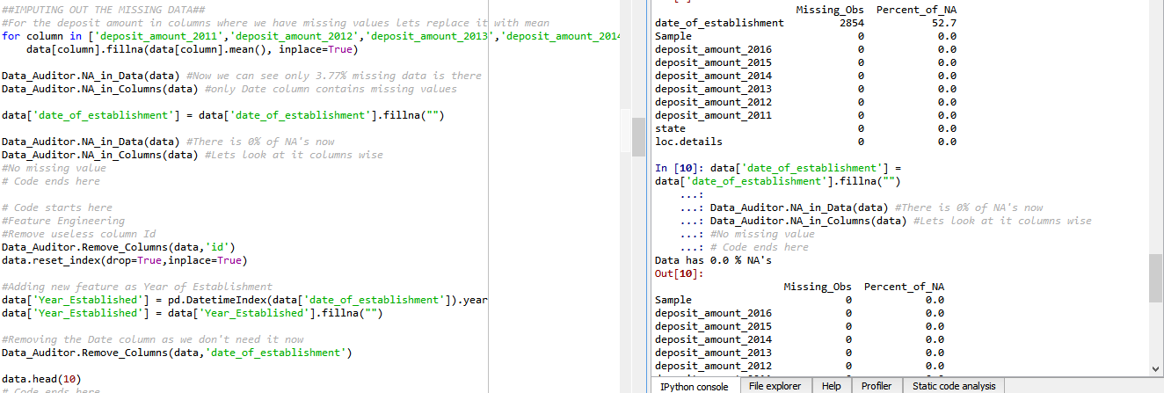
Imputing missing values cash deposit columns replacing by mean value
Observation:
Data contains 3.77% of Null values after cash deposit column imputations
Then replaced NA in Date Column with blank
Data contains 0.00% NA

Slide 9
Feature Engineering
Removed useless column id as it provides no information and add no value to data
Extracted Year as new feature from Date of Establishment as complete date did not give direct meaning to data, by extracting year the data was transformed into more informative
Removed Date of Establishment as it has no use Year will be required for better model predictions

Slide 10
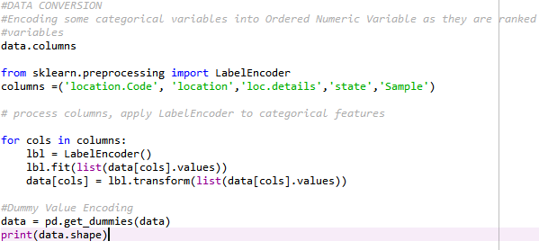
Label Encoding and Inserting Dummy variables
data output (5413 rows, 168 columns)
from (5413 rows, 14 columns)

Slide 11
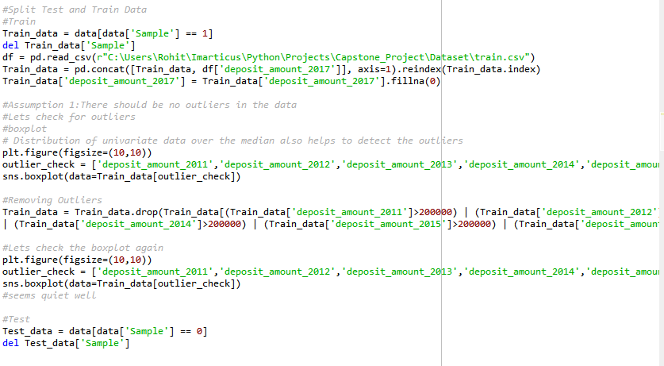
Splitting Test-Train Data

Slide 12
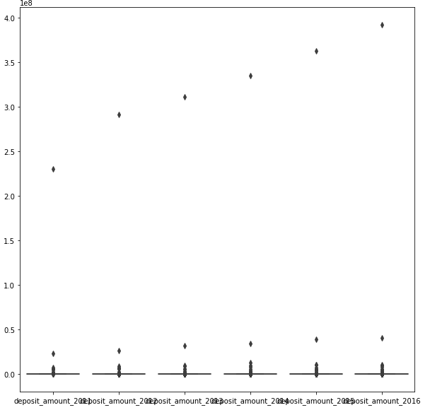
Data Visualisation: Boxplots Checking for Outlier in Data
Outlier can be visible above 2,00,000 for each variable
Truncated values above 2,00,000

Slide 13
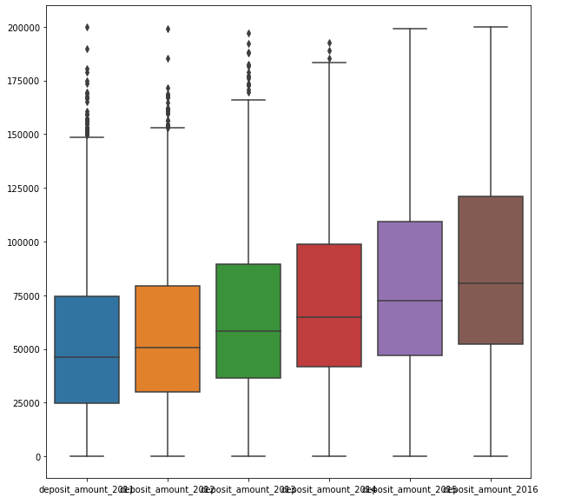
Boxplot after outlier removal

Slide 14
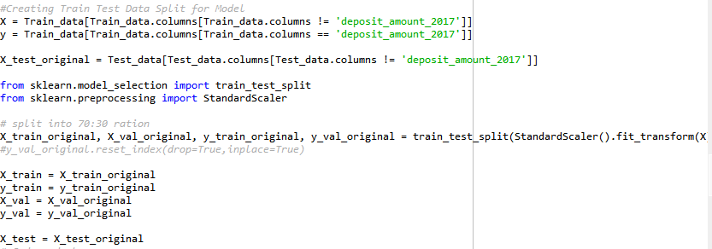
Split Train into Train and Actual To check Accuracy and RMSE Created Test in separate Data frame to predict

Slide 15
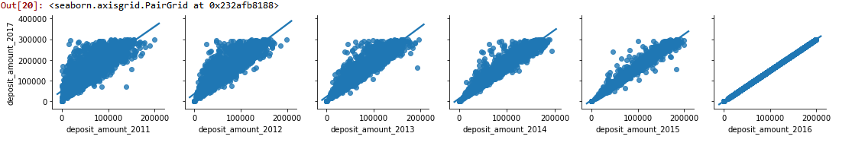
Data Visualisation: Linearity in Data Checking Linear relationship between dependent and independent variables using seaborn

Slide 16
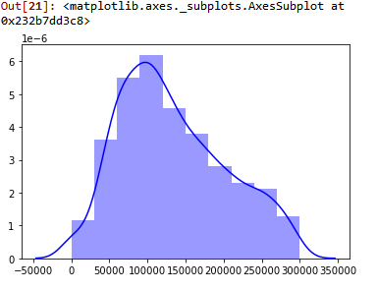
Data Visualisation: Histogram Dependant data should follow approximate normal distribution

Slide 17
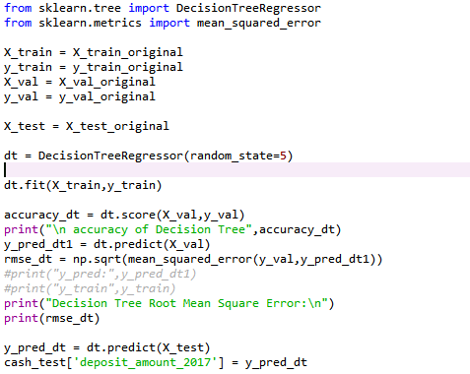
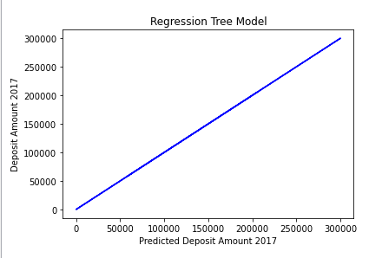
Model 1: Decision Tree
Visualizing Decision Tree results
Accuracy: 0.999987780877183
Root Mean Square Error:252.79370627587292

Slide 18
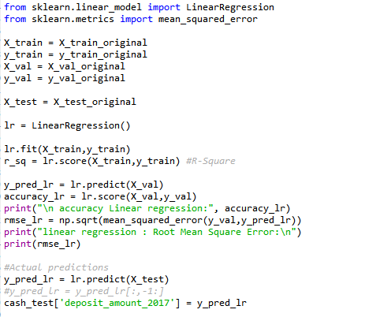
Model 2: Linear Regression
Accuracy: 0.8490420409604789
Root Mean Square Error: 28097.9250691301

Slide 19
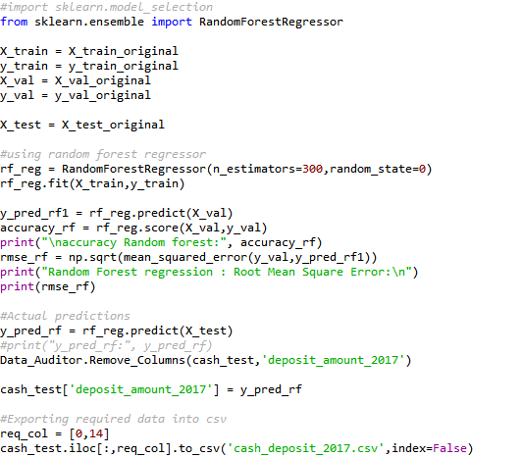
Model 3: Random Forest*
Accuracy: 0.9999935478207401
Root Mean Square Error: 183.69589639570066

Slide 20
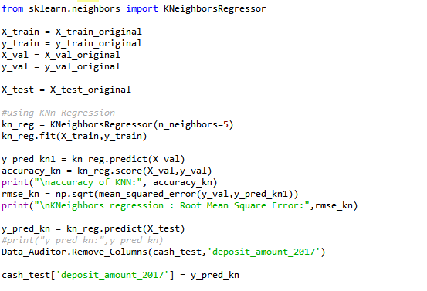
Model 4: KNn Regressor
Accuracy: 0.879950252619291
Root Mean Square Error: 25056.87275308279

Slide 21
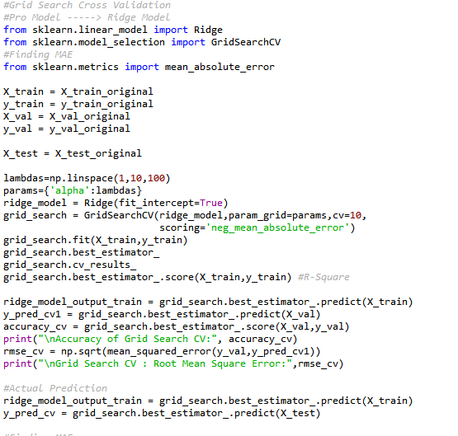
Model 5: Grid Search Cross-Validation
Accuracy: 0.9999918489408574
Root Mean Square Error: 206.46824412239008

Slide 22

Accuracy Comparison
Output File:

Slide 23
Final Outcome
Conclusion:
Decision Tree: "rmse": 252.793706
Linear Regression: "rmse": 28097.925069
Random Forest Regressor: "rmse": 183.695896
KNeighbors Regressor: "rmse": 25056.872753
GridSearch CV: "rmse": 206.468244
Considering RMSE Value:
Best suited model for prediction is: Random Forest Regressor
having lowest value of RSME ~ 183 with model Accuracy 99%

Slide 24
Thanks

