Slide 1


USED CAR PRICE PREDICTION
USING MACHINE LEARNING
NIKITA AGARWAL

Slide 2
Abstract
A car price prediction has been a high interest research area, as it requires noticeable effort and knowledge of the field expert. Considerable number of distinct attributes are examined for the reliable and accurate prediction.
For predicting the price of used cars Different machine learning prediction models were used to train the dataset.
Based on analysis either the Extra tree regression Model or the Random forest regressor have turned out to be the best models for price prediction with an accuracy ranging from 90% to 97%.

Slide 3
Dataset
This data set was collected from Kaggle and the title of dataset is 1000,000 UK used car dataset
Number of Instances: 10782
Number of Attributes: 9
The data set contains information of price, transmission, mileage, fuel type, road tax, miles per gallon (mpg), and engine size.
Dependent variable: price
Independent variables: model, year, transmission, mileage, fuel type, tax, miles per gallon, engine size.

Slide 4
Pre-Processing
The first step was to investigate the structure of the car producers’ datasets, looking at its shape and at the type of variables included. Functions like head(), shape, describe(), info, and, dtypes were used to investigate them.
Secondly we had converted 3 categorical columns into numerical columns using ordinal encoder in sklearn.
We had found 179 duplicate rows which were removed from dataset. Furthermore, we had checked for outliers in the dataset by histogram and box-whisker plots and extreme values were dropped because they inhibit prediction power of the model. and no missing value in the dataset.

Slide 5
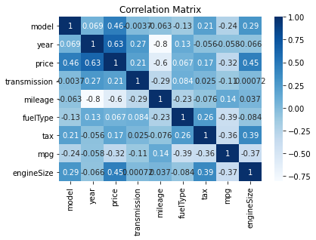
Feature Engineering
Price & Year have a direct connection -- maybe the older car has the less price.
Price and mileage are also correlated—maybe car with higher mileage, have lesser price.

Slide 6
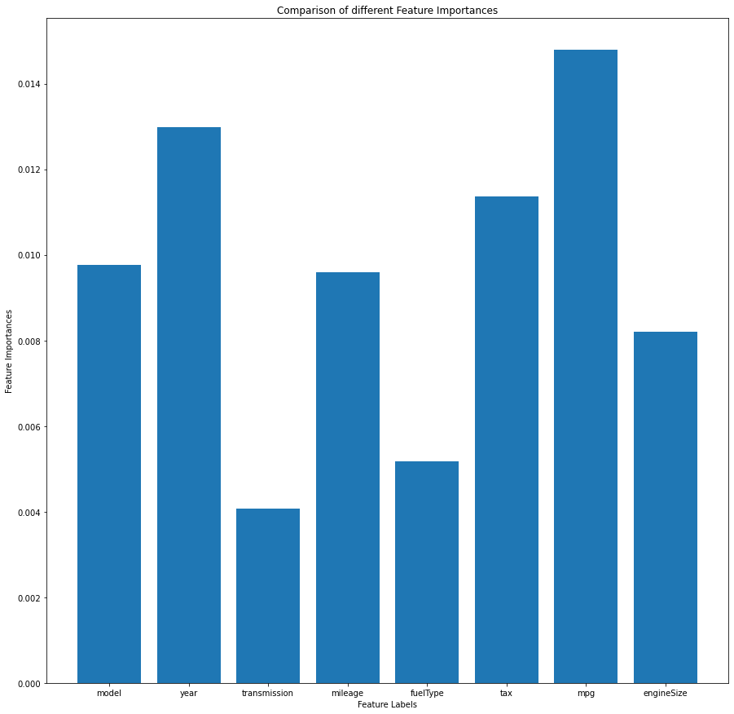
Extra tree classifier
We found that mpg, year, tax, model and mileage are the best features

Slide 7
Machine learning model development
Splitting the dataset into training and testing datasets. 80% of the dataset was used for training the model and 20% for testing the model for prediction. Random state of 42 was taken.
Furthermore, we did the standardization of the dataset and later applied PCA with 3 best feature
We have used the following regression models- Ridge, Lasso, Bayesian ridge, K neighbors regressor Decision tree regressor, AdaBoost regressor, Bagging regressor, Extra trees regressor and Random Forest regressor and calculated r2-score before and after PCA for all the regression models

Slide 8
Models | R2 Score
LR | 0.761
R | 0.761
L | 0.761
BR | 0.761
KNR | 0.933
DTR | 0.906
SVR | 0.008
ABR | 0.717
BR | 0. 953
ETR | 0.952
GBR | 0.955
RFR | 0.953
Models | RMSE
LR | 5566.262
R | 5566.288
L | 5566.216
BR | 5566.365
KNR | 2946.857
DTR | 3541.547
SVR | 11348.393
ABR | 7456.760
BR | 2464.032
ETR | 2472.653
GBR | 2408.301
RFR | 2474.418
Table 1: R2 score of the original dataset
Table 2: RMSE of the original dataset

Slide 9
Models | R2 Score
LR | 0.684
R | 0.684
L | 0.684
BR | 0.684
KNR | 0.918
DTR | 0.847
SVR | 0.031
ABR | 0.676
BR | 0.920
ETR | 0.924
GBR | 0.867
RFR | 0.921
Models | RMSE
LR | 5566.282
R | 5566.288
L | 5566.216
BR | 5566.365
KNR | 2946.857
DTR | 3453.756
SVR | 11348.393
ABR | 5971.693
BR | 2476.385
ETR | 2451.979
GBR | 2411.199
RFR | 2468.806
Table 3: R2 score after PCA of the dataset
Table 4: RMSE after PCA on the dataset
We found that extra tree regressor and random forest regressor have the more then 90% accuracy and the smallest root mean square error that’s why we build the predication model using extra tree regressor.

Slide 10
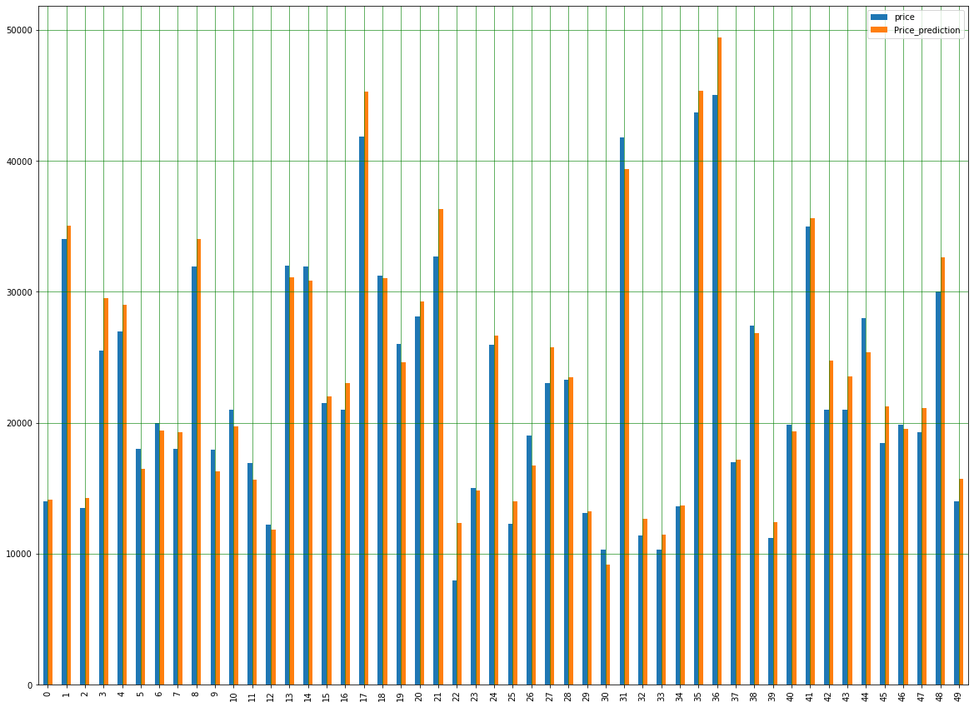
Conclusion
We also found that predicated price of used car is somewhat similar to given price.

Slide 11


