Slide 1

Group Number - 17

Slide 2

Summary :
The service is intended to minimize the use of physical documents.
Can manage and securely store the documents in Doc Locker.
Provides a service to access documents
Documents will be made available for the third person via QR code.

Slide 3
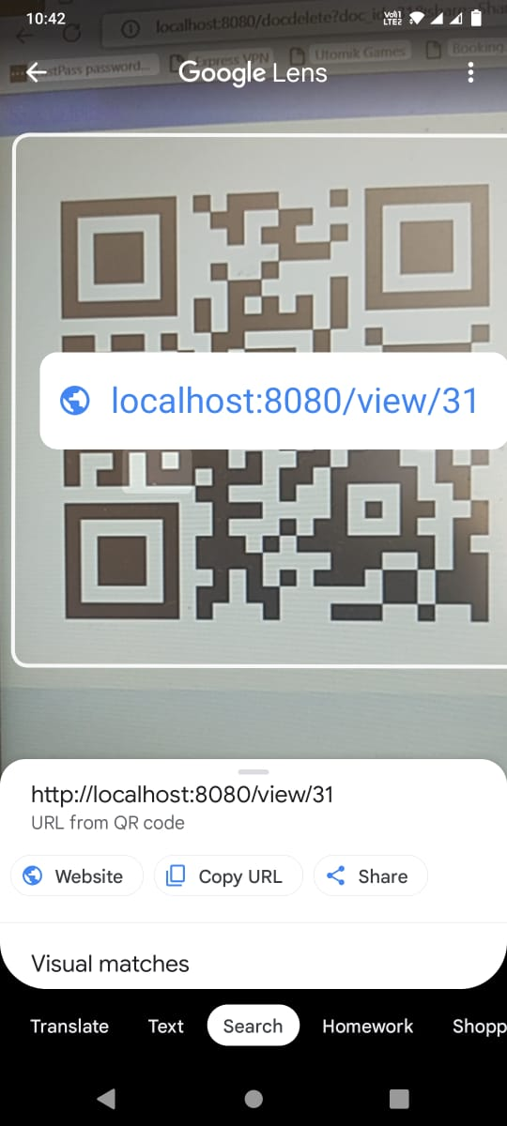
FEATURES INCLUDED :
1.File Management
2.Authentication
3.Dynamic QR code
4.Logical grouping

