Slide 1
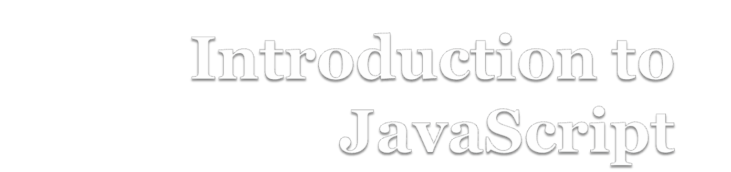

Slide 2
What is JavaScript?
JavaScript is a dynamic programming language that's used for web development, in web applications.
It allows you to implement dynamic features on web pages that cannot be done with only HTML and CSS.
JavaScript is a text-based programming language used both on the client-side and server-side.

Slide 3
JavaScript is not Java
Completely different types of languages that just
happen to be similarly named
JavaScript - programs are interpreted in the browser
Java - programs are compiled and can be run as stand-alone applications

Slide 4
Why JavaScript?
It’s easier to learn than most programming languages.
It allows you to make interactive Web pages.
JavaScript improves the performance of websites and web applications by reducing the code length.
It is a Case Sensitive Language.

Slide 5
Including JavaScript in HTML
JavaScript can be added to your HTML file in two ways:
Internal JS: We can add JavaScript directly to our HTML file by writing the code inside the <script> tag. The <script> tag can either be placed inside the <head> or the <body> tag according to the requirement.
External JS: We can write JavaScript code in other file having an extension .js and then link this file inside the <head> tag of the HTML file in which we want to add this code.

Slide 6
Syntax of <script>tag
The code for the script is contained in the <script>…</script> tag
<script type ="text/javascript">
.
.
.
</script>

Slide 7
Linking to a JavaScript file
<script src="filename" type="text/javascript">
</script>
script tag should be placed in HTML page's head
script code is stored in a separate .js file
JS code can be placed directly in the HTML file's body or head (like CSS)

Slide 8
Displaying text
The document.write() method writes a string of text to the browser
<script type="text/javascript">
<!--
document.write(“Hello, world!");
//-->
</script>

Slide 9
Comments in JavaScript
Two types of comments
  Single line
    Uses two forward slashes (i.e. //)
  Multiple line
    Uses /* and */

Slide 10
Single Line Comment Example
<script type="text/javascript">
// This is my JavaScript comment
document.write("<h1>Hello!</h1>");
</script>

Slide 11
Multiple Line Comment Example
<script type="text/javascript">
<!--
/* This is a multiple line comment.
* The star at the beginning of this line is optional.
* So is the star at the beginning of this line.
*/
document.write("<h1>Hello!</h1>");
//-->
</script>

Slide 12
Simple javascript program
<html>
<body>
<script>
document.write("Hello World!")
</script>
</body>
</html>

Slide 13
Appliction’s of Javascript
Creating web and Mobile apps
Game Development
Building web servers and developing server application
Smartwatch Apps.

Slide 14
Thank You!!!

