Slide 1
Software Testing
Presented By: Nikita Ovhal
Guided By: Ms. Mohana Priya
(Project: Restaurant Management System)

Slide 2
Content
Web Basics
Html
Java
Database
Testing
Selenium
Cucumber

Slide 3
What is Web
World Wide Web, which is also known as a Web, is a collection of websites or web pages stored in web servers and connected to local computers through the internet.
These websites contain text pages, digital images, audios, videos, etc. Users can access the content of these sites from any part of the world over the internet using their devices such as computers, laptops, cell phones, etc.
The WWW, along with internet, enables the retrieval and display of text and media to your device.

Slide 4
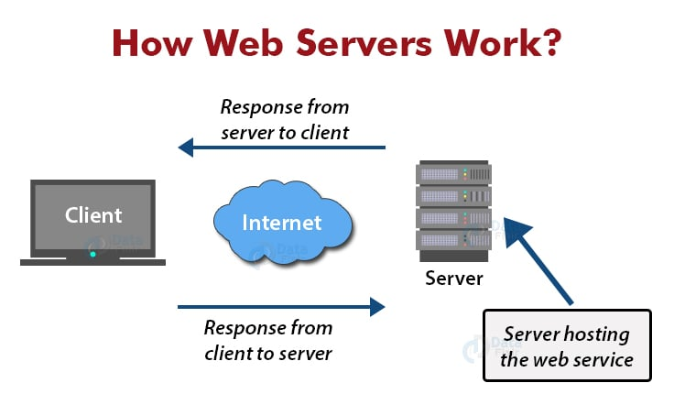
How web Servers work
.

Slide 5
What is Html
HTML stands for Hyper Text Markup Language
HTML is the standard markup language for creating Web pages
HTML describes the structure of a Web page
HTML consists of a series of elements
HTML elements tell the browser how to display the content

Slide 6
Structure of Html
<!DOCTYPE html> <html> <head> <title>Page Title</title> </head> <body> <h1>This is a Heading</h1> <p>This is a paragraph.</p> </body> </html>

Slide 7
What is CSS
CSS stands for Cascading Style Sheets.
CSS describes how HTML elements are to be displayed on screen, paper, or in other media
CSS saves a lot of work. It can control the layout of multiple web pages all at once.
External style sheets are stored in CSS files.

Slide 8
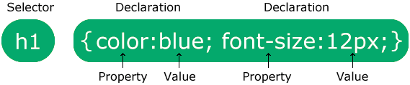
CSS Syntax
A CSS rule consists of a selector and a declaration block.
The selector points to the HTML element you want to style.
The declaration block contains one or more declarations separated by semicolons.
Each declaration includes a CSS property name and a value, separated by a colon.
Multiple CSS declarations are separated with semicolons, and declaration blocks are surrounded by curly braces.

Slide 9
What is JavaScript
JavaScript (js) is a light-weight object-oriented programming language which is used by several websites for scripting the WebPages.
It is an interpreted, full-fledged programming language that enables dynamic interactivity on websites when applied to an HTML document.
With JavaScript, users can build modern web applications to interact directly without reloading the page every time.
The traditional website uses js to provide several forms of interactivity and simplicity.

Slide 10
JavaScript Example
<script>
document.write("Hello JavaScript by JavaScript");
</script>
3 Places to put JavaScript code
Between the body tag of html
Between the head tag of html
In .js file (external javaScript)

Slide 11
Java
Java is a general-purpose, class-based, object-oriented programming language designed for having lesser implementation dependencies.
It is a computing platform for application development.
Java is fast, secure, and reliable, therefore. It is widely used for developing Java applications in laptops, data centers, game consoles, scientific supercomputers, cell phones, etc.

Slide 12
Features of Java
Simple
Object-Oriented: Object
Class
Inheritance
Polymorphism
Abstraction
Encapsulation

Slide 13
Applications of Java
It is used for developing Android Apps
Helps you to create Enterprise Software
Wide range of Mobile java Applications
Scientific Computing Applications
Use for Big Data Analytics
Java Programming of Hardware devices
Used for Server-Side Technologies like Apache, JBoss, GlassFish, etc.

Slide 14
Database
Database is a collection of interrelated data which helps in the efficient retrieval, insertion, and deletion of data from the database and organizes the data in the form of tables, views, schemas, reports, etc

Slide 15
Database Management System
Database management system is a software which is used to manage the database. For example: MySQL, Oracle, etc are a very popular commercial database which is used in different applications.
DBMS provides an interface to perform various operations like database creation, storing data in it, updating data, creating a table in the database and a lot more.
It provides protection and security to the database. In the case of multiple users, it also maintains data consistency.

Slide 16
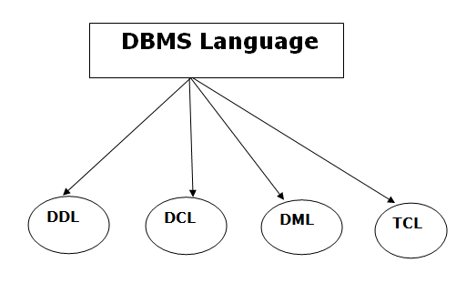
Database Languages is DBMS
Database languages can be used to read, store and update the data in the database.

Slide 17
Data Definition Language
DDL stands for Data Definition Language. It is used to define database structure or pattern.
Here are some tasks that come under DDL:
Create: It is used to create objects in the database.
Alter: It is used to alter the structure of the database.
Drop: It is used to delete objects from the database.
Truncate: It is used to remove all records from a table.
Rename: It is used to rename an object.
Comment: It is used to comment on the data dictionary.

Slide 18
Data Manipulation Language
DML stands for Data Manipulation Language. It is used for accessing and manipulating data in a database. It handles user requests.
Here are some tasks that come under DML:
Select: It is used to retrieve data from a database.
Insert: It is used to insert data into a table.
Update: It is used to update existing data within a table.
Delete: It is used to delete all records from a table.

Slide 19
Data Control Language
DCL stands for Data Control Language. It is used to retrieve the stored or saved data.
Here are some tasks that come under DCL:
Grant: It is used to give user access privileges to a database.
Revoke: It is used to take back permissions from the user.
There are the following operations which have the authorization of Revoke:
CONNECT, INSERT, USAGE, EXECUTE, DELETE, UPDATE and SELECT.

Slide 20
Transaction Control Language
TCL is used to run the changes made by the DML statement. TCL can be grouped into a logical transaction.
Here are some tasks that come under TCL:
Commit: It is used to save the transaction on the database.
Rollback: It is used to restore the database to original since the last Commit

Slide 21
What is Testing?
Testing is nothing but verifying the software to check whether it meets the customer requirement.
To find whether the any bug is there resolve in order to give quality software.

Slide 22
Types of Software Testing
Manual Testing :
Manual testing includes testing software manually, i.e., without using any automation tool or any script. There are different stages for manual testing such as unit testing, integration testing, system testing, and user acceptance testing. There are different stages for manual testing such as unit testing, integration testing, system testing, and user acceptance testing.
Automation Testing:
Automation Testing is a software testing technique that performs using special automated testing software tools to execute a test case suite.

Slide 23
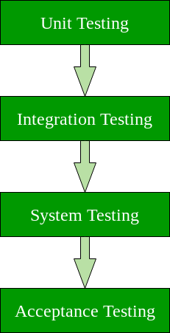
Levels of Testing

Slide 24
Unit Testing: A level of the software testing process where individual units/components of a software/system are tested. The purpose is to validate that each unit of the software performs as designed.
Integration Testing: A level of the software testing process where individual units are combined and tested as a group. The purpose of this level of testing is to expose faults in the interaction between integrated units.
System Testing: A level of the software testing process where a complete, integrated system/software is tested. The purpose of this test is to evaluate the system’s compliance with the specified requirements.
Acceptance Testing: A level of the software testing process where a system is tested for acceptability. The purpose of this test is to evaluate the system’s compliance with the business requirements and assess whether it is acceptable for delivery.

Slide 25
Software Testing Techniques
Black Box Testing:
Black Box Testing is a software testing method in which the functionalities of software applications are tested without having knowledge of internal code structure, implementation details and internal paths. Black Box Testing mainly focuses on input and output of software applications and it is entirely based on software requirements and specifications. It is also known as Behavioral Testing.
White-Box Testing:
White Box Testing is a testing technique in which software’s internal structure, design, and coding are tested to verify input-output flow and improve design, usability, and security. In white box testing, code is visible to testers, so it is also called Clear box testing, Open box testing, Transparent box testing, Code-based testing, and Glass box testing.

Slide 26
Gray Box Testing
Gray box testing is a software testing technique to test a software product or application with partial knowledge of internal structure of the application. The purpose of grey box testing is to search and identify the defects due to improper code structure or improper use of applications.
Gray Box Testing is a software testing method, which is a combination of both White Box Testing and Black Box Testing method.
It is primarily used in integration testing and penetration testing

Slide 27
What is Selenium?
Selenium is a free (open-source) automated testing framework used to validate web applications across different browsers and platforms.
You can use multiple programming languages like Java, C#, Python, etc to create Selenium Test Scripts.
Testing done using the Selenium testing tool is usually referred to as Selenium Testing.

Slide 28
Selenium tool Suite
Selenium Software is not just a single tool but a suite of software, each piece catering to different Selenium QA testing needs of an organization.
Here is the list of tools
Selenium Integrated Development Environment (IDE)
Selenium Remote Control (RC)
WebDriver
Selenium Grid

Slide 29
Selenium IDE
Selenium Integrated Development Environment (IDE) is the simplest framework in the Selenium suite and is the easiest one to learn.
It is a Chrome and Firefox plugin that you can install as easily as you can with other plugins.
However, because of its simplicity, Selenium IDE should only be used as a prototyping tool. If you want to create more advanced test cases, you will need to use either Selenium RC or WebDriver.

Slide 30
Selenium RC
Selenium RC was the flagship testing framework of the whole Selenium project for a long time.
This is the first automated web testing tool that allows users to use a programming language they prefer. As of version 2.25.0, RC can support the following programming languages:
Java
C#
PHP
Python
Perl
Ruby

Slide 31
Selenium Web Driver
It implements a more modern and stable approach in automating the browser’s actions.
It controls the browser by directly communicating with it.
The supported languages are the same as those in Selenium RC.
Java
C#
PHP
Python
Perl
Ruby

Slide 32
Selenium Grid
Selenium Grid is a tool used together with Selenium RC to run parallel tests across different machines and different browsers all at the same time. Parallel execution means running multiple tests at once.
Features:
Enables simultaneous running of tests in multiple browsers and environments.
Saves time enormously.
Utilizes the hub-and-nodes concept. The hub acts as a central source of Selenium commands to each node connected to it.

Slide 33
WebDriver commands
driver.get("www.facebook.com")
driver.findElement(By.id(“name")).sendKeys(“nikita ovhal");
driver.findElement(By.id("element567")).getText();
driver.findElement(By.id("btnK")).click();
driver.navigate().back();
driver.close();

Slide 34
What is TestNG
TestNG is an automation testing framework in which NG stands for “Next Generation”.
TestNG is inspired by JUnit which uses the annotations (@).
Using TestNG, you can generate a proper report, and you can easily come to know how many test cases are passed, failed, and skipped.
You can execute the failed test cases separately.

Slide 35
Sample code for TestNg Annotation
public class NewTest
{
@Test(description="This is testcase1")
public void testcase1() {
System.out.println("HR"); }
@Test(description="This is testcase2")
public void testcase2() {
System.out.println("Software Developer"); }
@Test(description="This is testcase3")
public void testcase3() {
System.out.println("QA Analyst"); }
}

Slide 36
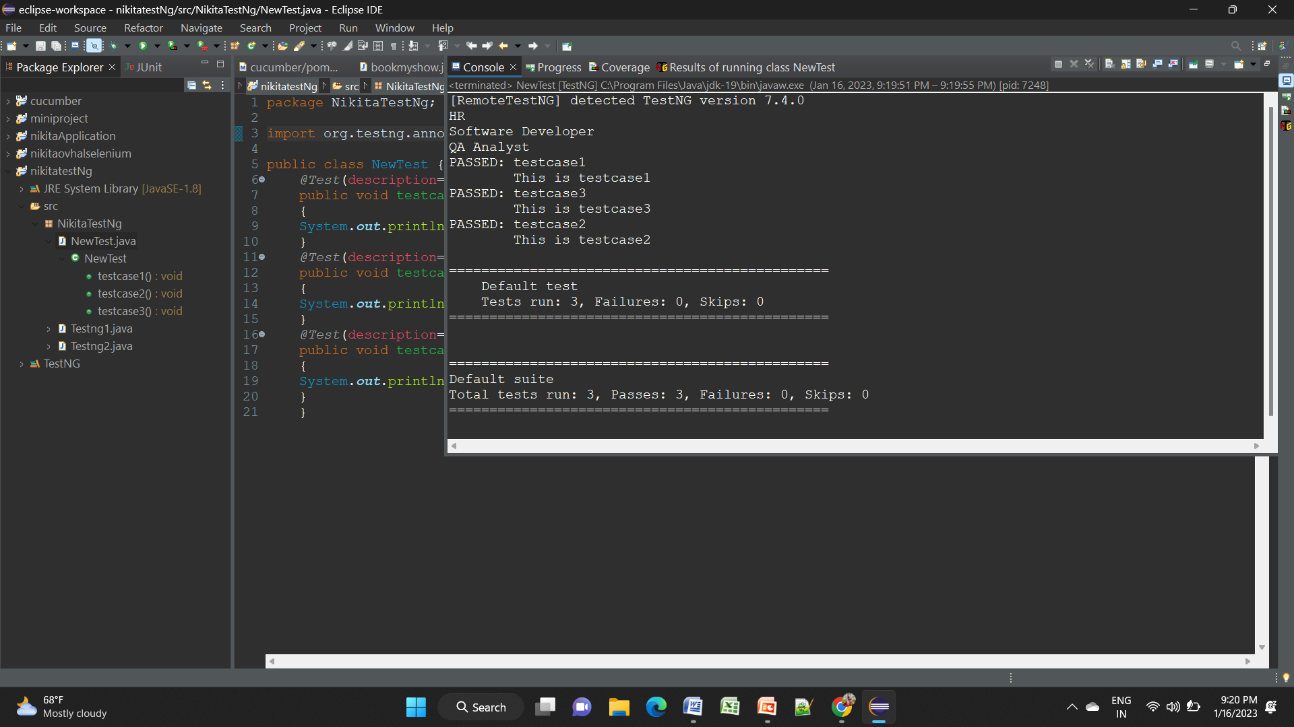
Output:

Slide 37
Cucumber Framework
Cucumber Framework in Selenium is an open-source testing framework that supports Behavior Driven Development for automation testing of web applications.
The tests are first written in a simple scenario form that describes the expected behavior of the system from the user’s perspective.
Largely used for acceptance tests, Cucumber is written in Ruby, while the tests are written in Gherkin, a non-technical and human-readable language.

Slide 38
Cucumber BDD framework mainly consists of three major parts:
Feature File: A file that stores data about features, their descriptions, and the scenarios to be tested is called a Feature File.
Step Definitions: A Steps Definitions file stores the mapping data between each step of a scenario defined in the feature file and the code to be executed.
Test Runner File:To run the test, one needs a Test Runner File, which is a JUnit Test Runner Class containing the Step Definition location and the other primary metadata required to run the test.

Slide 39
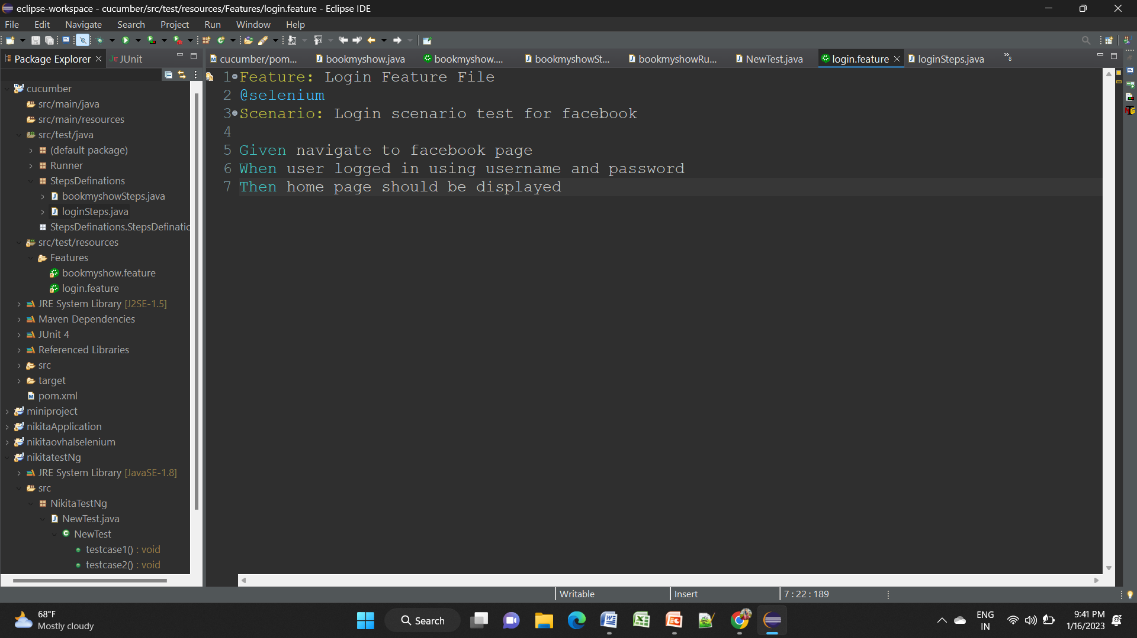
Feature file

Slide 40
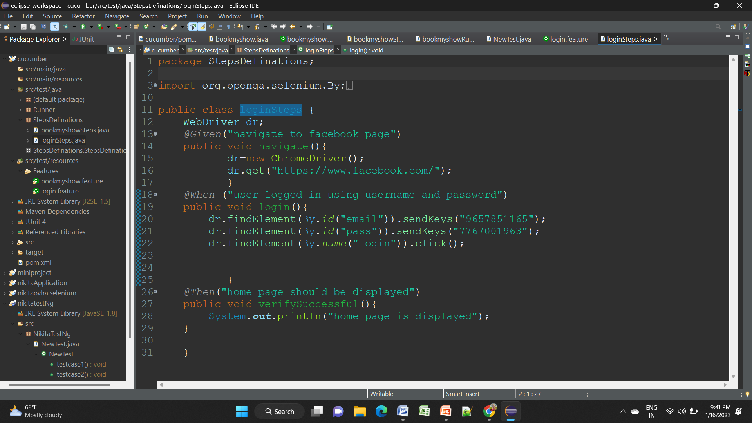
Step Definition File

Slide 41
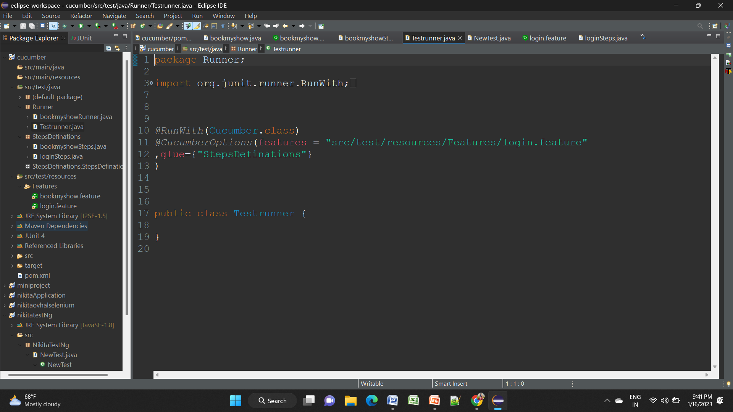
Test Runner file:

Slide 42
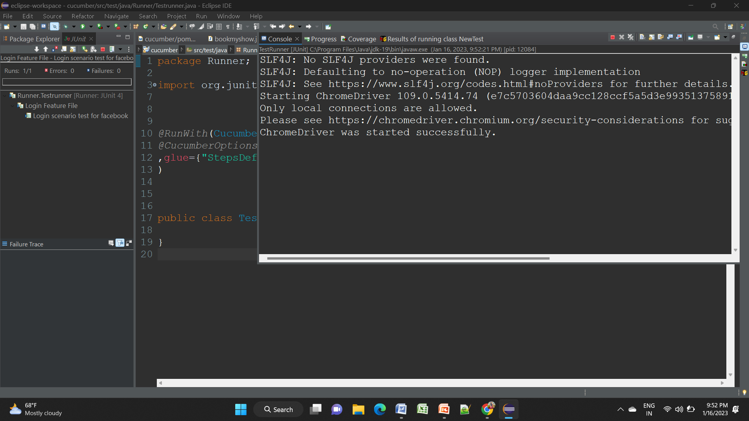
Output:

Slide 43
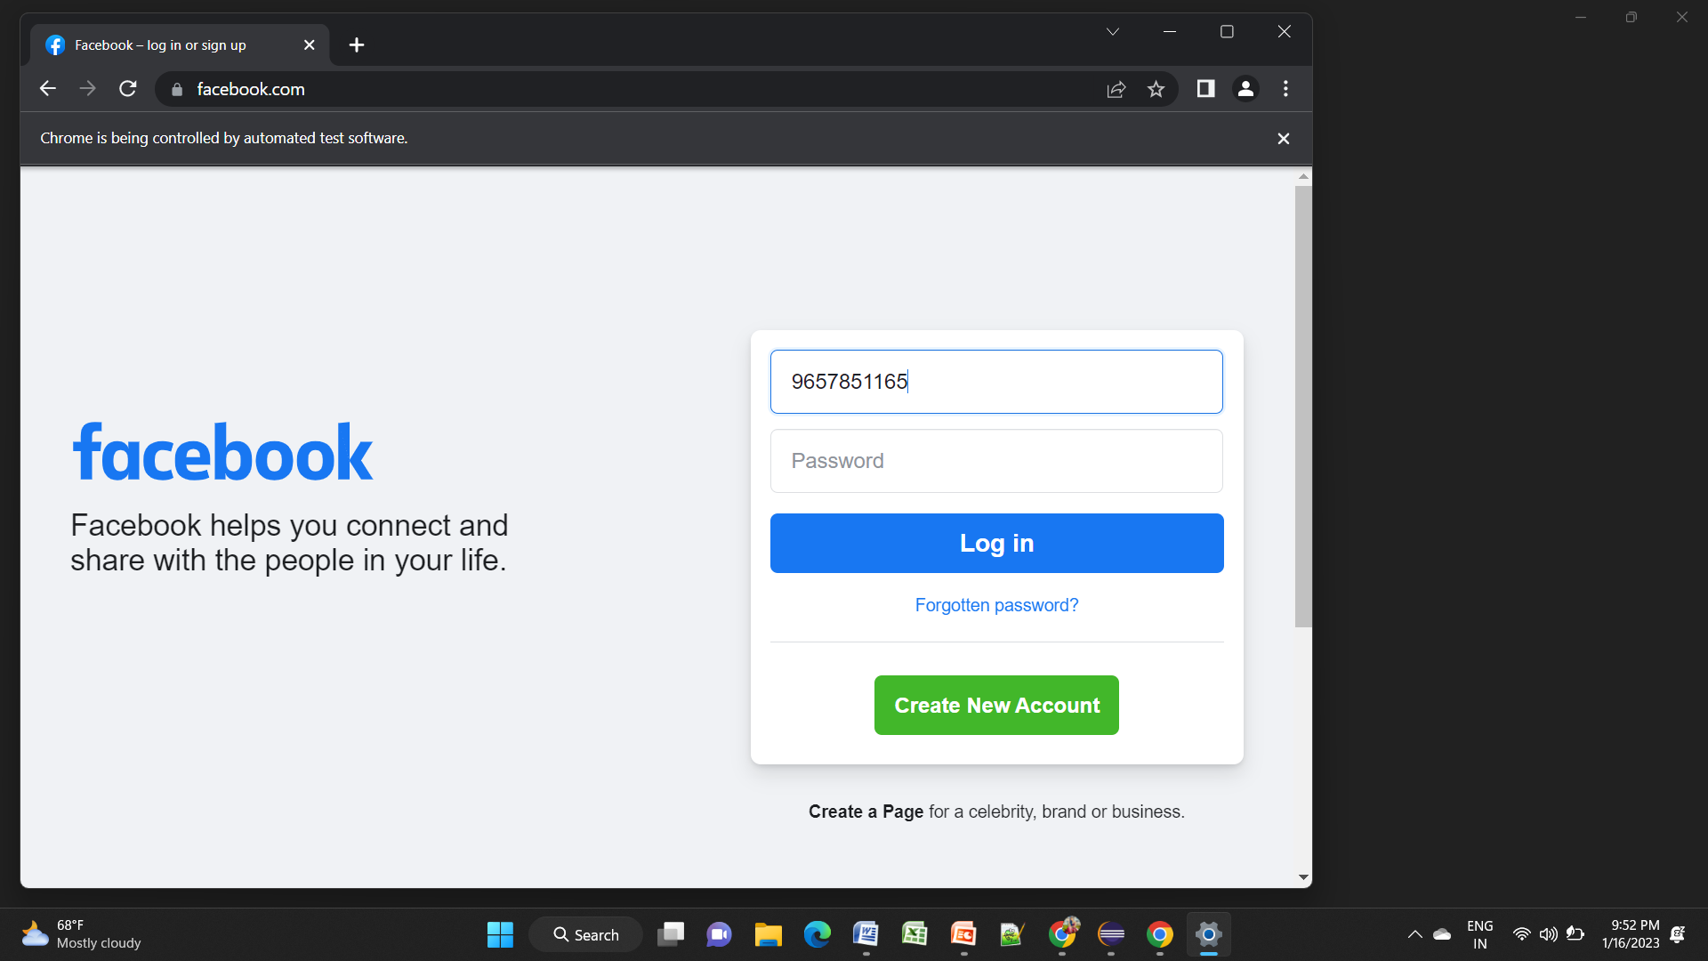

Slide 44
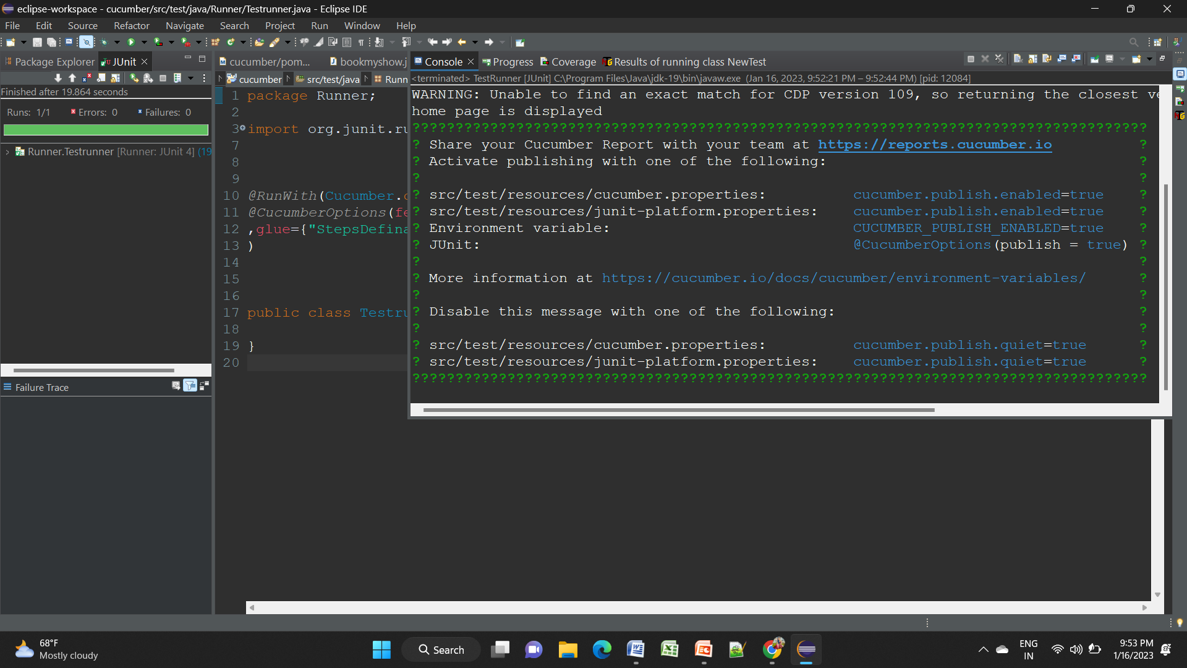

Slide 45
Thank You!

