Slide 1

A Major Project on CREDIT CARD FRAUD DETECTION USING ADA BOOST AND MAJORITY VOTING
Under the Guidance of
P. EDUKONDALU B. Tech , M. Tech.
Asst. Professor
Presented By
KUMARI NIKITA 21S11A1228
CHENNA SRIKANTH 21S11A1253
M. BHARATHI NAIK 21S11A1204
PUTUMBAKA REVANTHSAI 21S11A1239

Slide 2

CONTENTS
Introduction
Abstract
Existing System
Disadvantages Of Existing System
Architecture
Proposed System
Advantages of Proposed System
System Requirements
Result
Conclusion

Slide 3
INTRODUCTION
Credit card fraud detection is a critical issue in the financial industry, with billions of dollars lost annually due to fraudulent activities.
AdaBoost (Adaptive Boosting) is a powerful ensemble learning algorithm that combines multiple weak classifiers to form a strong classifier.
Majority Voting is a simple yet effective ensemble method where multiple classifiers are trained independently, and their predictions are combined by taking the majority vote to make the final decision.
Credit card fraud detection using AdaBoost and Majority Voting is a promising approach that combines the power of ensemble learning and majority voting to enhance the accuracy and robustness of fraud detection systems.
By leveraging these techniques, financial institutions can better protect their customers and reduce the financial impact of fraudulent activities.

Slide 4
ABSTRACT
This study explores the application of AdaBoost (Adaptive Boosting) and Majority Voting techniques to enhance the accuracy and reliability of fraud detection systems.
AdaBoost is utilized to combine multiple weak classifiers, typically decision trees, into a strong classifier by iteratively adjusting the weights of incorrectly classified instances.
Majority Voting aggregates the predictions of several classifiers to make a final decision, ensuring robustness by mitigating the biases of individual models.
The methodology involves preprocessing the dataset, selecting relevant features, and training multiple AdaBoost classifiers.
The outputs of these classifiers are then combined using Majority Voting to decide whether a transaction is legitimate or fraudulent.

Slide 5
EXISTING SYSTEM
Firstly, clustering model is used to classify the legal and fraudulent transaction using data clusterization of regions of parameter value.
Secondly, Gaussian mixture model is used to model the probability density of credit card user's past behavior so that the probability of current behavior can be calculated to detect any abnormalities from the past behavior.
Lastly, Bayesian networks are used to describe the statistics of a particular user and the statistics of different fraud scenarios.
The main task is to explore different views of the same problem and see what can be learned from the application of each different technique.

Slide 6
Disadvantages Of Existing System
Clustering Models: May not scale well with very large datasets, leading to performance issues and longer processing times.
GMM: Computationally expensive due to the expectation-maximization algorithm, which can be slow and require significant resources.
Bayesian Networks: Requires a large amount of data to accurately estimate the probabilities of different events and may not perform well with limited data.
Dynamic Nature of Fraud: Fraud patterns are constantly evolving these may struggle to keep up with new types of fraudulent behavior without frequent updates.

Slide 7
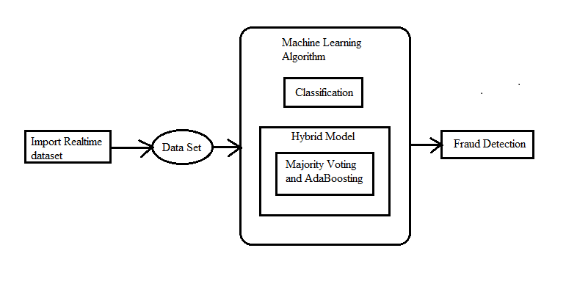
ARCHITECTURE DIAGRAM

Slide 8
PROPOSED SYSTEM
Total of twelve machine learning algorithms are used for detecting credit card fraud. The algorithms range from standard neural networks to deep learning models.
We used algorithms like SHA-256, KNN, CP-ABE (Ciphertext-Policy Attribute-Based Encryption).
The AdaBoost and Majority voting methods are applied for forming hybrid models.
AdaBoost (Adaptive Boosting) and Majority Voting are two powerful ensemble learning techniques that can significantly enhance the performance of machine learning models, particularly in complex tasks such as fraud detection.
The key contribution of this paper is the evaluation of a variety of machine learning models with a real-world credit card data set for fraud detection.

Slide 9
Advantages Of Proposed System
High Accuracy and Robustness: Combining AdaBoost with Majority Voting leverages the strengths of both methods, resulting in a highly accurate and robust fraud detection system.
Enhanced Focus on Frauds: The AdaBoost component ensures that the model pays extra attention to the fraudulent transactions, while Majority Voting provides a balanced decision-making process.
Scalability: The combined approach can handle large datasets and is scalable to accommodate the growing volume of credit card transactions.
Real-Time Detection: The models can be deployed in real-time systems to detect fraudulent transactions as they occur, providing immediate protection against fraud.
Adaptability to Changing Patterns: The adaptability of AdaBoost and the robustness of Majority Voting ensure that the system can keep up with evolving fraud patterns and new types of fraudulent activities.

Slide 10
System Requirements
HARDWARE REQUIREMENTS:-
Processor - Ryzen-7
RAM - 4GB(Min)
Hard Disk - 20GB
SOFTWARE REQUIREMENTS:
Operating System : Windows 11
Application Server : Tomcat 9.0
Front End : HTML, CSS, JavaScript
Database Connectivity : My SQL
Java Version : JDK 1.8

Slide 11

Result

Slide 12
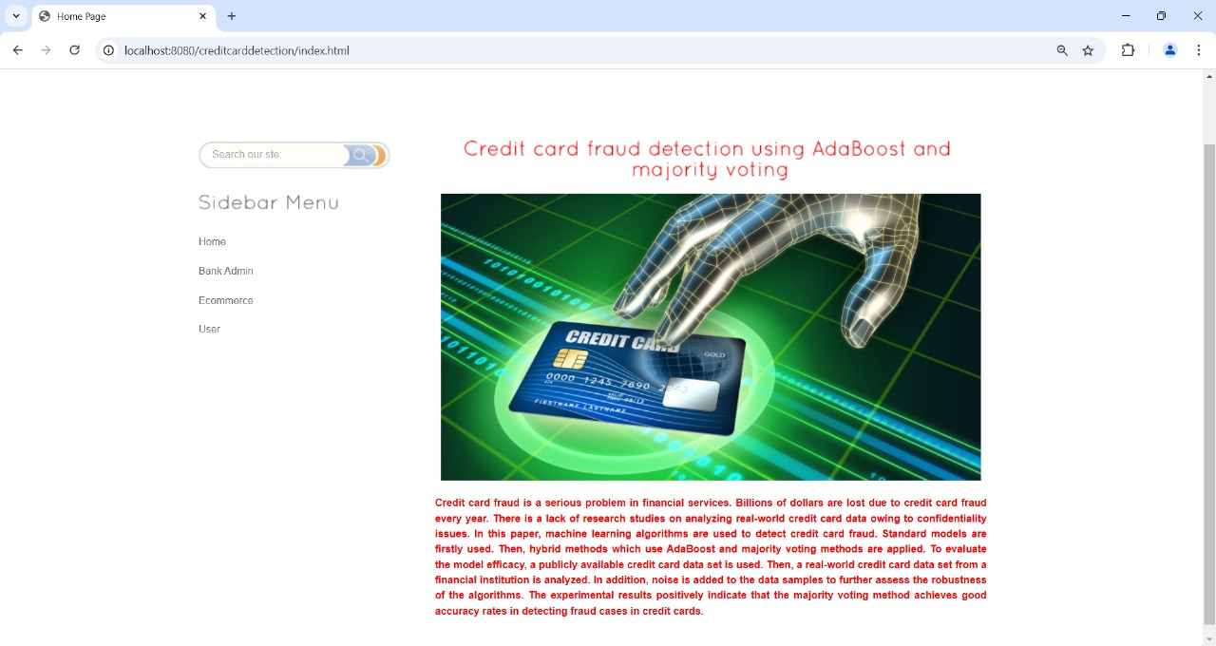

Slide 13
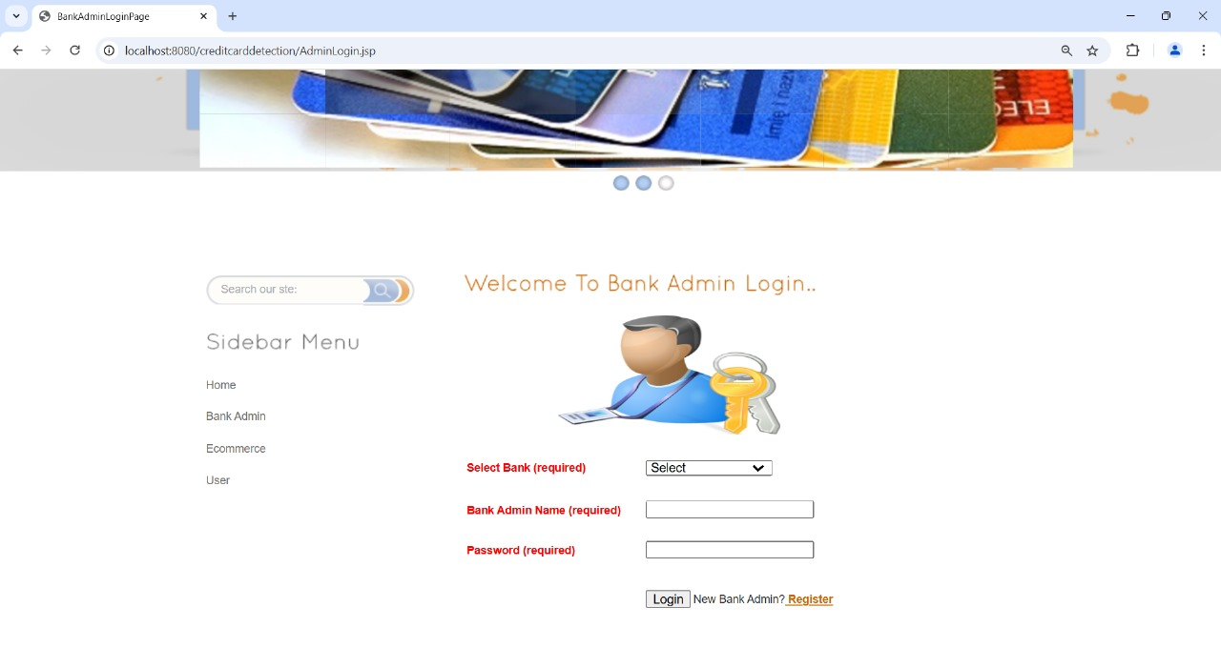

Slide 14
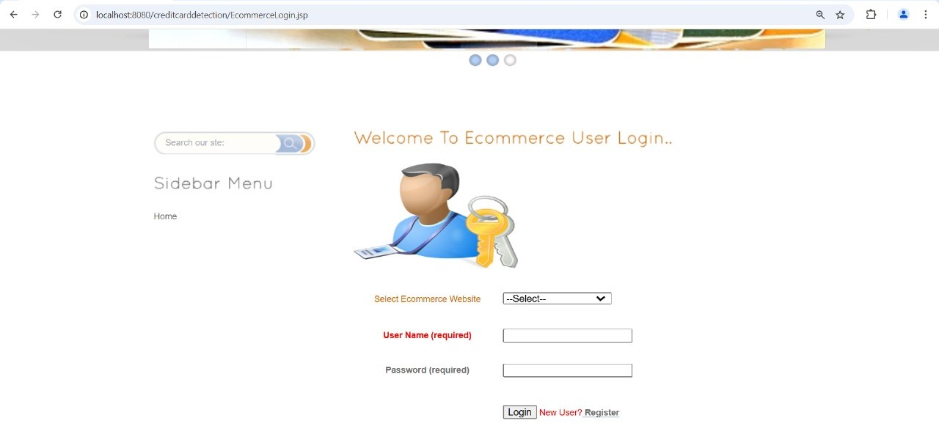

Slide 15
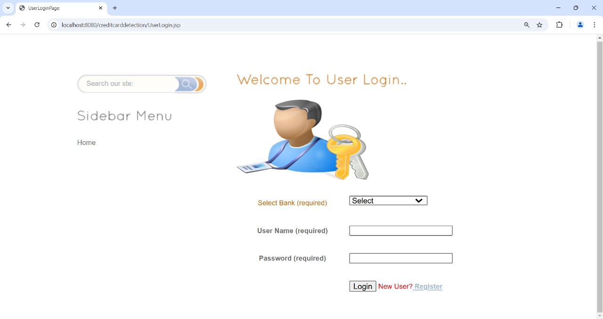

Slide 16
CONCLUSION
Credit card fraud detection using AdaBoost and Majority Voting presents a robust, efficient, and scalable solution to one of the most pressing challenges in the financial industry.
AdaBoost shines by iteratively improving weak classifiers and focusing on difficult-to-classify instances, which ensures that the model is highly sensitive to fraud patterns.
Majority Voting complements this by aggregating the predictions of multiple classifiers, thus reducing the biases and errors of individual models.
This combined approach is a valuable tool for financial institutions aiming to protect their customers and reduce the financial impact of fraud.
In conclusion, the integration of AdaBoost and Majority Voting in credit card fraud detection systems provides a sophisticated and powerful framework that not only improves detection accuracy but also offers robustness and scalability.

Slide 17
THANK YOU

