Slide 1
Analysis & Modeling OF 911 calls assigned to San Francisco Fire Department (SFFD)
DS-SF-30 Final Project Presentation
Nikita Attiguppe Dasharath

Slide 2
TABLE OF CONTENT
Outline | Slide 3
Summary | Slide 4
Number of Calls per hour | Slide 5
Geocoding | Slide 6
Modeling | Slide 7
Results | Slide 8
Conclusion | Slide 9
References | Slide 10
Next Steps | Slide 11

Slide 3
OUTLINE
Figure below shows the location of Fire engines and Battalion boundaries in San Francisco
[Image source: https://data.sfgov.org]

Slide 4
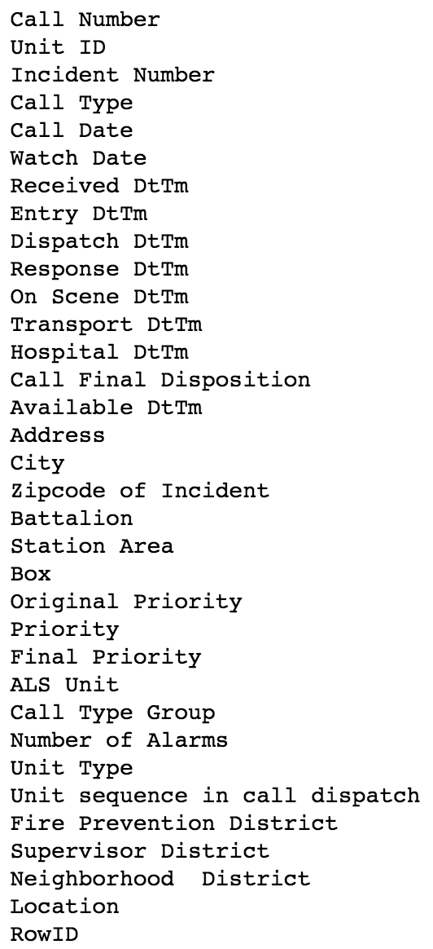
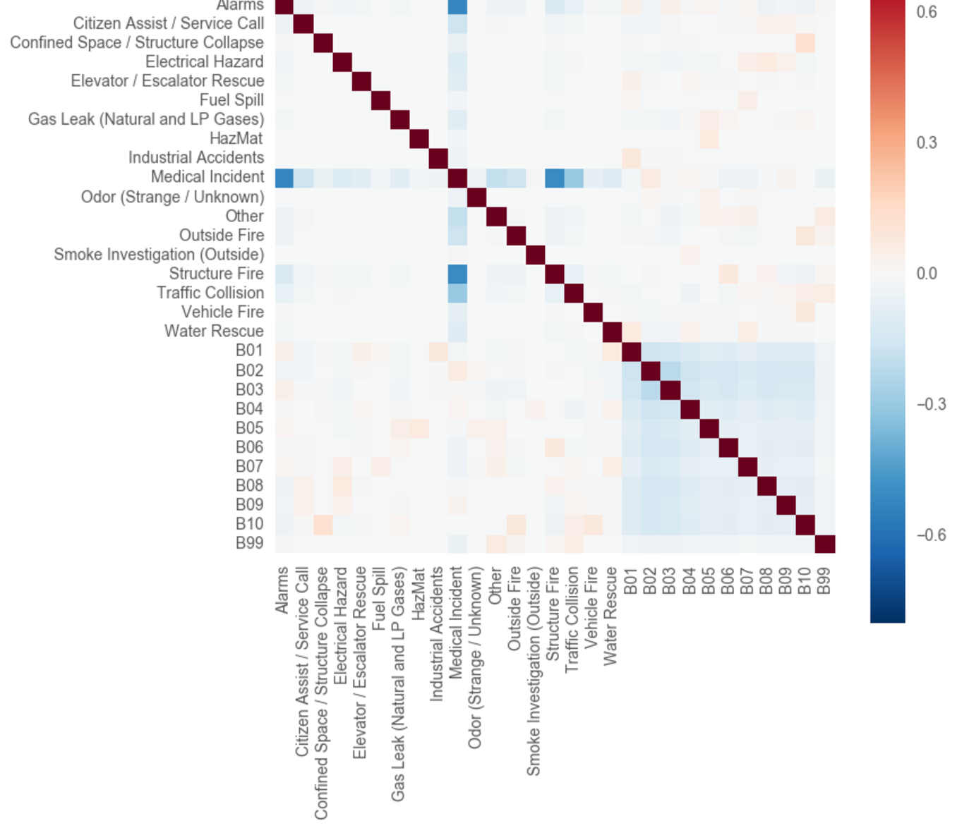
SUMMARY
Goal of the project is to determine the type, time and frequency of calls assigned to SFFD
[Data source: https://data.sfgov.org]
Time period: Dec 31, 2016 to Jan 7, 2017
First figure on the right shows the features in the data set
Second figure on the right shows the correlation between various types of calls and batalions

Slide 5
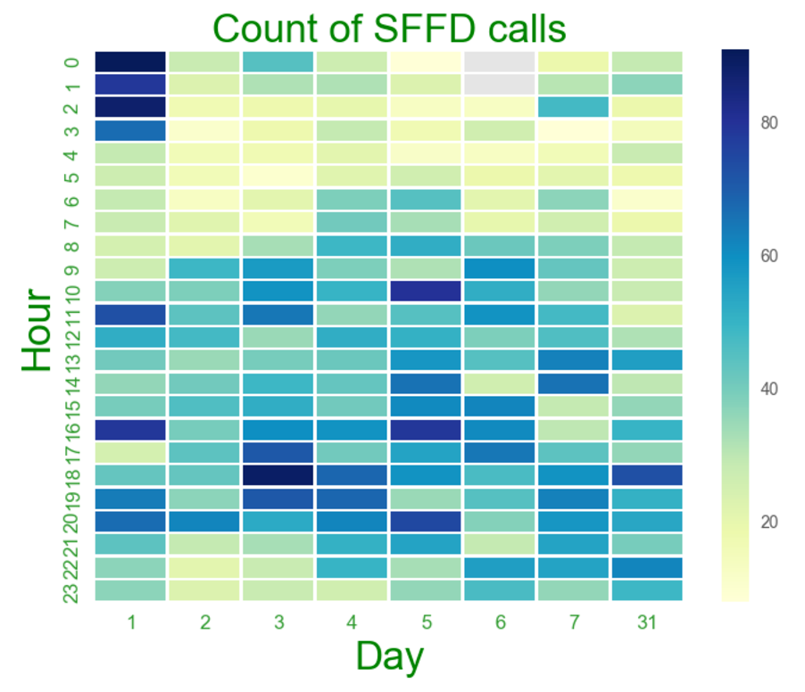
NUMBER OF CALLS PER HOUR
X-axis shows the day
Y-axis shows the hour
January 1st had the maximum calls in the first week of January 2017
Majority of the calls were between 12am – 4am and 5pm – 6pm on January 1st
Dec 31, 2016 and January 2nd 2017 had the least number of calls in the first week of January.

Slide 6
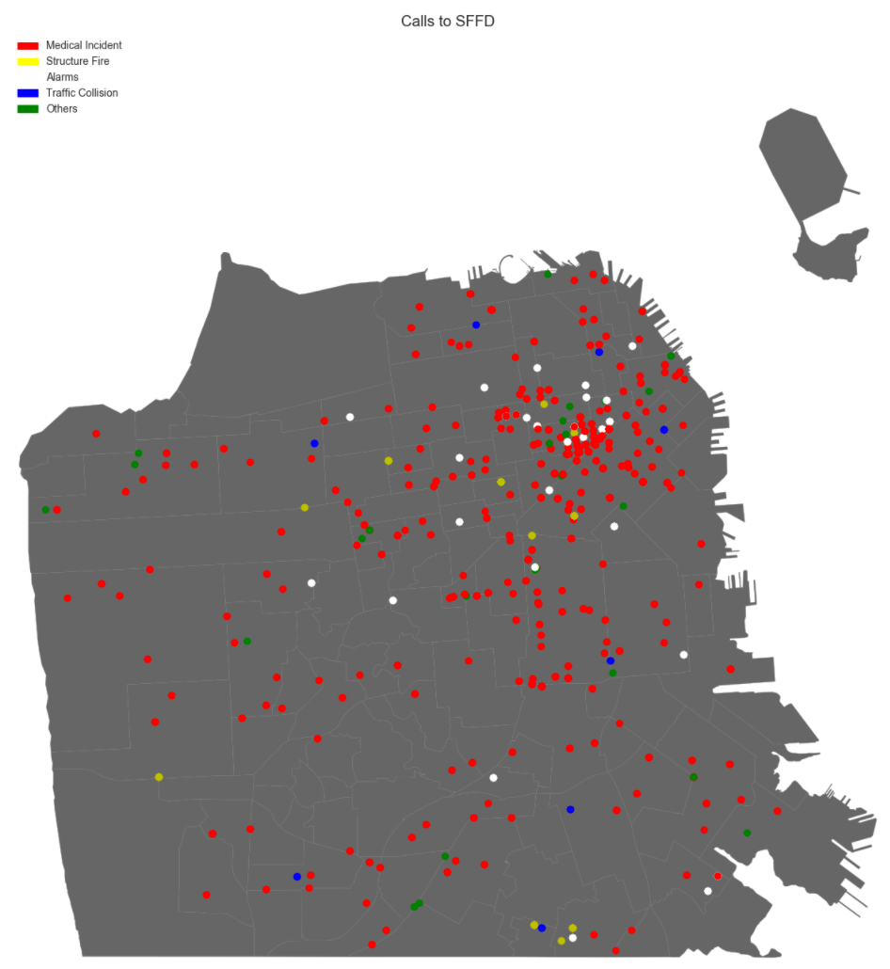
GEOCODING
Converted String Addresses to Latitude-Longitude using pygeocoder library
Figure shows the map of San Francisco and its neighborhood boundaries
Colored dots on the map are the majority types of calls assigned to SFFD
Map shows calls for January 1st 2017
72% of calls are Medical Incidents
50% of calls are from only four neighborhoods : Tenderloin, SoMa, Mission and Financial District/SB

Slide 7
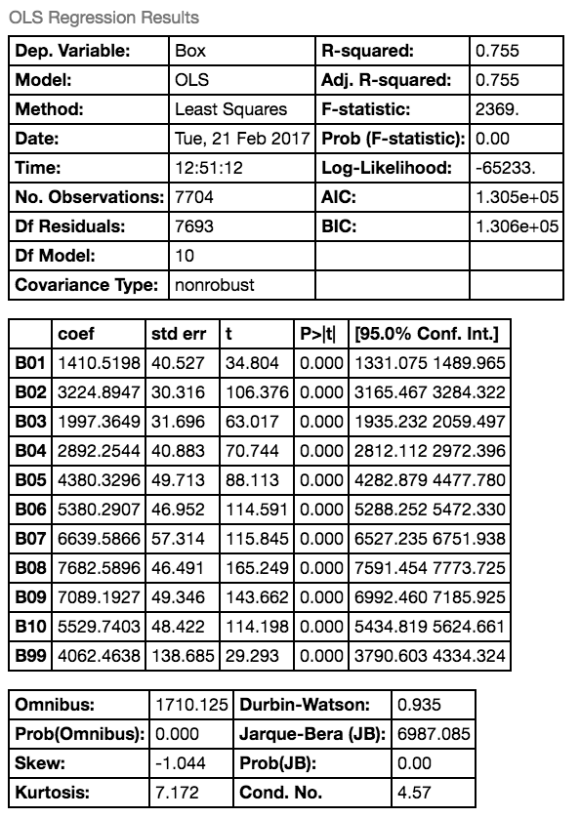

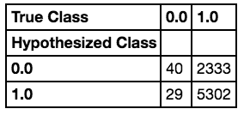
MODELING
Linear Regression and Regularization models for Box and Battalion have around 75.5% accuracy
Logistic Regression model for Medical Incidents and Battalion have around 69% accuracy

Slide 8
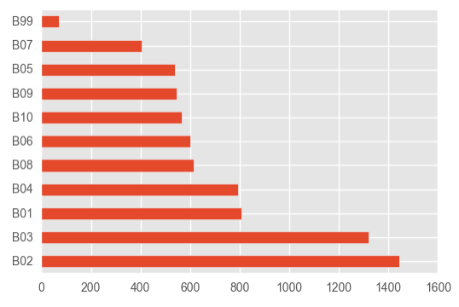
RESULTS
Time based analysis of the calls assigned to San Francisco Fire Department showed increase in calls during holidays such as New Years Eve. It also sowed less number of calls from 5am in the morning till noon
Majority of the calls are assigned to four battalions (B02, B03, B01, B04) where there are more incidents as compared to other neighborhoods.

Slide 9
CONCLUSION
Classification of call frequency based on neighborhood and time of the day describe the calls to San Francisco Fire Department.
Although Medical Incidents are the most common type of calls assigned to SFFD, predicting such incidents using Battalion has an accuracy of only 70%. Analysis with few years of call data could improve the accuracy.
Integrating call data with neighborhood data would help improvise the models.

Slide 10
REFERENCES
General Assembly course material
http://stackoverflow.com/
https://www.kaggle.com
pandas.pydata.org
seaborn.pydata.org
https://github.com/sfroid/sfcoord2nbh
http://sensitivecities.com/so-youd-like-to-make-a-map-using-python-EN.html#.WKy_6BIrKRs

Slide 11
NEXT STEPS
Incorporate more San Francisco Fire Department call Data
Analysis of Response times of calls for call type and severity of the incidents

