Slide 1
Digital Portfolio
STUDENT NAME: NIKITA BALAJI
REGISTER NO AND NMID: 2428M0032 & 1CB65FF39C22100B7D74A9E3B76D2D3C
DEPARTMENT: BSc Data Science
COLLEGE: Kumaraguru College Of Liberal Arts And Science, BHARATHIYAR UNIVERSITY

Slide 2
PROJECT TITLE
Interactive Academic Portfolio: Built with HTML & CSS

Slide 3


AGENDA
Problem Statement
Project Overview
End Users
Tools and Technologies
Portfolio design and Layout
Features and Functionality
Results and Screenshots
Conclusion
Github Link
3/21/2024 Annual Review

Slide 4

PROBLEM STATEMENT
With the shift towards digital-first solutions, there is a growing need for academic portfolios that go beyond static documents. Conventional methods are not scalable, interactive, or visually engaging, limiting the visibility of students’ accomplishments in a competitive environment.

Slide 5

PROJECT OVERVIEW
This project demonstrates the application of front-end web development skills by creating a digital portfolio with HTML and CSS. It serves as a professional platform for presenting academic records, technical expertise, and personal projects, while reflecting creativity, design thinking, and practical coding knowledge.

Slide 6

WHO ARE THE END USERS?
- Students (for showcasing achievements)
- Recruiters (for evaluating skills and projects)
- Academic institutions (for reference and validation)

Slide 7

TOOLS AND TECHNIQUES
- HTML5: Structure and content
- CSS3: Styling and design
- GitHub: Version control and hosting
- Visual Studio Code: Development environment

Slide 8
POTFOLIO DESIGN AND LAYOUT
- Clean and responsive design
- Navigation bar for easy access
- Separate sections for About Me, Projects, Skills, Achievements, Contact
- Minimalistic style focusing on readability and professionalism
8

Slide 9
FEATURES AND FUNCTIONALITY
- Responsive web design (desktop & mobile compatible)
- Organized project showcase with descriptions
- Links to GitHub repositories
- Interactive navigation for seamless user experience
- Contact section with form/links

Slide 10
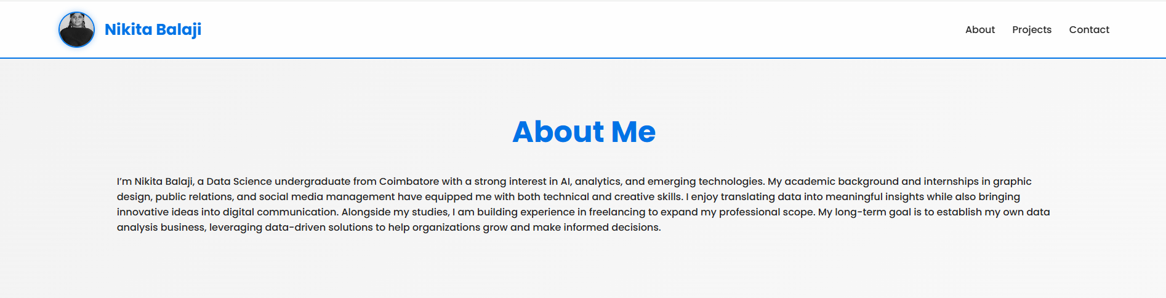
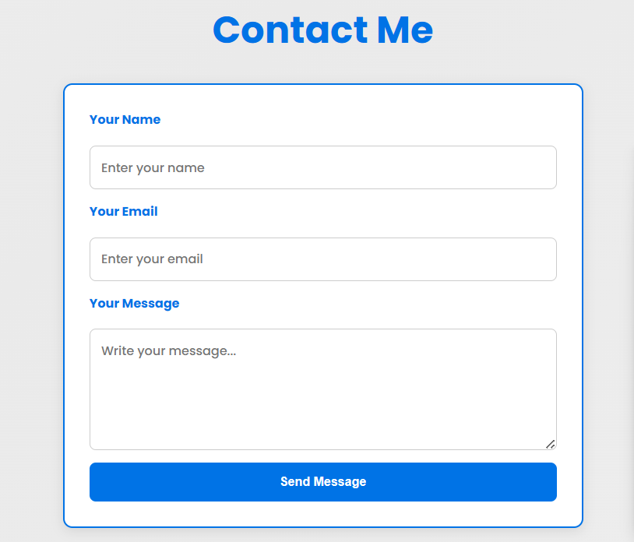
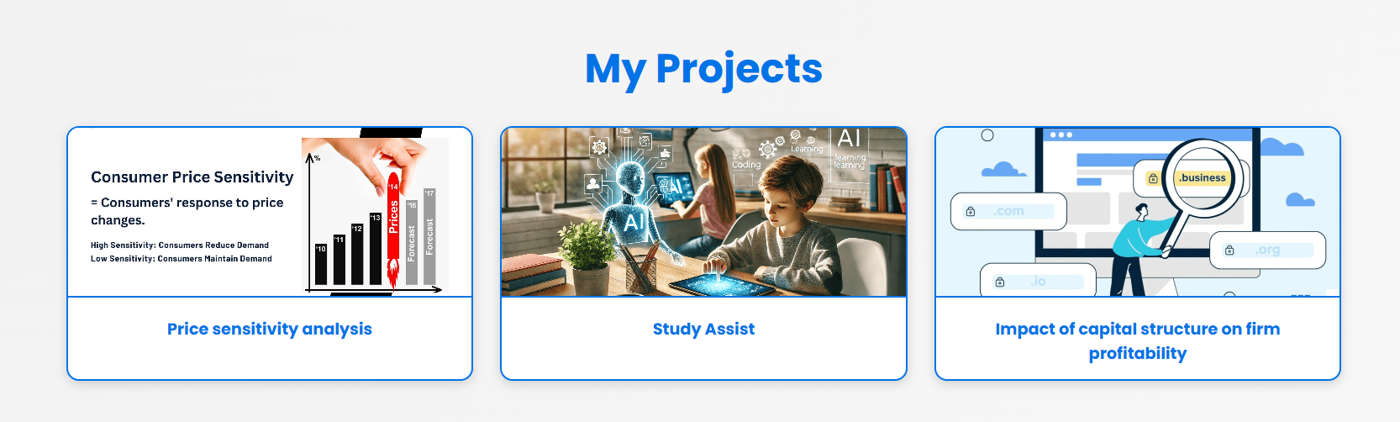

RESULTS AND SCREENSHOTS
3/21/2024 Annual Review
10

Slide 11
CONCLUSION
The digital portfolio provides an innovative and interactive platform for showcasing academic and professional milestones. It demonstrates practical application of web development skills (HTML & CSS) while improving professional visibility.
11

