Slide 1
Detecting and Classifying Toxic Comments IDS 566 – TEXT ANALYTICS
Nikita Bawane – 661069000
Ritu Gangwal - 670646774
Utkarsh Ujwal - 659563520

Slide 2
AGENDA
Overview and Motivation
Dataset Description and feature engineering
LDA and Topic Modelling
Sentiment Analysis
Vector Featurization and Model Evaluation
Future Considerations

Slide 3
OVERVIEW AND MOTIVATION
The threat of abuse and harassment online means that many people stop expressing themselves and give up on seeking different opinions. Platforms struggle to effectively facilitate conversations, leading many communities to limit or completely shut down user comments.
The background for the problem originates from the multitude of online forums, where-in people participate actively and make comments. As the comments sometimes may be abusive, insulting or even hate-based, it becomes the responsibility of the hosting organizations to ensure that these conversations are not of negative type.
The task was thus to build a model which could make prediction to classify the comments into various categories.
Understanding the problems:
Given a group of sentences or paragraphs, used as a comment by a user in an online platform, classify it to belong to one or more of the following categories — toxic, severe-toxic, obscene, threat, insult or identity-hate with either approximate probabilities or discrete values (0/1).
Task was to figure out whether the data belongs to zero, one, or more than one categories out of the six listed above, the first step before working on the problem was to distinguish between multi-label and multi-class classification.
We have a multi-label classification problem to solve. The next step was to gain some useful insights from data which would aid further problem solving.

Slide 4
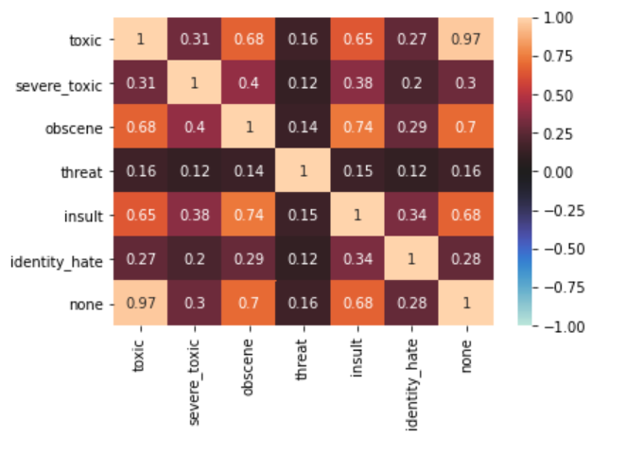
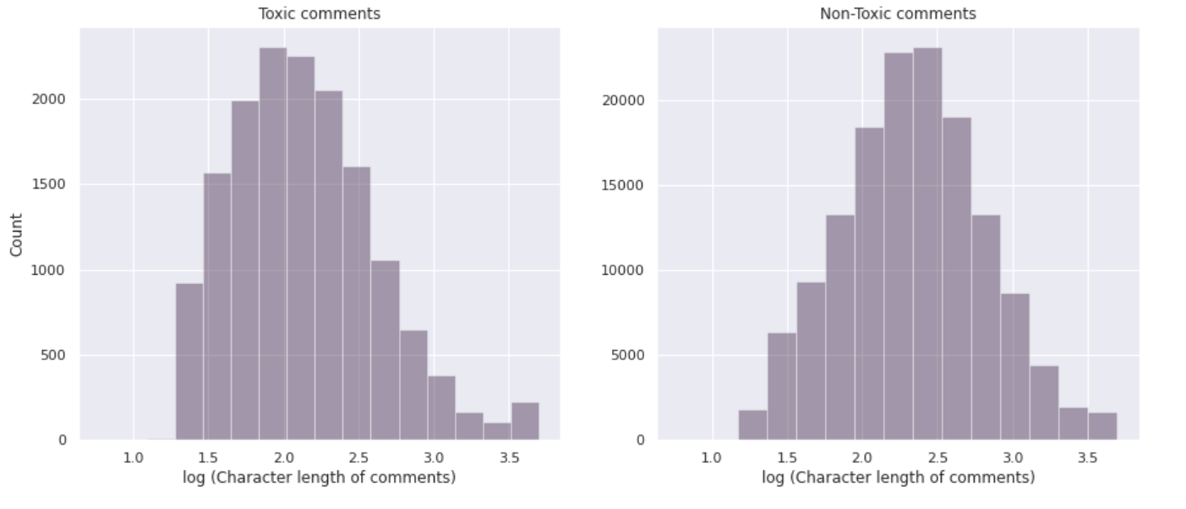
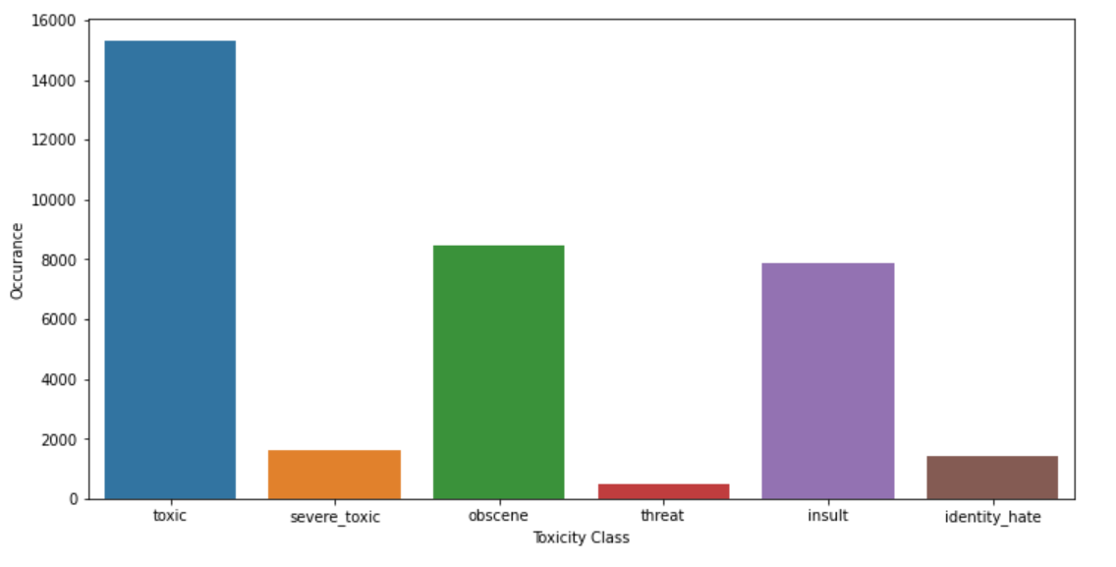
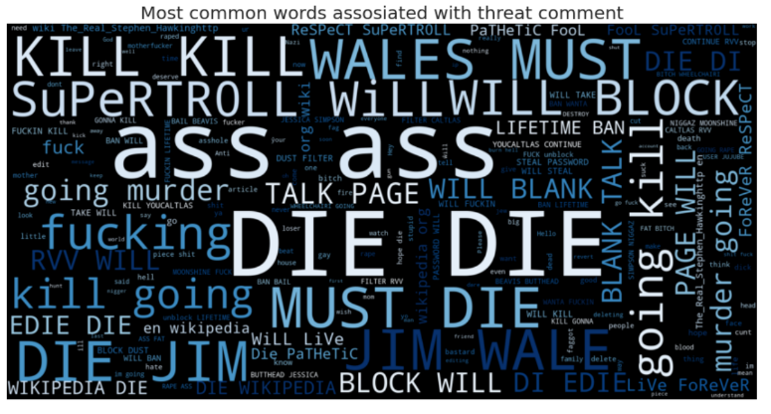
DATASET DESCRIPTION AND FEATURE ENGINEERING
Train dataset -159,571 comments and test dataset – 153,164 comments
The dataset contains comments and six toxic labels i.e. output labels namely - toxic, severe-toxic, obscene, threat, insult, identity-hate.
Out of total 159571 comments 16225 are Toxic and 143346 are Nontoxic.
People tend to use CAPITAL LETTERS while being toxic.
Individuals don’t tend to follow grammar rules or unique words while spewing toxicity.
There is a significant usage of !!! when someone is trying to show “not nice” emotions

Slide 5
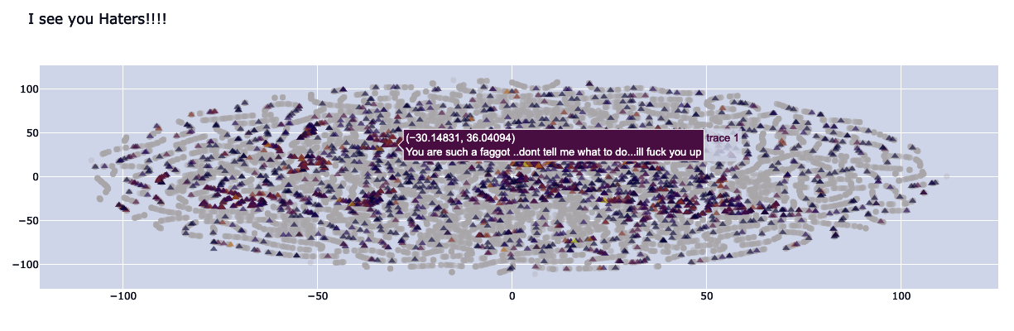
TOPIC MODELING USING LDA
Topic modelling is one of the forms of unsupervised Clustering algorithm that segregates large corpus, while it preserves statistical relationships that help in classification. The goal is to uncover latent(hidden) variables that govern document semantics, and these hidden variables represent different abstract topics.
To discover hidden themes in the collection of data
Using classification, summarize the documents
One of the most used techniques for topic modelling is Latent Dirichlet Allocation (LDA). With LDA models, the document is represented as a mixture of random latent topics, where every topic has been characterized by their distribution over words.
Comment Distribution using T-SNE and Plotly:
This is the distribution of comments from the dataset via Plotly and t-SNE.
The darker the color the more labels a comment checks.
t-SNE is basically an unsupervised, non-linear technique used for visualizing high dimensional data

Slide 6
Sentiment Analysis Below is the data mining process we have used in our sentiment analysis as our initial step:
Implementation
Data Analysis
Moved forward with TextBlob as its accuracy is high.
Removed all the positive sentiments comments and reduced our training set to 37072 lines.
Calculated sentiment score of a particular comment by using TextBlob and Vedar algorithms.
Accuracy of TextBlob: = 77.37%
Accuracy of Vader: = 73.58%
Data Pre-processing
HTML decoding of the data is performed using Beautiful Soup.
The tokenizer correctly handled URLs, common emoticons, phone numbers, punctuations and hashtags, repetition of symbols.
Removed the stop words, perform POS tagging, lemmatizing .
Data Extraction
Data source = Kaggle Jigsaw Toxic comment classification challenge
Output Data
Pre-processed Data
Input Data

Slide 7
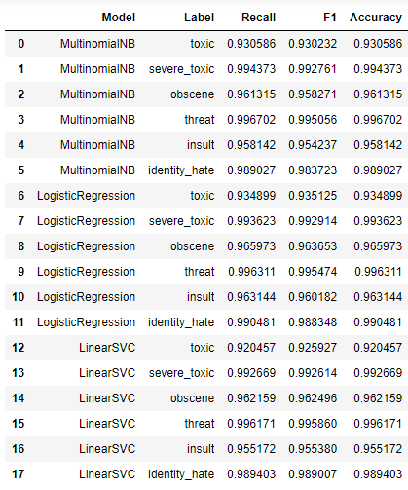
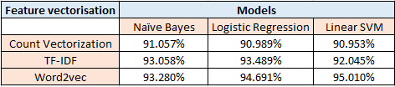
Vector Featurization and Model Evaluation
Designed various machine learning models using Count vectorization, TF-IDF and Word2Vec.
TF-IDF Test Results
Based on the cross validation above, we noticed both i.e., the linear SVC model and Logistic Regression models perform good.
Multinomial Naive Baye model is used as our baseline and it does not perform well for the threat label and identity_hate labels as seen in the table above. This is because these two labels have the least number of observations.
On comparing the accuracies on the test data for toxic label across all the three feature vectorizations as shown in the table below, we found that Word2Vec - SVM has the highest accuracy and performs better as compared to other two features.

Slide 8
Conclusion and Future Scope
Limitations : Unable to classify sarcastic comments or sentences containing swear words but is in fact not toxic.
Future Scope:
a). We would like to implement sentiment analysis by NRC dictionary which can further quantify our sentiments and help in proper toxic comment classification.
b). We also recommend a proposal to improve the NLP classifiers by using other algorithms such as Convolutional Neural Networks (CNN) and test their performances against different LSTM models.
c). We suggest using kernel SVM for text processing and text classification if after visualising the decision boundary, it comes out to be non linear. It requires a grid search for hyper-parameter tuning to get the best results.

Slide 9

THANK YOU &
Don’t be TOXIC!!!!!! ☺

