Slide 1
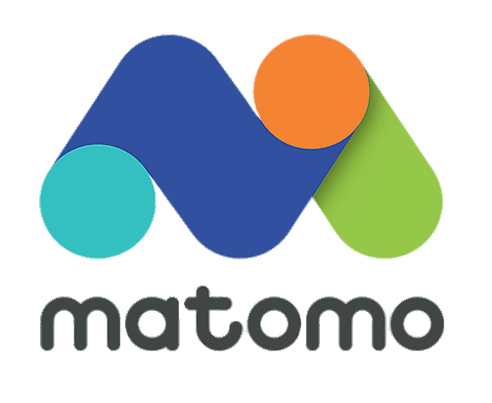

Matomo: An Open-Source Web Analytics Tool
Nikita Belii
12/01/2024
ISM 4420
https://assets.stickpng.com/images/62bc721e071dec17849af318.png

Slide 2
Introduction
What is Matomo?
Matomo is a popular open-source web analytics platform. It helps businesses track and analyze website traffic while giving them full control over their data.
Why Matomo?
Unlike tools like Google Analytics, Matomo focuses on user privacy and ensures compliance with regulations like GDPR. It’s a great option for companies that want detailed analytics but don’t want to share their data with third parties.
Quick Facts:
Open-source and self-hosted options available.
Over 1 million websites use Matomo worldwide.

Slide 3
Launch Date/Year
When was Matomo launched?
Matomo was first launched in 2007 under the name Piwik.
The journey from Piwik to Matomo:
In 2018, Piwik was rebranded as Matomo to reflect its commitment to providing more transparency and privacy-focused analytics.
Fun Fact:
The name "Matomo" means “honesty” in Japanese, highlighting its focus on data privacy and user trust.

Slide 4
Customer Target Market
Who uses Matomo?
Matomo is used in a wide range of industries, but it’s especially popular among organizations that prioritize data privacy.
Key Target Markets:
Healthcare and Finance: Industries with strict privacy regulations (e.g., GDPR, HIPAA).
Government Agencies: Needing full ownership and control of analytics data.
Small to Medium-Sized Businesses (SMBs): Seeking affordable yet powerful web analytics.
Nonprofits and Educational Institutions: Often attracted to its open-source and customizable nature.
Why it appeals to these industries:
Matomo allows organizations to track and analyze data without sharing it with third-party companies, making it a top choice for privacy-conscious users.

Slide 5
Free Trial and pricing
Does Matomo offer a free trial?
Yes! Matomo provides a 21-day free trial for its Cloud version, giving you full access to all features without needing a credit card.
How to Get Started:
Sign up on the Matomo website.
Enter your details—no payment required.
Explore the Cloud features risk-free!
How much does Matomo cost?
Matomo offers two main pricing options:
Cloud Version: Starts at $23/month (for up to 50,000 pageviews). Pricing scales with traffic.
Self-Hosted Version: Free to download and use.
Additional costs may include hosting fees and optional premium add-ons (like heatmaps).
Which option should you choose?
Go with Cloud if you want a hassle-free setup.
Opt for Self-Hosting if you need total control over your data.

Slide 6
Installation Process
How do you set up Matomo?
Matomo offers two installation options: Cloud and Self-Hosted.
Cloud Version:
No installation required.
Sign up, configure your settings, and start using analytics immediately.
Self-Hosted Version:
Download Matomo: Get the software from matomo.org.
Upload Files: Upload the Matomo files to your web server.
Create a Database: Set up a MySQL database on your server.
Run the Installer: Access Matomo in your browser and follow the guided setup.
Install Tracking Code: Copy and paste the Matomo tracking code into your website's HTML.
Which option to choose?
Cloud: Quick and easy setup, better for non-technical users.
Self-Hosted: Offers complete control over data but requires technical knowledge.

Slide 7
Clickstream Analysis Metrics
What is Clickstream Analysis?
Clickstream analysis tracks how users interact with a website, such as the pages they visit, the order they navigate, and how long they spend on each page.
Matomo's Clickstream Metrics:
Pageviews: Total number of pages viewed by visitors.
Unique Visitors: Counts each visitor only once, no matter how many pages they visit.
Session Duration: Measures how long visitors stay on your site.
Bounce Rate: Percentage of visitors who leave after viewing only one page.
Traffic Sources: Shows where your visitors come from (e.g., search engines, social media).
Entry and Exit Pages: Tracks which pages visitors enter and leave your site.
Why it matters:
These metrics help businesses identify popular pages, improve user navigation, and reduce bounce rates.

Slide 8
Real-Time Reporting
Does Matomo provide real-time reporting?
Yes! Matomo offers real-time analytics that lets you monitor visitor activity as it happens.
Real-Time Metrics Provided:
Live Visitors: Shows how many people are currently on your site.
Pages Viewed: Tracks which pages are being visited in real time.
Current Location: Provides geographic data about active visitors.
Referrals: Identifies the sources bringing live visitors to your site (e.g., social media, direct links).
Real-Time Goals: Tracks conversions, such as form submissions or downloads, as they happen.
Why is real-time reporting useful?
Helps monitor the effectiveness of campaigns instantly.
Quickly identifies performance issues on your site.

Slide 9
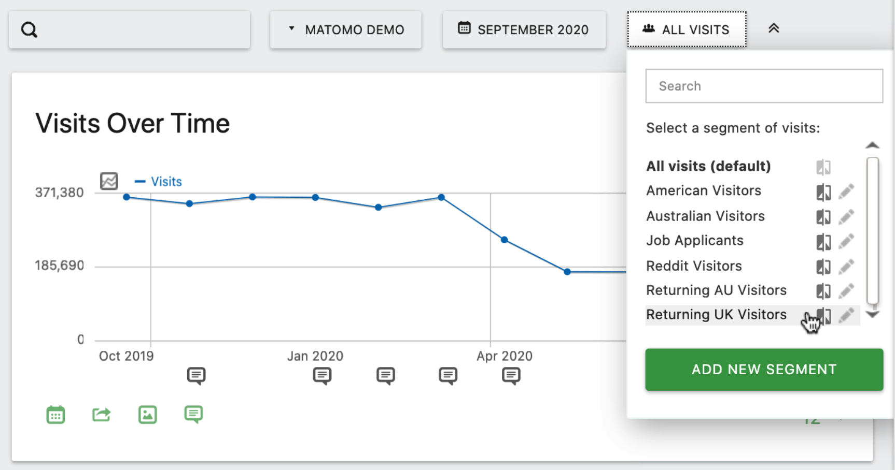
Report Segmentation
Does Matomo support report segmentation?
Yes, Matomo offers robust segmentation capabilities to filter and analyze data more effectively.
What is Report Segmentation?
It’s the ability to divide website analytics into smaller, meaningful groups based on specific criteria (e.g., device type, traffic source, location).
Examples of Segmentation in Matomo:
By Device: Desktop vs. mobile visitors.
By Traffic Source: Search engines, direct traffic, or social media.
By Location: Insights by country, state, or city.
By User Behavior: New vs. returning visitors.
How does it help?
Better understand specific audience groups.
Tailor marketing strategies for different customer segments.
https://matomo.org/faq/reporting-tools/working-with-segments-apply-update-delete-email-reports/

Slide 10
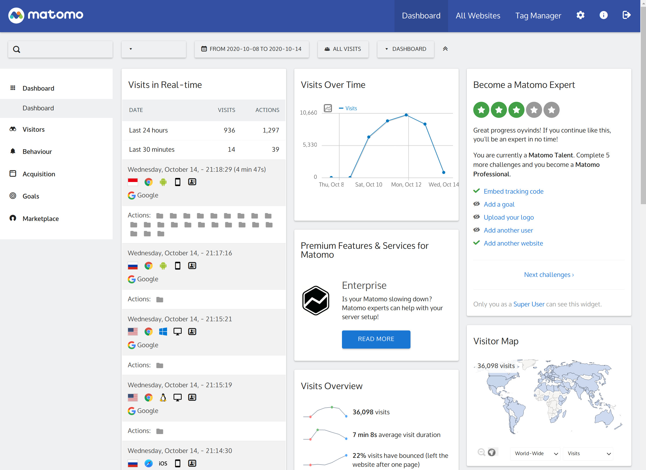
Dashboard Features
What does the Matomo dashboard offer?
The Matomo dashboard is highly customizable, allowing users to focus on the metrics that matter most.
Key Features:
Customizable Widgets: Choose from a variety of widgets like visitor maps, traffic sources, or goals.
Drag-and-Drop Layout: Rearrange widgets to create a personalized view.
Real-Time Updates: See live data directly on your dashboard.
Multi-Dashboard Support: Create multiple dashboards for different teams or projects.
Common Widgets Available:
Traffic overview.
Goal conversion rates.
Visitor location map.
Search engine referrals.
https://linuxreviews.org/images/e/ed/Matomo_dashboard_-_default_2020-09-14.jpg

Slide 11
Unique Features
What makes Matomo unique?
Matomo stands out with features that prioritize privacy, control, and flexibility, making it a strong alternative to tools like Google Analytics.
Key Unique Features:
Open-Source Software:
Self-hosted option lets you fully control your data.
Customize the tool to meet specific business needs.
Privacy by Design:
Fully GDPR and HIPAA compliant.
No data sharing with third parties.
No Data Sampling:
Unlike Google Analytics, Matomo doesn’t approximate your data.
Provides full and accurate datasets.
Heatmaps and Session Recording (Add-On):
Visualize user behavior with heatmaps.
Replay visitor sessions to analyze their navigation.
E-Commerce Tracking:
Advanced tools for tracking product views, cart actions, and conversions.
Why it matters:
Matomo offers peace of mind for organizations that prioritize privacy while providing detailed insights.

Slide 12
Usability
How easy is it to use Matomo?
Matomo is designed to be user-friendly and accessible, whether you’re a technical expert or a beginner.
Key Usability Features:
Intuitive Interface:
Clean layout with clear navigation menus.
Simple, customizable dashboards make it easy to access the metrics you need.
Extensive Documentation:
Detailed guides, FAQs, and tutorials are available on the Matomo website.
CMS Integration:
Seamlessly integrates with popular platforms like WordPress, Drupal, and Joomla.
No Coding Skills Required:
Tracking can be set up with just a copy-paste of the tracking code.
Responsive Design:
Works well on both desktop and mobile devices.
Why it’s accessible:
Matomo’s self-hosted version offers flexibility for developers, while its Cloud version is perfect for non-technical users who want quick results.

Slide 13
advantages
Drawbacks
Technical Setup for Self-Hosting:
Requires technical skills for installation and maintenance.
Add-On Costs:
Features like heatmaps are paid extras.
High Costs for Large Traffic (Cloud):
Pricing for Cloud scales significantly with traffic volume.
Learning Curve:
Customization and advanced features may take time to master.
Full Data Ownership:
Your data stays private, ensuring security and compliance with privacy laws.
Privacy-Focused:
Fully GDPR and HIPAA compliant.
Customizable and Flexible:
Open-source software allows for full customization.
Affordable for Small Businesses:
Free self-hosted version and scalable Cloud pricing.
Accurate Data:
No data sampling; complete datasets for better decision-making.

Slide 14
Search Engine Optimization (SEO)
Can Matomo be used for SEO?
Yes! Matomo includes several features that make it a useful tool for improving search engine performance.
Key SEO Features in Matomo:
Keyword Tracking:
Analyze which keywords drive the most traffic to your website.
Search Engine Reports:
Identify top-performing search engines for your site.
Page Performance:
Track how individual pages rank and perform in search results.
Search Query Data:
Insights into what visitors are searching for on your site.
SEO Add-Ons (Optional):
Paid integrations that enhance SEO reporting and analysis.
How does this help?
These features allow businesses to optimize their content for search engines, improve rankings, and attract more organic traffic.

Slide 15
References
Matomo Official Website:
https://matomo.org
Matomo Pricing Page:
https://matomo.org/pricing
Matomo Features and Documentation:
https://matomo.org/features
Matomo Community Forums:
https://forum.matomo.org
Third-Party Reviews and Case Studies:
TechRadar Review: https://www.techradar.com
Capterra Review: https://www.capterra.com

