Slide 1
FAKE NEWS DETECTION USING ML UNDER GUIDANCE OF DR.PRAVIN FUTANE SIR HEAD OF DEPARTMENT AND PROFESSOR ,INFORMATION TECHNOLOGY
Mangesh Myadamwar(331032)
Rushika Solankar(331054)
Stuti Wali(331063)
Nikita Dara(331071)
Prajwal Suryavanshi(331066)

Slide 2

What is our project?
What is Input to it?
What is Output to it?

Slide 3
Confusion Matrix :
It is a table that describes performance of classification model on set of test data for which the true values are known.
Ex:
COVID 19 (Binary predictions in Yes/No)
Total patients : 165
Real Data :
Covid Yes=105 Patients
No Covid =60 Patients
ML Predicted data :
Covid Yes = 110 Patients
No Covid = 55 Patients
Total Patients (165) | Predicted NO | Predicted Yes
Actual NO | 50 | 10
Actual Yes | 5 | 100

Slide 4
Components of Confusion matrix :
True Positive(TP)
In this case we predicted yes and those have covid.
True Negative(Tn)
In this case we prdicted no and they don’t have covid
False Positive(FP)
In this case we predicted yes but actually they don’t have covid.
False Negative(FN)
In this case we predicted no but actually they have covid.

Slide 5
Total Patients (165) | Predicted NO | Predicted Yes
Actual NO | TN=50 | FP=10 | 60
Actual Yes | FN=5 | TP=100 | 105
 | 55 | 110
Total Patients (165) | Predicted NO | Predicted Yes
Actual NO | TN=50 | FP=10
Actual Yes | FN=5 | TP=100

Slide 6
Calculations :
Accuracy (TP+TN)/Total=(100+50)/165=0.91
Error rate (FP+FN)/Total=(10+5)/165=0.09
TP rate TP/Actual yes=100/105=0.95
FP rate FP/Actual no=10/60=0.17
TN rate TN/Actual no=50/60=0.83
Precision TP/Predict yes=100/110=0.91
Total Patients (165) | Predict NO | Predict Yes
Actual NO | TN=50 | FP=10 | 60
Actual Yes | FN=5 | TP=100 | 105
 | 55 | 110

Slide 7
Workflow
Loading library and dataset
Visualizing and processing dataset
Dataset splitting as train and val
Confusion Matrix
Applying text feature extraction
Test trained model from val dataset
Training ML model
Applying ML Algo

Slide 8
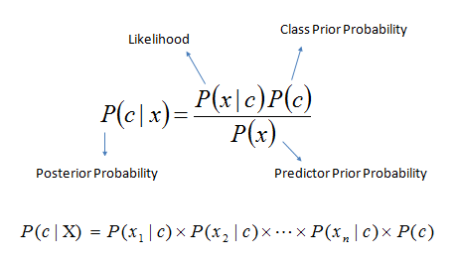
naive BAYES – ML ALGORITHM
Naive Bayes are mostly used in Natural Language processing(NLP) problems.Naive Bayes predit the tag of a text.
Bayes theorem calculate probability P(c|x).
Stopword - These are common word that don’t
really add anything to classification like able ,either,else .ever ,so on.
Stemming - Stemming to take out the root of work.
Example | Positive / Negative
“ilikethemovie” | POSITIVE
“itsagoodmovienicestory” | POSITIVE
“nicesongbutsadlyboringend” | NEGATIVE

Slide 9
Feature Extraction in Text
Count Vectorizer
Tfidf Vectorizer

Slide 10
Thank you

