Slide 1
Player Selection
Presented By:
Nikita Deshmukh
3/4/2019

Slide 2
Problem Statement
How can you make the team from the number of players?
Proposed System:
In this System we can add the players, add the games ,select the players for p
articular game by their skills also we can make the team of only girls or only boys.
Also we can select the player using there id.

Slide 3
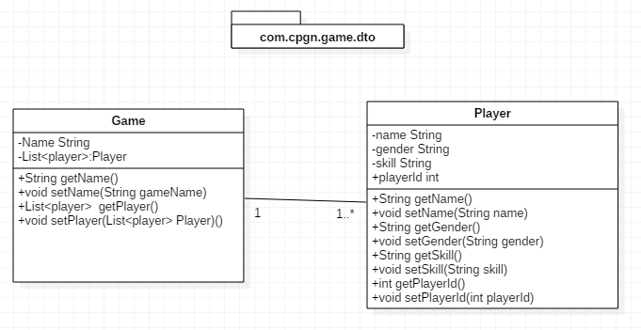
Pojo Classes

Slide 4
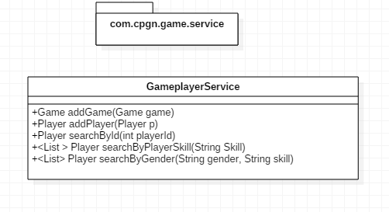
Service Interface

Slide 5
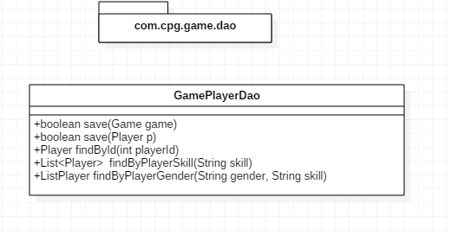
Repository Interface

Slide 6
Thank You

