Slide 1
morphological analysis
Computational linguistics
Nikita Dilip Girase
Roll No : 63

Slide 2
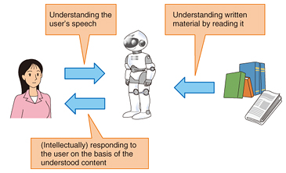
Introduction to NLP
The computers and human being deals with each other using NLP.

Slide 3


Slide 4
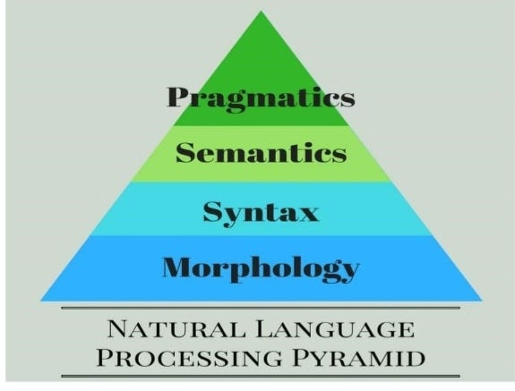
Steps IN NLP

Slide 5
Morphological analysis
Morphological analysis is a field of linguistics that studies the structure of words.
It identifies how a word is produced through the use of morphemes.
A morpheme is a basic unit of the English language.
The morpheme is the smallest element of a word that has grammatical function and meaning.

Slide 6
Morphological analysis is important in NLP because it allows for more accurate text processing and analysis. For example, it can be used to identify the tense of a verb or the plurality of a noun, which is essential for accurate language understanding.
There are various techniques used for morphological analysis in NLP.
One common technique is stemming, which involves removing the suffixes from a word to reduce it to its root form. Another technique is lemmatization, which involves reducing a word to its base or dictionary form, or lemma.
Morphological analysis is a crucial aspect of many NLP tasks, such as information retrieval, text classification, and machine translation. It helps NLP models to understand the nuances of language and accurately process text data.

Slide 7
Examples
Board ,pen
Showcase ,cocktail
ing

Slide 8
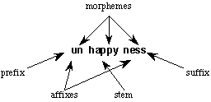
Morphemes
Smallest meaning bearing units constituting a word.
Morphemes
1)stem → tree, go ,fat
2)Affixes → a)Pre --> (postpone)
b)Suf --> based
Example: un-happy-ness

Slide 9

Types of Morphology:
1.Inflectional Morphology
2.Derivational Morphology:

Slide 10
Inflectional morphology
Inflectional morphology is the study of the processes that distinguish the forms of words in certain grammatical categories. This includes processes such as affixation and vowel change, which create inflectional morphemes.
An inflectional morpheme is a suffix that’s added to a word to assign a particular grammatical property to that word, such as its number, mood, tense, or possession.
However, an inflectional morphology can never change the grammatical category of a word.
Example : cat → cats ,law -> lawyer

Slide 11
Derivational morphology
Derivational morphology is the study of the formation of new words that differ either in syntactic category or in meaning from their bases.
Thus, a derivational morpheme is an affix we add to a word in order to create a new word or a new form of a word.
Example : danger-> danger+ous

Slide 12
Disadvantages :
Complexity: Morphological analysis can be quite complex, especially when analyzing languages with complex morphology. This complexity can make it difficult to learn and apply in practical situations.
Time-consuming: Morphological analysis can be time-consuming, especially when analyzing large bodies of text. This can make it impractical in situations where time is a constraint.
Limited scope: Morphological analysis focuses on the structure and meaning of individual morphemes, which can be limiting in understanding the overall meaning and context of a word.
Requires expertise: Morphological analysis requires expertise and knowledge of the language being analyzed. Without this expertise, it can be challenging to apply morphological analysis effectively.
Limited application: Morphological analysis is most effective when analyzing inflectional languages, such as Latin or Russian. It may not be as effective when analyzing languages with simpler morphology, such as English.
Ambiguity: Morphological analysis can be ambiguous in cases where a word can have multiple meanings or can be inflected in different ways, leading to potential misinterpretation.

