Slide 1

Machine learning III
“Deep Learning Training Workflow”
Name : Girase Nikita dilip
Roll no. :63

Slide 2
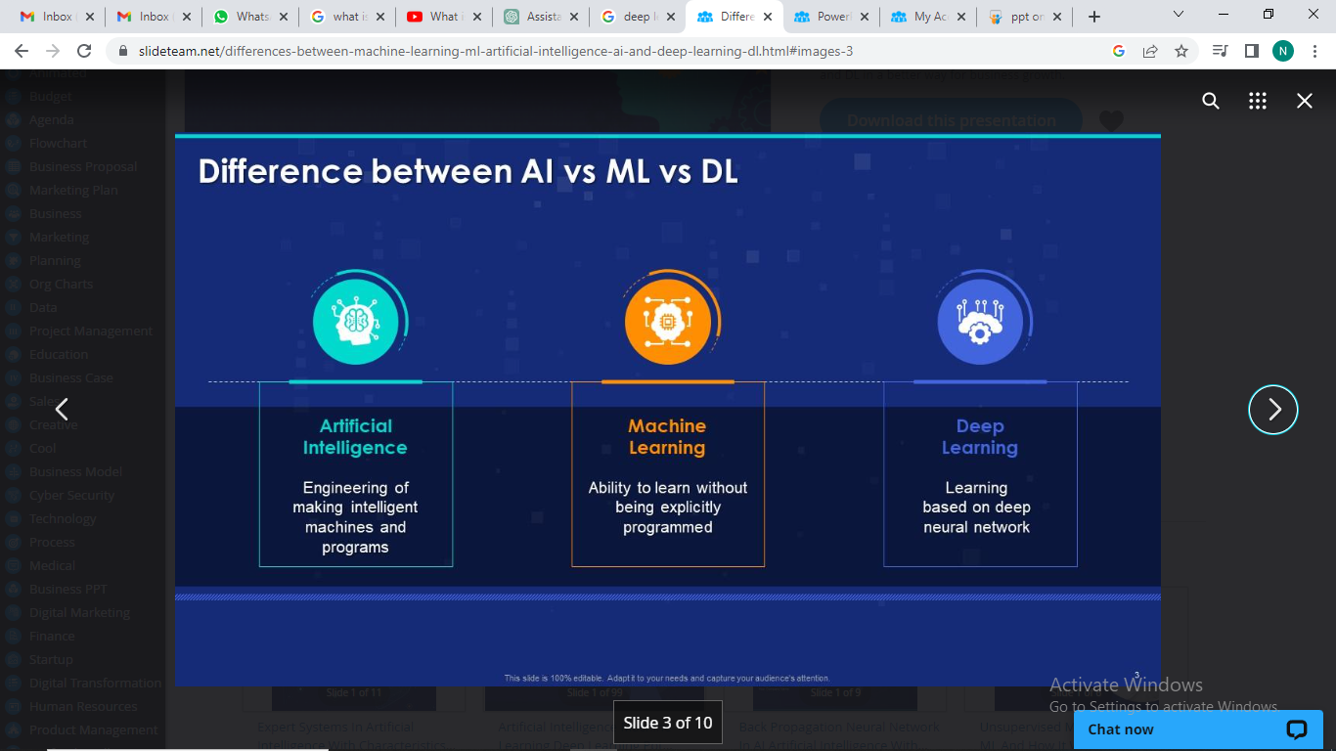

Slide 3
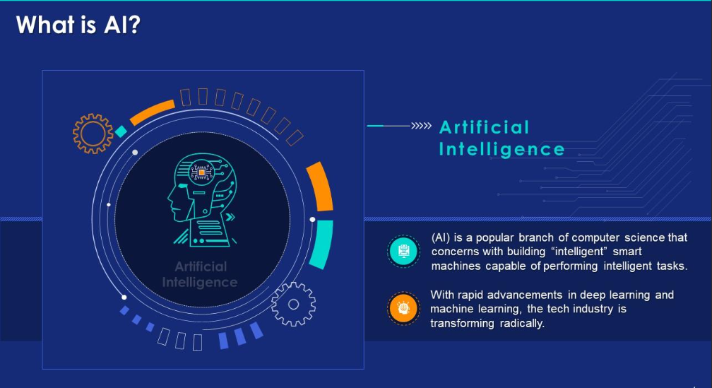

Slide 4
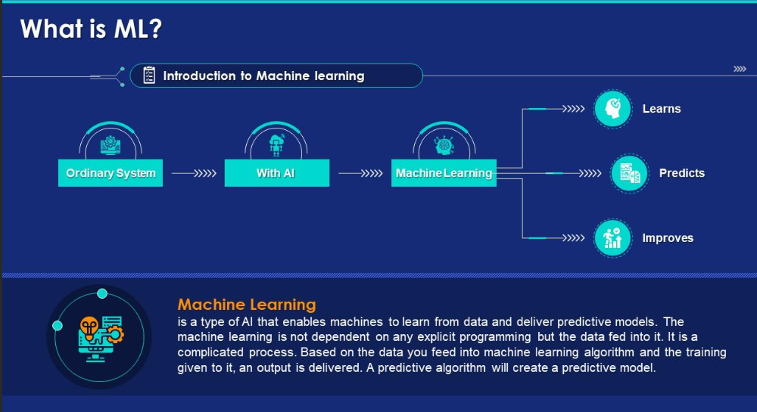

Slide 5
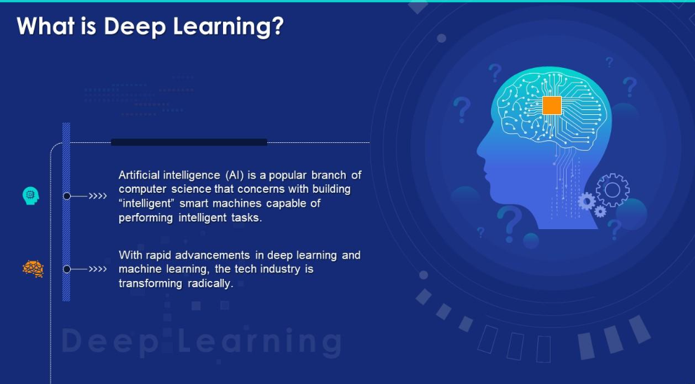

Slide 6
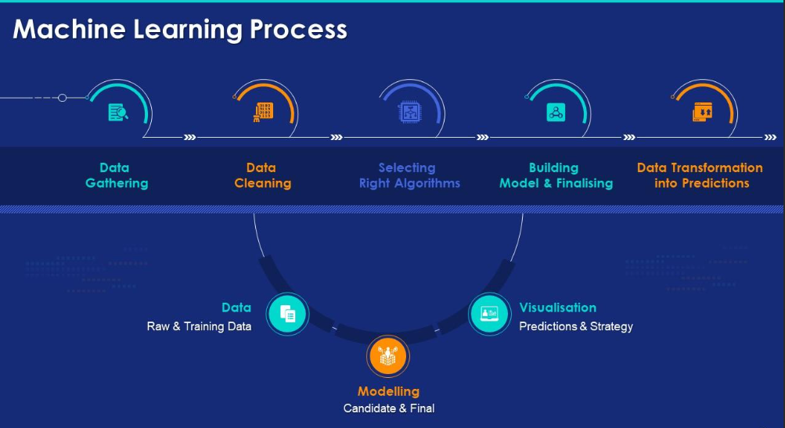

Slide 7
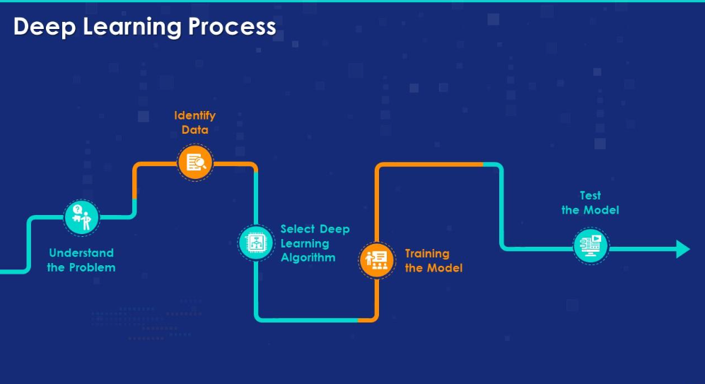

Slide 8
