Slide 1

Machine learning III
“Deep Learning Training Workflow”
Name : Girase Nikita dilip
Roll no. :63

Slide 2
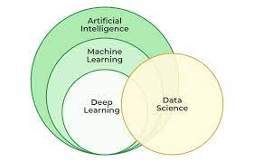
Deep Learning
Deep learning is a machine learning technique that teaches computers to do what comes naturally to humans: learn by example.
Deep learning is a key technology behind driverless cars, enabling them to recognize a stop sign.
In deep learning, a computer model learns to perform classification tasks directly from images, text, or sound.

Slide 3

The deep learning workflow has seven primary components:
Acquiring data
Preprocessing
Splitting and balancing the dataset
Building and training the model
Evaluation
Hyperparameter tuning
Deploying our solution (For Industry)

Slide 4

1. Acquiring Data

Slide 5

2. Pre-processing

Slide 6

3. Splitting and Balancing the Dataset

Slide 7

4. Building and Training the Model

Slide 8

5. Evaluating Performance

Slide 9
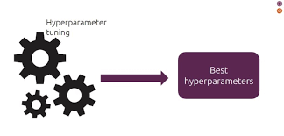
6. Tuning Hyperparameters

Slide 10

7. Deployment (For Industry)

