Slide 1
Thresholding
Image Processing and Computer Vision
Nikita Dilip Girase
Roll No : 63

Slide 2
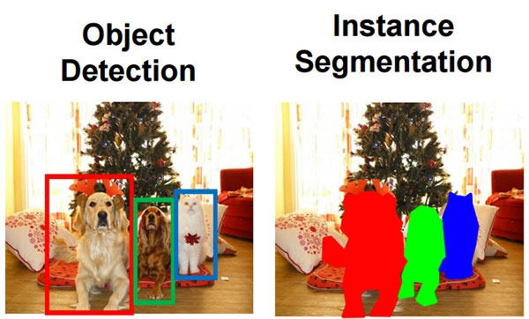
Image Segmentation
Image segmentation involves converting an image into a collection of regions of pixels that are represented by a mask or a labeled image.
By dividing an image into segments, you can process only the important segments of the image instead of processing the entire image.

Slide 3
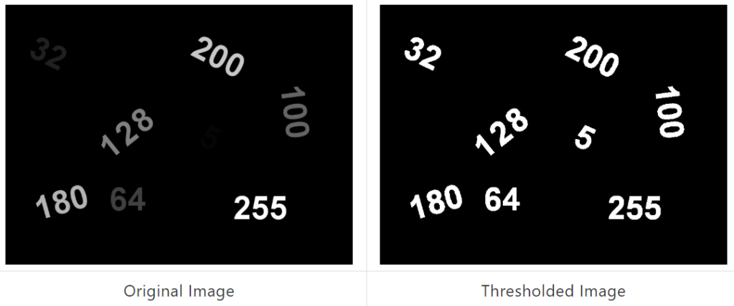
Thresholding
Thresholding plays a very important role in segmentation this make a difference between the object and background of image.
Image thresholding is a simple, yet
effective, way of partitioning an image
into a foreground and background.
Both having different intensity, so we
Can differentiate

Slide 4
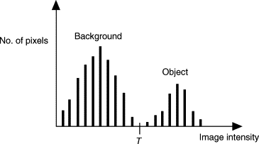
Thresholding can be define as:
1)Single level Thresholding
2)Multi level Thresholding

Slide 5
Single level Thresholding
Suppose that a image f(x,y),has light object on a dark background. If we draw histogram of this type of image ,it will have two dominant modes of grey levels.
One group near to 0 : dark background
One group maximum : light Object
So at any point (x,y), if
f(x,y) > T , it called object
f(x,y) < T , it called background

Slide 6
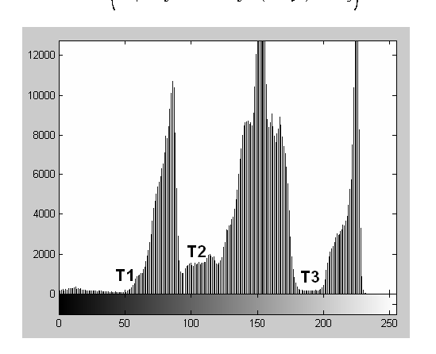
Multi level Thresholding
Now, let us consider that 3 dominant modes of the image histogram for two types of light object and dark background.
This is called multilevel thresholding because we have used more than one threshold for separation of an image information.

Slide 7
Types of Thresholding
Global thresholding: if thresholding (Th) depend upon only the grey level of image.
Local Thresholding: if thresholding (Th) depend upon only the grey level of image and some local properties also.
Adaptive Thresholding: When thresholding depends upon grey level, local properties and spatial co-ordinates of pixels. This is also called Dynamic thresholding

