Slide 1
Mutual Fund Analytics Platform
Project at a Glance
40
87K+
End-to-End Data Engineering, ETL Pipeline & Interactive Dashboard
Fund Schemes
Data Rows
Author: Nikita Gaikwad Role: Data Analyst Intern Company: Bluestock Fintech Pvt. Ltd. Duration: 7 Days | June 2026 Tools: Python, SQL, Power BI
10
4.5 Yrs
Datasets
NAV History
4
6
Dashboard Pages
Risk Metrics
BLUESTOCK FINTECH

Slide 2
Problem Statement & Objectives
Problems We Solve
Project Objectives
P1
Data Fragmentation
O1
Build automated ETL pipeline from AMFI data
NAV, AUM, SIP data scattered across AMFI website in different formats
O2
Design normalised 5-table SQLite star schema
P2
Performance Gap
No unified platform to compare funds on risk-adjusted basis
O3
Perform comprehensive EDA on 87K+ rows
P3
No Benchmark Tracking
O4
Compute Sharpe, Sortino, Alpha, Beta, VaR
Retail investors can't see if their fund beats Nifty 50
O5
Build 4-page interactive Power BI dashboard
P4
Investor Blind Spot
Analyse investor transaction demographics
Limited visibility into demographic & geographic SIP patterns
O6
O7
Compare fund returns vs benchmark indices
P5
Slow Reporting
Static monthly PDFs — no live self-service dashboards
O8
Document & present the complete platform
2 / 12

Slide 3
Data Sources & Dataset Inventory
#
Dataset
Size
Description
01
fund_master
40 rows
40 real mutual fund schemes with metadata
02
nav_history
46,000 rows
Daily NAV Jan 2022 to May 2026
03
aum_by_fund_house
90 rows
Quarterly AUM for 10 fund houses
04
monthly_sip_inflows
48 rows
Month-wise SIP inflow data
05
category_inflows
144 rows
Net inflows by fund category
06
industry_folio_count
21 rows
Total MF folios by type
07
scheme_performance
40 rows
Risk-return metrics per scheme
08
investor_transactions
32,000 rows
SIP, Lumpsum, Redemption transactions
09
portfolio_holdings
322 rows
Top equity holdings per fund
10
benchmark_indices
8,050 rows
Nifty 50, Nifty 100, BSE SmallCap daily
Sources: AMFI India | mfapi.in | NSE India | BSE India
3 / 12

Slide 4
System Architecture & ETL Pipeline
EXTRACT
TRANSFORM
LOAD
ANALYSE
VISUALISE
AMFI India CSVs
Pandas cleaning
SQLite database
Jupyter EDA
Power BI 4 pages
mfapi.in REST API
→
Forward-fill NAV
→
Star schema design
→
Risk metrics
→
Slicers & filters
NSE/BSE Bhavcopy
Compute returns
CSV flat-file backup
Fund Scorecard
PDF + PNG export
4 / 12
Star Schema: dim_fund | dim_date | fact_nav | fact_transactions | fact_performance

Slide 5
EDA Highlights — Industry & AUM Analysis
₹81L Cr
₹31,002 Cr
26.12 Cr
9.35 Cr
Industry AUM Dec 2025
SIP Inflow Dec 2025
Total Folios Dec 2025
Active SIP Accounts
Key EDA Findings
AUM Growth:
Industry AUM grew 2x from Rs.30L Cr (2022) to Rs.62L Cr (2025) — consistent upward trend
SBI Dominance:
SBI Mutual Fund leads with Rs.12.5L Cr AUM, followed by ICICI Pru (Rs.10.7L Cr) and HDFC (Rs.9.3L Cr)
SIP Milestone:
SIP inflows crossed Rs.31,002 Cr in Dec 2025 — an all-time high reflecting India's equity culture
Category Mix:
Liquid funds show highest inflows (green in heatmap), Small Cap funds show highest returns but volatility
Folio Growth:
Total folios doubled from 13.26 Cr (2022) to 26.12 Cr (2025) — mass retail participation
5 / 12

Slide 6
EDA Highlights — Investor Behaviour Analysis
Transaction Type Split
Age Group vs Avg SIP Amount
Lumpsum 58.49%
56+
₹10,800
Redemption 35.34%
46-55
₹10,600
SIP 6.17%
26-35
₹10,400
State-wise Insights
18-25
₹10,200
Punjab
36-45
₹10,100
Tamil Nadu
Key Insight: 56+ age group invests most per SIP. Lumpsum dominates transactions at 58.49%.
Madhya Pradesh
Rajasthan
Gujarat
6 / 12

Slide 7
Fund Performance Metrics
CAGR
Sharpe
Sortino
(NAV_end/NAV_start)^(1/n)-1
(Rp-Rf)/Std(Rp)×√252
(Rp-Rf)/Downside_Std
Annualised return
Return per unit risk
Downside risk-adjusted
Alpha
Beta
Max DD
Fund Return - Benchmark
OLS Slope vs Nifty100
min(NAV/RunMax-1)
Excess over benchmark
Market sensitivity
Worst peak-to-trough
Risk-free rate (Rf) = 6.5% p.a. (RBI repo rate proxy) | Annualised using √252 trading days
7 / 12

Slide 8
Fund Scorecard — Top 10 Rankings
Composite Score = 30% × 3yr Return + 25% × Sharpe + 20% × Alpha + 15% × Expense Ratio (inv.) + 10% × Max DD (inv.)
Rank
Scheme Name
Score
3yr Return
Sharpe
Category
1
ICICI Pru Midcap Fund - Regular
73.62
18.08%
0.95
Equity
2
HDFC Top 100 - Direct Plan
61.00
13.38%
0.96
Equity
3
DSP Midcap Fund - Regular
59.81
17.16%
0.90
Equity
4
HDFC Mid-Cap Opps - Regular
59.13
16.58%
0.87
Equity
5
Kotak Emerging Equity - Regular
59.13
18.23%
0.96
Equity
6
SBI Small Cap - Direct Plan
56.62
22.38%
0.90
Equity
7
Mirae Asset Large Cap - Regular
55.00
14.81%
1.06
Equity
8
ABSL Small Cap - Regular
56.62
22.38%
0.90
Equity
9
Nippon India Large Cap - Direct
55.00
14.84%
0.96
Equity
10
UTI Flexi Cap Fund - Regular
53.00
15.18%
0.80
Equity
8 / 12

Slide 9
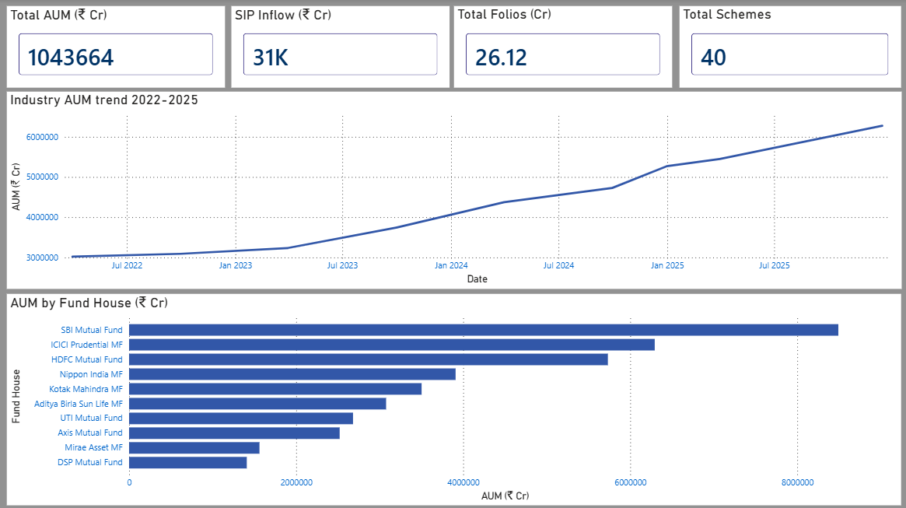
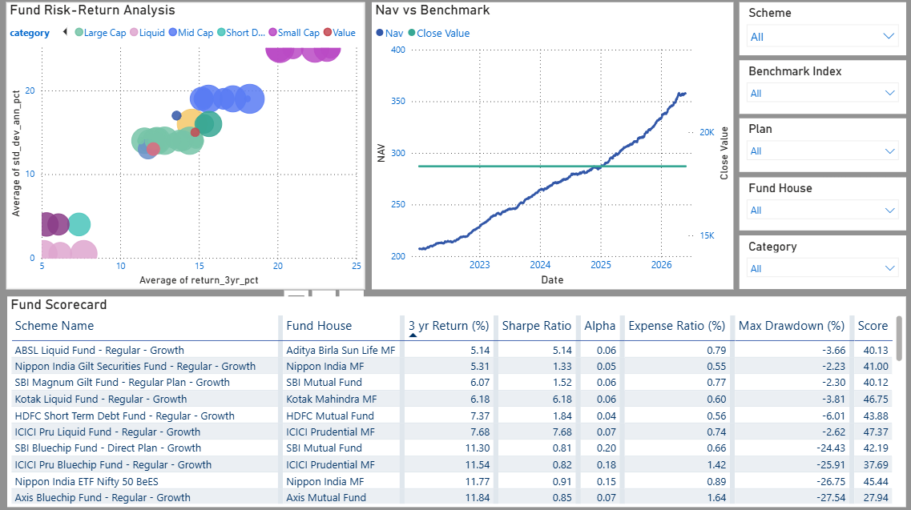
Power BI Dashboard — Pages 1 & 2
Page 1 — Industry Overview
Page 2 — Fund Performance
9 / 12

Slide 10
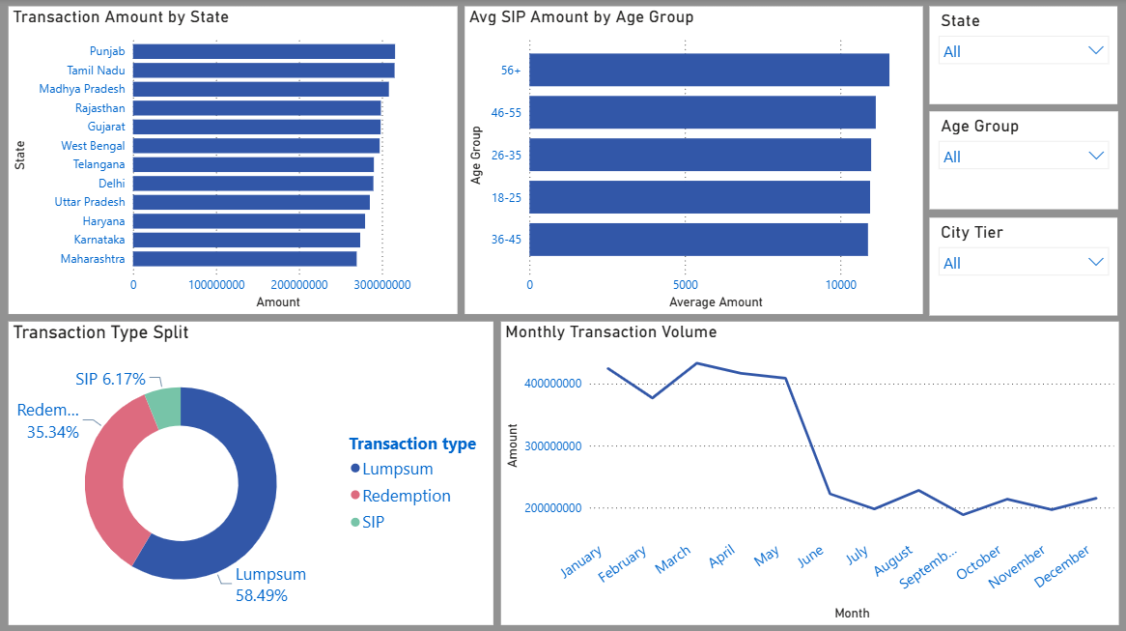
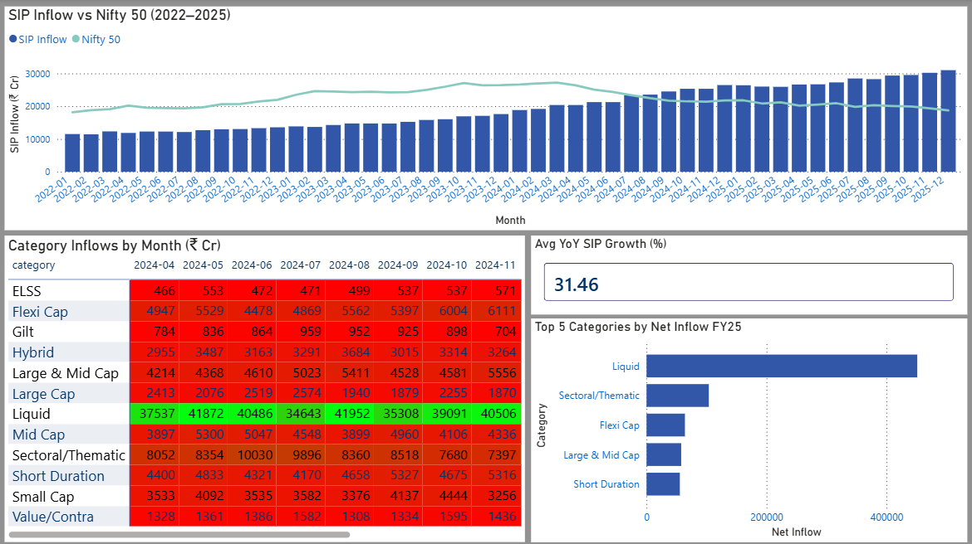
Power BI Dashboard — Pages 3 & 4
Page 3 — Investor Analytics
Page 4 — SIP & Market Trends
10 / 12

Slide 11
Key Findings & Insights
01
Top Performer
02
Highest Risk
ICICI Pru Midcap ranks #1 in Fund Scorecard with composite score 73.62
Small Cap funds carry max risk — ABSL Small Cap VaR = -2.39% daily
03
SIP At-Risk
04
AUM Leader
97.8% of investors (1,332/1,362) show gaps >35 days — critical retention issue
SBI Mutual Fund dominates with Rs.12.5L Cr — largest AMC in India
05
Concentration
06
Liquid Dominance
Axis Bluechip most concentrated (HHI 2,967); UTI Mid Cap most diversified (1,240)
Liquid funds show highest category inflows — risk-averse investor preference
BLUESTOCK FINTECH | MUTUAL FUND ANALYTICS CAPSTONE | JUNE 2026

Slide 12
Thank You
Nikita Gaikwad | Data Analyst Intern | Bluestock Fintech Pvt. Ltd.
Project Details
GitHub:
https://github.com/nikitagaikwad0111/Bluestock-MF-Capstone.git
Technologies:
Python | SQL | Power BI | Pandas | Matplotlib | SciPy
Data Source:
AMFI India | mfapi.in | NSE India | BSE India
Duration:
7 Working Days | June 2026
All data sourced from publicly available AMFI India, NSE & BSE. For educational purposes only.

