Slide 1
Database Management System
Learner
Session 01: Introduction to Database Management Systems
C3: Protected
Notes:
Enter the course title.
Enter the knowledge level that will be addressed through this course.

Slide 2

About the Author
Created By: | Prasanna Barani - 128673
Credential Information: | Has 5.8 yrs of experience in Data warehousing
Version and Date: | V 2.1 – 2/11/2010
Cognizant Certified Official Curriculum
Notes:
The Course Metadata screen displays data about the content. Metadata is nothing but data about data. This screen displays various information such as course owner, credential information, copyrights and so on.
First, enter the associate name or the vendor who created the training presentation and the associate id in the Created By row.
Second, briefly state credentials of the creator in the training area; or, why participants should listen to you. For example, if the training is on Java, the credential could be:
Sun Certified Java Programmer
5 yrs of experience in Java, EJB, Java Beans, JDBC etc.
Finally, enter the current version number and the corresponding date of the training presentation. For example, if this the first release then enter 1.0. and January 1, 2004 for Date.

Slide 3







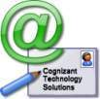

Icons Used
Hands on Exercise
Questions
Tools
Coding Standards
Test Your Understanding
Reference
A Welcome Break
Contacts
Try it Out

Slide 4
Introduction to Database Management Systems Session [01]: Overview
Introduction: This session gives a brief overview of the entire Database Management System (DBMS)

Slide 5
Introduction to Database Management Systems :Session [01]: Objective
Objective:
After completing this chapter, you will be able to:
Explain the need for a database
Explain the File-based systems
Define database and DBMS
Explain some of the features of the DBMS
Identify the usage of database
Notes:
The session objectives will contain the list of learning objectives in a bulleted list

Slide 6
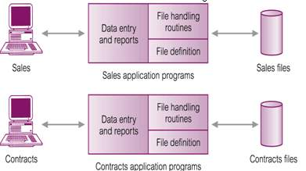
File—Based Systems
Earlier organizations were storing data as part of File Systems which is a collection of application programs that perform services for the end users
Each program defines and manages its own data
Notes:
This is the content slide. Enter the content for the topic in this slide. Ensure that comprehensive speaker notes are available for each slide.

Slide 7
Limitations of File—Based Approach
The limitations of the file—based approach are:
Separation and isolation of data
Duplication of data
Data dependence
Incompatible file formats
Fixed Queries/Proliferation of application programs
Notes:
This is the content slide. Enter the content for the topic in this slide. Ensure that comprehensive speaker notes are available for each slide.

Slide 8
Database Systems
A database (DB) is a collection of inter-related computer files, whose data contents and structure are described in a data dictionary and which are under the control of a Database Management System (DBMS)
A DBMS is a software system that enables users to define, create, maintain, and control access to the database
Notes:
This is the content slide. Enter the content for the topic in this slide. Ensure that comprehensive speaker notes are available for each slide.

Slide 9
Database Management Systems
Database is a shared collection of logically related data (and a description of this data), designed to meet the information needs of an organization
System catalog (metadata) provides description of data to enable program – data independence
Logically related data comprises entities, attributes, and relationships of an organization’s information
Notes:
This is the content slide. Enter the content for the topic in this slide. Ensure that comprehensive speaker notes are available for each slide.

Slide 10
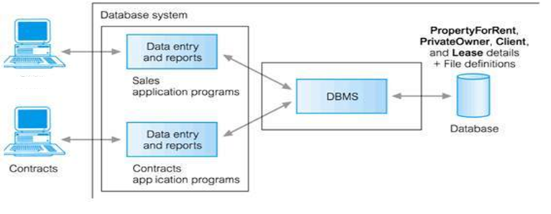
Database Management Systems (Contd.)
The figure illustrates the Database approach where Sales and Contracts departments are using their application programs to access the database through the DBMS:
Sales
Contracts application programs
Notes:
This is the content slide. Enter the content for the topic in this slide. Ensure that comprehensive speaker notes are available for each slide.

Slide 11
Database Systems
A database system consists of:
The database (data)
A DBMS (software)
A DDL and a DML (Part of the DBMS)
Application programs
Notes:
This is the content slide. Enter the content for the topic in this slide. Ensure that comprehensive speaker notes are available for each slide.

Slide 12
Features of Database Systems
Following are the features of Database System:
Self-describing nature of a database system
Insulation between programs and data
Data abstraction
Support of multiple views of the data
Sharing of data and multi-user transaction processing
Centralized data management
Data independence
Systems integration
Notes:
This is the content slide. Enter the content for the topic in this slide. Ensure that comprehensive speaker notes are available for each slide.

Slide 13
Database Users
Database Administrators
Database Designers
End-users: Following are the categories of End-users
Casual
Naïve or Parametric
Sophisticated
Stand-alone
Notes:
This is the content slide. Enter the content for the topic in this slide. Ensure that comprehensive speaker notes are available for each slide.

Slide 14

Questions from participants
Notes:
This is the content slide. Enter the content for the topic in this slide. Ensure that comprehensive speaker notes are available for each slide.

Slide 15
Test Your Understanding
What are the main drawbacks of File-Based Systems?
What do you mean by data inconsistency?
What is the role of a database designer?
Notes:
Pls. provide the answers for the questions.

Slide 16
Introduction to Database Management Systems Session [01]: Summary
Database approach emerged mainly because:
The definition of data was embedded in application programs, rather than being stored separately and independently
There was no control over access and manipulation of data beyond that imposed by application programs
Notes:
This is the content slide. Enter the content for the topic in this slide. Ensure that comprehensive speaker notes are available for each slide.

Slide 17
Introduction to Database Management Systems Session [01]: Source
Thomas Connolly and Carolyn Begg, “Database Systems – A Practical Approach to Design, Implementation and Management” , Pearson Education , 4th Edition
Elmasri and Navathe, “Fundamentals of Database Systems”, Pearson Education Edition, 4th Edition
Disclaimer: Parts of the content of this course is based on the materials available from the Web sites and books listed above. The materials that can be accessed from linked sites are not maintained by Cognizant Academy and we are not responsible for the contents thereof. All trademarks, service marks, and trade names in this course are the marks of the respective owner(s).

Slide 18
<List the sources from where you have taken the content for this session. This could be books, Web sites, or articles>
You have completed the Session 1 of Introduction to Database Management Systems.
Notes:
Enter the course title.
Enter the knowledge level that will be addressed through this course.

