Slide 1
Database Management System Learner
Session 04: Introduction to Data Modeling
C3: Protected
Notes:
Enter the course title.
Enter the knowledge level that will be addressed through this course.

Slide 2

About the Author
Created By: | Prasanna Barani - 128673
Credential Information: | Has 5.8 yrs of experience in Data warehousing
Version and Date: | V 2.1 – 2/11/2010
Cognizant Certified Official Curriculum
Notes:
The Course Metadata screen displays data about the content. Metadata is nothing but data about data. This screen displays various information such as course owner, credential information, copyrights and so on.
First, enter the associate name or the vendor who created the training presentation and the associate id in the Created By row.
Second, briefly state credentials of the creator in the training area; or, why participants should listen to you. For example, if the training is on Java, the credential could be:
Sun Certified Java Programmer
5 yrs of experience in Java, EJB, Java Beans, JDBC etc.
Finally, enter the current version number and the corresponding date of the training presentation. For example, if this the first release then enter 1.0. and January 1, 2004 for Date.

Slide 3









Icons Used
Hands on Exercise
Questions
Tools
Coding Standards
Test Your Understanding
Reference
A Welcome Break
Contacts
Try it Out

Slide 4
Introduction to Data Modeling session [4]: Overview
Introduction: This session explains the steps in the database design as well as the conceptual design using Entity-Relationship (ER) Modeling concepts

Slide 5
Introduction to Data Modeling Session [4]: Objectives
Objective:
After completing this session, you will be able to:
  Explain the steps involved in the database designing process
  Design a conceptual database using the ER Model
Notes:
The session objectives will contain the list of learning objectives in a bulleted list

Slide 6
Database Design Process
Steps in the database design process:
  Requirements collection and analysis phase
  Conceptual database design (uses ER Model)
  Logical database design (Relational Data Model)
  Physical database design
Notes:
This is the content slide. Enter the content for the topic in this slide. Ensure that comprehensive speaker notes are available for each slide.

Slide 7
Requirements Collection and Analysis Phase
Requirements collection and analysis phase is the process of collecting and analyzing information about the part of organization that is to be supported by the database system, and using this information to identify users’ requirements of new system
Information is gathered for each major user view including:
  A description of data used or generated
  Details of how data is to be used or generated

Slide 8
Conceptual Database Design
Conceptual database design refers to the process of constructing a model of the data used in an enterprise, independent of all physical considerations
Data model is built using the information in users’ requirements specification document
Conceptual data model is the source of information for logical design phase
Notes:
This is the content slide. Enter the content for the topic in this slide. Ensure that comprehensive speaker notes are available for each slide.

Slide 9
Conceptual Database Design (Contd.)
Logical database design refers to the process of constructing a model of the data used in an enterprise, based on a specific data model (such as relational), but independent of a particular DBMS and other physical considerations
Physical database design refers to the process of producing a description of the database implementation on the secondary storage. It describes base relations, file organizations, and indexes that are used to achieve efficient access to data
Notes:
This is the content slide. Enter the content for the topic in this slide. Ensure that comprehensive speaker notes are available for each slide.

Slide 10
ER Model
A database can be modeled as:
  A collection of entities
  Relationship among entities
An entity is an existing object that is distinguishable from other objects
An entity set is a set of entities of the same type that share the same properties
An entity is represented by a set of attributes; the descriptive properties possessed by all members of an entity set
Notes:
This is the content slide. Enter the content for the topic in this slide. Ensure that comprehensive speaker notes are available for each slide.

Slide 11
Attributes
Types of attributes:
  Simple and composite attributes
  Single-valued and multi-valued attributes
  Null attributes
  Derived attributes
Notes:
This is the content slide. Enter the content for the topic in this slide. Ensure that comprehensive speaker notes are available for each slide.

Slide 12
Relational Keys
Types of relational keys:
  Candidate Key
  Primary Key
  Alternate Keys
  Foreign Key
Notes:
This is the content slide. Enter the content for the topic in this slide. Ensure that comprehensive speaker notes are available for each slide.

Slide 13
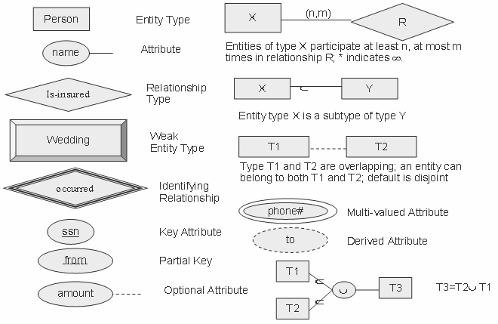
E-R Diagram Components
Notes:
Rectangles represent entity sets
Ellipses represent attributes
Diamonds represent relationship sets
Lines link attributes to entity sets and entity sets to relationship sets
Double ellipses represent multi-valued attributes
Dashed ellipses denote derived attributes
Primary key attributes are underlined

Slide 14
Allow time for questions from participants

Slide 15
Test Your Understanding
What is conceptual data modeling?
What is a candidate key and an alternate key?

Slide 16
Practice Exercise
A university database contains information about professors (identified by social security number, or SSN) and courses (identified by course id). Professors teach the courses. Each of the following situation concerns the ‘Teaches’ relationship set. For each situation, draw an ER diagram that describes it (assuming no further constraints hold):
  Professors can teach the same course in several semesters, and each offering must be recorded
  Professors can teach the same course in several semesters, and only the most recent such offering needs to be recorded(Assume this condition applies in all subsequent questions.)
  Every professor must teach some course
  Every professor teaches exactly one course (no more, no less)
Notes:
This is the content slide. Enter the content for the topic in this slide. Ensure that comprehensive speaker notes are available for each slide.

Slide 17
Introduction to Data Modeling Session[4]: Summary
Database design includes requirement analysis, conceptual database design, logical database design, and physical database design
Conceptual data modeling uses a high level data modeling concept of E-R Models

Slide 18
Introduction to Data Modeling Session[4]: Source
Thomas Connolly and Carolyn Begg, “Database Systems – A Practical Approach to Design, Implementation and Management” , Pearson Education , 4th Edition
Elmasri and Navathe, “Fundamentals of Database Systems”, Pearson Education Edition, 4th Edition
Korth, Sudarshan and Silberschatz, “Database System Concepts”, Mc Graw hill Publications, 5th Edition
Disclaimer: Parts of the content of this course is based on the materials available from the Web sites and books listed above. The materials that can be accessed from linked sites are not maintained by Cognizant Academy and we are not responsible for the contents thereof. All trademarks, service marks, and trade names in this course are the marks of the respective owner(s).

Slide 19
You have completed Session 4 of
Introduction to Data Modeling.
Notes:
Enter the course title.
Enter the knowledge level that will be addressed through this course.

