Slide 1
HOMEWORK 2
DECISION TREE

Slide 2
MY PROBLEM
CLASSIFY WHETHER OR NOT A GIVEN PERSON HAS A HEART DISEASE

Slide 3
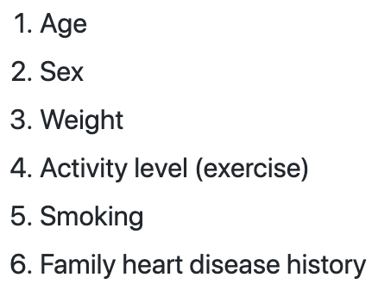
ATTRIBUTES

Slide 4
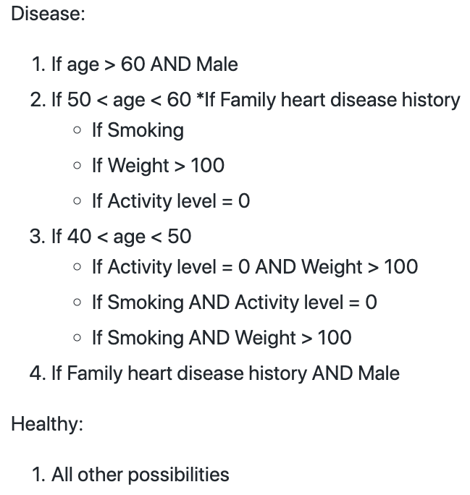
MY RULES

Slide 5
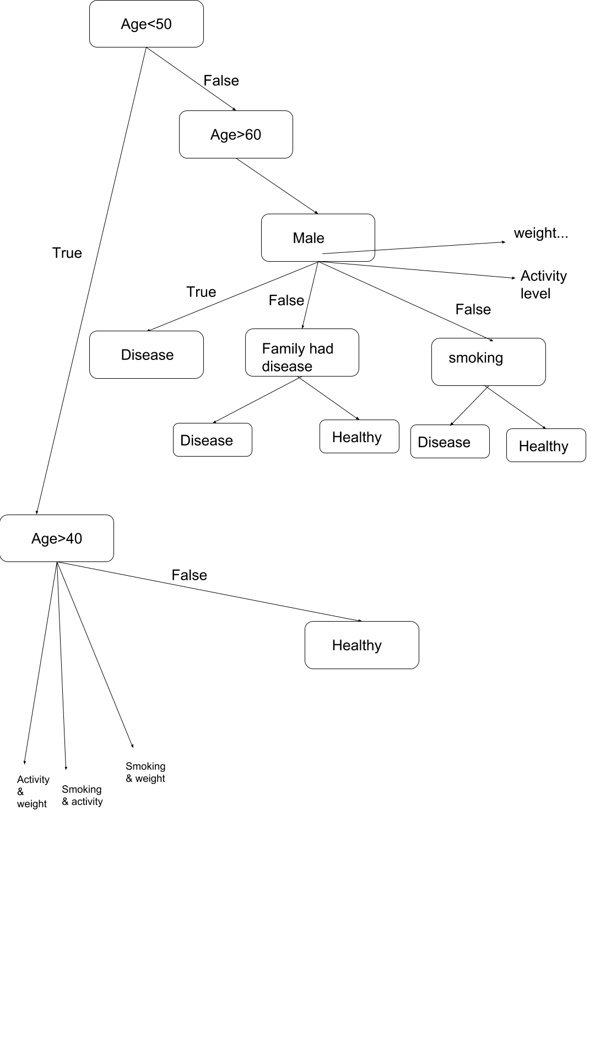
MY TREE

Slide 6
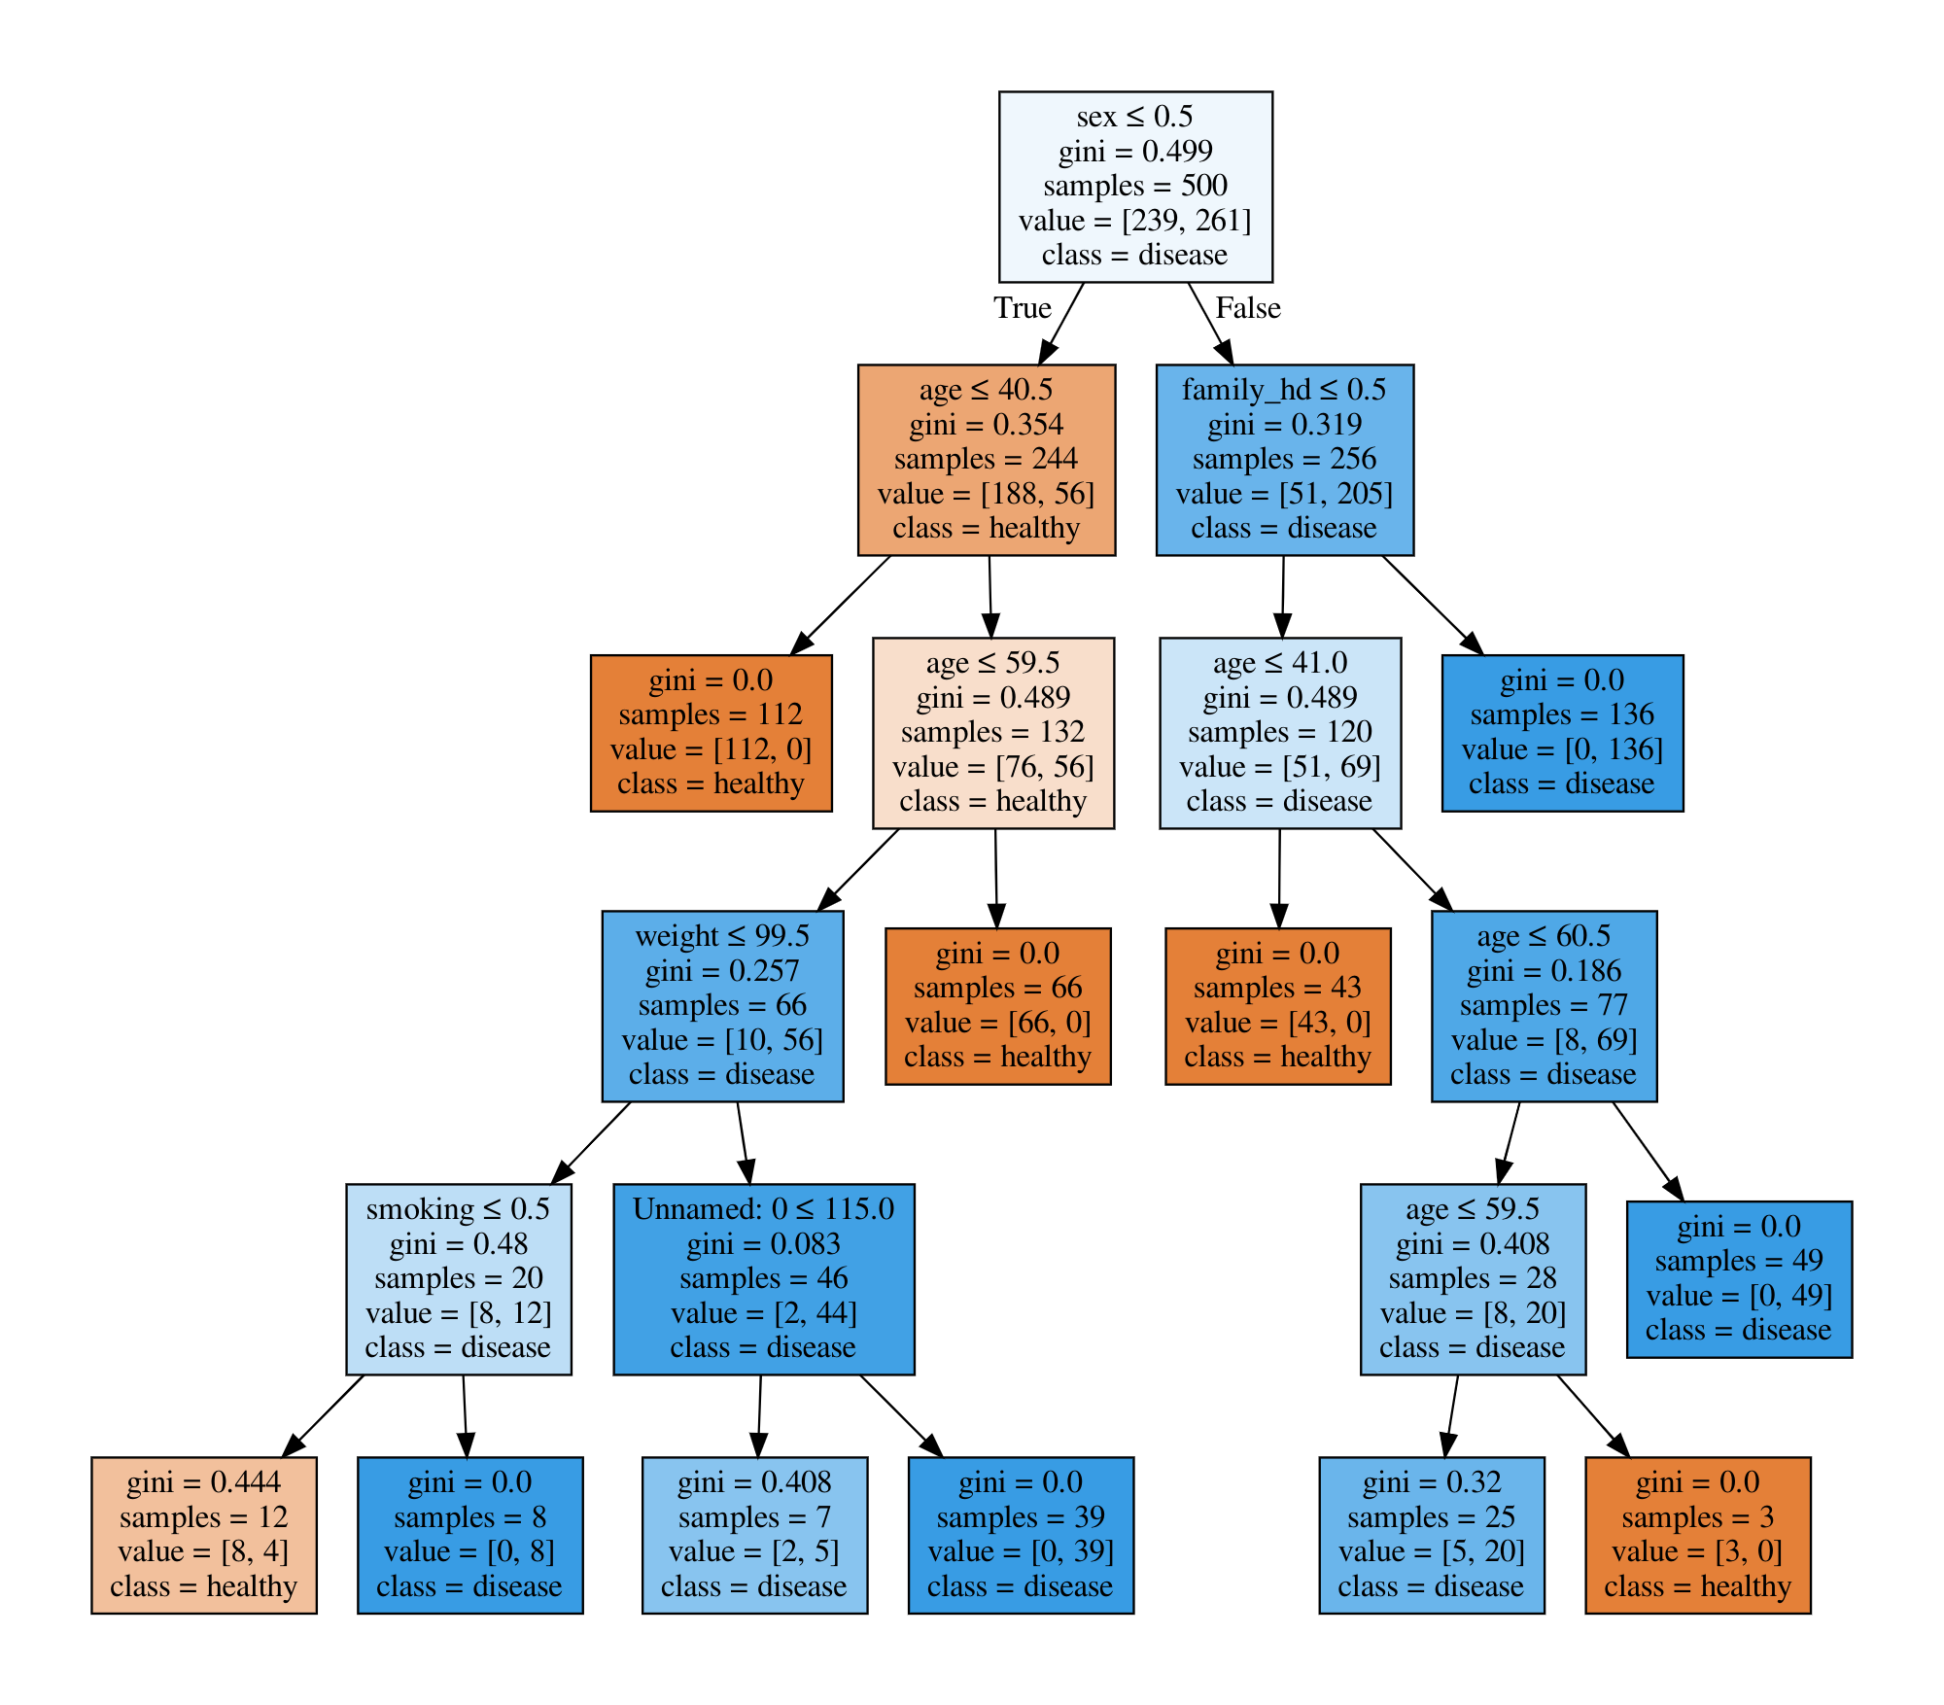
PRODUCED TREE

Slide 7
COMPARISON
Of the hand made, and generated trees

Slide 8
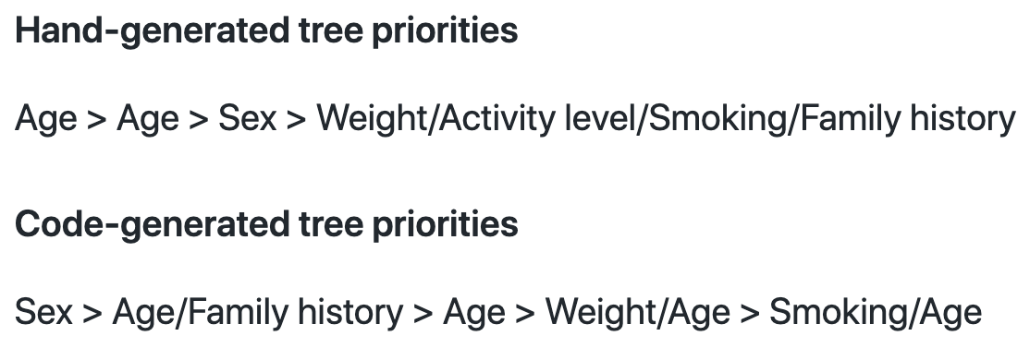
PRIORITIES

Slide 9
I tried to put emphasis on the attributes such as sex, age, and family heart disease history, and it was reflected in the code-generated tree, by being on top levels of the tree, and having large impact on the result.
The secondary attributes - smoking/weight/activity level, were used for creating rules for more specific classification. By creating these statistics, I hoped to reduce underfitting, and I believe I largely succeeded.
The code-generated tree also put the same amount of priority to these secondary statistics as I did, since they appear at 4th+ level of the tree.

Slide 10
CONCLUSION
94.4%
It seems that the rules that I was thinking about during the creation of 'right' data, were very similar to the rules which code-generated tree used.
code-generated decision tree was successful at identifying the trends in data, and creating the rules that dictate how each person should be classified

Slide 11
Thanks!

