Slide 1


Slide 2

Problem Statement
No consolidated view of sales trends over time.
Inability to clearly identify peak and off-peak sales days.
Limited visibility into hourly demand patterns across different store locations.
Difficulty in aligning staffing and operational resources with customer demand.
Lack of actionable insights for improving overall store performance.

Slide 3
Dataset Overview
The dataset contains transaction-level sales data from Afficionado Coffee Roasters (2025). It includes information about transaction time, product sales, store locations, quantity purchased, and revenue generated. The dataset is used to analyze sales trends, customer demand patterns, and store performance across different time periods.
Key Variables:
Transaction ID & Time
Quantity Sold
Unit Price & Revenue
Store Location
Product Category & Type

Slide 4
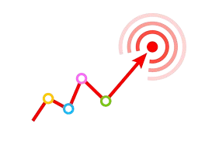
Project Objectives
Analyze sales trends over time.
Identify peak and off-peak sales periods.
Evaluate store-wise performance.
Understand customer demand patterns.
Support operational planning and staffing decisions.
Generate actionable business insights.

Slide 5
Analytical Methodology
1. Data Collection & Validation
Loaded transaction-level sales data
Checked for missing and duplicate records
2. Feature Engineering
Calculated Revenue (Quantity × Unit Price)
Derived Hour, Day of Week, and Time Buckets
3. Data Analysis
Sales Trend Analysis
Day-of-Week Performance Analysis
Time-of-Day Demand Analysis
Store Location Comparison
4. Dashboard Development
Created interactive visualizations in Power BI
Analyzed revenue, transactions, and demand patterns
5. Insight Generation
Identified peak hours and busiest days
Generated business recommendations for operational planning

Slide 6





Tools Used
Microsoft Excel – Data cleaning, formatting, and pivot analysis
SQL – Data querying and extraction
Power BI – Dashboard creation and data visualization
Microsoft PowerPoint – Presentation and reporting
GitHub – Project documentation and version control

Slide 7
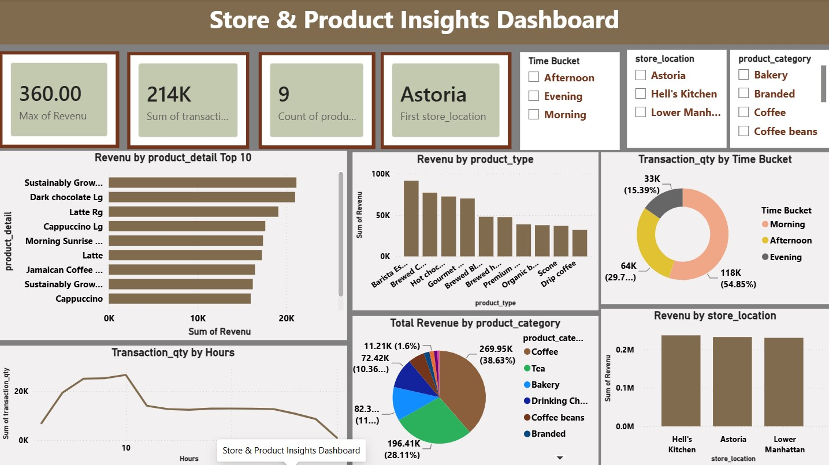
Store & Product Insights Dashboard
Key Insights:-
Morning contributes the highest revenue.
Revenue peaks during early operating hours.
Afternoon maintains steady sales.
Evening contributes the lowest share of revenue.
All three stores show comparable performance.

Slide 8
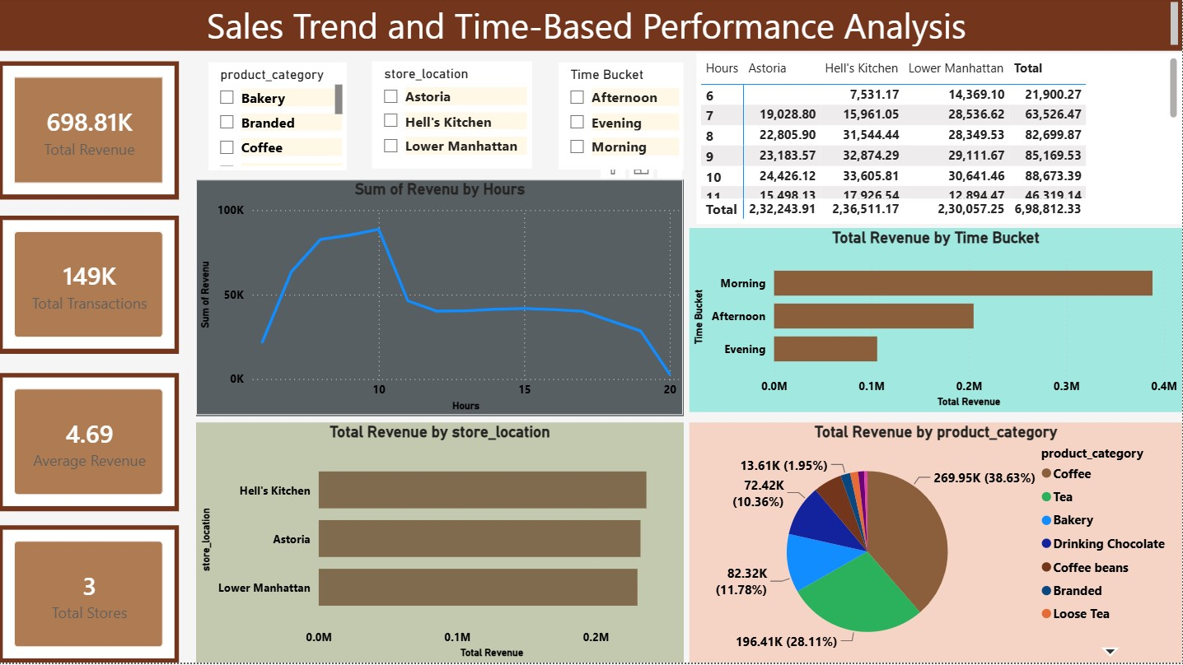
Sales Trend & Time-Based Performance Dashboard
Key Insights:-
Coffee is the highest revenue-generating category.
Tea is the second strongest category.
Top-selling products drive a significant share of revenue.
Store performance remains balanced across locations.

Slide 9

Overall Insights
Morning hours generated the highest sales.
Customer demand varied significantly across time periods.
Peak and off-peak sales patterns were clearly identified.
Coffee was the top-performing product category.
Store performance remained relatively balanced.
Data-driven insights can improve staffing and operational planning.

Slide 10
Business Recommendations
Increase staff availability during peak sales hours to improve customer service.
Optimize workforce scheduling based on hourly demand patterns.
Focus promotional activities during off-peak periods to boost sales.
Replicate successful sales strategies across all store locations.
Maintain adequate inventory for high-demand product categories.
Use data-driven insights for operational planning and decision-making.

Slide 11

This analysis provided valuable insights into sales trends, customer demand patterns, and store performance at Afficionado Coffee Roasters. By identifying peak sales hours, busiest days, and location-wise demand patterns, the dashboard supports better staffing, operational planning, and data-driven decision-making. The findings can help improve overall efficiency and business performance.

Slide 12
Thank You

