Slide 1

Note: The data and information in this document is reflective of a hypothetical situation and client. This document is to be used for KPMG Virtual Internship purposes only.
Sprocket Central Pty Ltd
Data analytics approach
-Nikita Gupta

Slide 2
Note: The data and information in this document is reflective of a hypothetical situation and client. This document is to be used for KPMG Virtual Internship purposes only.
Agenda
Introduction
Data Exploration
Model Development
Interpretation

Slide 3
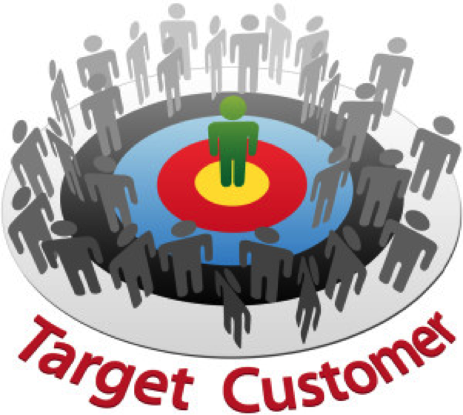
Note: The data and information in this document is reflective of a hypothetical situation and client. This document is to be used for KPMG Virtual Internship purposes only.
Introduction
TARGET CUSTOMERS- Analysis of customer dataset to determine customer trends and behaviour
Our objective is to create a customer profile based on the data available to us and focus on the high valued customers which will allow us to determine the kind of customers to target and build a suitable marketing strategy.
Factors to look into:
1.Job Industry category
2.Wealth segment
3.Age distribution
4.Most preferred brand of bike by customers

Slide 4
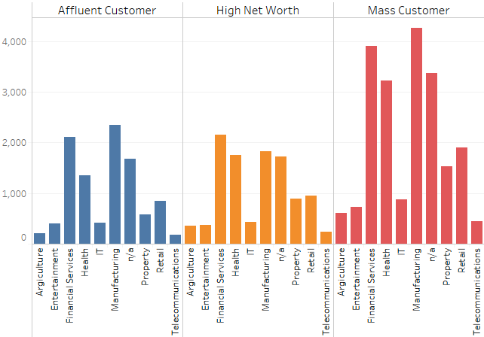
Note: The data and information in this document is reflective of a hypothetical situation and client. This document is to be used for KPMG Virtual Internship purposes only.
Data Exploration
Customer’s Age distribution
As we observe here, mass customer category is comparatively high than others, and the focus should be on the top 1000 customers from this category inorder to contribute more value to the organisation.
Customers from financial services and manufacturing industry should be given high priority.

Slide 5
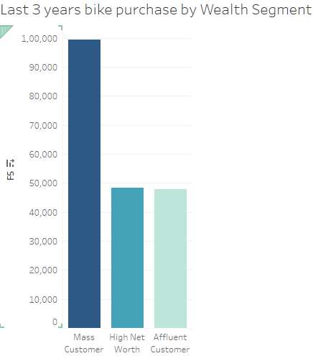
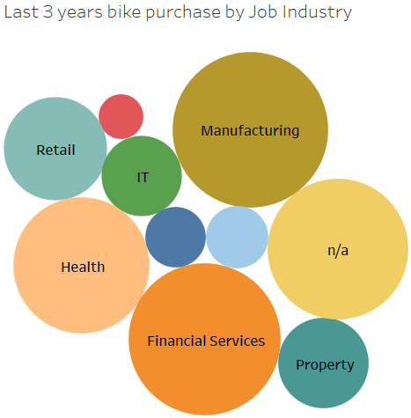
Note: The data and information in this document is reflective of a hypothetical situation and client. This document is to be used for KPMG Virtual Internship purposes only.
Model Development
Last 3 years bike related purchases
Mass customer contribute to more purchases.
Financial services, Manufacturing,Health,Retail,etc are of more importance comparatively.

Slide 6

Note: The data and information in this document is reflective of a hypothetical situation and client. This document is to be used for KPMG Virtual Internship purposes only.
Interpretation
High customer satisfaction will lead to an increase in revenue.
By providing the best services to the target customers, the customer experience is set high and in return the organization progresses with an increase in profit margin and reputation of the company.
Therefore, for any organisation to run smoothly – A customer is the king of the market..

Slide 7
Note: The data and information in this document is reflective of a hypothetical situation and client. This document is to be used for KPMG Virtual Internship purposes only.
Appendix

Slide 8
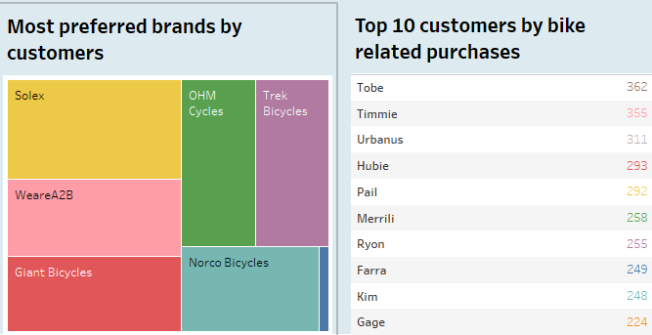
Note: The data and information in this document is reflective of a hypothetical situation and client. This document is to be used for KPMG Virtual Internship purposes only.
Appendix
Some conclusion withdrawn as to the top customers which add value to the organisation

