Slide 1

CS639 Mobile App Development
BraveU
Team 4
Nikita Jarile
Revati Deshmukh
Pranav Kullappa

Slide 2
Important URLS
README.md: https://github.com/nikitajarile/MobileAppProject2021/blob/main/README.md
Video Url: https://youtu.be/fJ3wIxnQz_E
FireBase Console: https://console.firebase.google.com/u/0/project/braveu-45098/overview
Google Developers Console: https://console.cloud.google.com/apis/dashboard?project=braveu&folder=&organizationId=

Slide 3
Description Of The Problem: Women Safety Issues
Public Harassment and WorkPlace Harassment
ActionAid.org Survey= In 2016,79% of women living in cities in India, 86% in Thailand, and 89% in Brazil have been subjected to harassment or violence in public, as had 75 % in London, UK.(Source : https://stopstreetharassment.org/resources/statistics/statistics-academic-studies/)
Domestic Violence
UN Survey 2020 = In COVID-19 lockdown,worldwide 18% women have experienced domestic violence in 1 year.(Source :https://www.un.org/en/desa)

Slide 4

Description of Users
Walking home alone at night, exploring an unknown place, getting lost, going on a date with stranger - all are situations in which women have felt vulnerable and still in this day and age being subjected to violence and domestic abuse
Whether you’re going out for a jog or headed off on a blind date, it’s never a bad idea to make sure you’ve got every safety box checked. Our app is subjected to be a safety tool for all such situations where women feel unsafe

Slide 5
Research of Market Apps
Women Safety:
Issues: Lot of ads, repetitive SOS message, lot of unnecessary info asked while registering
Citizen Cop
Issues: Location related Issues, too much permissions, issue with notification
Family locator
Issues: Tracking issues, login issues
Every other apps have either tracking or SOS alert messaging or record feature. We present to you BraveU with all these feature at a single spot integrated together to use

Slide 6



Main features of App
ALERT (SMS with current location)
NEARBY POLICE STATIONS
RECORD(Record and send the video)

Slide 7
Technology used In App
Android Studio
Google MAPs API
Google Locations API
Google Places API
Firebase
Google Developers Console

Slide 8
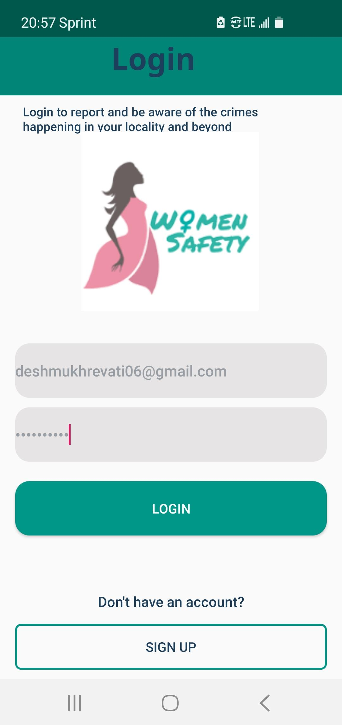
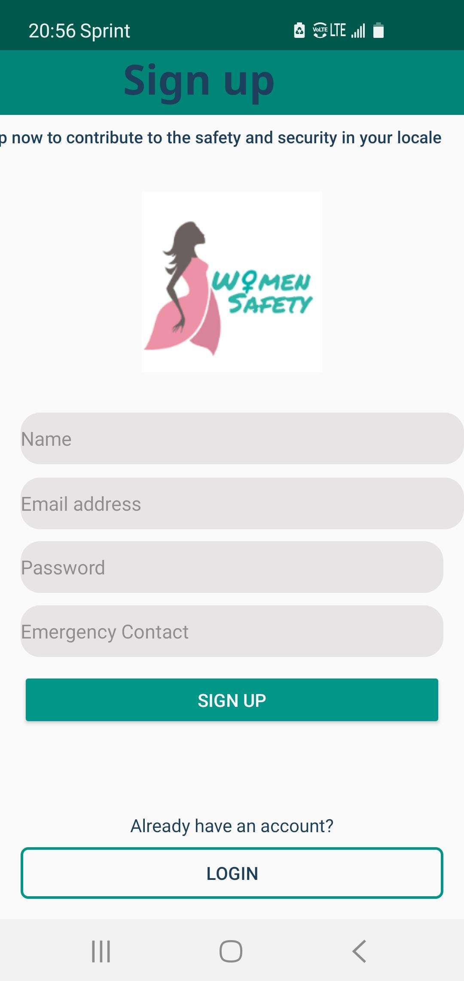
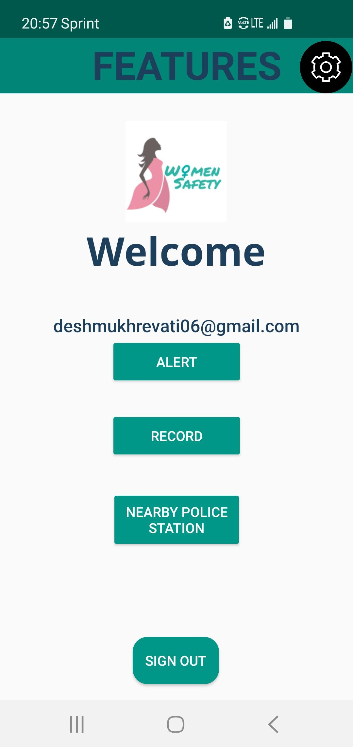
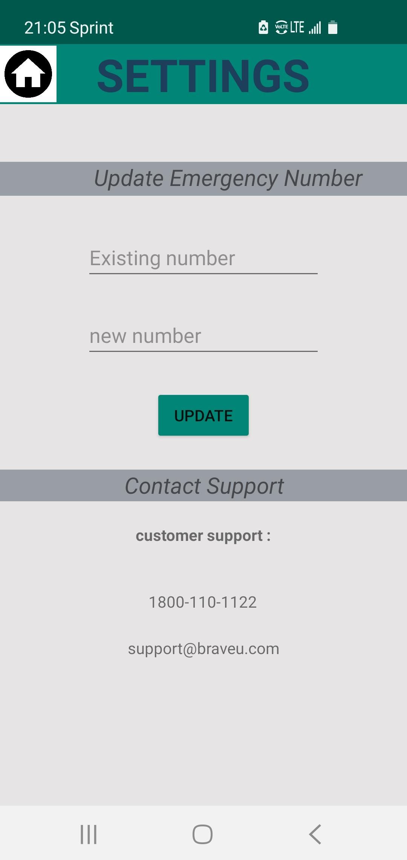
App Screenshots

Slide 9
Development Status
Implemented Nearby Police Station feature
Implemented Recording Video Feature
Implemented Settings to update emergency contact

Slide 10
Problems Encountered
Working with Maps - Updating current device’s location and last known location
Sending recorded video directly through the app
Permissions for SMS,Location and Camera.

Slide 11
Future Scope
Introduce one more feature to use the app without internet
Send recorded video automatically from the app
Add more than one emergency contacts
One time login option

Slide 12
“A life free of violence is a basic human right,one that every women,man and child deserves”
THANK YOU

