Slide 1

Deep Learning-based Monitoring of the Urban Traffic using MOBATSIM
Institute of Industrial Automation
and Software Engineering
INTERMEDIATE REPORT
Nikita Jhawar
M.Sc. Electrical Engineering

Slide 2
TIMELINE
Fault Injection in MOBATSim
Data Evaluation and PreProcessing
Analysis and Result Comparison
DATA Collection with respect to different possibilities
Implementation of DL Model

Slide 3
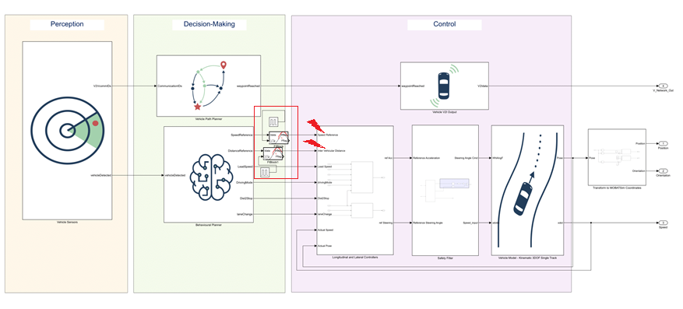
FAULT INJECTION

Slide 4
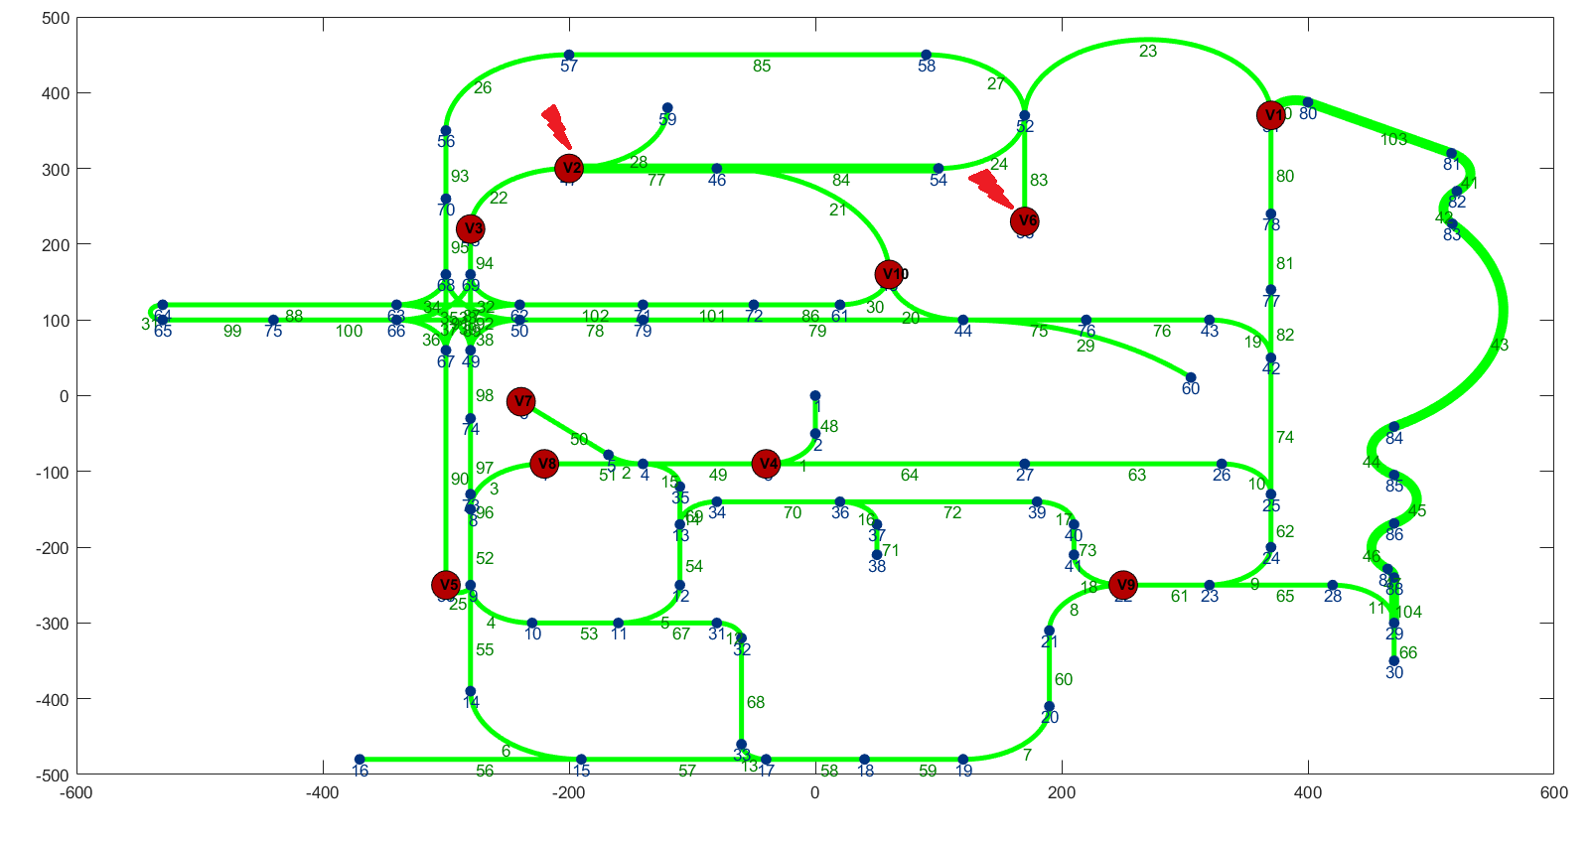

Slide 5
FAULT DETAILS
Vehicle | Target Component | Target Variable | Fault type | Fault duration | Injection Type
Vehicle 2 | Speed Sensor | Speed Reference | Noise, StuckAt, Offset/Bias | 0.6, 1.2, 1.8, 2.4, 3.0, 3.6, 4.2, 5 | Uniform (At 10 secs, At 30 secs)
 | Distance Sensor | Intervehicular Distance | Noise, StuckAt, Offset/Bias | 0.6, 1.2, 1.8, 2.4, 3.0, 3.6, 4.2, 5 | Uniform (At 10 secs, At 30 secs)
Vehicle 6 | Speed Sensor | Speed Reference | Noise, StuckAt, Offset/Bias | 0.6, 1.2, 1.8, 2.4, 3.0, 3.6, 4.2, 5 | Uniform (At 10 secs, At 30 secs)
 | Distance Sensor | Intervehicular Distance | Noise, StuckAt, Offset/Bias | 0.6, 1.2, 1.8, 2.4, 3.0, 3.6, 4.2, 5 | Uniform (At 10 secs, At 30 secs)

Slide 6
COLLECTION AND EVALUATION OF DATASET
Three driving scenarios have been considered: Urban City Traffic, Platoon Control, and Road Merge Collision
Three Error category has been considered: Bias/Offset, Stuck-at fault, and Noise.
For every scenario, 8 faulty cases will be simulated for each error category (80 faulty cases for each category as there are 10 vehicles)
Error values (for offset error), Injection time, and error duration have been predefined and chosen.
Bias/ Offset and Noise takes value 5.
Fault duration can any value in: [0.6, 1.2,1.8, 2.4, 3.0, 3.6, 4.2, 5]
The data is already resampled to a 0.02-sec sampling rate.
A total of 4000 samples are collected in every dataset.

Slide 7
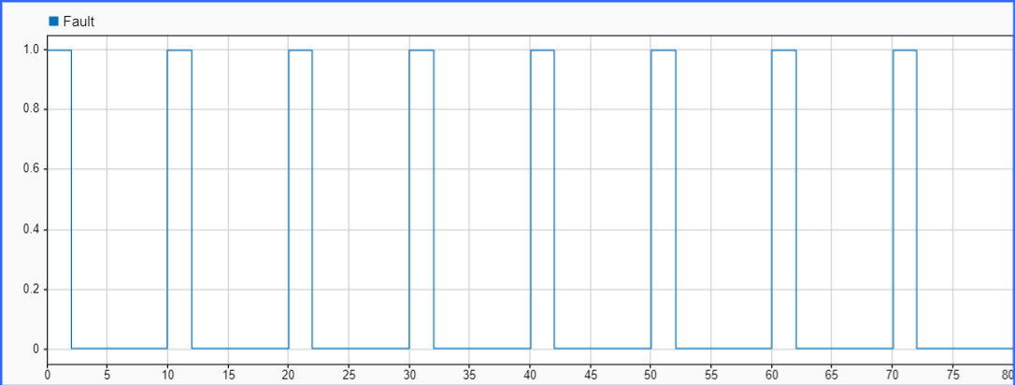
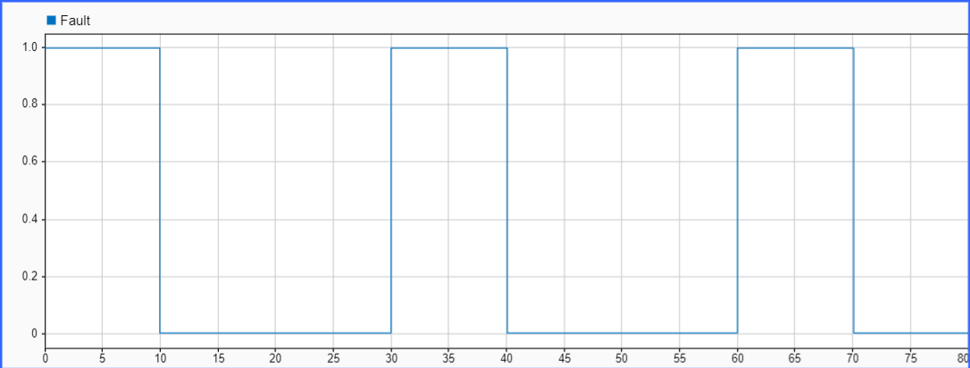
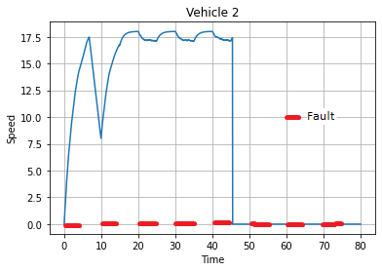
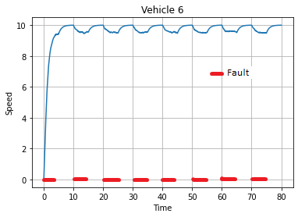
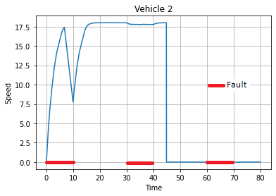
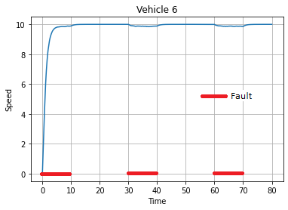
URBAN CITY TRAFFIC

Slide 8
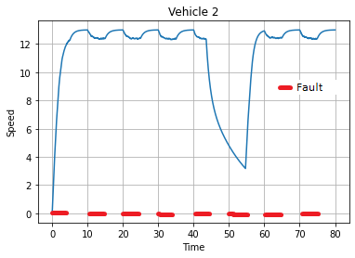
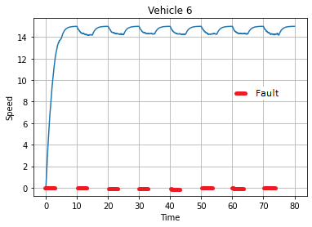
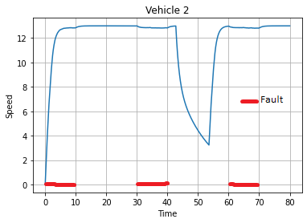
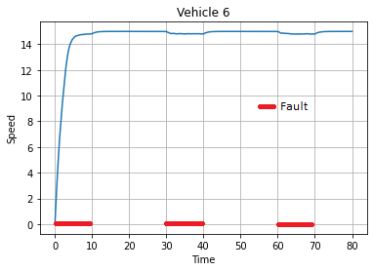
PLATOON CONTROL

Slide 9
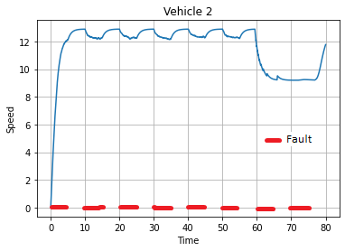
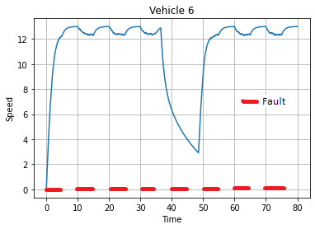
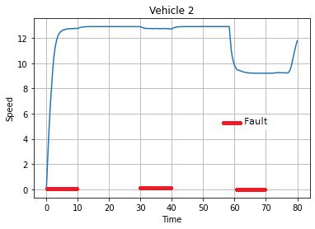
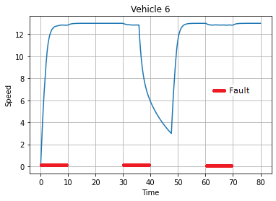
ROAD MERGE COLLISION

Slide 10
FINAL DATA FORMAT
Time | Speed | Rotation | Position | Translation
Seconds | Float | Float | Float | Float
Minimum No. of Attributes: 4
Initial Data Sample Rate: 0.005 seconds
Final Data Sample Rate: 0.02 seconds
Every Simulation Duration: 80 seconds (4000 entries for each simulation)
Total no. of simulations: 30 (Fault-free) + 240*3 (Faulty) = 750
[Faulty data includes fault-free entries where there is no error injection.]

Slide 11
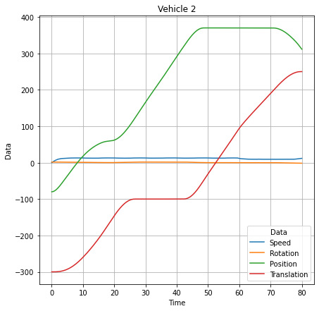
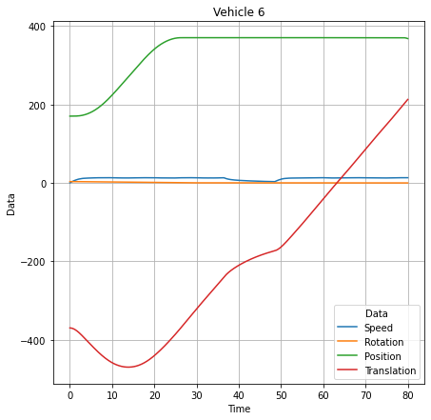

Slide 12
DATA PREPROCESSING
Initial Dataset is obtained with Timestamp and 8 data columns.
After evaluation, the final dataset format is Timestamp and 4 columns named: Speed, Rotation, Position, and Translation
During preprocessing, data is split into training examples, validation examples, and test examples
Pre-Processing will be performed with respect to every attribute: Speed, Position, Rotation, and Translation
All the features are concatenated and encoded accordingly for better accuracy in Deep Learning model

Slide 13
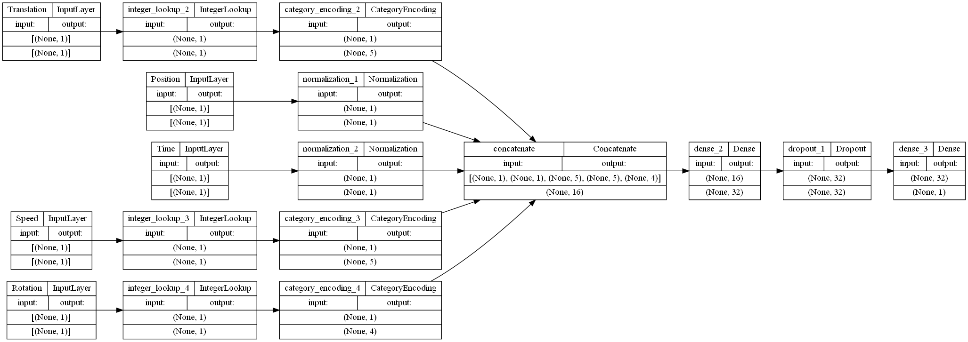

Slide 14
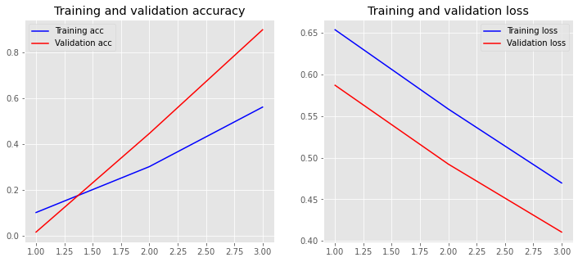
DL MODEL OUTPUT (Accuracy and Loss)

Slide 15
TOPICS TO DISCUSS
DATA GENERATION: Willing to include dataset for a non-uniform sample as well
DATA PREPROCESSING AND OUTPUT: Preprocessing and Output (in forms of accuracy and Loss) will be recorded for every attribute as well as for uniform and non-uniform dataset
FINAL REQUIREMENTS FOR THE THESIS: Need to know if any other processes should be executed.
SUBMISSION: Probable submission date for Thesis by 30th May, 2022

Slide 16
THANK YOU FOR YOUR
TIME AND ATTENTION

