Slide 1
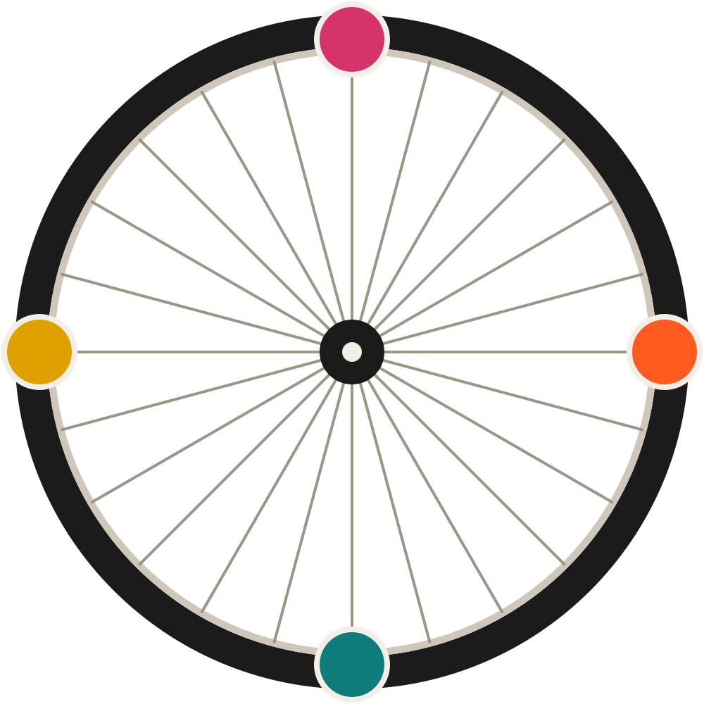
BIKE SUBSCRIPTIONS · MINNEAPOLIS, MINNESOTA
Spoke
& Chain
A bike that fits your life this month. Swap it when life changes.

Slide 2
THE PROBLEM
Buying a bike is easy.
Owning one isn’t.
Flat tires
and nowhere to fix them on a Tuesday.
Wrong bike
for the new job, the new kid, the new hill.
Theft
the fastest way to stop riding.

Slide 3
PLAN 01 OF 04
COMMUTER
City bike with lights, lock and fenders.
$39 / month
Tune-up every 90 days
Flat fixed in 24 hours
Theft replacement included
Illustrative pricing · fictional company

Slide 4
PLAN 02 OF 04
CARGO
Front-loader that carries two kids or a week of groceries.
$79 / month
Rain canopy and seat belts
Swap to a smaller bike any month
Free winter storage
Illustrative pricing · fictional company

Slide 5
PLAN 03 OF 04
ELECTRIC
Pedal-assist with 50 miles of range for hills and headwinds.
$99 / month
Battery health guaranteed
Loaner while yours is serviced
Insurance bundled in
Illustrative pricing · fictional company

Slide 6
PLAN 04 OF 04
KIDS
The right size now, the next size when they grow.
$25 / month
Unlimited size swaps
Helmet included
Balance bikes to 26-inch
Illustrative pricing · fictional company

Slide 7
HOW IT WORKS
Pick. Ride. Swap.
1
2
3
Choose a plan online
Ride as much as you like
Swap or stop any month
Delivered to your door, fitted to you, in 48 hours.
Maintenance, repairs and theft cover are included.
New job, new baby, new city — change bikes for free.
18,400 active riders
92% renew after 6 months
3.1M car trips replaced
Illustrative figures

Slide 8
FIRST MONTH FREE
Roll with us.
[spokeandchain.bike] · [(612) 000-0000]
Concept deck · fictional company

