Slide 1

Analyzing the Impact of Uncertainty Models on the Occurrence of Risks in Robot Applications
Institute of Industrial Automation
and Software Engineering
Kick-off Meeting – Master Thesis
Name: Nikita Majalikar
Study Program: Electrical Engineering

Slide 2
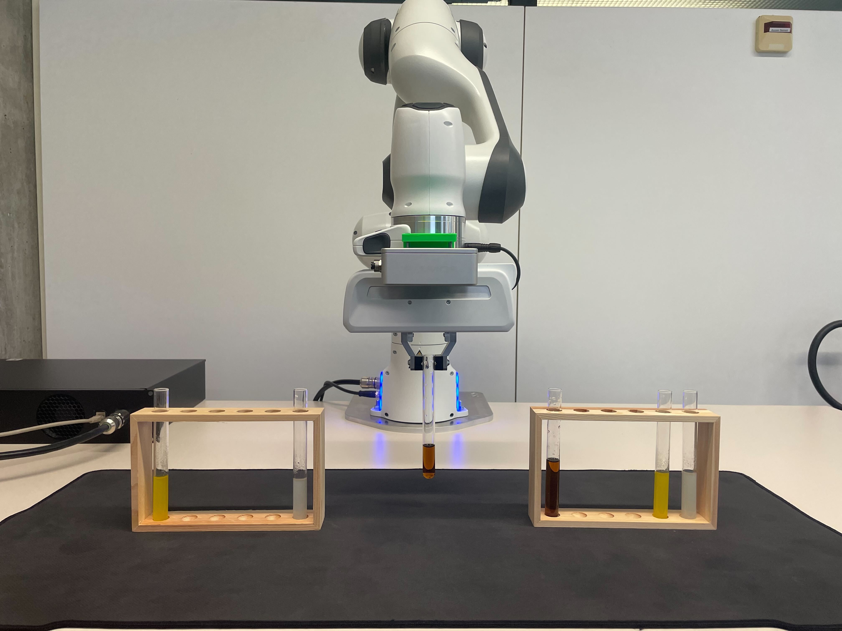
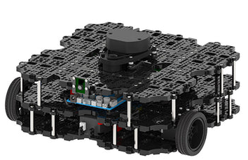
Motivation: Uncertainties and Safety
Safety is highly important for robot systems: Violations can result in severe accidents
Risk Models offer the possibility to consider/account for possible failures
Current/Existing risk model: decision trees with distinct parameter representation
Goal of Thesis: Incorporate uncertainty models in the risk model

Slide 3
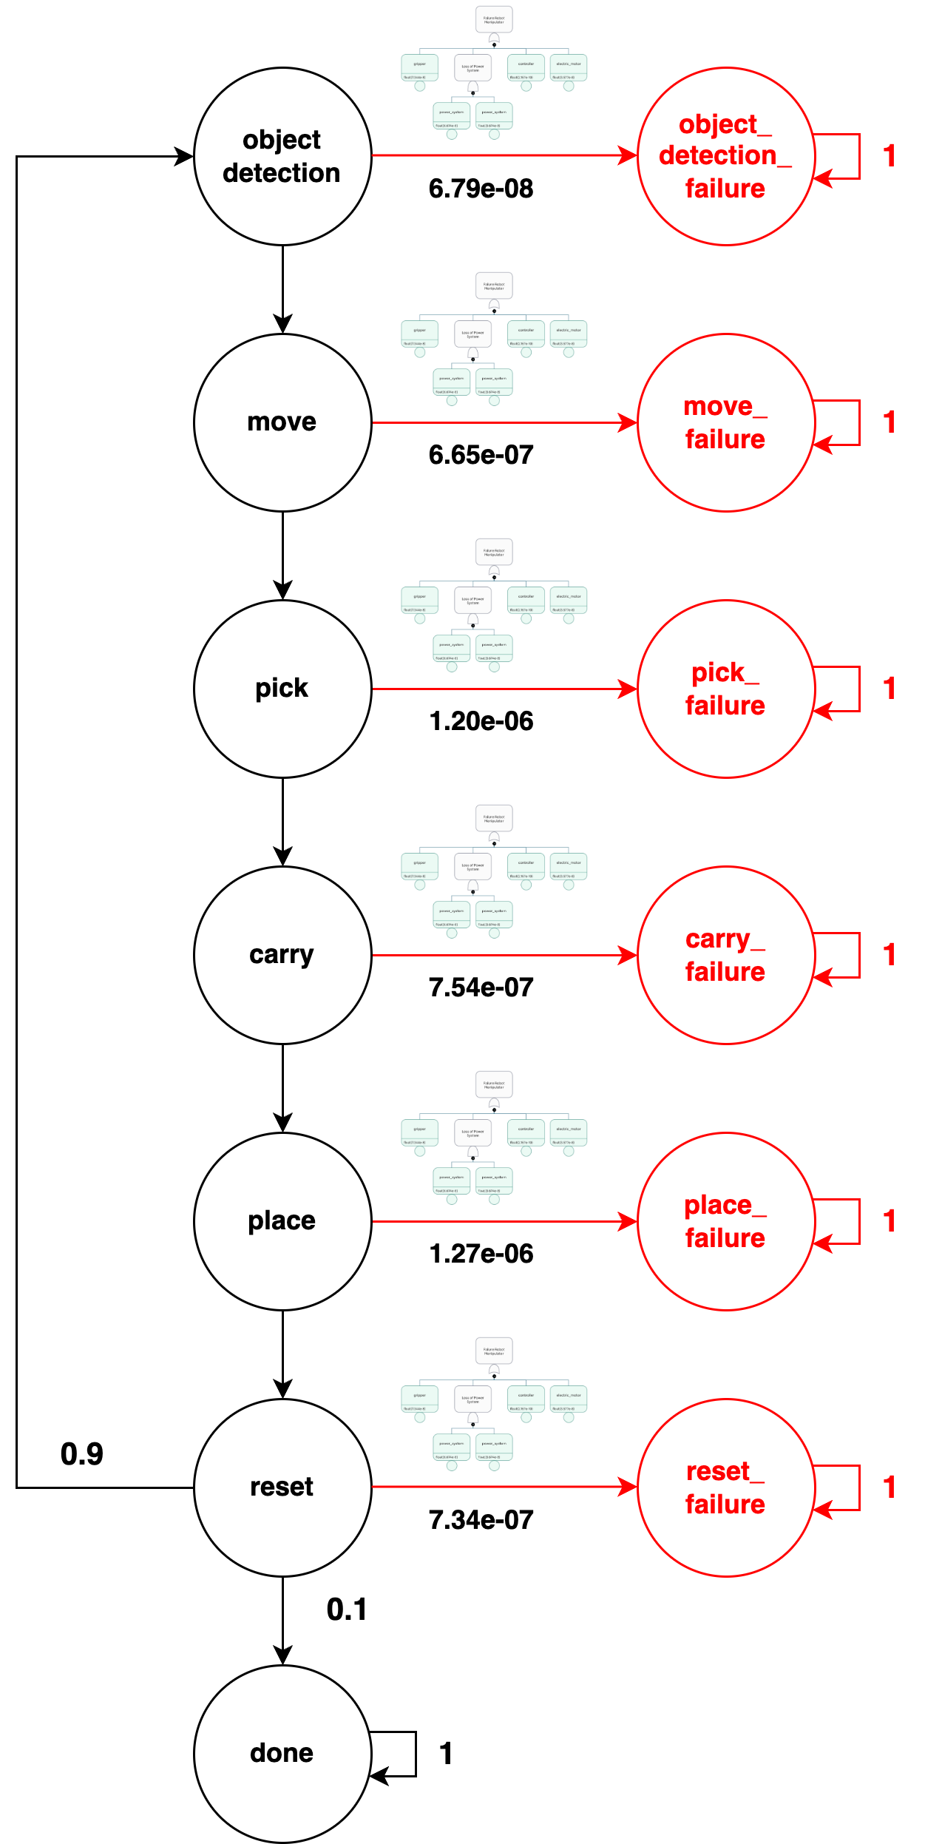
Task Description
Literature Review and Familiarization
Robotics Safety and Human-Robot Interaction (HRI), Uncertainty and Probabilistic Modeling
Simulation Environment – Gazebo
Implementation of Uncertainties in the Risk Model
Conducting real-world experiments in different configurations
Implementing uncertainty-aware parameter
Evaluation on the Influence of Uncertainties
Performing statistical analysis to study how the uncertainty models impact the risk analysis
Suggesting system constellations for low risk probability
Central Research Question: How can risk reduction methods be derived by developing uncertainty-aware risk models in the considered robot applications?

Slide 4
Approach to Project Execution
Dates:
Familiarization with concept till June 30, 2024
Design / Conception Phase till August 31, 2024
Presentation in 5 months
Submission of Thesis on November 7, 2024
Type of Execution: Conceptual model
Literature:
[1] W. -J. Baek and T. Kröger, "Safety Evaluation of Robot Systems via Uncertainty Quantification," 2023 IEEE International Conference on Robotics and Automation (ICRA), London, United Kingdom, 2023, pp. 10532-10538
[2] Baek, WJ., Ledermann, C., Kröger, T. (2023). Uncertainty Estimation for Safe Human-Robot Collaboration Using Conservation Measures. In: Petrovic, I., Menegatti, E., Marković, I. (eds) Intelligent Autonomous Systems 17. IAS 2022.

