Slide 1
Faculty Orientation Program on
410246: Laboratory Practice III

Slide 2
Group A: Design and Analysis of Algorithms
1. Write a program non-recursive and recursive program to calculate Fibonacci numbers and analyze their time and space complexity.
2. Write a program to implement Huffman Encoding using a greedy strategy.
3. Write a program to solve a fractional Knapsack problem using a greedy method.

Slide 3
1. Write a program non-recursive and recursive program to calculate Fibonacci numbers and analyze their time and space complexity.

Slide 4
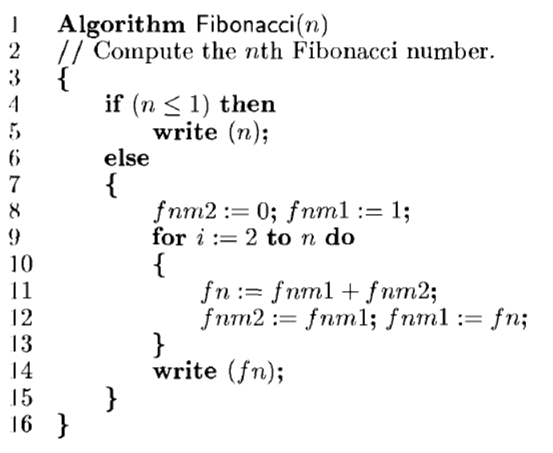
Iterative Algorithm

Slide 5
Analysis
Two cases (1) n = 0 or 1 and (2) n > 1.
When n = 0 or 1, lines 4 and 5 get executed once each. Since each line has an s/e of 1, the total step count for this case is 2.
When n > 1, lines 4, 8, and 14 are each executed once. Line 9 gets executed n times, and lines 11 and 12 get executed n-1 times each. Line 8 has an s/e of 2, line 12 has an s/e of 2, and line 13 has an s/e of 0. The remaining lines that get executed have s/e’s of 1. The total steps for the case n > 1 is therefore 4n + 1.

Slide 6
Iterative Program
# Program to display the Fibonacci sequence up to n-th term
nterms = int(input("Enter number of terms "))
# first two terms
n1, n2 = 0, 1
count = 0
# check if the number of terms is valid
if nterms <= 0:
print("Please enter a positive integer")
# if there is only one term, return n1
elif nterms == 1:
print("Fibonacci sequence upto", nterms,":")
print(n1)

Slide 7
# generate fibonacci sequence
else:
print("Fibonacci sequence:")
while count < nterms:
print(n1)
nth = n1 + n2
# update values
n1 = n2
n2 = nth
count += 1

Slide 8
Output
Enter number of terms 4 Fibonacci sequence:
0
1
1
2

Slide 9
Recursive Algorithm
Algorithm rFibonacci(n)
{
if (n <= 1)
return n;
else
return rFibonacci(n - 1) + rFibonacci(n - 2); }

Slide 10
Analysis
T(n) = T(n-1) + T(n-2) + c
= 2T(n-1) + c //from the approximation T(n-1) ~ T(n-2)
= 2*(2T(n-2) + c) + c
= 4T(n-2) + 3c
= 8T(n-3) + 7c
= 2^{k} * T(n - k) + (2^{k} - 1)*c
Let's find the value of k for which: n - k = 0
k = n
T(n) = 2^{n} * T(0) + (2^{n} - 1)*c
= 2^{n} * (1 + c) - c
T(n) = 2^{n}

Slide 11
Recursive Program
def fibonacci(n):
if(n <= 1):
return n
else:
return(fibonacci(n-1) + fibonacci(n-2))
n = int(input("Enter number of terms:"))
print("Fibonacci sequence:")
for i in range(n):
print(fibonacci(i))

Slide 12
Output
Enter number of terms:4 Fibonacci sequence:
0
1
1
2

Slide 13
2. Write a program to implement Huffman Encoding using a greedy strategy.

Slide 14
4
7
12
14
17
43
52
11
12
14
17
43
52
4
7
23
14
17
43
52
11
12
4
7

Slide 15
14
17
23
43
52
11
12
4
7
23
31
43
52
11
12
14
17
4
7

Slide 16
43
52
54
23
31
11
12
14
17
4
7

Slide 17
54
95
23
31
43
52
11
12
14
17
4
7

Slide 18
149
54
95
23
31
43
52
11
12
14
17
4
7

Slide 19
149
0
1
54
95
0
1
0
1
23
31
43
52
0
1
0
1
11
12
14
17
0
1
4
7

Slide 20
149
0
1
54
95
0
1
0
1
23
31
43
52
0
1
0
1
11
12
14
17
0
1
4
7
a = 0000
a

Slide 21
149
0
1
54
95
0
1
0
1
23
31
43
52
0
1
0
1
11
12
14
17
0
1
4
7
b = 0001
b

Slide 22
149
0
1
54
95
0
1
0
1
23
31
43
52
0
1
0
1
11
12
14
17
1
c
0
4
7
c = 001

Slide 23
149
0
1
54
95
0
1
0
1
23
31
43
52
0
1
0
1
11
12
14
17
0
1
d
4
7
d = 010

Slide 24
149
0
1
54
95
0
1
0
1
23
31
43
52
0
1
0
1
11
12
14
17
0
1
e
4
7
e = 011

Slide 25
149
0
1
54
95
0
1
0
1
23
31
43
52
0
1
0
1
f
11
12
14
17
0
1
4
7
f = 10

Slide 26
149
0
1
54
95
0
1
0
1
23
31
43
52
0
1
0
1
g
11
12
14
17
0
1
4
7
g = 11

Slide 27
149
0
1
54
95
0
1
0
1
23
31
43
52
0
1
0
1
11
12
14
17
a = 0000
b = 0001
c = 001
d = 010
e = 011
f = 10
g = 11
0
1
4
7

Slide 28
Implementation
def printNodes(node, val=''):
newVal = val + str(node.huff)
if(node.left):
printNodes(node.left, newVal)
if(node.right):
printNodes(node.right, newVal)
if(not node.left and not node.right):
print(f"{node.symbol} -> {newVal}")

Slide 29
# characters for huffman tree
chars = ['a', 'b', 'c', 'd', 'e', 'f', 'g']
# frequency of characters
freq = [ 4, 7, 12, 14, 17, 43, 54]
# list containing unused nodes
nodes = []
# converting characters and frequencies into huffman tree nodes
for x in range(len(chars)):
nodes.append(node(freq[x], chars[x]))

Slide 30
while len(nodes) > 1:
# sort all the nodes in ascending order based on their frequency
nodes = sorted(nodes, key=lambda x: x.freq)
# pick 2 smallest nodes
left = nodes[0]
right = nodes[1]
# assign directional value to these nodes
left.huff = 0
right.huff = 1

Slide 31
# combine the 2 smallest nodes to create new node as their parent
newNode = node(left.freq+right.freq, left.symbol+right.symbol, left, right)
# remove the 2 nodes and add their parent as new node among others
nodes.remove(left)
nodes.remove(right)
nodes.append(newNode)
# Huffman Tree is ready!
printNodes(nodes[0])

Slide 32
Output
a -> 0000 b -> 0001 c -> 001
d -> 010
e -> 011
f -> 10
g -> 11

Slide 33
3. Write a program to solve a fractional Knapsack problem using a greedy method.

Slide 34
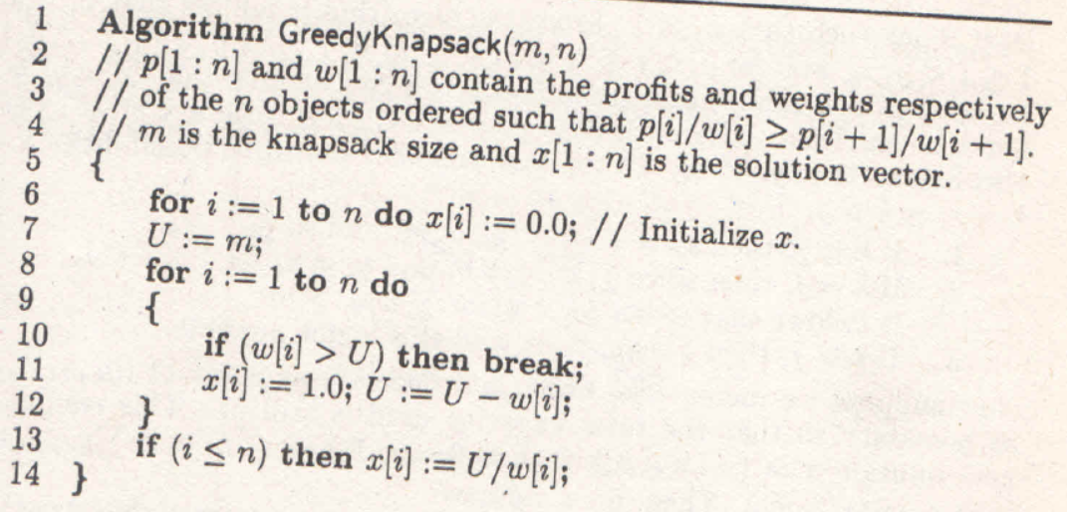

Slide 35
Implementation
def fractional_knapsack(value, weight, capacity):
# index = [0, 1, 2, ..., n - 1] for n items
index = list(range(len(value)))
# contains ratios of values to weight
ratio = [v/w for v, w in zip(value, weight)]
# index is sorted according to value-to-weight ratio in decreasing order
index.sort(key=lambda i: ratio[i], reverse=True)
max_value = 0
fractions = [0]*len(value)

Slide 36
for i in index:
if weight[i] <= capacity:
fractions[i] = 1
max_value += value[i]
capacity -= weight[i]
else:
fractions[i] = capacity/weight[i]
max_value += value[i]*capacity/weight[i]
break
return max_value, fractions

Slide 37
n = int(input('Enter number of items: '))
value = input('Enter the values of the {} item(s) in order: '.format(n)).split()
value = [int(v) for v in value]
weight = input('Enter the positive weights of the {} item(s) in order: '.format(n)).split()
weight = [int(w) for w in weight]
capacity = int(input('Enter maximum weight: '))
max_value, fractions = fractional_knapsack(value, weight, capacity)
print('The maximum value of items that can be carried:', max_value)
print('The fractions in which the items should be taken:', fractions)

Slide 38
Output
Enter number of items: 3
Enter the values of the 3 item(s) in order: 24 15 25
Enter the positive weights of the 3 item(s) in order: 15 10 18 Enter maximum weight: 20
The maximum value of items that can be carried: 31.5
The fractions in which the items should be taken: [1, 0.5, 0]

Slide 39
Reference :
Horowitz and Sahani, "Fundamentals of Computer Algorithms", University Press, ISBN: 978 81 7371 6126, 81 7371 61262

Slide 40
THANK YOU

