Slide 1
Crime Data Analysis for Los Angeles (2010 - 2018)
Team Members:
-Ashwini Kasbekar
-Eshan Bhatt
-Manasi Prabhune
-Prutha Shirodkar
-Ripal Bhavsar
-Nikita Nalawade

Slide 2
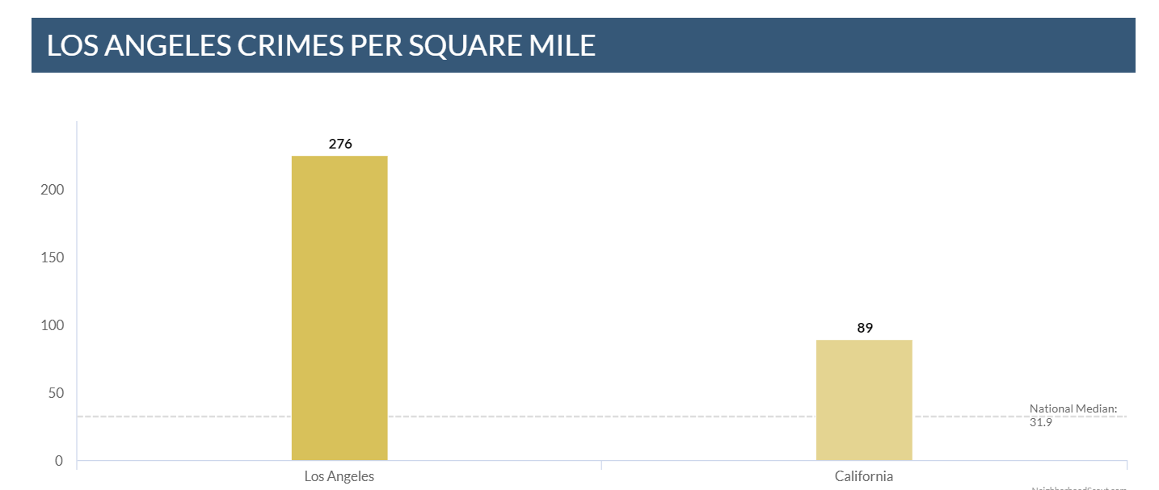
CHOICE OF DATASET

Slide 3
BUSINESS CASE
Analysis should include time-wise crime report
Identify the most used weapon
Maximum type of crimes in the city.
Most affected area.

Slide 4
DATA DESCRIPTION
Crime data from 2010 to Present - https://catalog.data.gov/dataset/crime-data-from-2010-to-present
ATTRIBUTES:
Date Reported
Date Occurred
Area ID
Crime Code
Victim Sex
Victim Descent
Premise Code
Weapon Used Code
Status Code
Time Occurred 1
Age

Slide 5
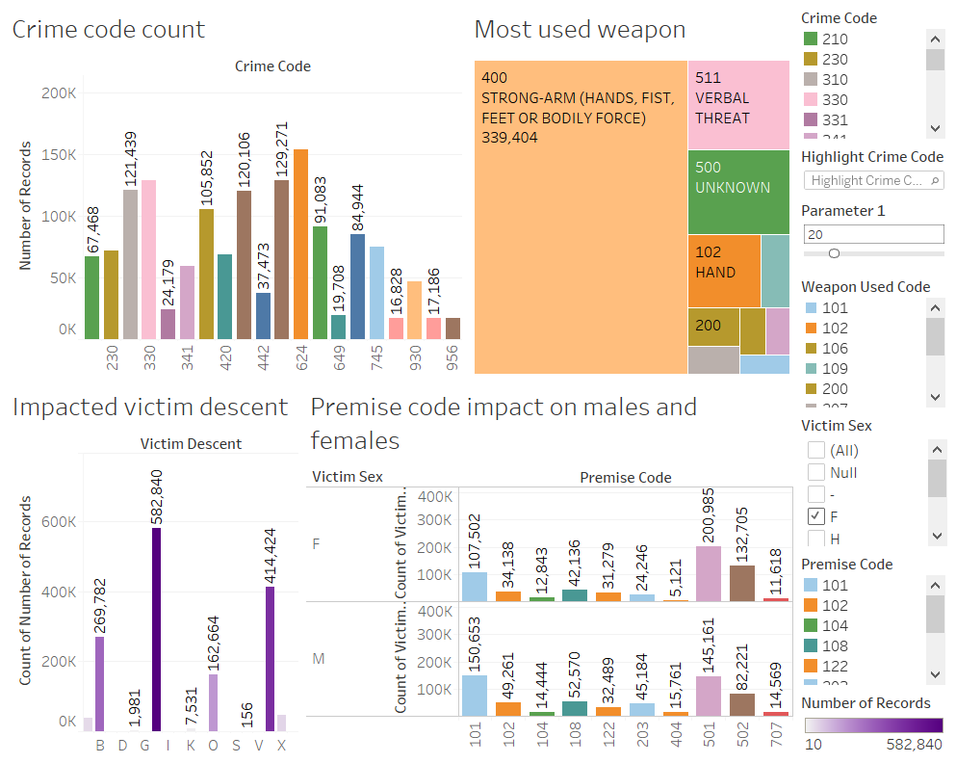
EXPLORATORY DATA ANALYSIS

Slide 6
DATA PREPROCESSING
Missing Values:
Performed data imputation to clean data.
Replaced missing values by M as males were the most impacted victim gender.
Replaced missing values of victim descent by calculating mode.
Dummy Variables:
Created dummies for all independent variables such as Area_ID, Victim Sex, Victim Descent etc.
Discretize:
Victime age, Time Occurred were discretized into multiple categories.
Binning:
Created 10 bins for the attributes Crime Code and Weapon Used Code each.
Notes:
Dummy Variables- necessary to have all independent variables to be numeric for analysis Area_ID, Victim Sex, Victim Descent, Status Code, Time Occurred, Age and Binned Weapon Used Code.
Discretize - This helps us in classify specific category of attribute

Slide 7
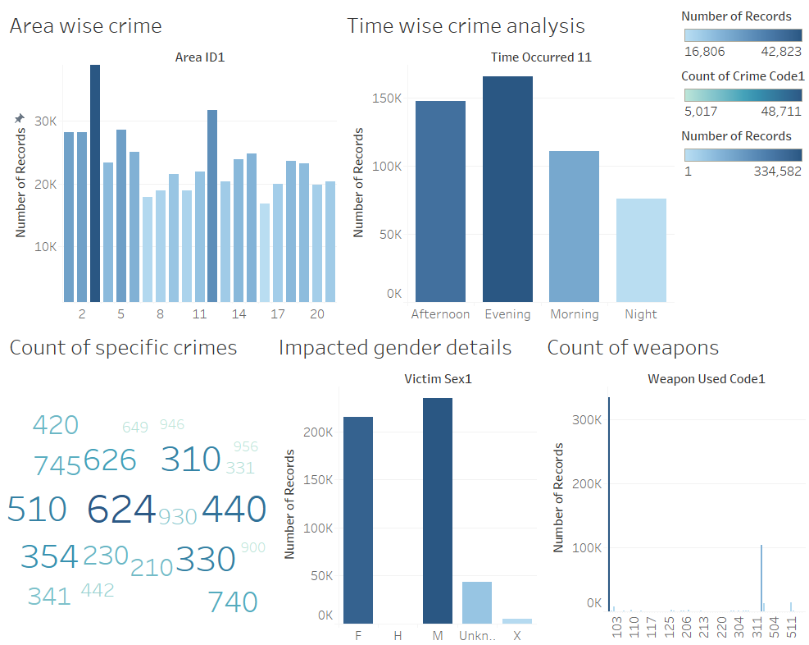
DATA ANALYSIS

Slide 8
MODELLING AND RESULTS
Naïve Bayesian Classifier:
Bayes theorem named after Rev. Thomas Bayes.
Works on conditional probability, probability that something will happen, given that something else has already occurred.
Calculate the probability of an event using its prior knowledge.
K- Nearest Neighbour:
Used for classification — the output is a class membership (predicts a class — a discrete value).
Classified by a majority vote of its neighbors,
Object is assigned to the class, most common among its k nearest neighbors.
Single Tree:
Divide the data set into smaller data sets based on the descriptive features until you reach a small enough set that contains data points that fall under one label.
Random Trees:
Method is a variation of bagging.
Works by training multiple weak regression trees using a fixed number of randomly selected features.
Takes the average value for the weak learners and assigns that value to the strong predictor.
Notes:
KNN- KNN can be used for classification — the output is a class membership (predicts a class — a discrete value).
Random Tree - The random trees method (random forests) is a variation of bagging. This method works by training multiple weak regression trees using a fixed number of randomly selected features (sqrt[number of features] for classification and number of features/3 for prediction), then takes the average value for the weak learners and assigns that value to the strong predictor.

Slide 9
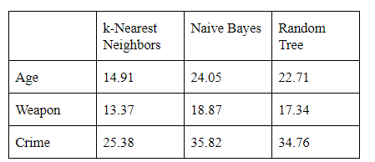
MODELLING RESULTS(BEST RESULTS FOR EACH CLASSIFIER)

Slide 10
RECOMMENDATIONS
Area 3 - Southwest LA and Area 12 - 77th Street of LA – Crime Prone!
Crime rate higher in the evening.
Most targeted group – Adult , followed by teen and kids.
Awareness campaigns based on various age groups.
Crimes committed using
Physical strength/ Verbal Threat.
Knife/ Blade of up to 6 inches.
Area with code 1-6 had use of gun/pistol/revolver
Recommend use of stringent regulations behind usage of weapons.
Notes:
The crime prone areas in LA are Area 3 i.e. Southwest LA and Area 12 i.e. 77th Street of LA.
Most of the crimes take place in evening. We recommend to tighten security measures during evening.
Most of the crimes are committed by using the physical strength by the criminals or by verbal threat. The most used weapon is the knife with blade 6 inches or less. The area codes 1 to 6 has the highest use of hand gun/pistol or revolver. We recommend using some stringent regulations behind usage of such weapons in these areas.
Adult age group is the most targeted age group for crimes in LA, followed by teen and kid. Necessary awareness campaigns and training can be given based on this analysis to people of various age groups.

Slide 11
CHALLENGES
Dataset Comprehension
Data Cleaning
Feature Selection

