Slide 1
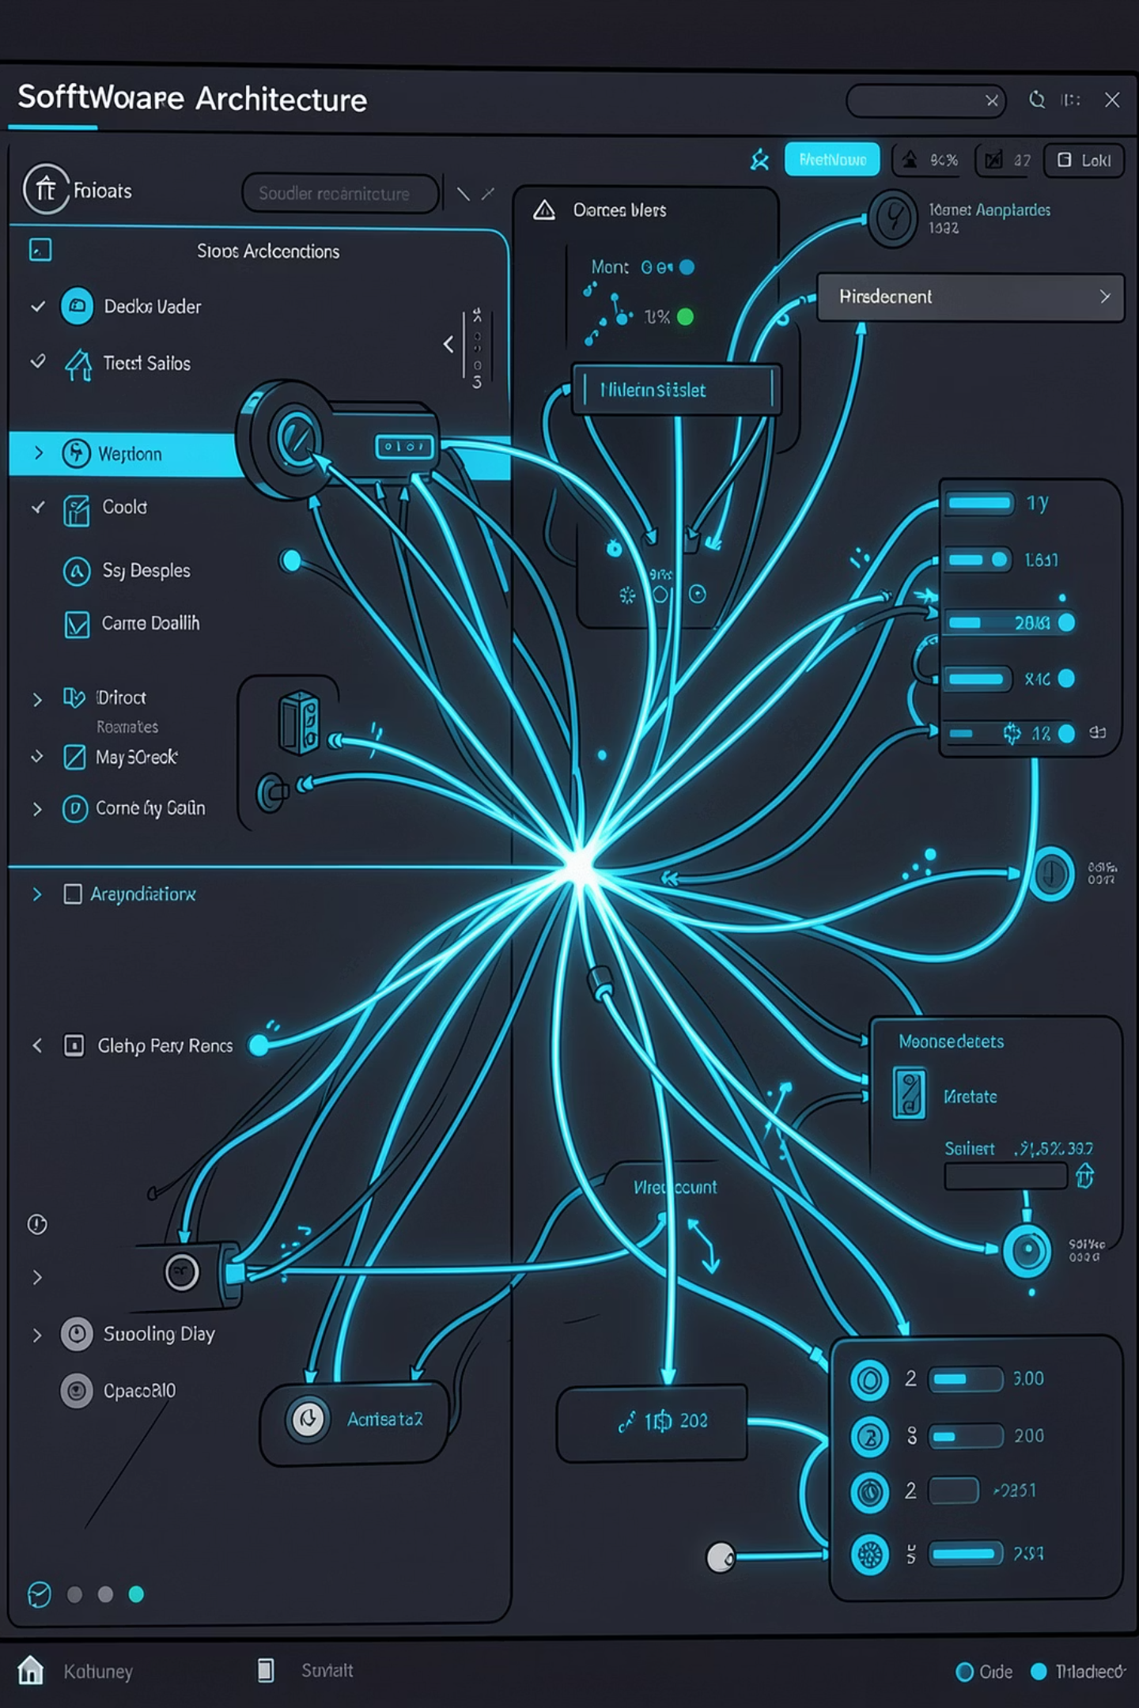
Lead Management System
System Architecture & Design Overview
REACT.JS
NODE.JS + EXPRESS
POSTGRESQL

