Slide 1
Lending Club Case Study
Group Members:
Nikita Patil
Modin B Shaik

Slide 2
Abstract
The Consumer Finance Company lending various types of loans to urban customers It’s the largest online loan marketplace, facilitating personal loans, business loans, and financing of medical procedures.
Borrowers can easily access lower interest rate loans through a fast online interface.
The objective of analysis is to understand the driving factors (or driver variables) behind loan default, i.e. the variables which are strong indicators of default.

Slide 3

Problem Solving Methodology
Data Understanding
Data Cleaning
Univariate Analysis
Segmented Analysis
Bivariate Analysis
Insights
Referring to data attributes and its meaning.
Remove Duplicated data. Standardizing values, drop null values, impute missing values, drop outliers values.
Analyze each column, plotting the distributions of each column.
Create a set of ranges from an entire range of the data to analyze the data segment wise
Study the relationship between two variables and understand how one impact the other
Examining the plots and concluding the observations to identify the driving factors of loan defaults

Slide 4
Observations on the entire data set
Maximum borrowers are from US Army and the zip code of maximum borrowers is 112xx.
Most of the borrowers are staying on the rent followed by mortgage category
CA and NY states have more loan borrowers and most of the loans are issues for debt consolidation purpose
Term for 36 months has more loan as compared to 60 months
There are more than 14000 loans that are not verified
Maximum loans are issues in Dec-11 and in May-16 most of the loan credit reports are pulled
Employment length for most of the borrowers is between 0-3 indicating that the people who are very early in their career needs more loan
Most of the loans are given with 9-12 interest rate range to the borrowers with annual income between 39000–40000
Fully paid loan count is more than 25000 whereas the charged-off loans count is less than 5000 which implies that most of the loans are fully paid by the borrowers
A and B grade loas were issued more than any other loan category followed by A4, B3, A5 and B5 sub grades
Maximum loan borrowers have 6-9 open accounts and 10-20 total accounts
Revol credit utilization for most of the borrowers lies between 40-50 and revolving credit balance for most of the borrowers is 0-1000
Dti ratio for maximum loans is 12-15
Maximum people have applied for loan amount between 9000–10000.
Maximum funded amount is between 9000–10000.
Maximum investor funded amount is between 4000-5000 followed by 9000–10000.

Slide 5
Observations on the loan defaulters
The count of defaulters are higher in 36 months term with about 2500 charge-off whereas it is just 2000 for 60 month term.
So, there is a possibility that short term loans are more risky and prone to higher default rate
Borrowers who are staying on rent or fall under mortgage category are more likely to default the loan
CA state has more number of loan defaulters followed by FL and NY. If we compare the total number of loans issues in FY and NY, FL has more defaulters than NY
Majority default cases happened in Dec-2011 also majority loans were issued in this year which is indicating financial slowdown or recession
In May-16 most of the loan credit reports are pulled out of which around 1700 were for loan defaults and 5900 for fully paid loans
Loans borrowed with the purpose of debt consolidation resulted in more default
Most of defaulted borrowers are in decreasing order in grades. B, C and D grade loans results in more defaults whereas A and B category loans are majority paid fully
B5 Sub-grade loans resulted in more default cases followed by B3, C2, B4, C1
Borrowers with annual income between 39k–40k have more default rate followed by people in the range of 35k-36k and 29-30k
people with 12-15 Dti ratio are more prone to loan default
Most of the loan defaulters have employment length of 10 years
Borrowers who are source verified have less default rate than non verified or verified borrowers

Slide 6
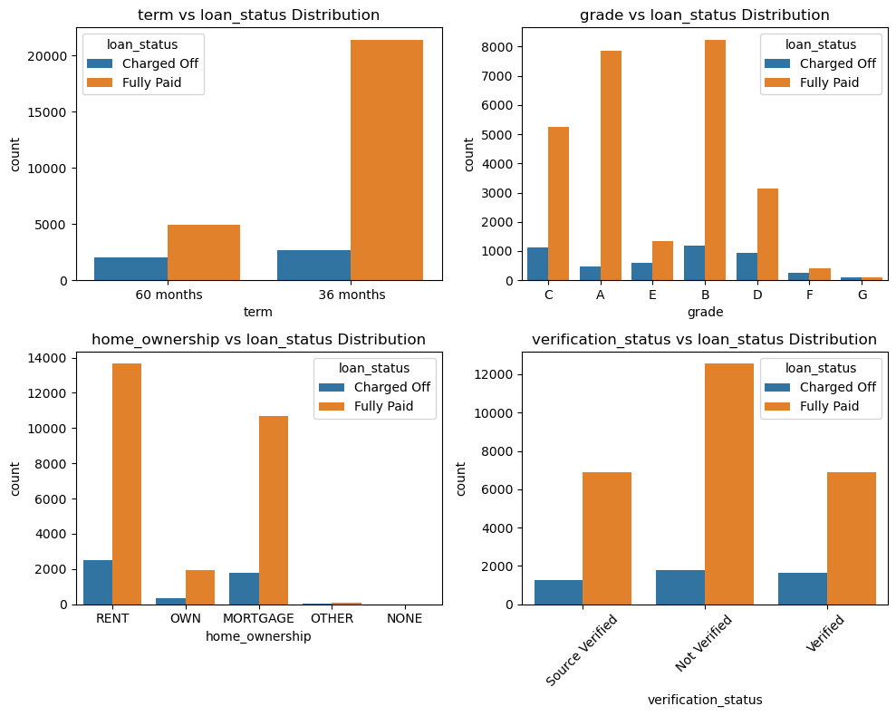
Analysis of loan default factors
The count of defaulters are higher in 36 months term with about 2500 charge-off whereas it is just 2000 for 60 months term. There is a possibility that short term loans are more risky and prone to higher default rate
B, C and D grade loans results in more defaults whereas A and B category loans are majority paid fully
Borrowers who are staying on rent or fall under mortgage category are more likely to default the loan
Borrowers who are source verified have less default rate than non verified or verified borrowers

Slide 7
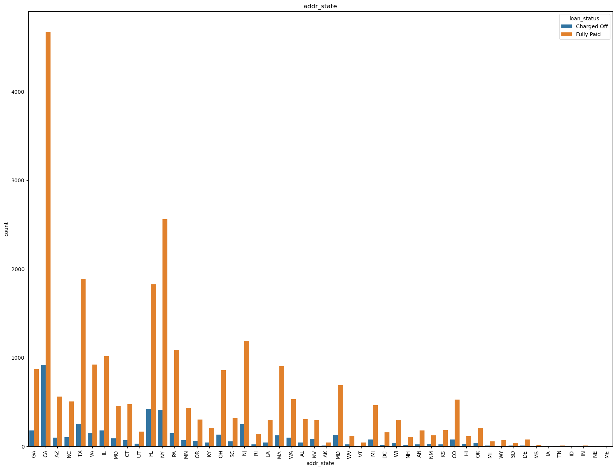
Analysis of loan default factors
The lending company should control the number of loans issued to borrowers who are from CA, NY, and FY.
If we compare the total number of loans issued in FL and NY, FL has more defaulters than NY.

Slide 8
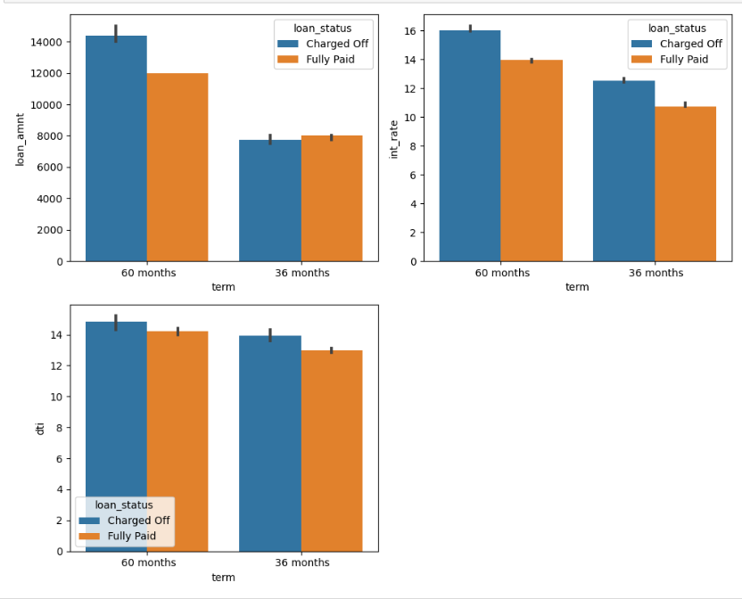
Impact of Term over Loan Amount, Interest Rate and Dti
Observations:
It appears that more borrowers defaulted on loans with terms of 60 months than 36 months when the loan amount is higher whereas when the loan amount is lesser there is not much different in loan default and fully paid rate.
Both the 36-month tenure and the 60-month tenure have higher default rates with higher interest rates.
As the Debit to Income Ratio increases, charge-offs are increasing as compared to fully paid loans.

Slide 9
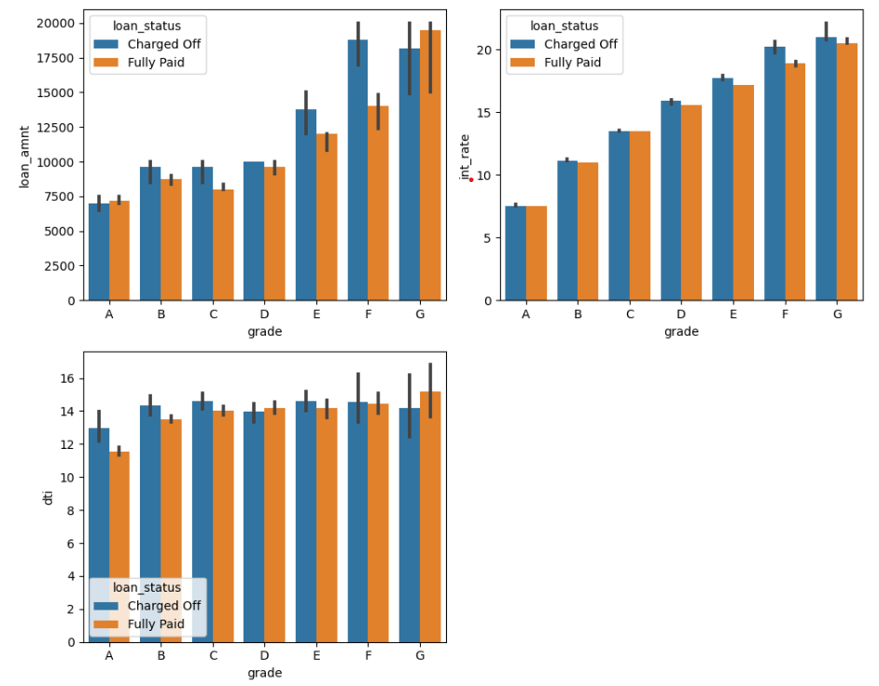
Impact of Loan Grade over Loan Amount, Interest Rate and Dti
Observations:
F, G and E grade people are more prone to loan default. Loans with lower grades are issued with more amount that can be another reason for default.
The interest rate gradually rises as grade drops. and they are increasingly likely to default on the loan.
In terms of each grade and loan status, the dti hasn't changed all that much.

Slide 10
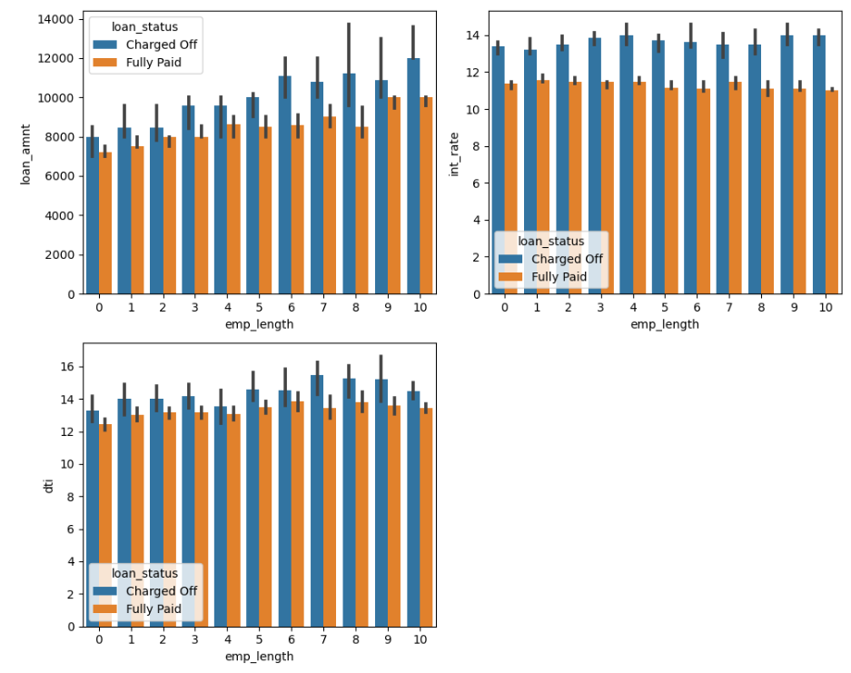
Impact of Employment Length over Loan Amount, Interest Rate and Dti
Observations:
As the employment length increases loan amount increases so does the default rate
Interest rates looks similar for borrowers with all the employment lengths
DTI and Employment Length do not indicate any patterns about defaults.

Slide 11
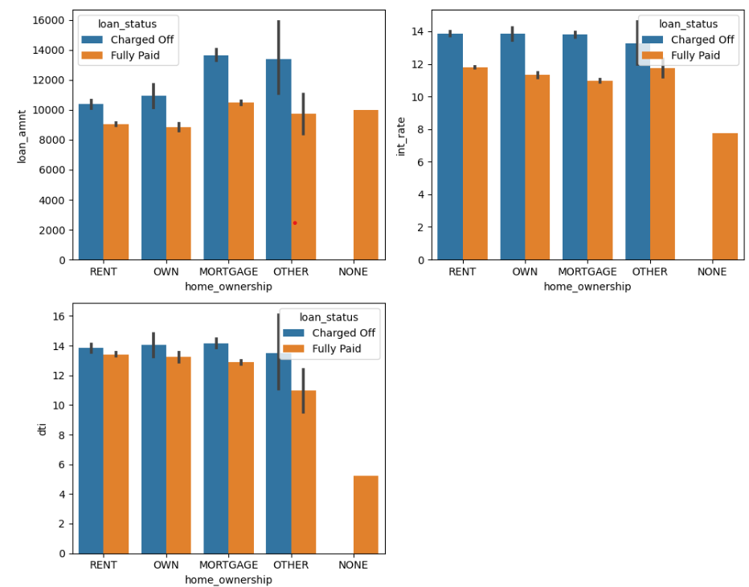
Impact of Home Ownership over Loan Amount, Interest Rate and Dti
Observations:
With higher loan amount, borrowers from Mortgage and Other home ownership types has more default rate
When the interest rate is high, the default rate is high regardless of home ownership.
It is observed that higher the dti, more is the default rate across all the borrowers irrespective of their home ownership type.

Slide 12
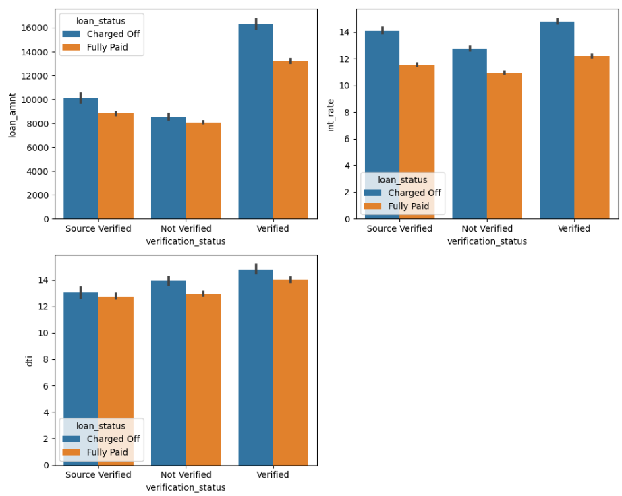
Impact of Verification Status over Loan Amount, Interest Rate and Dti
Observations:
Loan amounts for verified loans are higher and so is the default rate.
Higher interest rates cause loan default regardless of verification status.
The dti ratio for defaulted loans is higher across all categories of verification status.

Slide 13
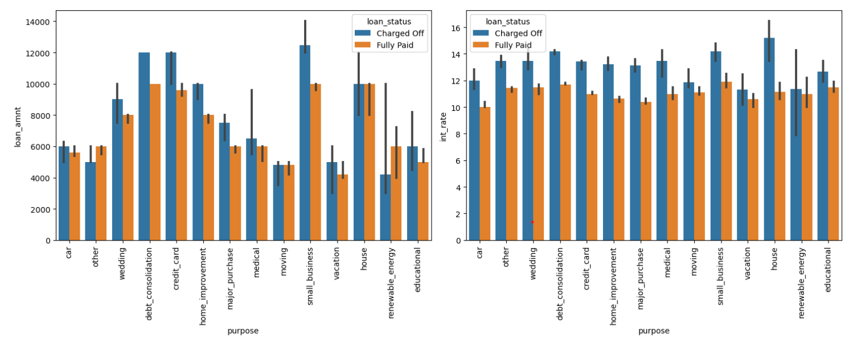
Impact of Loan Purpose over Loan Amount and Interest Rate

Slide 14
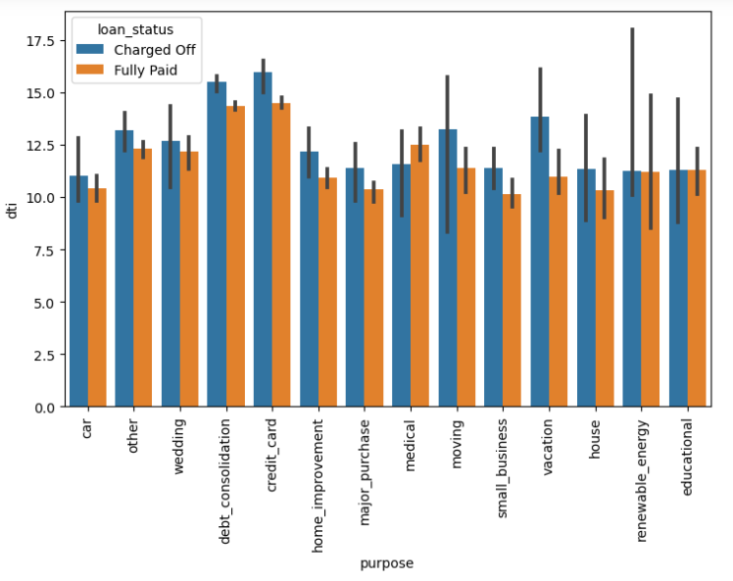
Impact of Loan Purpose over Dti
Observations:
Default rates for small businesses are higher when the loan amount is likewise large followed by debt consolidation and credit card loans.
Home loans and small business loans tends to default more if the interest rates are higher
Higer the dti ratio, more is the default rate for credit card and deb consolidation loans

Slide 15
Conclusions:
As more borrowers defaulted on loans with terms of 60 months when the loan amount is higher, lending company should reduce such high amount loans having 60 months tenure.
Lending company should thoroughly investigate loan applications for F, G and E grade loans as they are more prone to loan default. Also they should rethink on the Loans amounts for these grades.
Loan applications from borrowers staying on Rent or Mortgage should be well examined before approving high loan amounts.
For the borrowers residing in CA, NY, and FY a little more scrutiny is required. In addition to that if we compare the total number of loans issued in FL and NY, FL has more defaulters than NY which adds FL to the scrutiny list.
Loans borrowed with the purpose of debt consolidation by small businesses resulted in more defaults. The company should reduce issuing loans to small businesses.
Higer the DTI ratio, more is the default rate for credit card and deb consolidation loans. Lending company should reduce the credit and deb consolidation loans for the people with high DTI ratio

