Slide 1
SALES AND PROFIT DASHBOARD SUMMARY
Visualization Report | Prepared by Nikita Singh | 2025

Slide 2
OVERALL SALES AND PROFIT OVERVIEW
• Total Sales: 2.30M
• Total Profit: 286.40K
• Total Quantity Sold: 38K
• Current Month Sales: 90.47K
• Overall Profit Percentage: 12.47%
The dashboard represents performance across countries, industries, and segments for the years 2020–2023.
Note: “Q3 and Q4 show stronger sales performance across all segments.”

Slide 3
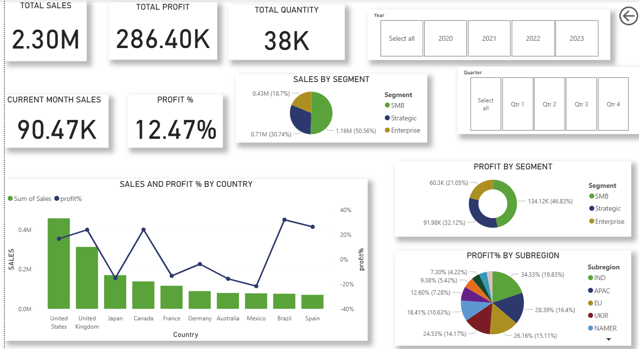
SALES AND PROFIT BY SEGMENT
• SMB segment contributes the highest share of sales at 50.56%.
• Strategic segment follows with 30.74% and Enterprise with 18.7%.
• In terms of profit, SMB leads with 46.83% followed by Strategic (32.12%) and Enterprise
(21.05%).

Slide 4
SEGMENT ANALYSIS
SMB segment drives over half of total sales (50.56%) indicating strong demand in small-to-mid businesses.
Enterprise segment, although smaller in sales, has a higher customer retention rate.
Strategic accounts contribute consistent revenue across all quarters.
Insight: Investing in Enterprise upselling could improve profit share.

Slide 5
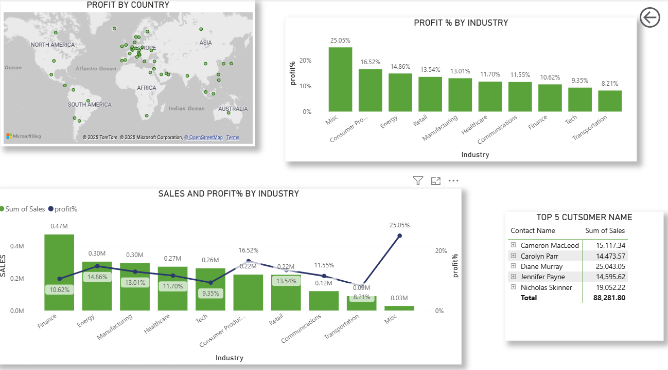
SALES AND PROFIT BY COUNTRY AND SUBREGION
• The United States has the highest sales volume, followed by the United Kingdom.
• Profit percentage varies by country, showing stronger margins in the U.S. and Brazil.
• By subregion, IND and APAC regions show dominant profit contributions.

Slide 6
Country & Subregion Analysis
United States and United Kingdom are the top contributors, accounting for over 35% of total sales.
European and North American regions show higher profit consistency.
Emerging markets like India (IND) and APAC show rapid growth potential with 19.8% and 16.4% profit share respectively.
Recommendation: Focus marketing efforts in APAC to leverage higher margin opportunities.

Slide 7
PROFIT PERCENTAGE AND SALES BY INDUSTRY
The 'Misc' industry shows the highest profit margin at 25.05%.
Finance, Energy, and Manufacturing sectors also contribute significantly to total sales.
Transportation and Tech industries show lower profit margins below 10%.
Finance and Manufacturing contribute significantly in absolute sales volume.
Transportation and Tech lag behind, suggesting operational cost reviews.
Insight: Diversifying product offerings in high-profit industries can lift total profitability.
TOP 5 CUSTOMERS BY SALES
• The top 5 customers contributed a combined sales value of 88.28K.
• Nicholas Skinner and Diane Murray are the highest-value customers.
• Customer retention and targeted offers to these clients could enhance profitability
“Top customers contribute ~4% of overall revenue.”
“Customer loyalty programs and upsell opportunities should focus on Diane Murray and Nicholas Skinner (top spenders).”
Retention efforts for lower-tier customers like Jennifer Payne could boost recurring sales.”
Insight: “Introducing tiered discounts or personalized outreach could enhance customer value.”

Slide 8
RECOMMENDATIONS & CONCLUSION
Strengths:
Strong SMB and Strategic performance.
Consistent profit margins.
Weaknesses:
Uneven regional performance.
Underperforming industries (Transportation, Tech).
Recommendations:
Expand APAC and IND presence.
Focus marketing on Enterprise clients.
Improve cost management in low-margin sectors.

