Slide 1
Arima graphics

Slide 2
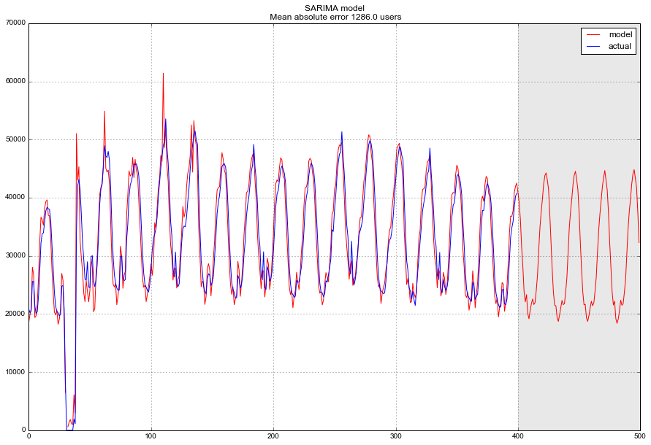

Slide 3
