Slide 1
Итоги

Slide 2
Итоги
Реализация
Теория

Slide 3
Реализация

Slide 4
1. Language
Python (model building )
R ( data analysis, statistical analysis)

Slide 5
Python | R

Slide 6


2. Notebook

Slide 7
3. Libraries

Slide 9
Теория

Slide 10
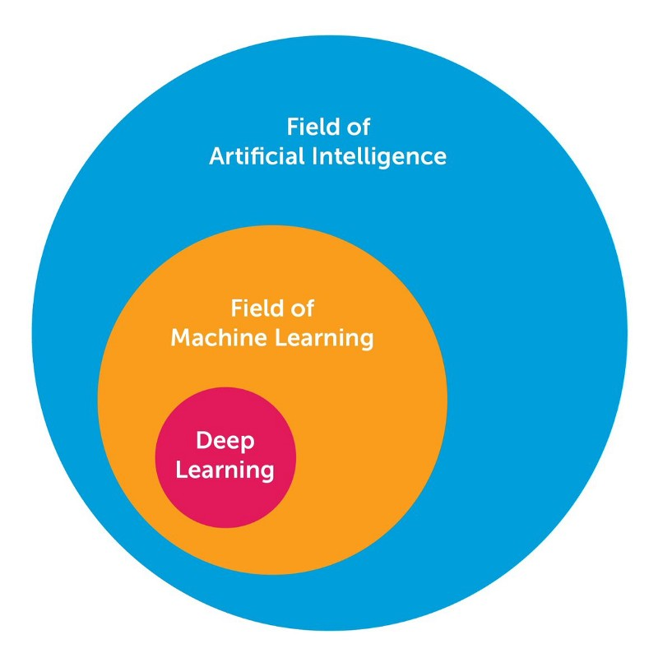

$$AI←ML←DL$$

Slide 11
Типы машинного обучения
Machine Learning
Supervised learning
Unsupervised learning
Reinforcement learning

Slide 12
Типы задач
Supervised learning
Unsupervised learning
Regression problem
Classification problem
Clustering problem
Dimension reduction

Slide 13
Regression problem
«Classical»
algorithms
Neural networks

Slide 14
«Classical»
algorithms
Regression models
Autoregressive models
Tree models
Linear regression
(Lasso regression, Ridge regression)
Arima
(Sarima, Regarima)
Random forest

Slide 15
Neural networks
Recurrent neural network
LSTM

Slide 16
Classification problem
«Classical»
algorithms
Neural networks

Slide 17
«Classical»
algorithms
Logistic regression

Slide 18
Neural networks
Capsule neural network

Slide 19
Dsds
Machine learning
Unsupervised learning
Supervised learning
Reinforcement learning

Slide 20
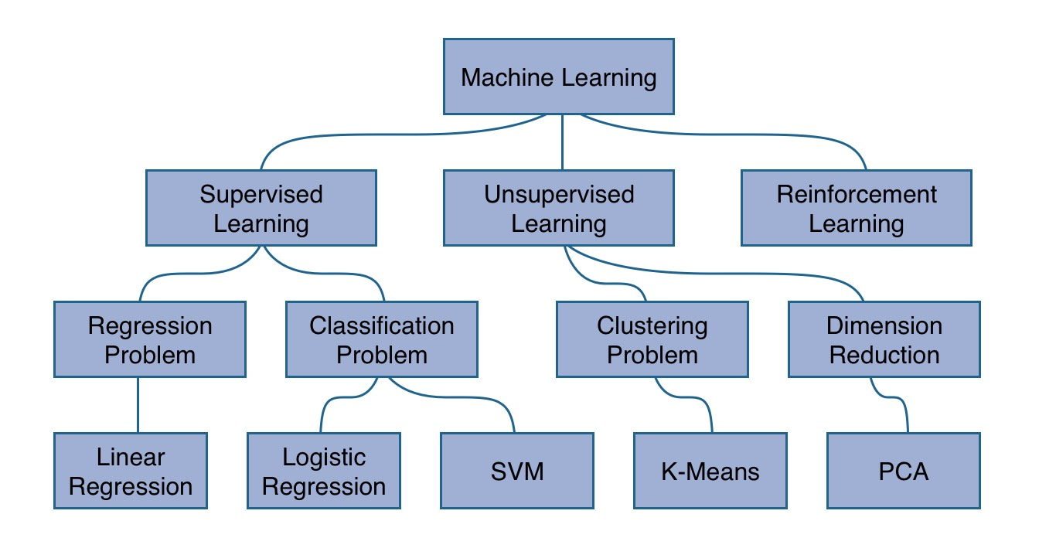

Slide 21
Полезные материалы
Курсы:
Книги:

