Slide 1
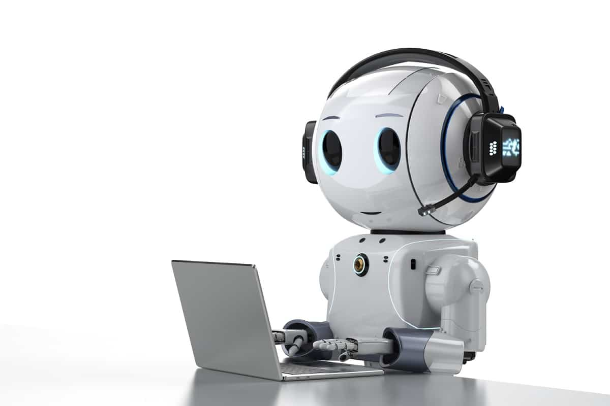
UniGuide:
DAVV university
assistant chatbot
Deep
Learning
(DS6A - 402)
Presented to : Mr. Rahul sharma
Presented By : Nikita Purandare (DS6A2128)

Slide 2
Index
01
Problem Statement
02
Dataset
03
TechStack
04
Working
05
Future Advancements

Slide 3


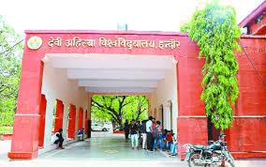
Students and visitors often have common queries related to university academics, admissions, departments, and facilities, which can overwhelm support staff and lead to delays in response.
UniGuide aims to solve this problem by providing an AI-powered chatbot that can understand natural language queries and respond accurately using large language model (LLM) capabilities.
The goal is to deliver fast, helpful, and contextually appropriate replies 24/7, improving communication and support efficiency within the academic ecosystem.
Devi Ahilya Vishwavidyalaya(DAVV)
Grade A+ accreditation NAAC

Slide 4
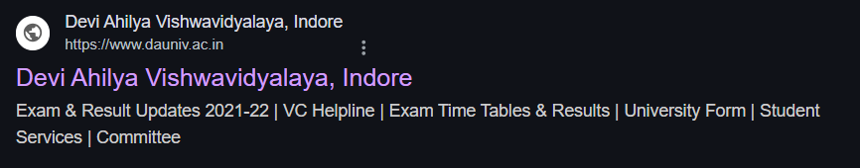
Dataset Overview
🌐 Web Scraping – Official DAVV Website content used as the primary data source through a web crawler build with the help of Beautifulsoup, tqdm and urllib.
Collected Approximately 1.5MB data.
Text Preprocessing – Cleaned and chunked into meaningful segments and removed extra spaces , html tags and various other noises.

Slide 5
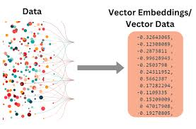
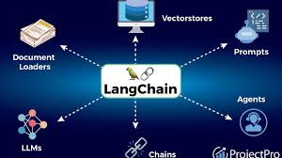
🛠️ Tech Stack Used in UniGuide
🧠 Backend (AI & Logic)
Python
Flask – Web framework to handle HTTP requests.
LangChain – Orchestrates retrieval-based question answering
Sentence Transformers – For generating sentence embeddings (all-MiniLM-L6-v2)
FAISS – Vector similarity search for semantic retrieval.
BeautifulSoup + Requests – Used to scrape structured and unstructured data from DAVV Official Website
Groq LLM - (llama-3.3-70b-specdec) it is a is a 70B-parameter multilingual model using speculative decoding for faster inference.

Slide 6
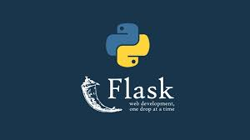

💻 Frontend
HTML/CSS – Chat UI layout and design
JavaScript –
Handles the chat toggle
Captures user input
Sends/receives data from backend using fetch().
Dynamic Chatbox Interface – Simulates a real-time conversation.
🗃️ Data & Storage
Vector Store – Stores document embeddings for retrieval
🗃️ Environment & Configuration
dotenv – For managing environment variables like API keys securely.
.

Slide 7
Working of
UniGuide
1. User Interaction & Input Handling
The user types a query into the chatbot interface on the frontend.
The message is captured and sent via a POST request to the Flask backend (/predict endpoint).
2. Backend Processing with Sentence Embedding
The Flask backend receives the query and passes it to the interactive_qa() function.
The query is embedded using Sentence Transformers and matched against preloaded data using vector similarity search.
A response is generated using a QA chain (e.g., LangChain + LLM).
3.Response Display
The backend sends the response back to the frontend.
The chatbot UI displays the answer in the conversation box along with the user’s original message.

Slide 8
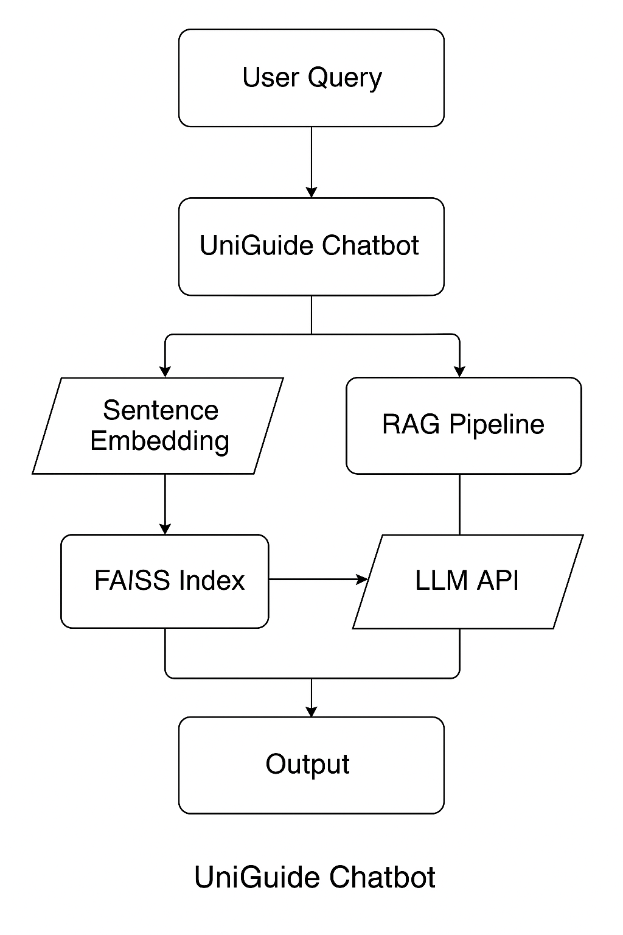

Slide 9
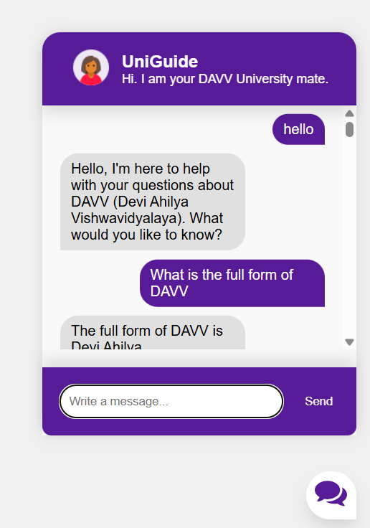
Let’s go and check how the UniGuide works…..

Slide 10


Future Advancements
Chat History : Implement conversational memory using RAG (Retrieval-Augmented Generation) or LangChain to maintain context over multiple turns.
Personalization & Learning : Use reinforcement learning or feedback-based systems to personalize responses based on user preferences or past interactions.
Advanced Intent Detection : Upgrade to transformer-based classifiers (like BERT, RoBERTa, or fine-tuned LLaMA models) for better accuracy in intent classification.
Web & App Integration : Deploy the chatbot into a web or mobile app with real-time response using Flask, FastAPI, or React Native.

Slide 11
THANK
YOU

