Slide 1
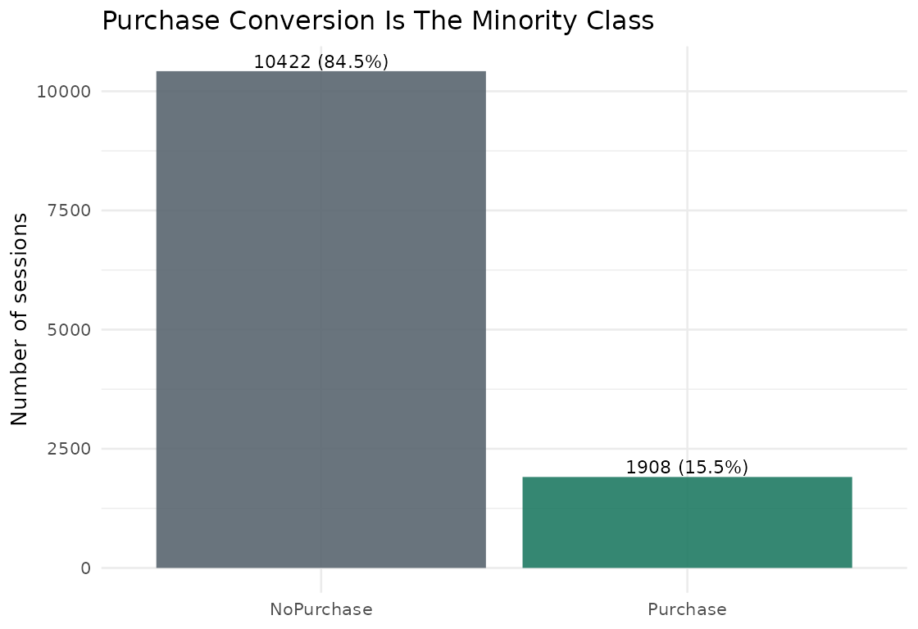
Problem And Data
Predicting Online Purchase Conversion From Session Behavior
Goal: predict whether an online shopping session will generate revenue.
Dataset: UCI online shoppers data with 12,330 sessions.
Purchases are the minority class: 15.5% of rows.
Business use: rank sessions for targeted marketing or on-site intervention.

Slide 2
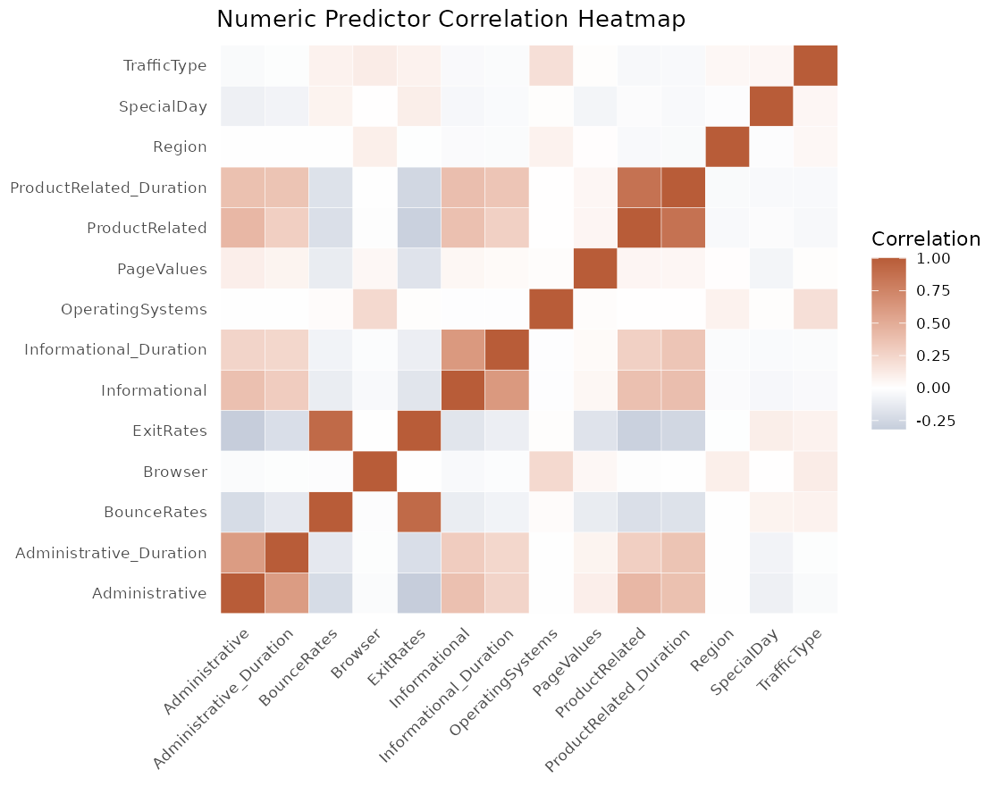
Modeling Approach
Predicting Online Purchase Conversion From Session Behavior
Created binary target from the Revenue field.
Used stratified training and test split to preserve class balance.
Compared logistic regression, decision tree, and random forest.
Used cross-validation for tuning and threshold selection.

Slide 3
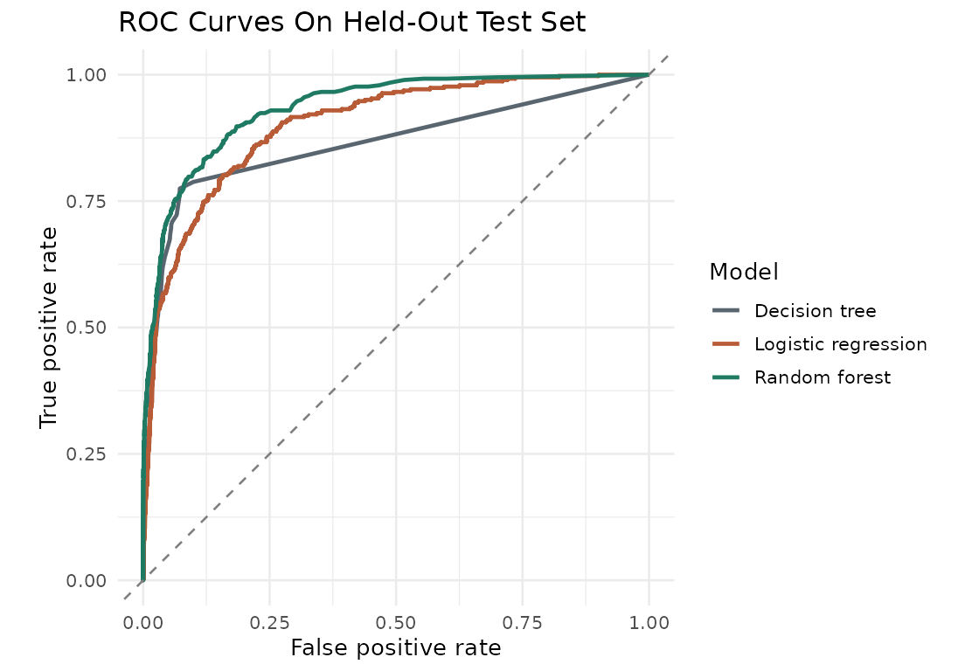
Final Model
Predicting Online Purchase Conversion From Session Behavior
Selected model: Random forest.
Test ROC AUC: 0.935.
Test F1 score: 0.716.
Threshold selected to balance precision and sensitivity for purchase sessions.
AUC 0.935
F1 0.716
Accuracy 0.909

Slide 4
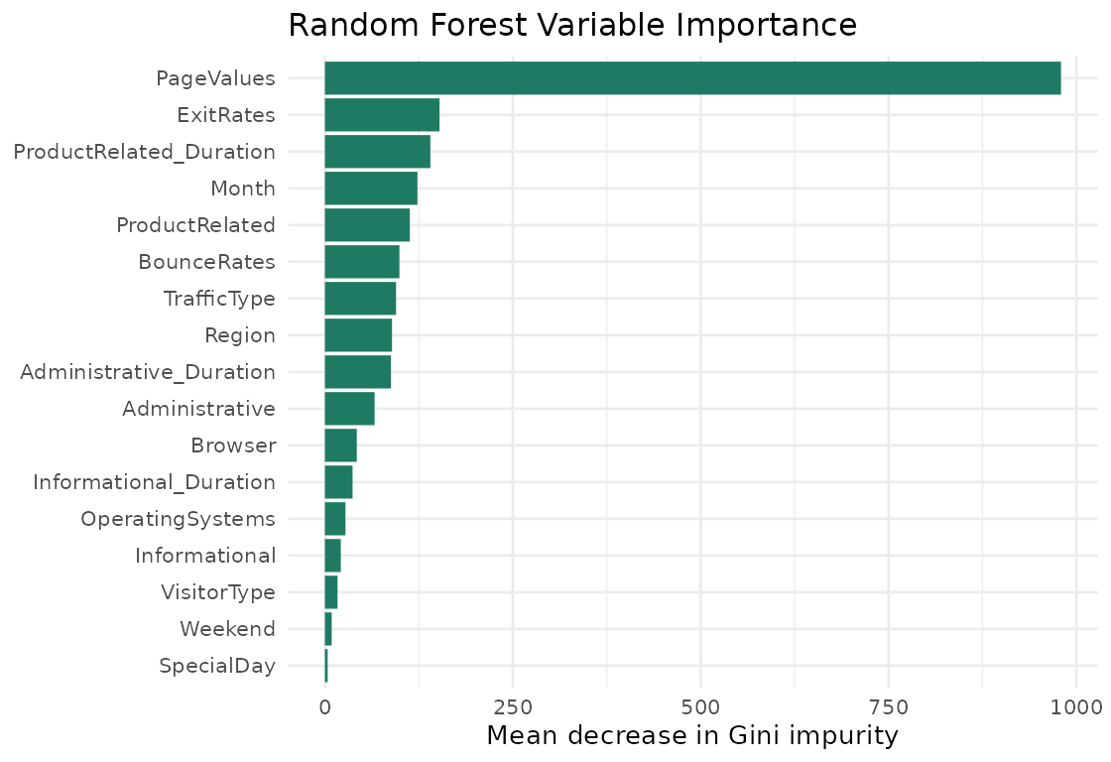
Key Drivers
Predicting Online Purchase Conversion From Session Behavior
Most important predictors in the tree ensemble:
PageValues, ExitRates, ProductRelated_Duration, Month, ProductRelated.
These are predictive signals, not proof of causation.
Model scores should be used as a prioritization layer.

Slide 5
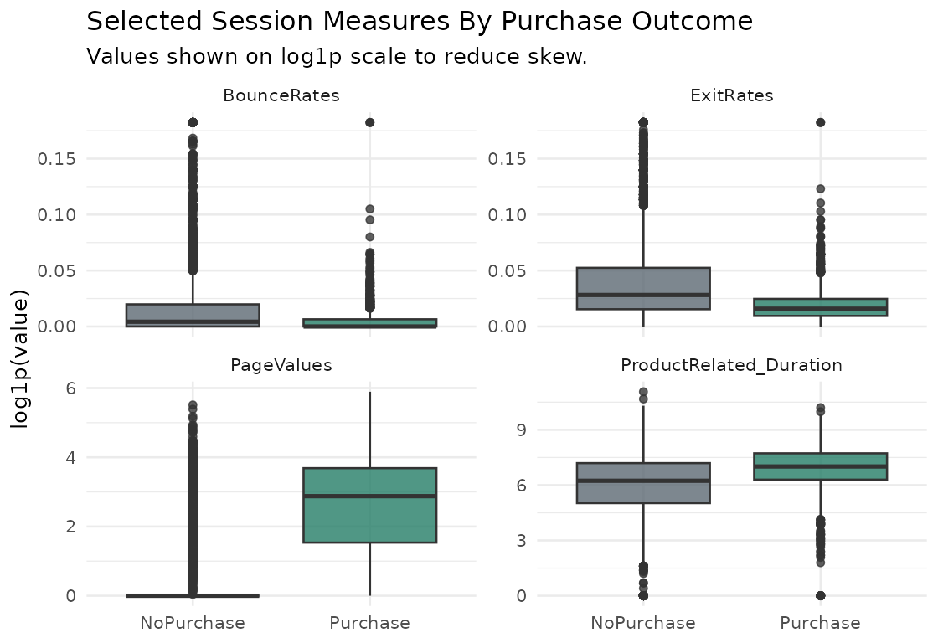
Recommendation
Predicting Online Purchase Conversion From Session Behavior
Use model scores to rank sessions for controlled marketing experiments.
Do not assume an intervention creates incremental revenue without A/B testing.
Improve with product, customer, pricing, margin, and campaign data.
AI assistance is disclosed in the report and repository.

